Slide 1
第三、四、五章作业讲解
陈岭
lingchen@cs.zju.edu.cn

Slide 2
Chap. 3
6 Edition: Ex. 3.8, 3.9, 3.10, 3.15

Slide 3
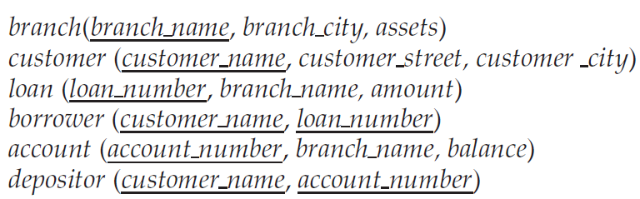
3.8 Consider the bank database of Figure 3.19, where the primary keys are underlined.Construct the following SQL queries for this relational database.
  a. Find all customers of the bank who have an account but not a loan.
  b. Find the names of all customers who live on the same street and in the same city as “Smith”.
  c. Find the names of all branches with customers who have an account in the bank and who live in “Harrison”.

Slide 4
  a. Find all customers of the bank who have an account but not a loan.
(select customer_name
from depositor)
except
(select customer_name
from borrower)

Slide 5
  b. Find the names of all customers who live on the same street and in the same city as “Smith”.
select F.customer_name
from customer F join customer S using(customer_street, customer_city)
where S.customer_name = ’Smith’

Slide 6
  c. Find the names of all branches with customers who have an account in the bank and who live in “Harrison”.
select distinct branch_name
from account natural join depositor natural join
customer
where customer_city = ’Harrison’

Slide 7
3.9 Consider the employee database of Figure 3-20, where the primary keys are underlined. Give an expression in SQL for each of the following queries.
  a. Find the names and cities of residence of all employees who work for First Bank Corporation.
  b. Find the names, street addresses, and cities of residence of all employees who work for First Bank Corporation and earn more than $10,000.
  c. Find all employees in the database who do not work for First Bank Corporation.
  d. Find all employees in the database who earn more than each employee of Small Bank Corporation.
  e. Assume that the companies may be located in several cities. Find all companies located in every city in which Small Bank Corporation is located.
  f. Find the company that has the most employees.
  g. Find those companies whose employees earn a higher salary, on average, than the average salary at First Bank Corporation.

Slide 8
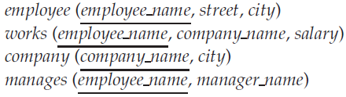

Slide 9
  a. Find the names and cities of residence of all employees who work for First Bank Corporation.
select e.employee name, city
from employee e, works w
where w.company_name = ’First Bank
Corporation’ and w.employee_name =
e.employee_name

Slide 10
  b. Find the names, street addresses, and cities of residence of all employees who work for First Bank Corporation and earn more than $10,000.
select *
from employee
where employee_name in
(select employee_name
from works
where company_name = ’First Bank
Corporation’ and salary > 10000)

Slide 11
  c. Find all employees in the database who do not work for First Bank Corporation.
select employee_name
from employee
where employee_name not in
(select employee_name
from works
where company_name = ’First Bank
Corporation’)

Slide 12
  d. Find all employees in the database who earn more than each employee of Small Bank Corporation.
select employee_name
from works
where salary > all (select salary
from works
where company_name
= ’Small Bank
Corporation’)

Slide 13
  e. Assume that the companies may be located in several cities. Find all companies located in every city in which Small Bank Corporation is located.
select S.company_name
from company S
where not exists ((select city
from company
where company_name = ’Small Bank
Corporation’)
except
(select city
from company T
where S.company_name = T.company
name))

Slide 14
  f. Find the company that has the most employees.
select company_name
from works
group by company_name
having count (distinct employee_name) >= all
(select count (distinct employee_name)
from works
group by company_name)

Slide 15
  g. Find those companies whose employees earn a higher salary, on average, than the average salary at First Bank Corporation.
select company_name
from works
group by company_name
having avg (salary) > (select avg (salary)
from works
where company_name
= ’First Bank Corporation’)

Slide 16
3.10 Consider the relational database of Figure 3-20. Give an expression in SQL for each of the following queries.
  a. Modify the database so that Jones now lives in Newtown.
  b. Give all managers of First Bank Corporation a 10 percent raise unless the salary becomes greater than $100,000; in such cases, give only a 3 percent raise.

Slide 17
  a. Modify the database so that Jones now lives in Newtown.
Answer:
update employee
set city = ’Newton’
where person_name = ’Jones’

Slide 18
  b. Give all managers of First BankCorporation a 10-percent raise unless the salary becomes greater than $100,000; in such cases, give only a 3% raise.
Answer:
update works T
set T.salary = T.salary ∗
(case
when (T.salary ∗ 1.1 > 100000) then 1.03
else 1.1
)
where T.employee_name in (select manager_name
from manages) and
T.company name = ’First Bank Corporation’

Slide 19
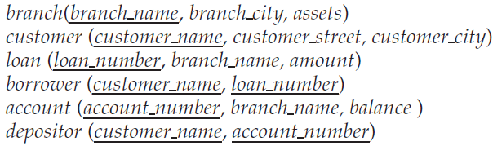
3.15 Consider the bank database of Figure 3.19, where the primary keys are underlined.Construct the following SQL queries for this relational database.
  a. Find all customers who have an account at all the branches located in “Brooklyn”.
  b. Find out the total sum of all loan amounts in the bank.
  c. Find the names of all branches that have assets greater than those of at least one branch located in “Brooklyn”.

Slide 20
  a. Find all customers who have an account at all the branches located in “Brooklyn”.
Answer:
with branchcount as
(select count(*)
from branch
where branch_city = ’Brooklyn’)
select customer_name
from customer c
where branchcount =
(select count(distinct branch_name)
from (customer natural join depositor natural
join account natural join branch) as d
where d.customer name = c.customer name)

Slide 21
  b. Find out the total sum of all loan amounts in the bank.
Answer:
select sum(amount)
from loan

Slide 22
  c. Find the names of all branches that have assets greater than those of at least one branch located in “Brooklyn”.
Answer:
select branch_name
from branch
where assets > some (select assets
from branch
where branch_city = ’Brooklyn’)

Slide 23
Chap. 4
6 Edition: Ex. 4.7, 4.12, 4.14

Slide 24
4.7 Consider the relational database of Figure Figure 4.11.Give an SQL DDL deﬁnition of this database. Identify referential-integrity constraints that should hold, and include them in the DDL deﬁnition.

Slide 25
Answer:
create table employee
  (person_name char(20),
  street char(30),
  city char(30),
  primary key (person_name) )
create table works
  (person_name char(20),
  company_name char(15),
  salary integer,
  primary key (person_name),
  foreign key (person_name) references employee,
  foreign key (company_name) references company)

Slide 26
Answer:
create table company
  (company_name char(15),
  city char(30),
  primary key (company_name))
create table manages
  (person_name char(20),
  manager_name char(20),
  primary key (person_name),
  foreign key (person_name) references employee,
  foreign key (manager_name) references employee)

Slide 27
4.12 For the database of Figure 4.11, write a query to find those employees with nomanager. Note that an employeemay simply have no manager listed or may have a null manager. Write your query using an outer join and then write it again using no outer join at all.

Slide 28
Answer:
select employee_name
from employee natural left outer join manages
where manager_name is null
select employee_name
from employee e
where not exists
  (select employee_name
  from manages m
  where e.employee_name = m.employee_name
  and m.manager_name is not null)

Slide 29
4.14 Show how to define a view tot credits (year, num_credits), giving the total number of credits taken by students in each year.
Answer:
create view tot_credits(year, tot_credits) as
  (select year, sum(credits)
  from takes natural join course
  group by year)

Slide 30
Chap. 5
6 Edition: Ex. 5.8, 5.12

Slide 31
5.8 Consider the bank database of Figure 5.25. Write an SQL trigger to carry out the following action: On delete of an account, for each owner of the account, check if the owner has any remaining accounts, and if she does not, delete her from the depositor relation.

Slide 32
Answer:
create trigger check-delete-trigger after delete on account
referencing old row as orow
for each row
delete from depositor
where depositor.customer_name not in
    ( select customer_name from depositor
    where account_number <> orow.account number )
end

Slide 33
5.12 Consider the following relations for a company database:
  emp (ename, dname, salary)
  mgr (ename, mname)
and the Java code in Figure 5.26, which uses the JDBC API. Assume that the userid, password, machine name, etc. are all okay. Describe in concise English what the Java program does. (That is, produce an English sentence like “It finds the manager of the toy department,” not a line-by-line description of what each Java statement does.)

Slide 34
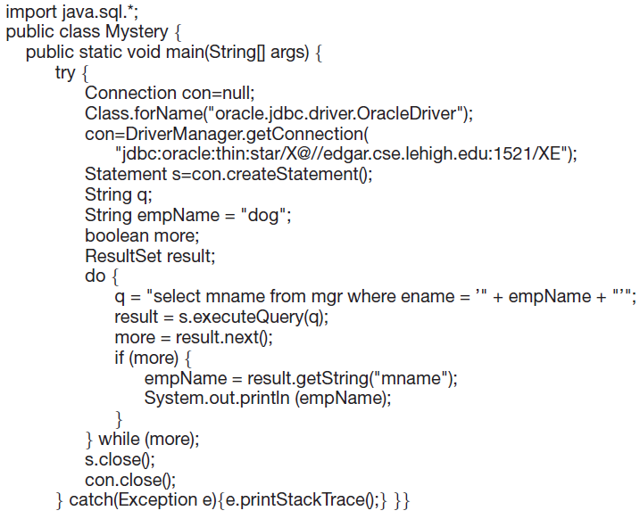

Slide 35
Answer: It prints out the manager of “dog” that manager’s manager, etc. until we reach a manager who has no manager (presumably, the CEO, who most certainly is a cat.)
NOTE: if you try to run this, use your OWN Oracle
ID and password, since Star, crafty cat that she is, changes her password.

