Slide 1
第七、八章作业讲解
陈岭
lingchen@cs.zju.edu.cn

Slide 2
Chap. 7
6 Edition: Ex. 7.1, 7.2, 7.20, 7.23

Slide 3
7.1 Construct an E-R diagram for a car insurance company whose customers own one or more cars each. Each car has associated with it zero to any number of recorded accidents. Each insurance policy (保单) covers one or more cars, and has one or more premium payments associated with it. Each payment is for a particular period of time, and has an associated due date, and the date when the payment was received.

Slide 4
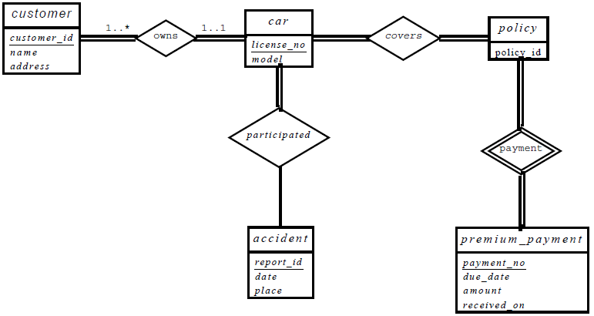
Answers：

Slide 5
7.2 Consider a database used to record the marks that students get in different exams of different course offerings (sections).
a. Construct an E-R diagram that models exams as entities, and uses a ternary relationship, for the database.
b. Construct an alternative E-R diagram that uses only a binary relationship between student and section.Make sure that only one relationship exists between a particular student and section pair, yet you can represent the marks that a student gets in different exams.

Slide 6
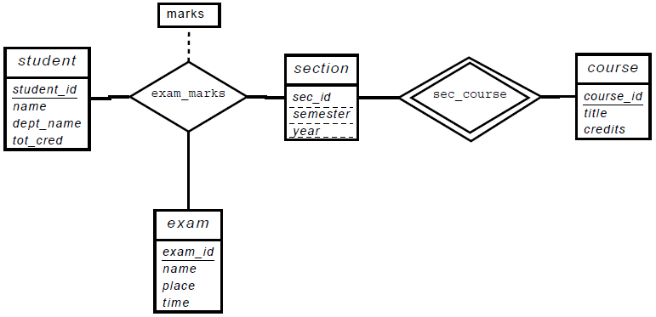
  Construct an E-R diagram that models exams as entities, and uses a ternary relationship, for the database.
  Answers:

Slide 7
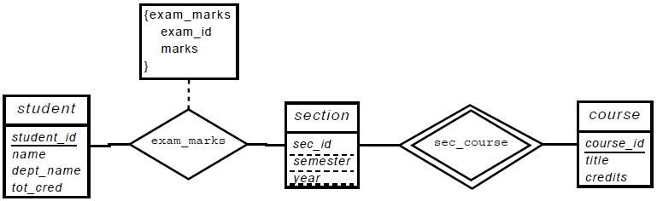
  b. Construct an alternative E-R diagram that uses only a binary relationship between student and section.Make sure that only one relationship exists between a particular student and section pair, yet you can represent the marks that a student gets in different exams.
  Answers:

Slide 8
7.20 Consider the E-R diagram in Figure 7.29, which models an online bookstore.
  a. List the entity sets and their primary keys.
  b. Suppose the bookstore adds Blu-ray discs and downloadable video to its collection. The same item may be present in one or both formats, with differing prices. Extend the E-R diagram to model this addition, ignoring the effect on shopping baskets.
  c. Now extend the E-R diagram, using generalization, to model the case where a shopping basket may contain any combination of books, Blu-ray discs, or downloadable video.

Slide 9
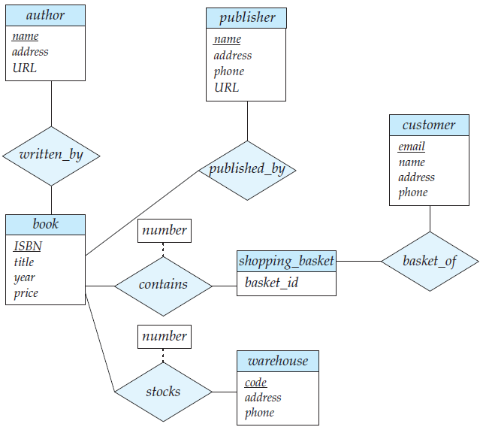

Slide 10
  a. List the entity sets and their primary keys.
  Answers:
author(name, address, URL)
publisher(name, address, phone, URL)
book(ISBN, title, year, price)
customer(email, name, address, phone)
shopping_basket(basket_id)
warehouse(code, address, phone)

Slide 11
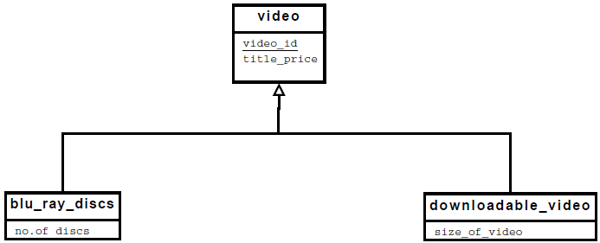
  b. Suppose the bookstore adds Blu-ray discs and downloadable video to its collection. The same item may be present in one or both formats, with differing prices. Extend the E-R diagram to model this addition, ignoring the effect on shopping baskets.
  Answers:

Slide 12
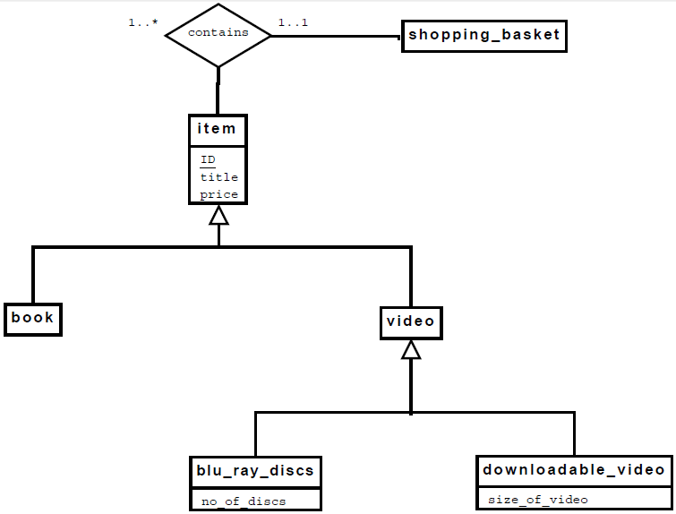
  c. Answers:

Slide 13
7.23 Design a database for an airline. The database must keep track of customers and their reservations, flights and their status, seat assignments on individual flights, and the schedule and routing of future flights.
Your design should include an E-R diagram, a set of relational schemas, and a list of constraints, including primary-key and foreign-key constraints

Slide 14
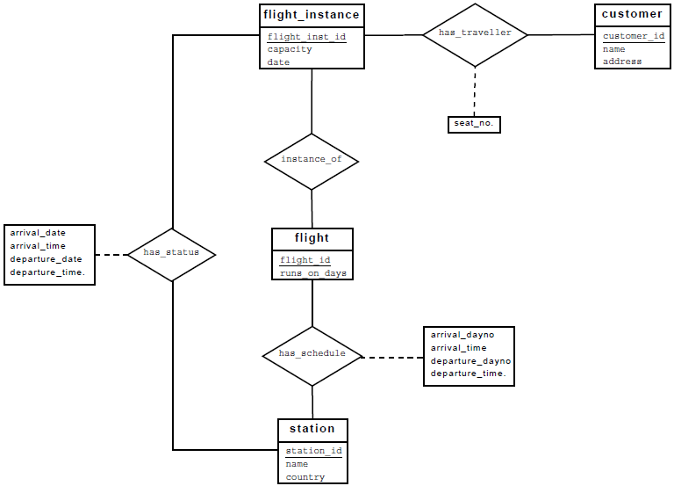

Slide 15
flight_instance(flight_inst_id, capacity, date)
customer(customer_id, name, address)
flight(flight_id, runs_on_days)
station(station_id, name, country)
has_traveller(
    flight_inst_id,
    customer_id,
    seat number,
    foreign key flight_inst_id references flight_instance,
    foreign key customer_id references customer
)
instance_of(
    flight_inst_id,
    flight_id,
    foreign key flight_inst_id references flight_instance,
    foreign key flight_id references flight
)

Slide 16
has_schedule(
    flight_id,
    station_id,
    order,
    arrival_dayno,
    arrival_time,
    departure_dayno,
    departure_time,
    foreign key flight_id references flight,
    foreign key station_id references station
)
has_status(
    flight_inst_id,
    station_id,
    arrival_date,
    arrival_time,
    departure_date
    departure_time
    foreign key flight_inst_id references flight_instance,
    foreign key station_id references station
)

Slide 17
Chap. 8
6 Edition: Ex. 8.1, 8.20, 8.21, 8.28

Slide 18
8.1 Suppose that we decompose the schema r (A, B, C, D, E) into
        r1(A, B, C)
        r2(A, D, E)
Show that this decomposition is a lossless decomposition if the following set F of functional dependencies holds:
        A → BC
        CD → E
        B → D
        E → A

Slide 19
Answers:
A decomposition {R1, R2} is a lossless-join decomposition if
R1 ∩ R2 → R1 or R1 ∩ R2 → R2.
Let R1 = (A, B, C), R2 = (A, D, E), and R1 ∩ R2 = A. Since A is a candidate key,
Therefore R1 ∩ R2 → R1.

Slide 20
8.20 Give a lossless-join, dependency-preserving decomposition into 3NF of schema R of Practice Exercise 8.1.
Answer:
R′ = {(A, B,C), (C, D, E), (B, D), (E, A)}.
Schema (A, B, C) contains a candidate key. Therefore R′ is a third normal form dependency-preserving lossless-join decomposition.

Slide 21
8.21 Normalize the following schema, with given constraints, to 4NF.
    books(accessionno, isbn, title, author, publisher)
    users(userid, name, deptid, deptname)
    accessionno→isbn
    isbn→title
    isbn→publisher
    isbn→→author
    userid→name
    userid→deptid
    deptid→deptname

Slide 22
Answer:
books_accnno(accessionno, isbn)
books_details1(isbn, title, publisher)
books_authors(isbn, author)
users(userid, name, deptid)
departments(deptid, deptname)

Slide 23

8.28 Show that the following decomposition of the schema R of Practice Exercise 8.1 is not a lossless-join decomposition:
        (A, B, C)
        (C, D, E).
        Hint: Give an example of a relation r on schema R such that

Slide 24
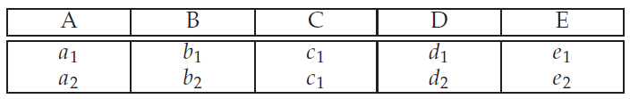
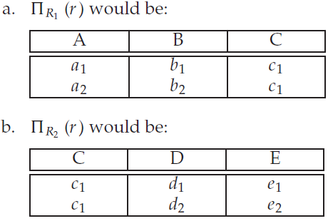
Answer: Following the hint, use the following example of r :
With R1 = (A, B, C), R2 = (C, D, E) :

Slide 25
