Slide 1


3. Double Hashing
§4 Open Addressing
f ( i ) = i * hash₂( x ); /* hash₂( x ) is the 2nd hash function */
 hash₂( x ) ≡ 0 ;
 make sure that all cells can be probed.
 Tip: hash₂( x ) = R – ( x % R ) with R a prime smaller than TableSize, will work well.
Note: ① If double hashing is correctly implemented, simulations imply that the expected number of probes is almost the same as for a random collision resolution strategy.
② Quadratic probing does not require the use of a second hash function and is thus likely to be simpler and faster in practice.
1/3

Slide 2

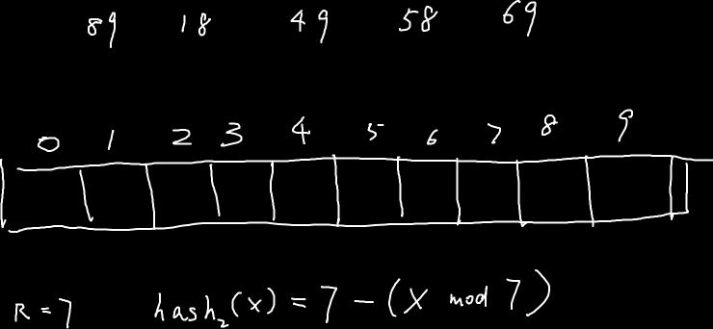
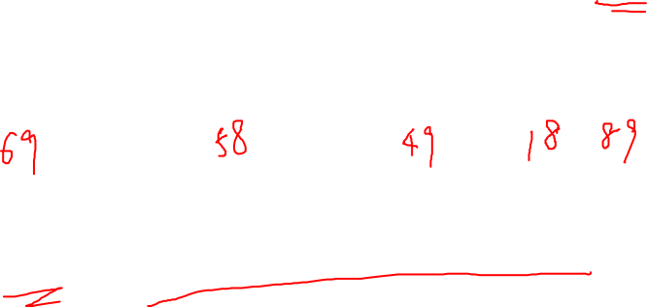


Slide 3


§5 Rehashing
Uhhhh…
insertion might fail ☹
What will happen
if the table is more than half full?
Because
I enjoy giving you headaches …
Just kidding ☺
Say which probing method
do you like?
Practically speaking
I would prefer to use quadratic hashing…
What, anything wrong with it?
Oh come on! Haven’t we had
enough hashing methods?
Why do we need rehashing ?
☞ Build another table that is about twice as big;
☞ Scan down the entire original hash table for non-deleted elements;
☞ Use a new function to hash those elements into the new table.
Then what can we do?
If there are N keys in the table, then T (N) =
O(N)
Question: When to rehash?
Answer:
① As soon as the table is half full
② When an insertion fails
③ When the table reaches a certain load factor
2/3

Slide 4
§5 Rehashing
Note: Usually there should have been N/2 insertions before rehash, so O(N) rehash only adds a constant cost to each insertion.
However, in an interactive system, the unfortunate user whose insertion caused a rehash could see a slowdown.
Read Figures 7.23
for detailed implementation of rehashing.
3/3

Slide 5
About The Final Exam
考试题型：
  判断（10题20分）
  单选（20题60分）
  填空（4空12分）
  函数（1题8分）
基本概念，错题分析，真题练习

Slide 6
About The Final Exam
期末考试将于2020年1月10日18:30-20:30在PTA（https://pintia.cn/）进行。

Slide 7
About The Final Exam
学生须携带照片清晰的身份证或学生证于考试开始前10分钟到达紫金港计算中心大门外，根据张贴墙上的名单查到自己的考试座位号。

Slide 8
About The Final Exam
当被允许入场时，到指定座位就座。

Slide 9
About The Final Exam
考试期间只允许使用“OMS客户端”访问PTA，用自己的考试账号登录。不要启动任何其他浏览器，否则监考系统将生成作弊纪录。

Slide 10
About The Final Exam
一旦启动OMS客户端，未经监考老师允许不得关闭窗口，更不得以任何方式登出。即使提前退出考试，也不可以自己关闭客户端，必须等监考老师来处理。否则监考系统将生成作弊纪录。

Slide 11
About The Final Exam
闭卷考试，只允许带笔入场。考试中严禁访问除PTA外的其它网站，严禁使用任何即时通讯工具。

Slide 12
About The Final Exam
学生可随时将问题解答提交给裁判系统。允许反复提交。判断、选择、填空题的结果会在考试结束后显示；函数题的结果即时反馈。但请注意：如果你自己不主动提交，系统不会自动替你提交解答。

Slide 13
About The Final Exam
每个考生可以在13:55之后的任何时刻开始考试。注意：一旦考试开始，则倒计时开启，并且不会因为浏览器关闭或重启机器而停止。当倒计时结束、或时间到达16:10时，该考生的考试结束。

Slide 14
About The Final Exam
考试时长为120分钟，然而主考有权在遇到不可预见的问题时改变考试时长。一旦时长更改，将尽最大可能以统一方式及时通知所有学生。

Slide 15
About The Final Exam
当有突发事件（例如断网、断电、系统崩溃）使得考试无法进行，则考试将另行安排时间进行传统书面笔试。但请注意：按照惯例，考试最后10分钟如果出现问题，则以系统恢复时的结果为最终结果，不另做弥补。

