Slide 1
高级数据结构和算法分析
Advanced Data Structures and Algorithm Analysis
主讲教师： 何钦铭
Instructor: He, Qinming
E-mail: hqm@zju.edu.cn
 助教（Teaching Assistant）
☺ 陈可一（957385228@qq.com）

Slide 2
重要的教学平台：
1. 直播平台： 钉钉直播
  返校之前的每周一3-5节，可回看录像
2. 网络教学： 学在浙大
  课程介绍、课件、通知、随堂测试、内容要点视频
3. 作业和project： PTA平台 https://pintia.cn/
  每周一次作业，本周日晚上前完成
  Project: 7题选一题，分组，返校后Presentation

Slide 3



 教材 (Text Book)
Data Structures and
Algorithm Analysis in C
(2nd Edition)
Mark Allen Weiss
陈 越 改编
Email: weiss@fiu.edu

Slide 4
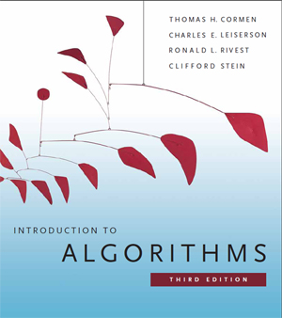
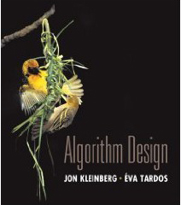
 教材 (Text Book)
Algorithm Design
Jon Kleinberg, Eva Tardos
Addison Wesley, 2005
Introduction to Algorithms
(3rd Edition)
Thomas H. Cormen, Charles E. Leiserson, Ronald L. Rivest and Clifford Stein
The MIT Press. 2009

Slide 5







课程评分方法 (Grading Policies)
Homework
(10)
Discussions
(10)
Research Project
+Peer Review (30)
MidTerm
(10*)
Total ≤ 60
Q&A
(0.5 each)
Final Exam (40*)

Slide 6
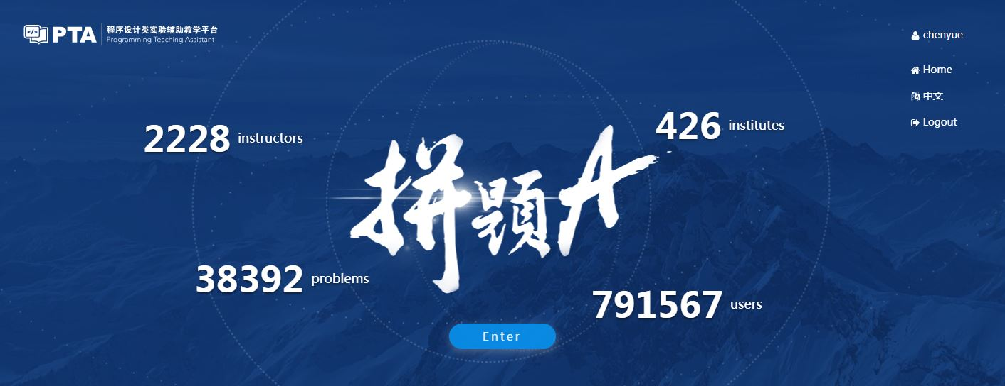
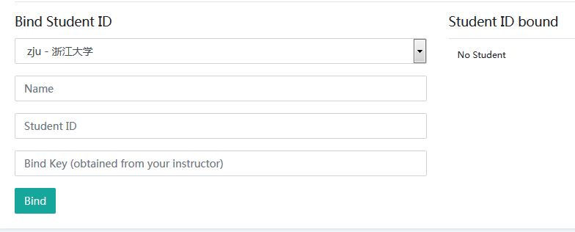
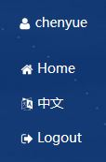
Homework Assignments (10)
Register and login at https://pintia.cn/
Bind your student ID with bind key
Enter
512977

Slide 7
Research topics (26)
Done in groups of 3
7 topics to choose from
Report (20 points)
In-class presentation (10~15 minutes, 6 points)
The speaker will be chosen randomly from all the contributors
If there are many volunteers, at most 3 groups will be chosen to give presentations
For those groups not to give presentations, each will gain bonus points = report points / 10

Slide 8

Research Reports
Peer Review
Group_Total = G_{T} × 50% + G_{PR} × 50%
Fullmark = 20

Slide 9
Peer review is for the reviewer
Editing someone else’s work is one of the best ways to learn how to edit your own
  It’s much easier to see what’s working and what isn’t in someone else’s paper than in your own.
Writing is revision
  The more you practice reading and critiquing someone else’s work, the stronger your editing skills will be when it’s time to apply them to your own work.
Any skill level works
  You can learn a great deal about the fundamentals of good writing from carefully reading and reviewing poor writing, figuring out why it’s not succeeding and what it needs to succeed.

Slide 10
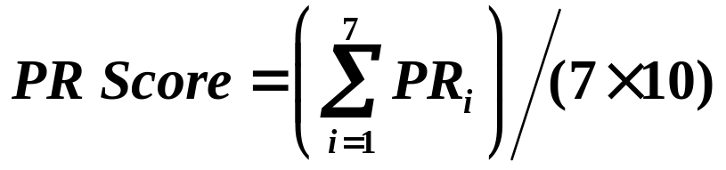
Process
Submit initial version for peer review (1 week)
Participate in peer review (2 days)
Revise paper and submit to TA (2 days)
Receive final grading from TA
ALL Groups
PR_{i} Fullmark = 40

Slide 11
Discussions (10)
Done in groups
Random in-class discussion topics
Each takes 3~5 minutes
Each full-mark is 10

Slide 12

Q&A
For volunteers only
0.5 point for each question asked/answered
come and claim your credits after each class session

Slide 13
诚信守则
（Code of Academic Honesty）
One must get a full mark to be eligible to take the final exam.
As long as there is one action of academic dishonesty in this semester, one will not be eligible to take the final exam and one’s course score will be zero.

Slide 14
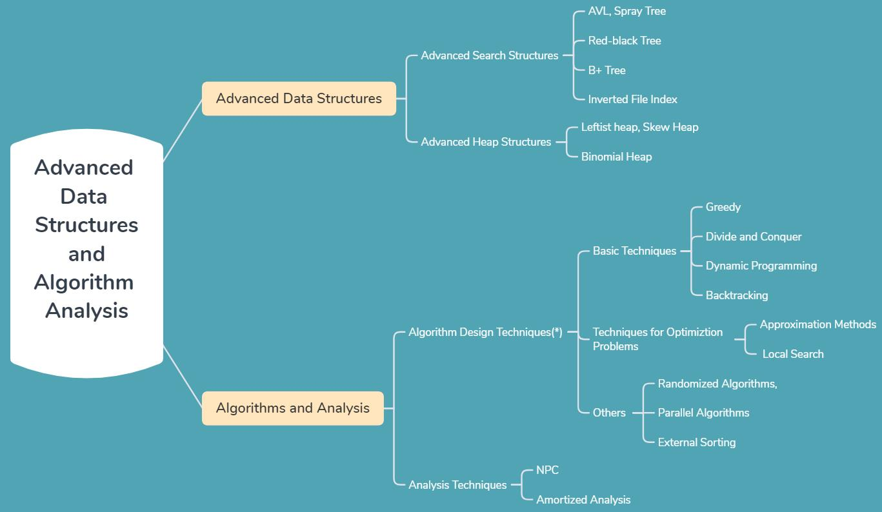

Slide 15
Main topics:
(1)advanced data structures:
  advanced search structures:
    AVL, Spray tree
    Red-black tree
    B+ Tree
    Inverted file index
  advanced heap structures:
    Leftist heap, skew heap
    Binomial heap

Slide 16
Main topics:
(2)algorithms and analysis:
  algorithm design techniques(*):
    Divide and conquer, Dynamic programming, Greedy, Backtracking
    Approximation methods, Local search
    Randomized algorithms,Parallel algorithms
    External sorting.
  analysis techniques:
    NP-C
    amortized anlysis

