Slide 1


Backpack Moon: E-Commerce Website
A Basic E-Commerce Platform for Bag Purchasing
INTEGRATED DEVELOPMENT PROJECT -1 (IDP-1)

Slide 2
Project Team & Supervision
Academic Supervision
Development Team
Supervisor: Arpita Roy
Lecturer, Department of CSE
Md. Omar Faruk — 232010116
Tarun Pain — 221010150
Md. Farid Hasan — 221010053
Md. Pias Hossain — 222010151
Md. Boney Amin — 222010357
Course
Integrated Development Project -1 (IDP-1)

Slide 3
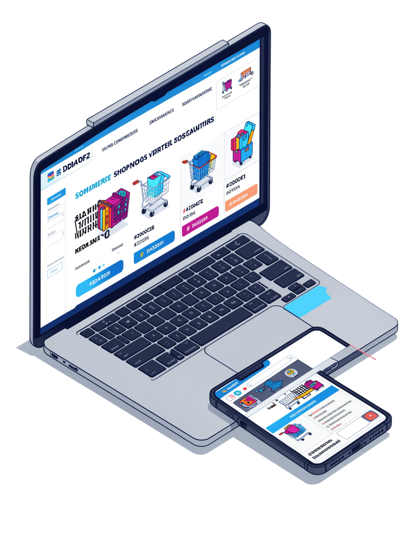
Project Overview & Objectives
Backpack Moon is a direct-to-consumer digital platform designed to showcase, market, and sell minimalist, high-utility backpacks and accessories. The platform delivers a frictionless, modern shopping experience optimized for both mobile and desktop users.
Target Audience
Students, travelers, professionals, and outdoor enthusiasts
B2C Model
Business-to-consumer transactions with 2–3% conversion rate target

Slide 4
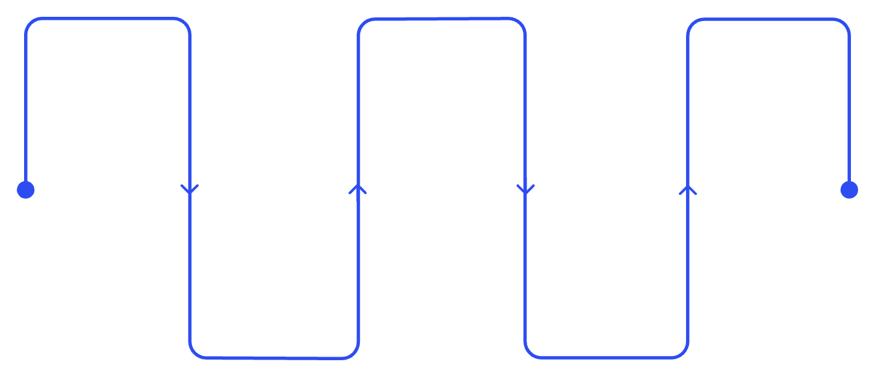
Technical Architecture
Development Technologies
HTML & CSS
JavaScript
Development Methodology
Semantic markup with responsive styling and separation of content from presentation
Dynamic, interactive web experiences and asynchronous communication
Requirements
Implementation
Deployment
Gather and document needs
Code modules and integrate
Release and maintain system
System Design
Testing
Architect solution and interfaces
Verify, debug and validate
Bootstrap 5.3.0
Font Awesome 6.4.0
Open-source framework for rapid responsive development with pre-built components
Comprehensive icon library for modern UI design and visual consistency
The Waterfall Model allows focused execution at each phase while maintaining feedback loops throughout development.

Slide 5

Project Scope & Limitations
In Scope
Current Limitations (MVP)
Product showcase with categorization by use (casual, school, hiking, travel, party, shopping)
Filtering by price, color, and material
Shopping cart with discount code support
Secure payment gateway integration
User account management and order tracking
Fully responsive design for all devices
Payment, watchlist, and review system not included in current version
Limited to select product categories only
Advanced inventory system for stock calculation currently missing
No advanced user authentication or security features in MVP
These limitations define the roadmap for future development iterations.

Slide 6
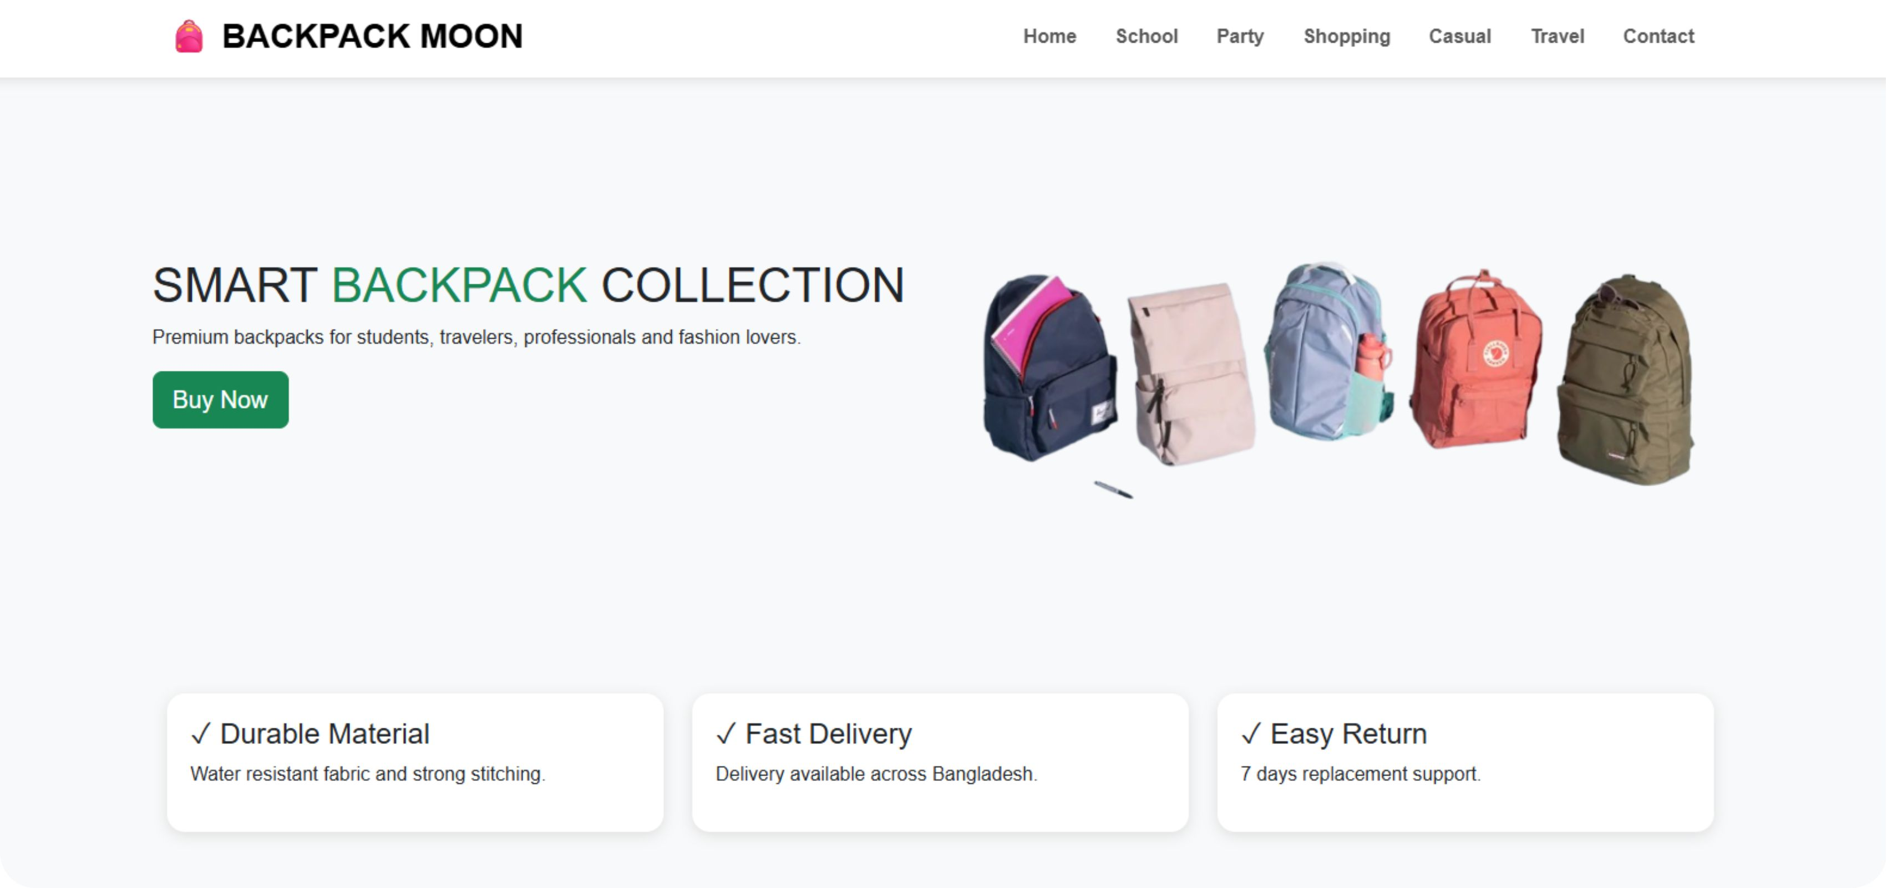

Slide 7
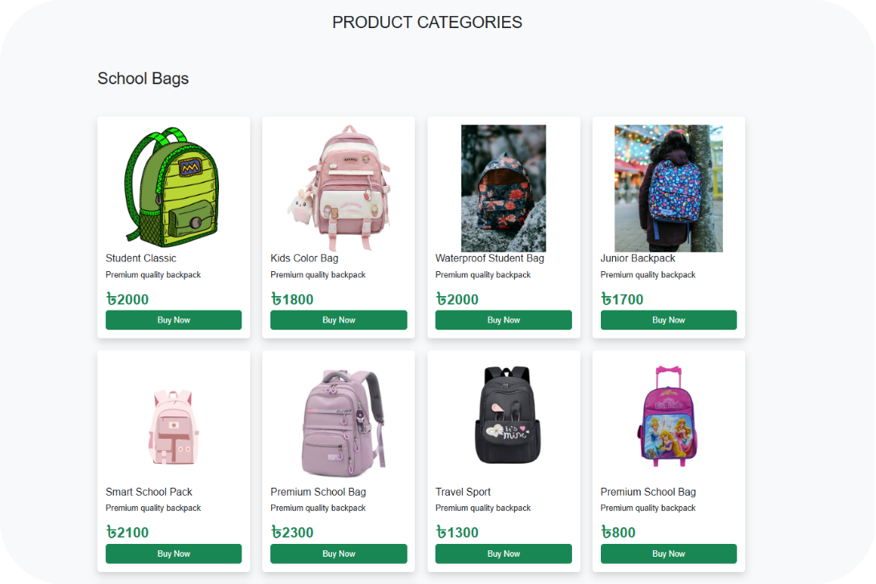
Product Categories & Catalog
Available Categories
School Bags: Comfortable backpacks designed for students
Party Bags: Stylish bags for events and special occasions
Shopping Bags: Reusable, eco-friendly shopping solutions
Casual Bags: Daily-use backpacks with modern aesthetics
Travel Bags: Durable bags for adventure and exploration
Each category displays products in a grid layout with images, descriptions, prices, and "Buy Now" buttons.

Slide 8
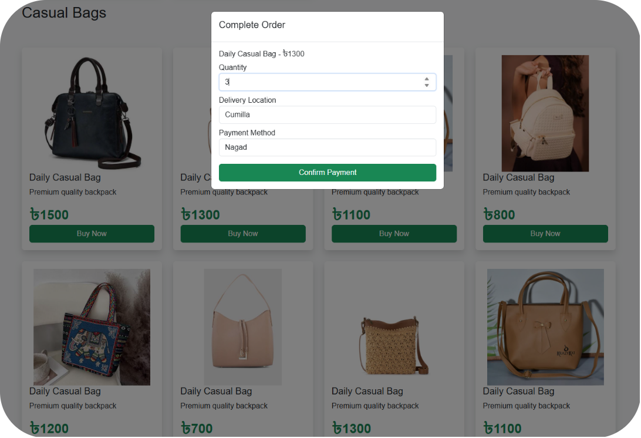
Shopping & Checkout Experience
Order Flow
Add to Cart: Simple product selection with quantity adjustment
Order Modal: Complete order form with product details and pricing
Delivery Locations: Dhaka, Chattogram, Rajshahi, Sylhet, Khulna, Barishal, Rangpur, Mymensingh, Cumilla
Payment Methods: Cash on Delivery, bKash, Nagad, Visa, Mastercard, and bank transfers
Order Confirmation: Instant confirmation with total amount display

Slide 9

Key Achievements & Conclusion
The Backpack Moon e-commerce website has been successfully developed and thoroughly tested, demonstrating robust functionality for core e-commerce operations.
Responsive Design
Mobile-first approach using Bootstrap grid system, achieving full responsiveness across all device sizes
Dynamic Product Catalog
JavaScript-powered listings with real-time filtering, sticky navigation, and smooth scrolling
Seamless Checkout
Modal-based order form with instant confirmation and support for multiple local and international payment methods
Solid Foundation
Clean, minimalist design aligned with brand identity — ready for future enhancements including authentication, inventory management, and a review system

Slide 10
Thank You
Backpack Moon: E-Commerce Website Project
Department of Computer Science Engineering
October 2024

