Slide 1
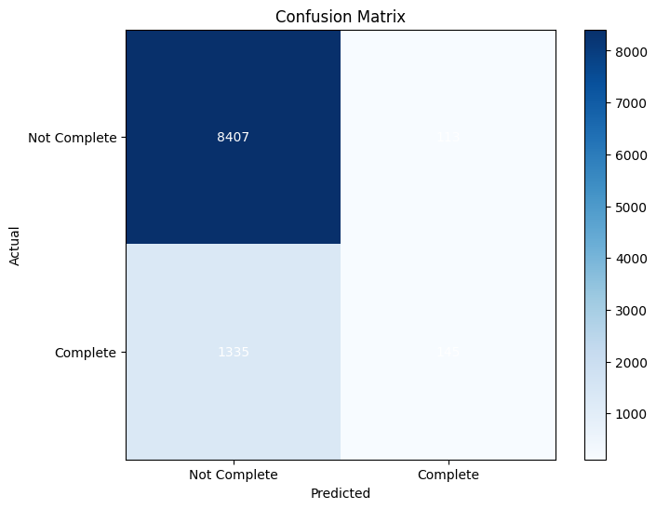
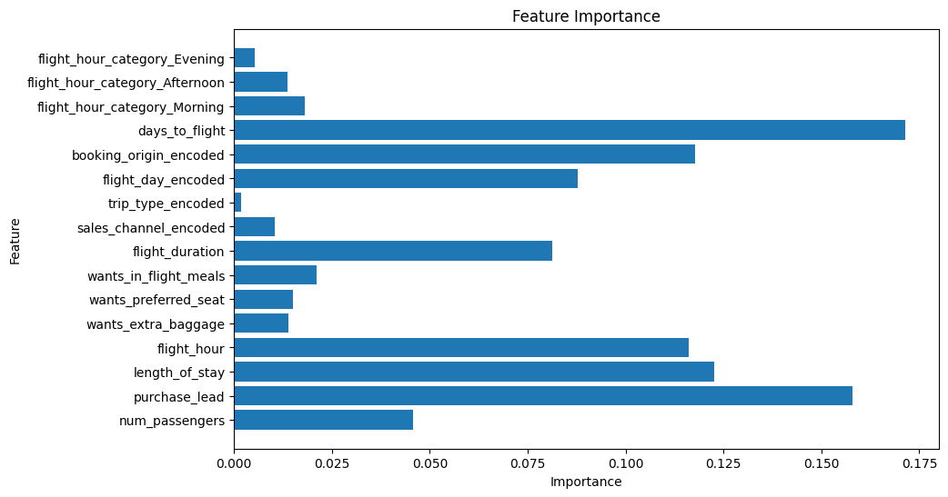
Predictive Model Evaluation Summary
Findings:
Developed a model to predict flight bookings.
Explored data features and prepared them for analysis.
Trained two machine learning algorithms (Random Forest and XGBoost) for classification.
Addressed class imbalance using SMOTE oversampling technique.
Key Points:
Both Random Forest and XGBoost achieved similar performance.
SMOTE improved the model's ability to identify actual bookings (precision) but missed some true bookings (recall).
There's potential to improve model performance through further optimization and feature engineering.
Additional Notes:
The report focuses on Random Forest results, achieving:
Precision of 0.35 and recall of 0.28 for predicting completed bookings.
High precision (0.88) and recall (0.90) for identifying non-bookings.
This suggests the model excels at identifying users who won't book but struggles to capture all those who will.

