Slide 1
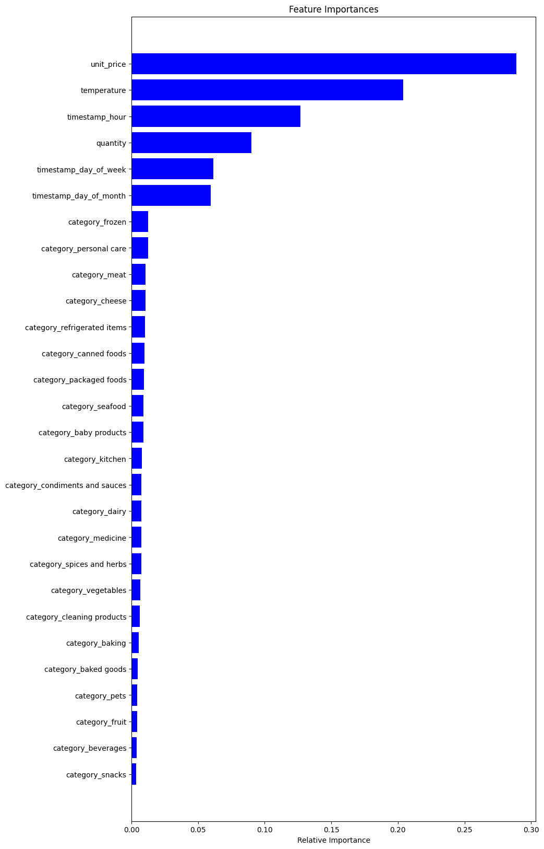
Better stocking of products
Findings:
Used random forest regressor as algorithm since we were dealing with a continuous numerical value.
Achieved 0.38 avg MAE value which is almost 50% of the target mean of the variable targeted(estimated_stock_pct)
Major contributor to prediction were unit price , temperature and hour
Recommendation
More datasets need to be introduced, or existing datasets need to be further engineered
Further steps
This algorithm can be turned into an API
The client can validate if this solves the problem statement and give insights on how he wants it to be improved

