Slide 1
CORE BANKING
Pratyush Priyadarshi
20449173

Slide 2
INTRODUCTION
XYZ Bank provides banking services to users.
Once a person becomes a customer of the bank, he/she can perform basic banking operations such as :-
Credit money
Debit money
Query transaction details
It is proposed to develop an automated system to support typical operations/services of a bank namely:-
User management operations
Money transactions

Slide 3
Scope and Overview
The scope of the Core Banking System will be to provide the functionality as described in Functional Requirements below.
The system will be developed on a Linux box using CPP language and would provide a console-based user-interface.

Slide 4
Functional Requirements
The functional requirement of the application is
1.Bank Staff (Clerk)
2.Customer
Authentication and Authorization
All users logging into the system should be authenticated using a unique login-id and password.

Slide 5
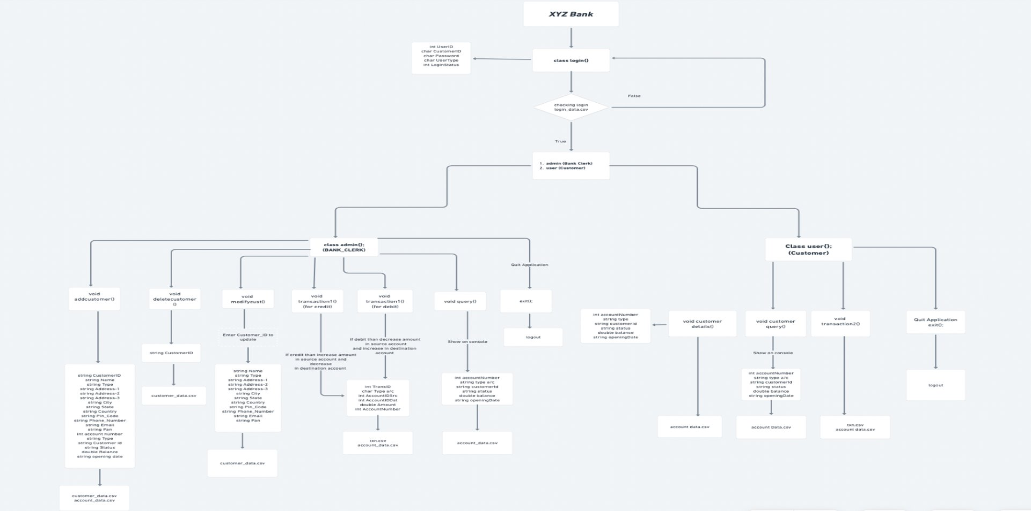
Designing Phase

Slide 6
Bank Clerk(admin)
Customer
Add a customer into the system to create an account
Delete a customer from the system
Modify a customer’s details
Credit money to customer account
Debit Money from the customer account
Query/Report on customer account & transactions
Quit Application
View Customer Details
Transfer money from one account to another
Query/Report on the account & transactions
Quit Application

Slide 7
Division of code
It consists of 3 parts:
CPP Files
CSV Files
HEADER Files

Slide 8
CPP Files
Name of file - corebanking.cpp
Core banking is the main source file which is basically skeleton of project runs in a CPP extension file. It contains login header file for implementing further.

Slide 9
CSV Files
login_details.csv
This CSV file is for all the data of the admin and user which were used to login into the system.
customer_details.csv
This CSV file is for all the details of the customer which were added at the time of creating an account.
account_data.csv
This CSV file is for all the account data which were added at the time of creating an account or after the transaction.
Txn.csv
This CSV file is for all the details of the transaction with their respective id’s.

Slide 10
Header Files
The header file names are:-
login.h
main_admin.h
addcustomer.h
modifycust.h
transaction_admin.h
addtxnfile_admin.h
txnidgenerate_admin.h
deletecustomer.h
query.h
main_user.h
customerdetails.h
customerquery.h
transaction_user.h
addtxnfile_user.h
txnidgenerate_user.h

Slide 11
Header Files
login.h
This login.h header file which contains an admin.h and user.h headers files which called after taking all inputs that is customer id and password.
main_admin.h
This admin.h header file contains addcustomer.h , modifycust.h , transaction_admin.h(credit + debit),deletecustomer.h , query.h and exit. Basically, admin takes all information's of customer like add, delete, transfer money, query/report and quit application.
addcustomer.h
This addcustomer.h header file contains adding a new customer all details like Name, Type, Address1 , Address2, Address3, City, State, Country, Pin code, Phone number, Email, PAN , Balance, type, status, Opening Date, customeriid, password, utype, junk.

Slide 12
modifycust.h​
This modifycust.h header file contains modifying customer details like Name, Type, Address1 , Address2, Address3, City, State, Country, Pin code, Phone number, Email, PAN , Balance, type, status, Opening Date, customeriid, password, utype, junk by using user-id .
transaction_admin.h
This transaction_admin.h header file contains select credit or debit card and enter source and destination account number having addtxnfile_admin.h .
addtxnfile_admin.h
This addtxnfile_admin.h header file contains used to create a transaction id after the completion of payment.
txnidgenerate_admin.h
This txnidgenerate_admin.h header file contains used to transfer all the data of the transaction to their respective txn.csv file.
deletecustomer.h
This deletecustomer.h header file contains deleting the customer details by using their user-id.

Slide 13
query.h
This query.h header file contains used to show all the list of the customers which were added in the bank with their information.
main_user.h
This main_user.h header file contains the user in this all the tasks which were performed by the user are called to perform.
customerdetails.h
This header file is used to view the customer details individually by entering their personal user id.
customerquery.h
This customerquery.h header file is used for transaction purposes like credit or debit money from one account to another account.
transaction_user.h
This transaction_user.h header file is used to create a transaction id after the completion of payment.
addtxnfile_user.h
This addtxnfile_user.h header file is used to transfer all the data of the transaction to their respective csv files.

Slide 14
txnidgenerate_user.h
This file is used to show the data of the customer account which was added in the bank with their details.

Slide 15
THANK YOU

