Slide 1
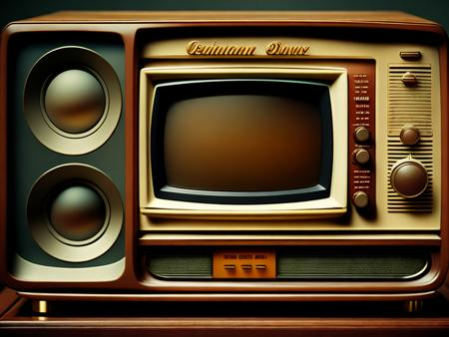
The Evolution of Television
Presented by:
SHIVANI KUMARI

Slide 2
Introduction
Mechanical Television (19th-early 20th century):
Electronic Television (1930s-1940s):
1930: Charles Jenkins broadcasts the first television commercial in the United States.
1936: The BBC initiates regular high-definition television broadcasts.
1939: RCA introduces the first mass-produced television sets at the New York World's Fair.
Color Television (1960s):
1960: NTSC color television standard adopted in the United States.
1967: The UK launches color broadcasts using the PAL system.
Smart TVs and Streaming (2010s-Present):
2010s: Smart TVs with internet connectivity become prevalent, enabling access to streaming services.
2015: The rise of 4K Ultra High Definition (UHD) television.
2020s: Continued advancements in display technology, including OLED and QLED.
1884: Paul Nipkow, a German inventor, develops the Nipkow disk, an early scanning device.
1927: Philo Farnsworth, an American inventor, demonstrates the first working prototype of an all-electronic television system.

Slide 3
The Evolution of Television
1884: Paul Nipkow, a German inventor, develops the Nipkow disk, a rotating scanning disk considered an essential component of early television systems.
1936: The Berlin Summer Olympics becomes one of the first major events to be televised.
Color Television (1950s-1960s):
1956: The first wireless remote control is introduced, revolutionizing how viewers interact with their TVs.
Mechanical Television (1880s-1920s):
1927: Philo Farnsworth, an American inventor, successfully demonstrates the first fully electronic television system.
Black and White Broadcasting (1930s-1950s):
1930s: Television broadcasting begins with black and white images and limited programming.
1940s: Television gains popularity after World War II, with the introduction of commercial broadcasting.
1954: RCA introduces the first color television set to the market.
1960s: Color broadcasting becomes more widespread, although it takes time for color television sets to become affordable for the average consumer.
Remote Control and Cable TV (1950s-1970s):
1970s: The rise of cable television expands channel options, offering improved reception and specialized programming.
Satellite Television and VCRs (1970s-1980s):
1975: HBO becomes the first cable network to use satellite technology for content delivery.
1980s: Video Cassette Recorders (VCRs) gain popularity, allowing viewers to record and watch programs at their convenience.
2020s: Streaming services, such as Netflix, Hulu, and Amazon Prime Video, reshape how viewers access and consume content.
Transition to Digital (1990s-2000s):
1996: Digital television (DTV) standards are established, paving the way for higher-quality images and sound.
2009: Many countries switch from analog to digital broadcasting, enhancing picture and sound quality while freeing up spectrum space.
High-Definition and Flat Panel Displays (2000s-2010s):
2000s: High-Definition Television (HDTV) becomes widely adopted, offering significantly improved picture quality.
2010s: Flat-panel displays, including LCD, LED, OLED, and QLED, replace traditional cathode-ray tube (CRT) TVs.
Smart TVs and Streaming (2010s-Present):
2010s: Smart TVs with internet connectivity and built-in streaming capabilities become commonplace.

Slide 4
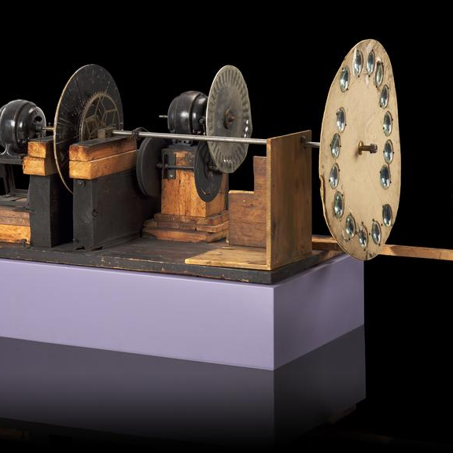
The Invention of Television
Paul Nipkow (1884):
German engineer Paul Nipkow patented the Nipkow disk, a rotating scanning disk with holes arranged in a spiral pattern.
Nipkow's disk became a fundamental component in early mechanical television systems.
Charles Francis Jenkins (1923):
American inventor Charles Francis Jenkins demonstrated one of the earliest electromechanical television systems using a Nipkow disk.
Jenkins is credited with conducting the first-ever public demonstration of television.
Philo Farnsworth (1927):
Philo Farnsworth, an American inventor, successfully demonstrated the first fully electronic television system.
Farnsworth's system used a cathode-ray tube (CRT) and electronic scanning, eliminating the need for mechanical components like the Nipkow disk.
Vladimir Zworykin (1929):
Russian-American engineer Vladimir Zworykin developed the iconoscope, an electronic camera tube that played a crucial role in the development of electronic television.
Zworykin's work laid the foundation for the electronic television systems that would later become the standard.

Slide 5
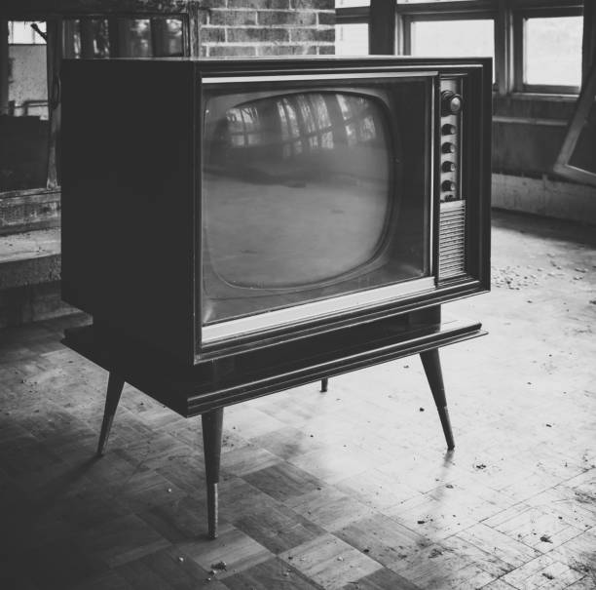
Black and White Television
Early Mechanical Television:
The concept of television dates back to the late 19th and early 20th centuries when inventors were experimenting with mechanical television systems.
Paul Nipkow, a German engineer, developed the Nipkow disk in 1884, which was a rotating scanning disk used in early mechanical television systems.
Charles Francis Jenkins (1923):
Charles Francis Jenkins, an American inventor, was an early pioneer in the field of television.
In 1923, Jenkins demonstrated one of the first electromechanical television systems. This system used a rotating Nipkow disk to scan images.
Philo Farnsworth (1927):
Philo Farnsworth, an American inventor, played a crucial role in the development of electronic television.
In 1927, Farnsworth successfully demonstrated the first fully electronic television system, eliminating the need for mechanical components like the Nipkow disk.
RCA and Commercialization (1930s):
The Radio Corporation of America (RCA) became a key player in the commercialization of television.
RCA, under the leadership of David Sarnoff, played a significant role in the development and promotion of electronic television sets.
World's First Regular Television Service (1936):
The BBC (British Broadcasting Corporation) initiated the world's first regular high-definition television service in 1936, using electronic television technology.
This marked the transition from experimental broadcasts to regular, scheduled programming in black and white.
Mass Adoption (1940s-1950s):
Black and white television sets became more widely available and affordable to the general public in the post-World War II era.
The 1950s witnessed the rapid growth of television as a medium for entertainment and information.

Slide 6
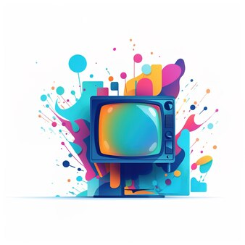
Color Television
Early Experiments:
Various inventors conducted early experiments with color television, including Georges Valensi, who filed a patent for a color television system in 1908.
John Logie Baird (1928):
Scottish inventor John Logie Baird successfully transmitted the first color television images in 1928 using a mechanical system. However, the color images were not of high quality.
Peter Goldmark (1940):
American engineer Peter Goldmark, working at CBS (Columbia Broadcasting System), developed a practical and successful color television system called the CBS Field-Sequential System.
In 1940, CBS demonstrated the first color television broadcast using Goldmark's system.
NTSC Color Television Standard (1953):
The NTSC (National Television System Committee) color television standard was established in the United States in 1953.
The NTSC standard specified the technical parameters for color television broadcasting, including the number of scan lines, frame rate, and the encoding of color information.
RCA and Compatible Color System (1954):
RCA (Radio Corporation of America) developed a compatible color system that could be used with existing black-and-white television sets.
The RCA system, compatible with the NTSC standard, allowed broadcasters to transmit color signals, which could be received in color by viewers with color television sets and in black and white by viewers with monochrome sets.
First Commercial Color Broadcasts (1950s):
The first coast-to-coast color broadcast in the United States took place on January 1, 1954, when the Tournament of Roses Parade was televised in color.
NBC (National Broadcasting Company) and CBS started regular color broadcasts in the mid-1950s.

Slide 7

Lucky Goldstar
Innovative Display Technologies:
LG is known for its innovative display technologies, including OLED (Organic Light-Emitting Diode) and NanoCell technology.
OLED TVs from LG offer stunning picture quality with individually lit pixels, providing deep blacks and vibrant colors.
Smart TV Features:
LG televisions come equipped with Smart TV capabilities, allowing users to access a variety of streaming services, apps, and online content.
The webOS platform, developed by LG, is often praised for its user-friendly interface and responsiveness.
Thin and Sleek Design:
LG is recognized for its commitment to design aesthetics, and many LG TVs feature a thin and sleek profile.
The company's design philosophy often incorporates minimal bezels and clean lines, enhancing the overall visual appeal of their television models.

Slide 8
The Invention of LG Television
Foundation of Goldstar (1958):
LG, initially known as Goldstar, was founded in 1958 by Koo In-hwoi as a chemical company.
The company later diversified into various industries, including electronics, and adopted the name LG (Lucky Goldstar).
Entry into Electronics (1960s-1970s):
In the 1960s and 1970s, LG (then Goldstar) expanded its business into the electronics sector, manufacturing consumer goods like radios and televisions.
Television Manufacturing (1980s-Present):
LG continued to evolve its electronics division, and by the 1980s, it was actively involved in manufacturing televisions.
The company focused on technological advancements, such as introducing flat-screen TVs and adopting innovative display technologies like OLED in later years.
OLED Display Technology (2007):
LG played a pioneering role in the development and popularization of OLED (Organic Light-Emitting Diode) display technology.
In 2007, LG introduced its first OLED TV prototype, showcasing the potential for vivid colors, high contrast, and thin form factors.
WebOS Smart TV Platform (2014):
LG developed the webOS platform for its Smart TVs, offering a user-friendly interface and efficient navigation through apps and content.
The webOS platform has been widely praised for its simplicity and responsiveness.

Slide 9
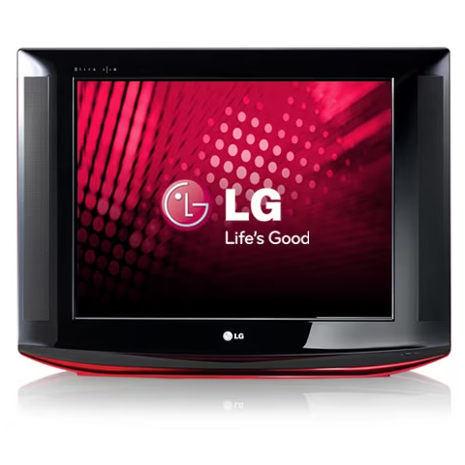
The Evolution of LG Television
Early CRT Televisions (1980s):
LG, initially known as Goldstar, entered the television market with the production of Cathode Ray Tube (CRT) televisions in the 1980s.
These early models were part of the transition from black-and-white to color television.
Flat-Screen and Slim Designs (1990s-2000s):
In the 1990s and 2000s, LG focused on developing flat-screen televisions, moving away from the bulkier CRT designs.
The company introduced slimmer and more stylish designs, enhancing the aesthetic appeal of their TVs.
Adoption of LCD and Plasma (2000s):
LG embraced the shift to newer display technologies, producing LCD (Liquid Crystal Display) and Plasma TVs.
This era marked a significant improvement in picture quality and provided consumers with more choices in terms of screen sizes and resolutions.
Introduction of LED TVs (2010s):
LG, like many other manufacturers, transitioned to Light Emitting Diode (LED) technology for backlighting in their LCD TVs.
LED TVs offered better energy efficiency, improved contrast ratios, and enhanced color reproduction.

Slide 10
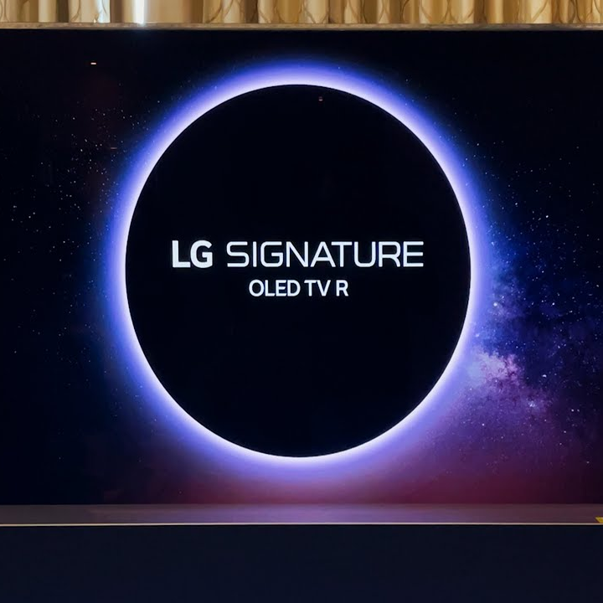
The Evolution of LG Television
Pioneering OLED TVs (2013):
LG became a pioneer in OLED (Organic Light-Emitting Diode) display technology for TVs.
The introduction of OLED TVs marked a breakthrough, providing superior contrast, deep blacks, and more vibrant colors compared to traditional LED/LCD displays.
webOS Smart TV Platform (2014):
LG developed and integrated the webOS Smart TV platform into its television lineup.
webOS offered a user-friendly interface, smooth navigation, and access to various apps and streaming services.
4K UHD and HDR (2010s):
LG played a leading role in the adoption of 4K Ultra High Definition (UHD) resolution in their TVs, providing a sharper and more detailed viewing experience.
High Dynamic Range (HDR) technology was also incorporated to enhance contrast and color accuracy.
AI and ThinQ Technology (2018):
LG introduced ThinQ AI (Artificial Intelligence) technology to their TVs, enabling enhanced voice control and integration with other smart home devices.
AI capabilities were employed to optimize picture and sound quality based on content and viewing conditions.
Rollable OLED TV (2019):
LG showcased the world's first rollable OLED TV, the LG SIGNATURE OLED TV R, demonstrating the company's commitment to pushing the boundaries of TV design.

Slide 11
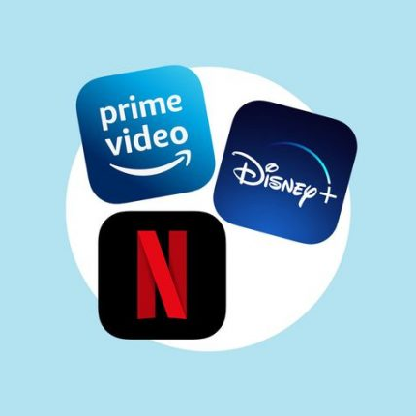
Streaming Services
Netflix:
Netflix is a popular streaming service that offers a vast library of movies, TV shows, documentaries, and original content. LG Smart TVs usually come with a dedicated Netflix app.
Amazon Prime Video:
Amazon Prime Video provides a wide selection of movies, TV series, and Amazon Originals. LG TVs often include the Amazon Prime Video app for easy access.
Hulu:
Hulu is a streaming service that offers a combination of current-season TV episodes, original content, and a vast library of movies. LG Smart TVs typically have a Hulu app.
Disney+:
Disney+ is a platform that features content from Disney, Pixar, Marvel, Star Wars, and National Geographic. LG Smart TVs often come with a pre-installed Disney+ app.
YouTube:
YouTube is a video-sharing platform that provides a diverse range of content, including user-generated videos, music, and official channels. LG TVs typically have a YouTube app.
Apple TV:
LG Smart TVs support the Apple TV app, allowing users to access Apple TV+ for original content, as well as purchase or rent movies and TV shows from the iTunes Store.
Google Play Movies & TV:
LG TVs may have the Google Play Movies & TV app, enabling users to buy or rent movies and TV shows directly from the Google Play Store.
Vudu:
Vudu is a service that allows users to rent or buy movies and TV shows. Some LG Smart TVs come with the Vudu app for convenient access to a wide range of content.
Plex:
Plex is a media server platform that allows users to organize and stream their own media libraries. LG TVs often support the Plex app for users who want to access their personal media collections.

Slide 12

Future Trends
8K Resolution and Beyond:
As technology advances, there's a possibility that LG will continue to push the boundaries of display resolution. This may involve an increased focus on 8K TVs and, eventually, even higher resolutions to deliver incredibly sharp and detailed images.
Improved OLED Technology:
LG has been a leader in OLED display technology. Future trends may involve further advancements in OLED, such as improved durability, increased brightness levels, and innovations in how OLED panels are manufactured to make them more cost-effective.
Enhanced AI Integration:
Artificial Intelligence (AI) is likely to play an increasingly important role in LG TVs. Future models may feature more advanced AI capabilities, allowing for smarter content recommendations, better voice control, and personalized user experiences.
Expanded Smart Home Integration:
LG may deepen its integration with smart home ecosystems, allowing users to control and monitor various smart home devices directly from their TVs. This could include compatibility with virtual assistants like Amazon Alexa and Google Assistant.
Immersive Audio and Sound Technologies:
The audio experience is a crucial aspect of television viewing. Future LG TVs might incorporate advanced sound technologies, including immersive audio formats like Dolby Atmos, to create a more immersive home theater experience.
Flexible and Rollable Displays:
Building on LG's innovation with the rollable OLED TV, future trends could involve the development of more flexible and rollable display technologies. This might lead to TVs that can be adjusted in size or even retracted when not in use, providing users with more flexibility in their living spaces.

Slide 13
Conclusion
LG televisions have evolved significantly, from early CRT models to cutting-edge OLED displays, showcasing LG's commitment to embracing and advancing display technologies.
LG's commitment to design excellence is evident in the evolution of TV aesthetics. The company has consistently delivered slim, stylish, and sleek designs, enhancing the overall viewing experience.
LG has become a global leader in OLED technology, introducing TVs that offer unparalleled picture quality with deep blacks, vibrant colors, and flexibility, as seen in the rollable OLED TV.
Looking forward, LG is likely to continue pushing boundaries with trends such as higher resolutions, enhanced AI integration, and innovations in flexible display technologies, reaffirming its commitment to staying at the forefront of the television industry.
Technological Advancements:
Smart TV Revolution:
LG played a pivotal role in the Smart TV revolution, integrating features like webOS, providing users with intuitive interfaces and access to a wide range of streaming services.
Design Innovation:
OLED Leadership:
Future-Focused Trends:

Slide 14

Thank You

