Slide 1
DevOp’s Building blocks
Lessons-02

Slide 2
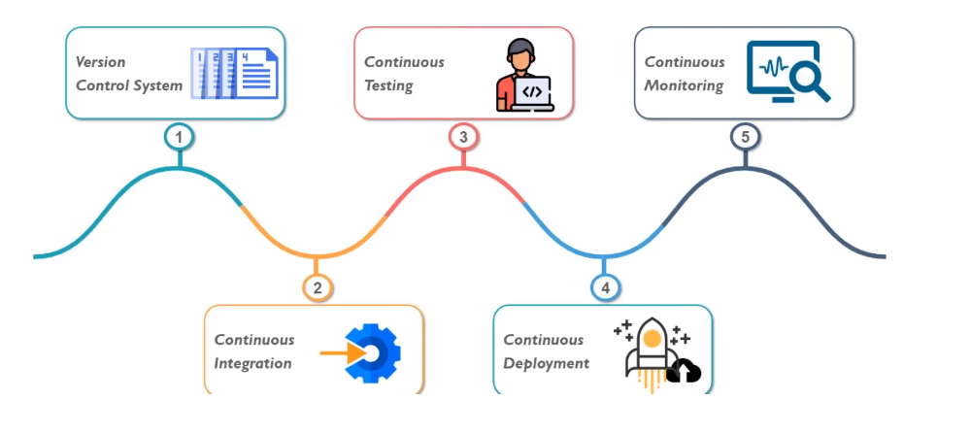
DevOp’s Model

Slide 3
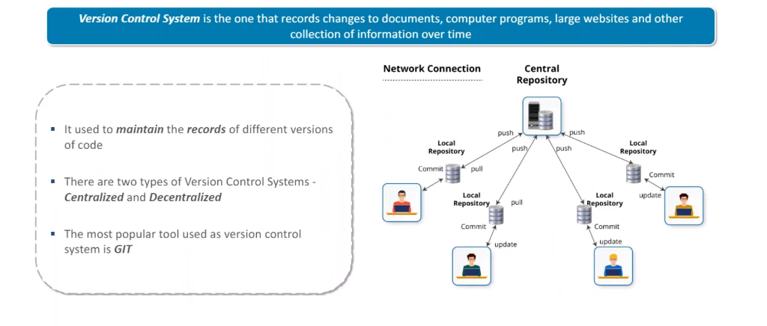
Version Control Systems

Slide 4
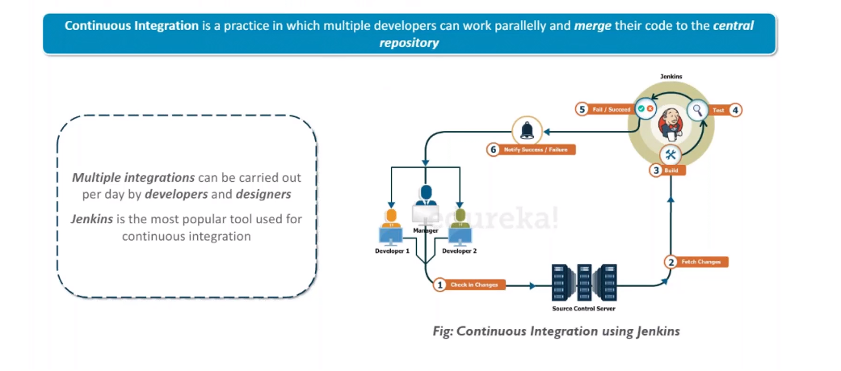
Continuous Integration

Slide 5
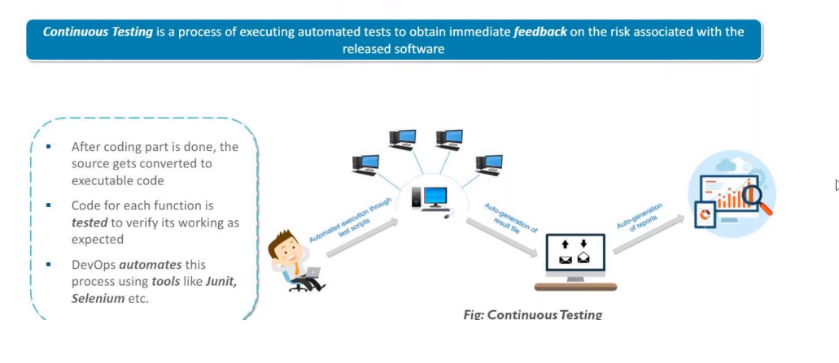
Continuous Testing

Slide 6
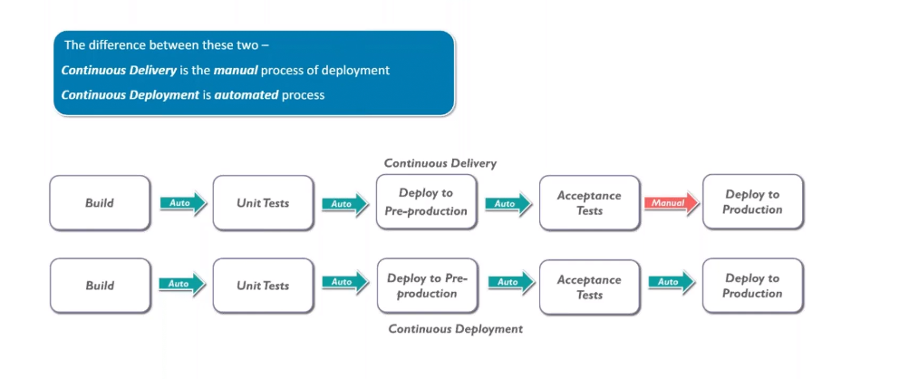
Continuous Deployment

Slide 7
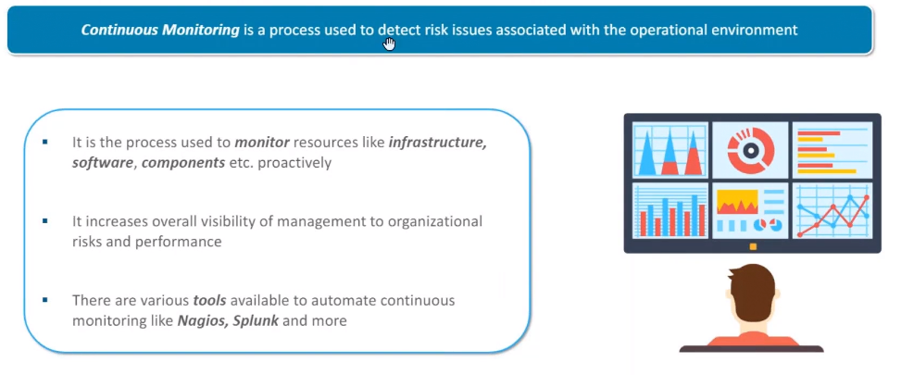
Continuous Monitoring

