Slide 1
DevoP’s
Lessons-03
Installation of cicd pipeline

Slide 2
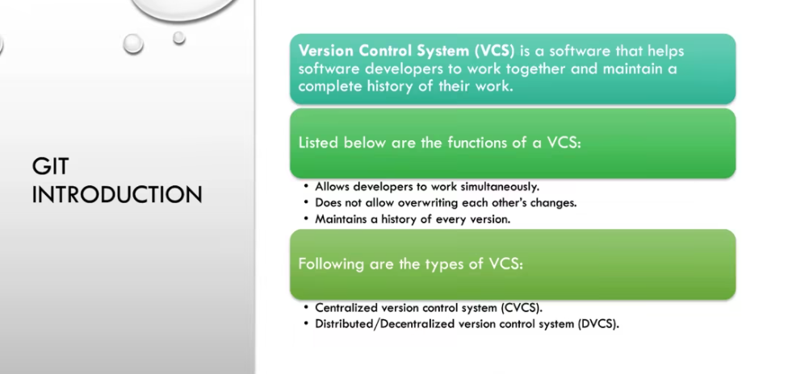
GIT-GITHUB

Slide 3
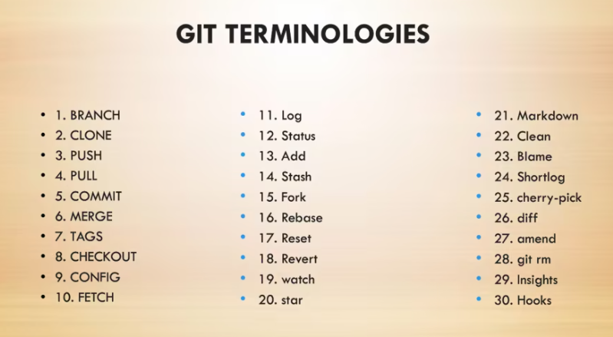
GIT

Slide 4
Git setup and Configurations.
- www.git-scm.com
-git –version
- www.github.com
#git init
#git remote add origin https
#git add index.html (staging)
#git commit –m “Add Website”
#git push origin master

Slide 5
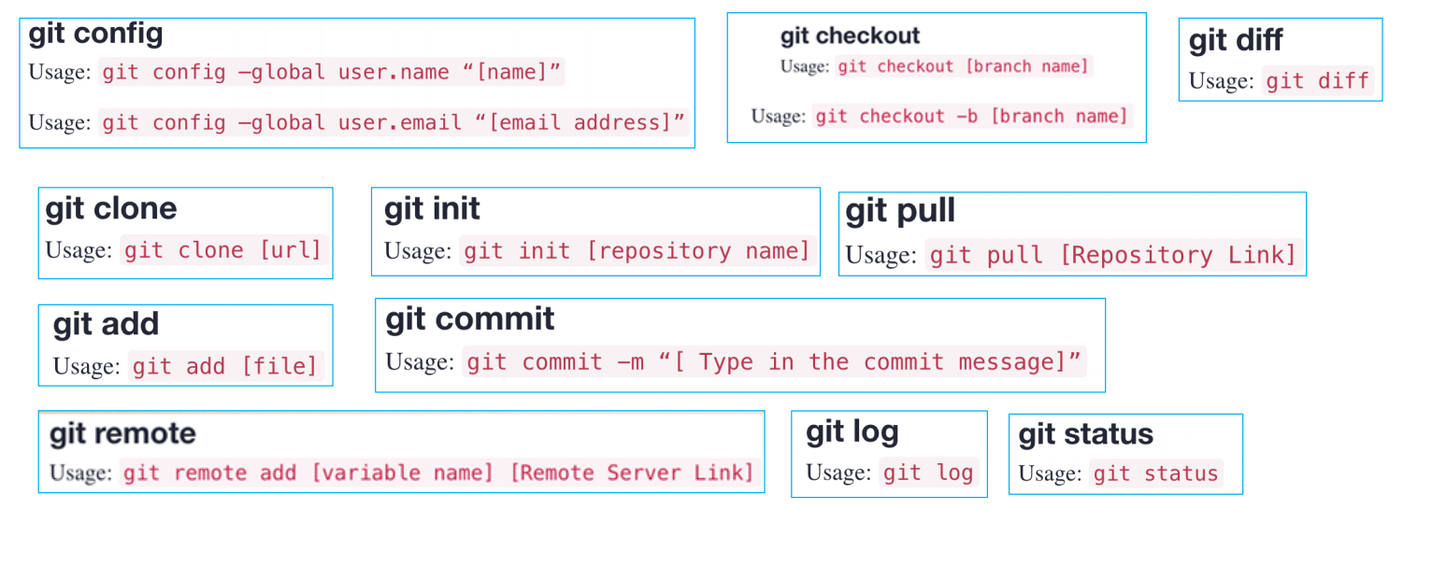
Examples:

Slide 6
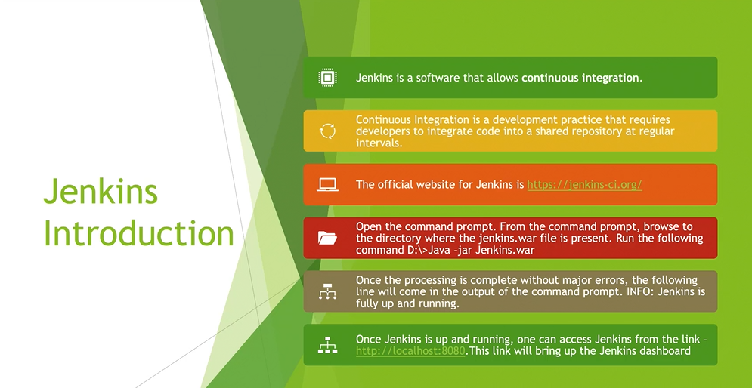
JENKINS

Slide 7
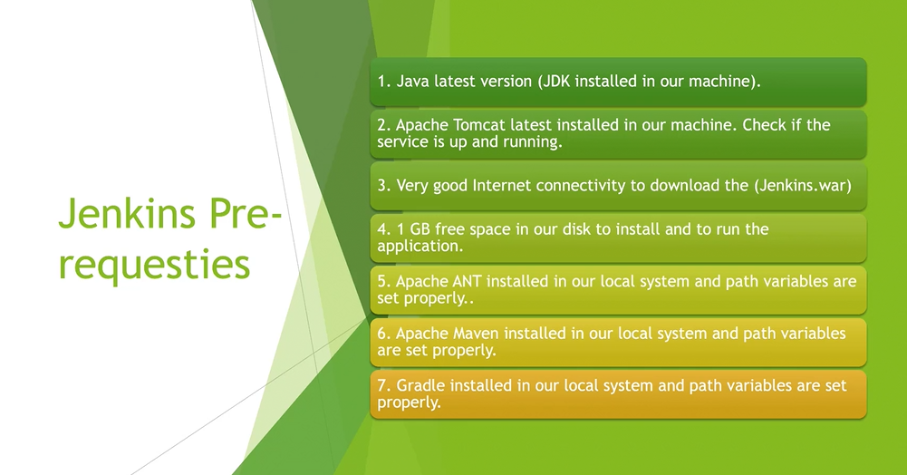

Slide 8
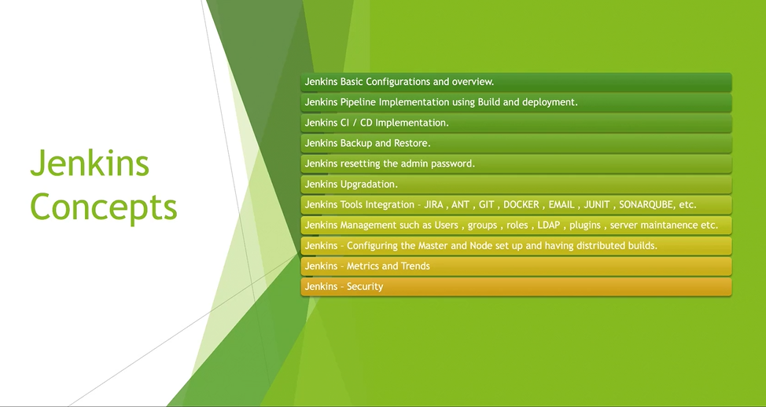

Slide 9
- www.Jenkins.io
#yum install java-1.8* -y (java –version)
#wget –o /etc/yum.repos.d/Jenkins,repo https://pkg.Jenkins.io/redhat-stable/Jenkins.repo
#rpm –import https://pkg.Jenkins.io/redhat-stable/Jenkins.io.key
#yum install Jenkins –y
#systemctl start Jenkins
#netstat –an | grep 8080

