Slide 1
DevOp’s
Lessons-4: DOCKER

Slide 2
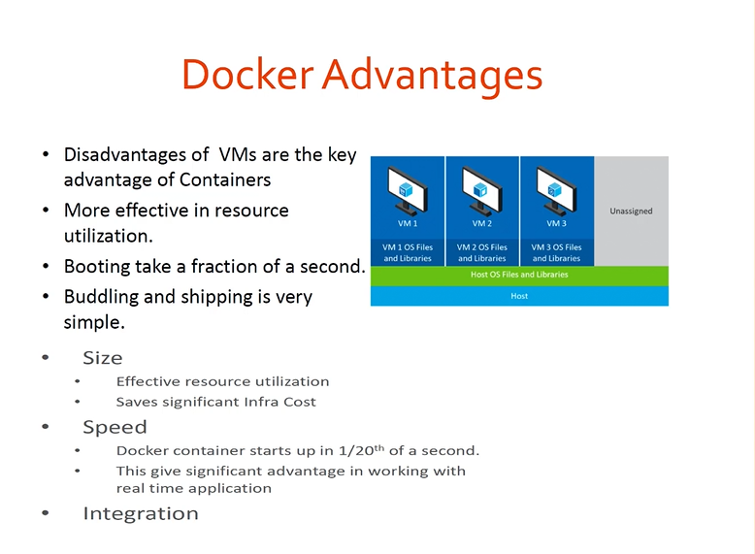

Slide 3

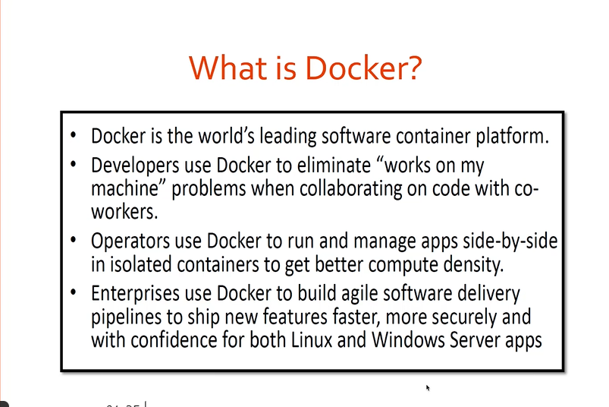
What is Docker

Slide 4
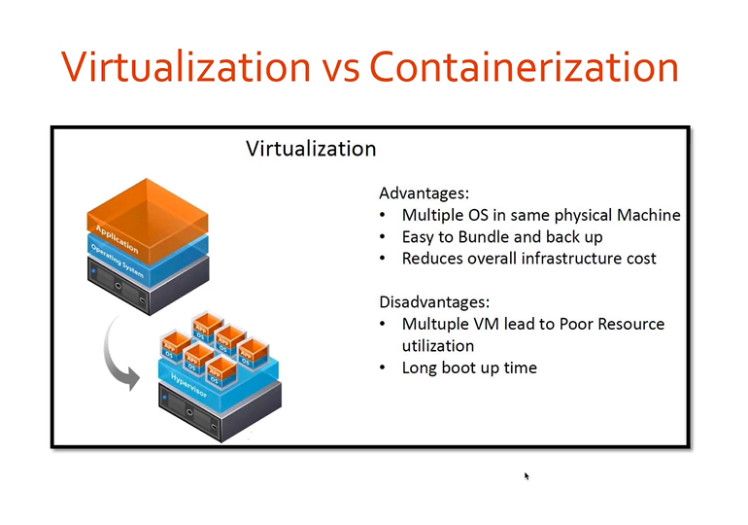

Slide 5
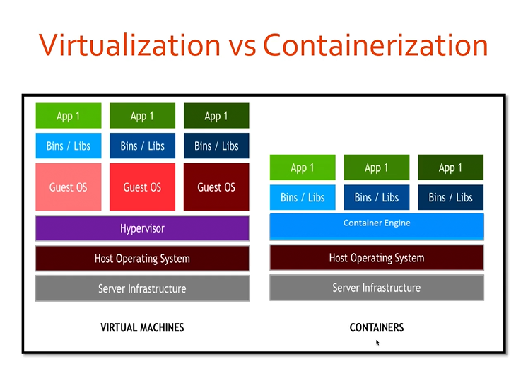

Slide 6
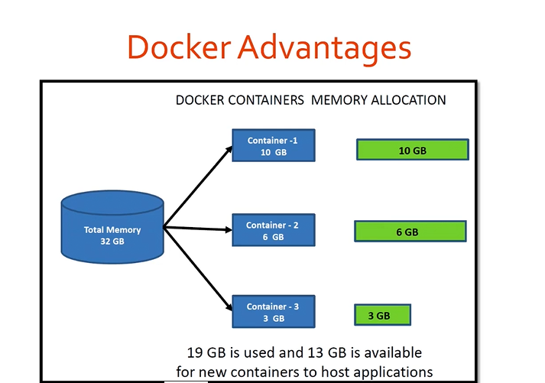

Slide 7
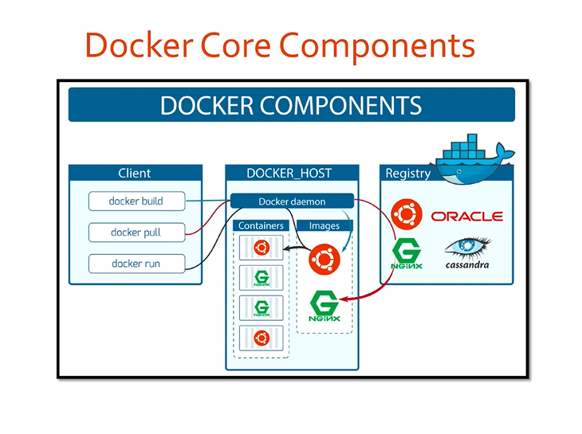

Slide 8
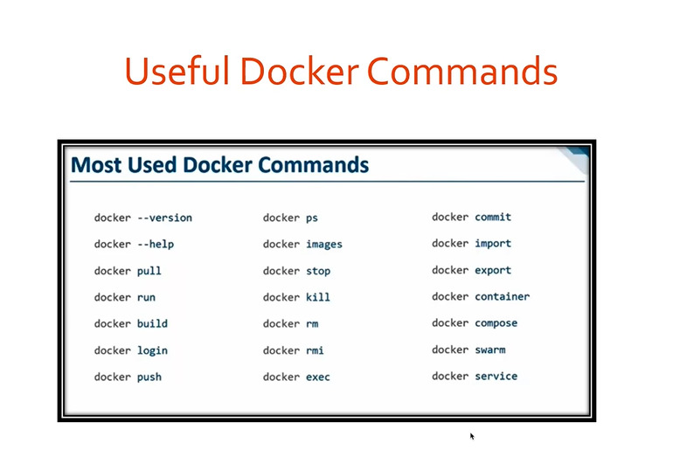
Docker Installations
$docker images, docker pull ubuntu,
$docker run ubuntu, docker build –t myimage.
$docker container logs, kill, rm, run, start.
Then container ID.
$docker login, docker push, docker ps, docker ps –a, docker stop fei5006-86t86j,
$docker kill fe95929
$docker-compose build
$docker-compose up

Slide 9
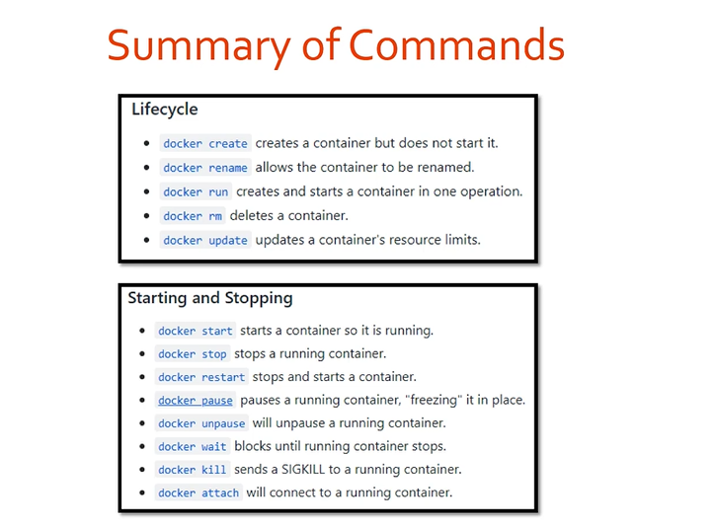

Slide 10
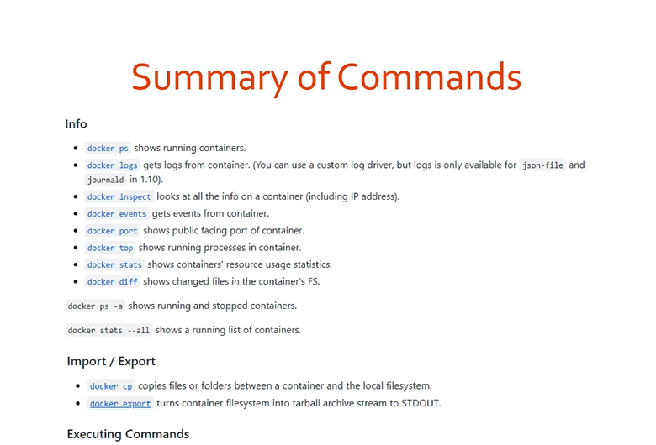
www.hub.docker.com

Slide 11
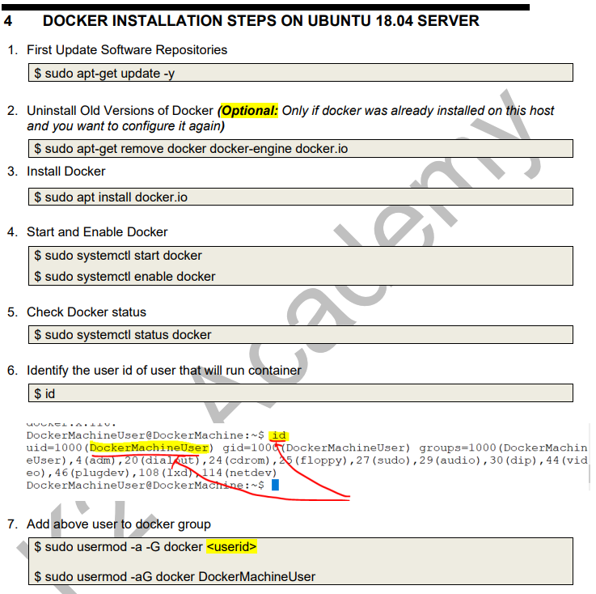
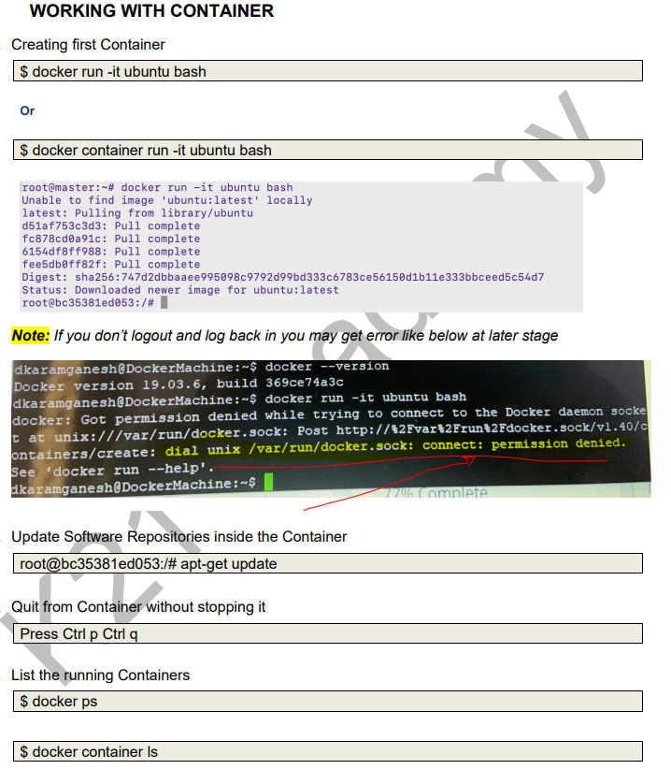
INSTALLATION

Slide 12
