Slide 1
DevOp’s
Lessons-05: ANSIBLE AS IN CONFIGURATION MANAGEMENT.

Slide 2
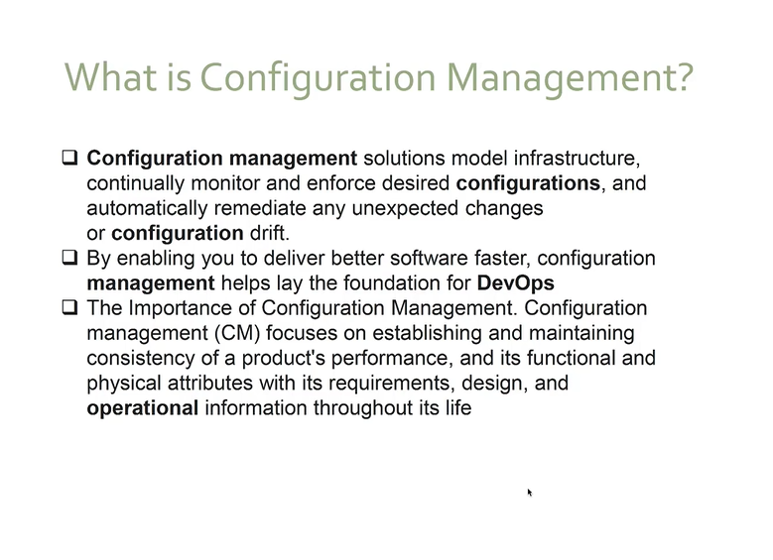

Slide 3
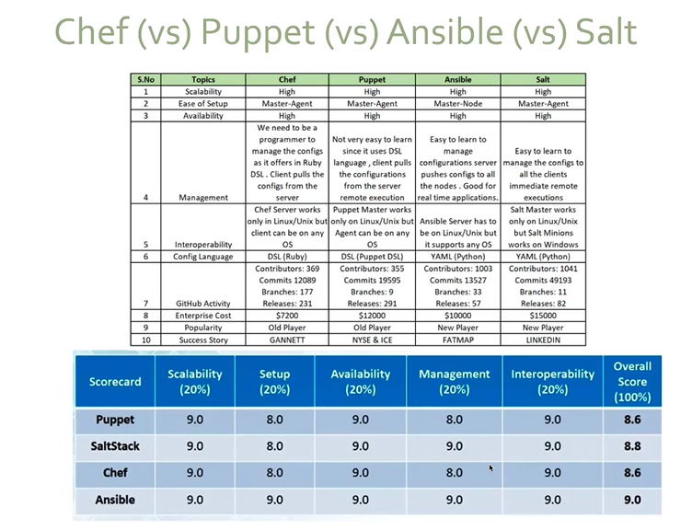

Slide 4
What is Ansible ?
- Ansible is an Open source IT configuration Management , Deployment and Orchestration tool.
- It aims at providing large productivity gains to a wide variety of Automation challenges.
WHY ANSIBLE ?
- Simple: Uses a simple human readable yaml synthax called playbook.
- Agentless: No agent to be install.
- Powerful and flexible: Can enable you to model even the most complex IT workflow.

Slide 5
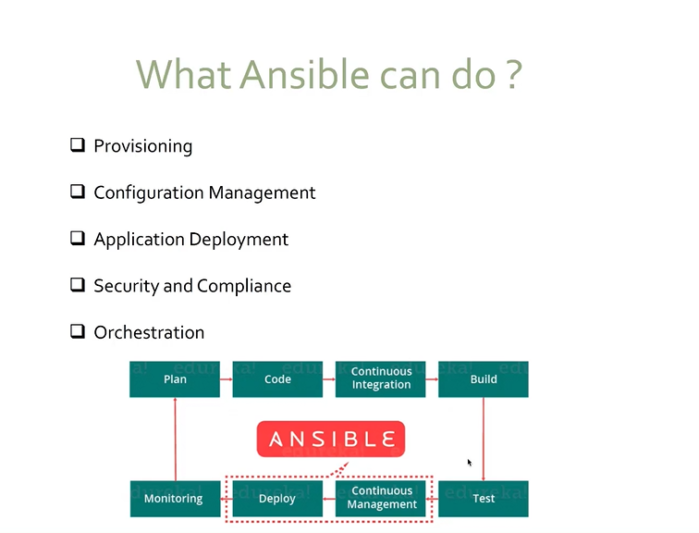

Slide 6
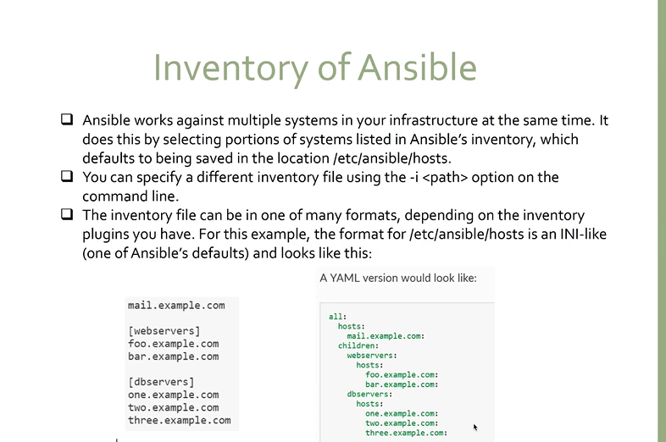

Slide 7
