Slide 1
DevOp’s
Lesson-1

Slide 2
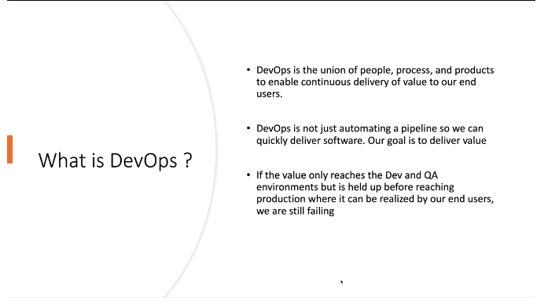
What is DevOp’s?
-

Slide 3
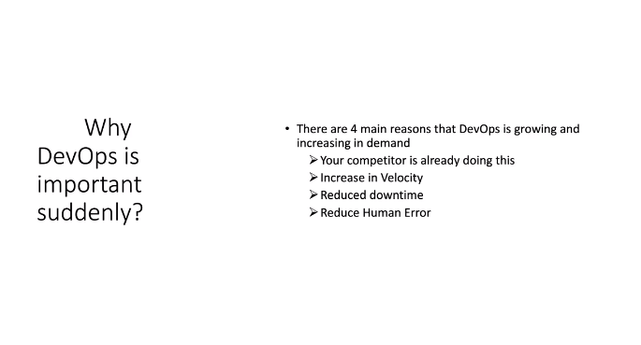
Why DevOp’s - (People,process &tools)

Slide 4

- Improve speed to Production ( market)
- Continuous Integration and Delivery
- Higher quality and fewer failures.
- Innovation and creativity
- Resource and Cost reduction.

Slide 5
Principle of DevOp’s
- The First Way - FLOW: Understand and increase the flow of work (Left to Right)
- The Second Way - FEDBACK: Create short feedback loops that enables continues improvement ( Right to Left)
- The Third Way – Continuous experimentation and learning: - Create a culture that fosters:\- Experimentation, taking risk and learning from failure.
Understand the repetition and practice is the prerequisite for mastery.

Slide 6
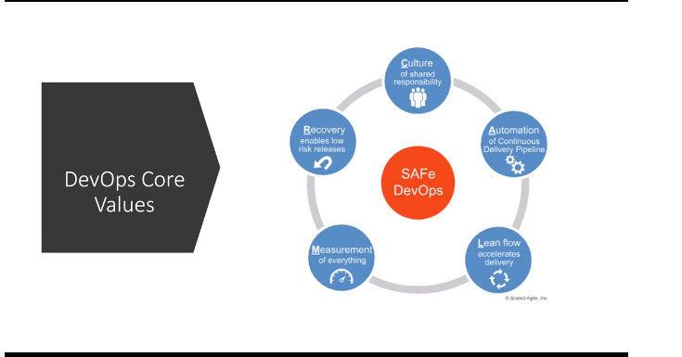
DevOp’s Core Values

Slide 7
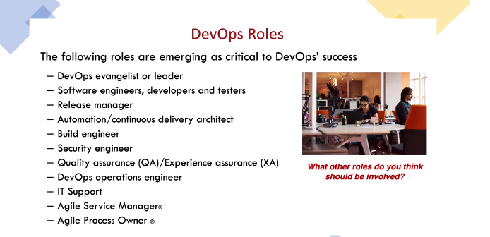
DevOp’s Roles

Slide 8
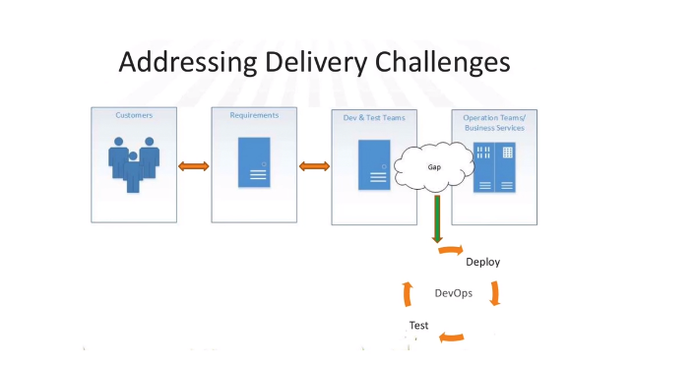

Slide 9
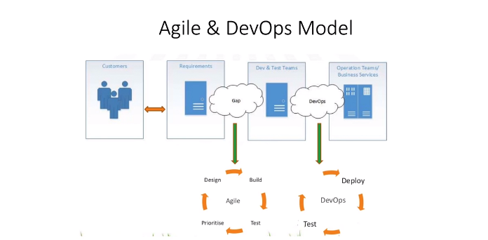

Slide 10


