Slide 1
Dynamic Weather Dashboard
1.Name-SAROJ OJHA
2.College Name-EATM COLLAGE
3.Department-CSE

Slide 2
OUTLINE
Problem Statement (Should not include solution)
System Development Approach (Technology Used)
Algorithm & Deployment (Step by Step Procedure)
Result
Conclusion
Future Scope(Optional)
References

Slide 3
Problem Statement
- People need quick access to real-time weather updates.
- Existing apps are often complex or overloaded with ads.
- Travelers and commuters require location-based forecasts for planning.
- A lightweight, web-based solution is needed to provide current, hourly, and daily forecasts.

Slide 4
System Approach
Frontend Technologies:
- HTML5 – Structure of the dashboard
- CSS3 – Styling & glassmorphism design
- JavaScript – Fetching API data, updating UI
APIs Used:
- OpenWeatherMap API → Weather data
- Geolocation API → User location
Design Approach:
- Clean, modern, glass-style UI
- Mobile responsive layout

Slide 5
Algorithm & Deployment
Algorithm:
1. Request user location with Geolocation API
2. Fetch weather data (current + forecast) from OpenWeatherMap
3. Parse JSON response
4. Display current temperature, humidity, wind speed, and icon
5. Render hourly and daily forecasts
6. Toggle temperature units (°C / °F)
Deployment:
- Local testing with Live Server
- Hosting via GitHub Pages / Netlify

Slide 6
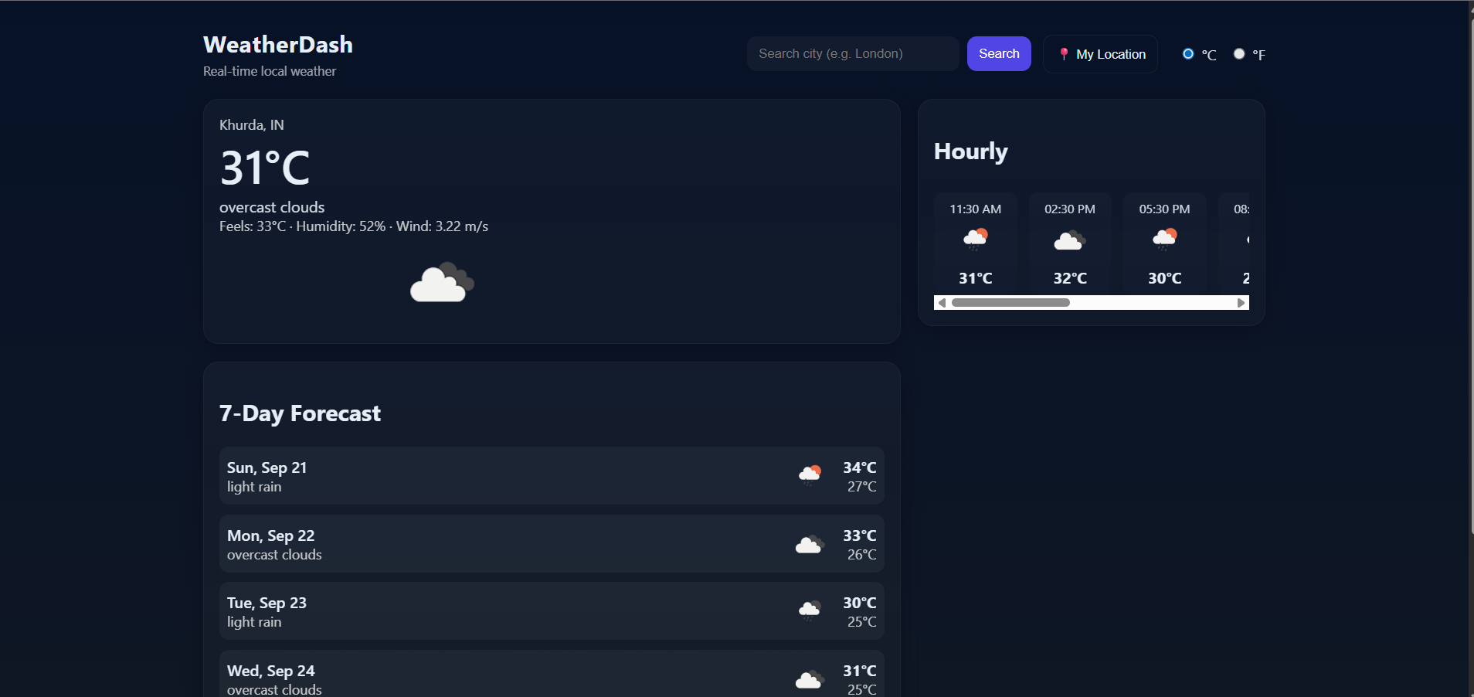
Result
Github link
https://github.com/Mr-Saroj/Weather-dashboard/settings
Deployment link
https://mr-saroj.github.io/Weather-dashboard/

Slide 7
Conclusion
- Provides a fast and user-friendly weather dashboard
- Eliminates the need for heavy apps
- Assists in daily planning & travel
- Demonstrates integration of APIs with frontend web technologies

Slide 8
Future scope(Optional)
- Add alerts for severe weather conditions
- Integrate maps for multiple cities
- Backend (Node.js/DB) for favorite locations
- Voice assistant integration for accessibility
Add backend integration (Node.js) for order management.
Secure payment gateway integration.
Admin dashboard for inventory updates.
AI-based product recommendations.

Slide 9
References
- OpenWeatherMap API Docs (https://openweathermap.org/api)
- MDN Web Docs – Geolocation API
- Bootstrap v5.3 (if used)
- Your GitHub Repository Link

Slide 10
THANK YOU

