Slide 1

Digital Hospital Management System:
Supervisor Name: Md. Ashiqussalehin
Designation: Lecturer
Green University Of Bangladesh
Presented By:
Sanzida Akter
Id: 191002205
Mohammad Anik Mollah
Id:193002033

Slide 2


Table of Contents
Introduction
Objectives
Motivations
System Requirement
Workflow Diagram
Features
Gantt Chart
Methodology and Approaches
User Requirements
Use case Diagram, Flow Chart, ER Diagram, Data flow diagram,
Testing Techniques.
Conclusion
Future Direction
Output
References

Slide 3
Introduction
Hospital Management System is a system enabling hospitals to manage information and data related to all aspects of healthcare – processes, providers, patients, and more, which in turn ensures that processes are completed swiftly and effectively.

Slide 4
Objectives
To enhancing personnel productivity,
To facilitating hospital operations,
To improving the process quality and ensuring patient safety,

Slide 5
Motivation
DHMS information system helps Processing Speed & Results.
It helps to track and control Cost Effective.
It can helps to Reduction in Errors.
It gives data Security & Retrieving Ability.
It also helps to improve Patient Care.
DHMS helps to faster the Quality & Compliance.

Slide 6
Methodology and Approaches:
The sequential approach in understanding expectative information needs and ability to modify the current descriptions
Define information need as configurations linked to the typical data formats.
Declaration of the relationships between data domains.
Analysis of the system target, which is the representation of the user's information needs as a set of initial entities in the domain area.
Definition of the relationship between the various data set
Development of the database in MySQL using tables and allowing “Id” as the primary key

Slide 7
Approaches:
1. Business Process Management
2. Related work
3.Discussion and future work

Slide 8
System Requirement:
Which Software we will use:
Frontend
HTML
CSS
Bootstrap
Laravel
Java/JavaScript
Backend
C#/PHP
Database
MySQL

Slide 9
Features
Key Features of a Hospital Management System
Management-oriented features:
Doctor timetables and scheduled appointments.
Operation room availability schedule and management.
Food management for patients’ diets and hospital cafeteria.
Patient-oriented functions:
Patient registration
Patient admittance information
Patient billing, insurance and credit tracking.
Patient notification

Slide 10
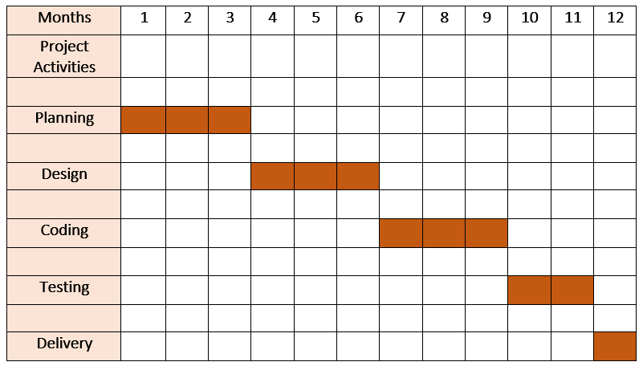
Gantt Chart

Slide 11
User Requirements:
Clinical
Patients
Doctors
Administrative
Record Office
Pharmacy
Laboratory

Slide 12
Use case diagram for Digital Hospital Management System
Dispense Drug
Users Management
Pharmacy
Costing
System Maintenance
Login
Drug Management
Test report
Administrator
Laboratory
Test Management
Prescription
Medical report query
Create record
Record Officer
Doctor
Patient

Slide 13
Start
Patient card log in
Record queue
no
Pick up
yes
Consultation with doctor
yes
Need test?
Laboratory
paid and tested?
Pharmacy
Tested?
no
no
yes/No
no
Paid?
Account
yes
Dispense drug
Flow Chart: Implementation for Hospital management system
End

Slide 14
Gender
Age
Notes
Name
Name
Employee
Gender
Age
MR NO
Patient
Check
Doctor
Specialist
Mfg Date
Name
r
To
Pharmacy ID
Fill in
Drug ID
Diagnostic
Email
MR NO
Price
Record Officer
Drugs
Price
Pharmacy
Address
Manufacture
Reference
Employee Name
Date
EXP Date
Employee ID
Recap
ICD
From
Employee Name
Report
Administrator
Letter No
Laboratory
Employee ID
Analysis
Lab Test
Result
Delivery
Input
Endorsem
Figure: ER Diagram for Digital Hospital Management System

Slide 15
Generate Hospital Management
Hospital Management
Generate Patient Report
Patient Management
Hospital Management System
Medicine Management
Generate Medicine Report
Test Management
Generate Test Report
Login Management
User Login Details
System User Management
Generate System User Report
Fig: Data Flow Diagram (1_Level)

Slide 16
1-Level DFD
1-level DFD-provides a more detailed breakout of pieces of the Context Level Diagram in subprocess.
Main entities and output of first level :
To process Hospital records and generate report of all Hospital
To process Processing Hospital Employee Records and generate report of all To process Hospital
To process Patient records and generate report of all Patient
To process Doctor records and generate report of all Doctor
To process Medicine records and generate report of all Medicine
To process Test records and generate report of all Test
To process Doctor Fees records and generate report of all Doctor Fees

Slide 17
Software Testing Techniques:
Some of software testing techniques given below –
Unit Testing (white Box Testing)
Integration Testing
System Testing
Functional Testing
Acceptance Testing
Smoke Testing
Regression Testing
Performance Testing
Security Testing
User Acceptance Testing
Black Box Testing

Slide 18
Use of Testing
Unit Testing(white Box testing) :
It helps to identify bugs early in the development process, before they become more difficult and expensive to fix.
It helps to ensure that changes to the code do not introduce new bugs.
popular frameworks and tools are in testing i- JUnit, NUnit, and xUnit.
System Testing:
System Testing is carried out on the whole system in the context of either system requirement specifications or functional requirement specifications or in the context of both. The software is tested such that it works fine for the different operating systems. I. In this, we just focus on the required input and output without focusing on internal working.
In this, we have security testing, recovery testing, stress testing, and performance testing .

Slide 19
Performance Testing:
It is designed to test the run-time performance of software within the context of an integrated system.
It’s also use to speed and effectiveness of the program.
It is also called load testing.
Acceptance Testing :
Acceptance testing is done by the customers to check whether the delivered products perform the desired tasks or not, as stated in requirements.
User Acceptance Testing:
User acceptance testing (UAT) is the safeguard against unfinished, ineffective, or faulty software products before go-live. Well-designed, high-quality UAT tests are thorough and reflect user requirements accurately, identifying problems that would go unnoticed in integration or unit tests.
Functional Testing:
Functional testing is a type of testing that seeks to establish whether each application feature works as per the software requirements.

Slide 20
Security Testing:
It is used to discover the weaknesses, risks, or threats in the software application.
It also help us to stop the nasty attack from the outsiders and
IT make sure the security of our software applications.
Object-Oriented Testing:-
This testing is a combination of various testing techniques that help to verify and validate object-oriented software.
This testing is done in the following manner:
Testing of Requirements,
Design and Analysis of Testing,
Testing of Code,
Integration testing,
System testing,
User Testing.
Black Box Testing:-

Slide 21
No. | Requirements | Unit Cost | Estimated Cost (TK)
1 | Jr. Web Developer(2 Person) (4 Months) | 20000/month | 16,0000
2 | Sr. Web Developer (1 month) | 60000 | 6,0000
3 | Domain Cost | - | 4,300
4 | Deployment Cost | - | 10,000
5 | Miscellaneous | - | 8,500
6 | Testing | 2000*10 | 20,000
 | Total |  | 262,800

Slide 22
Future Direction
Changing features depending user requirement.
Adding ID3 basic algorithms
Making an android application based on the website.

Slide 23
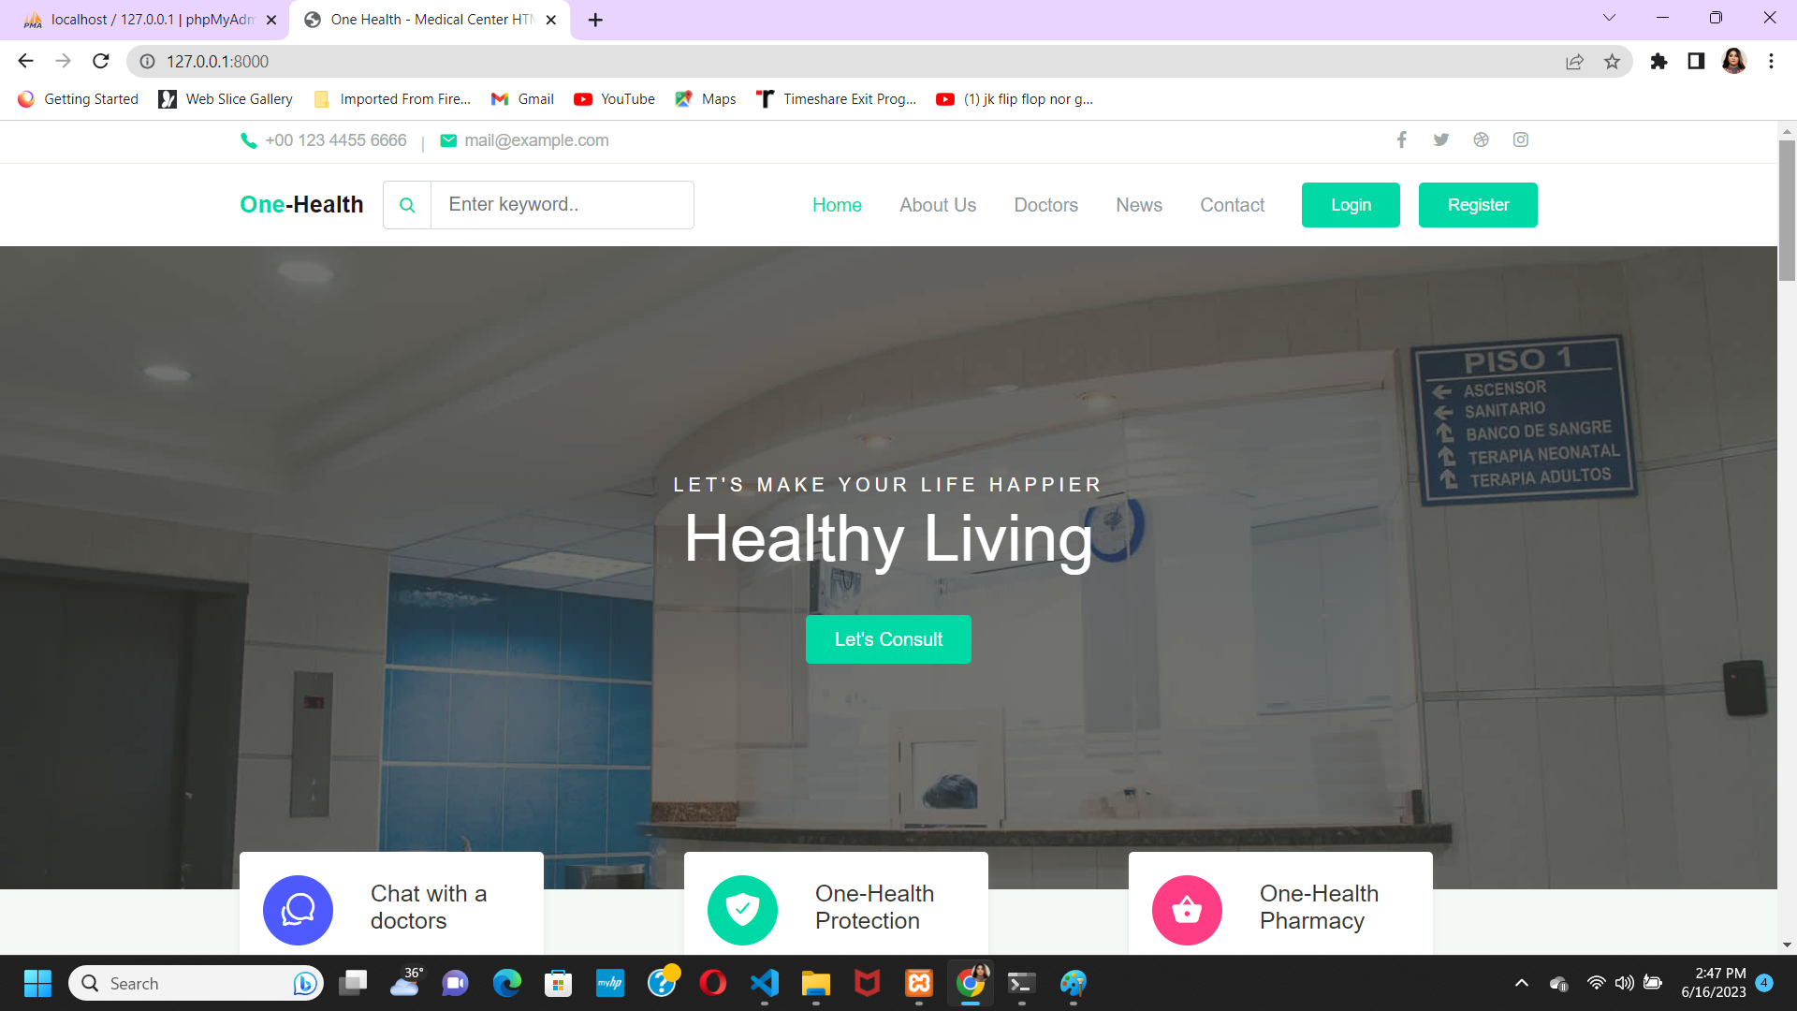
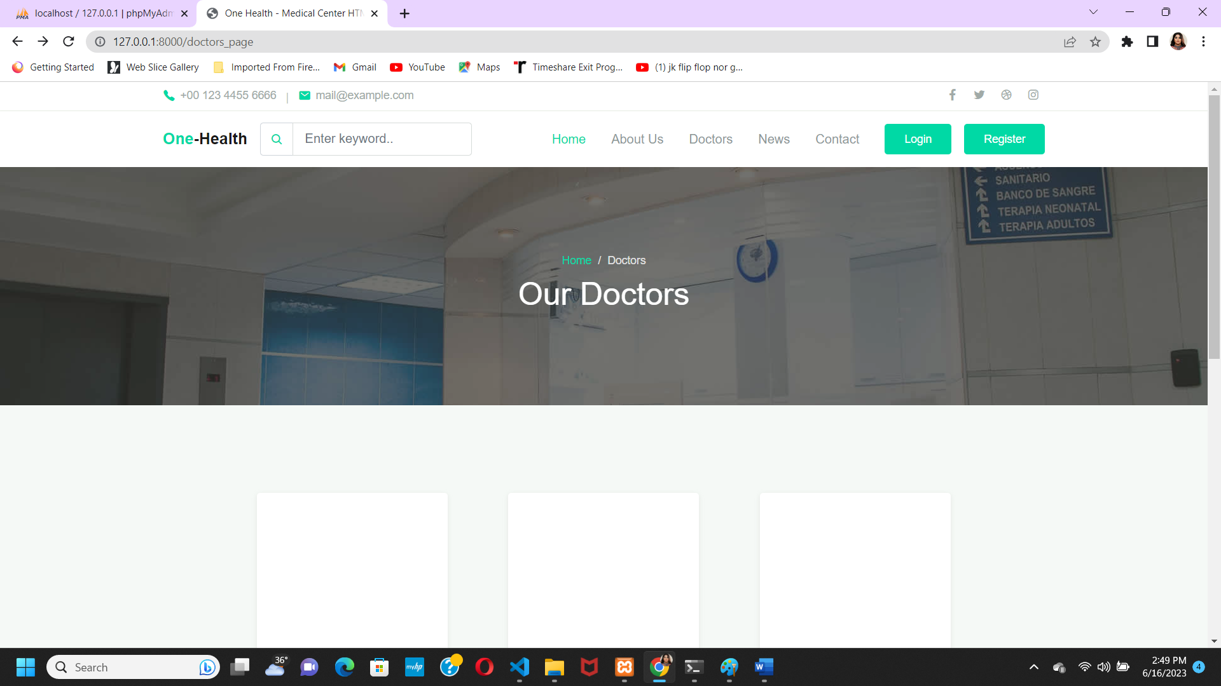
Output:

Slide 24
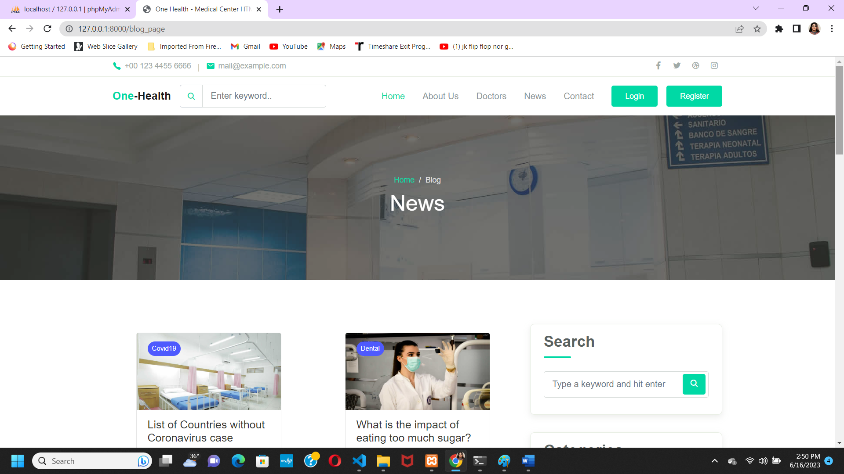
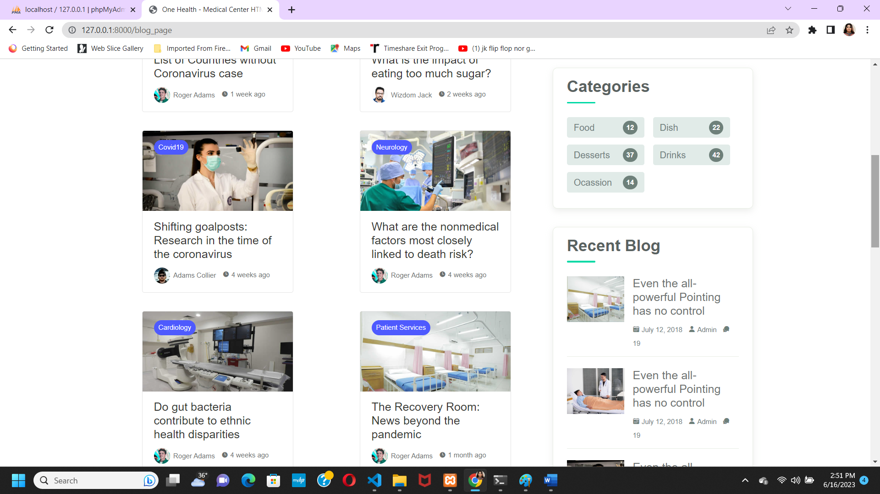

Slide 25
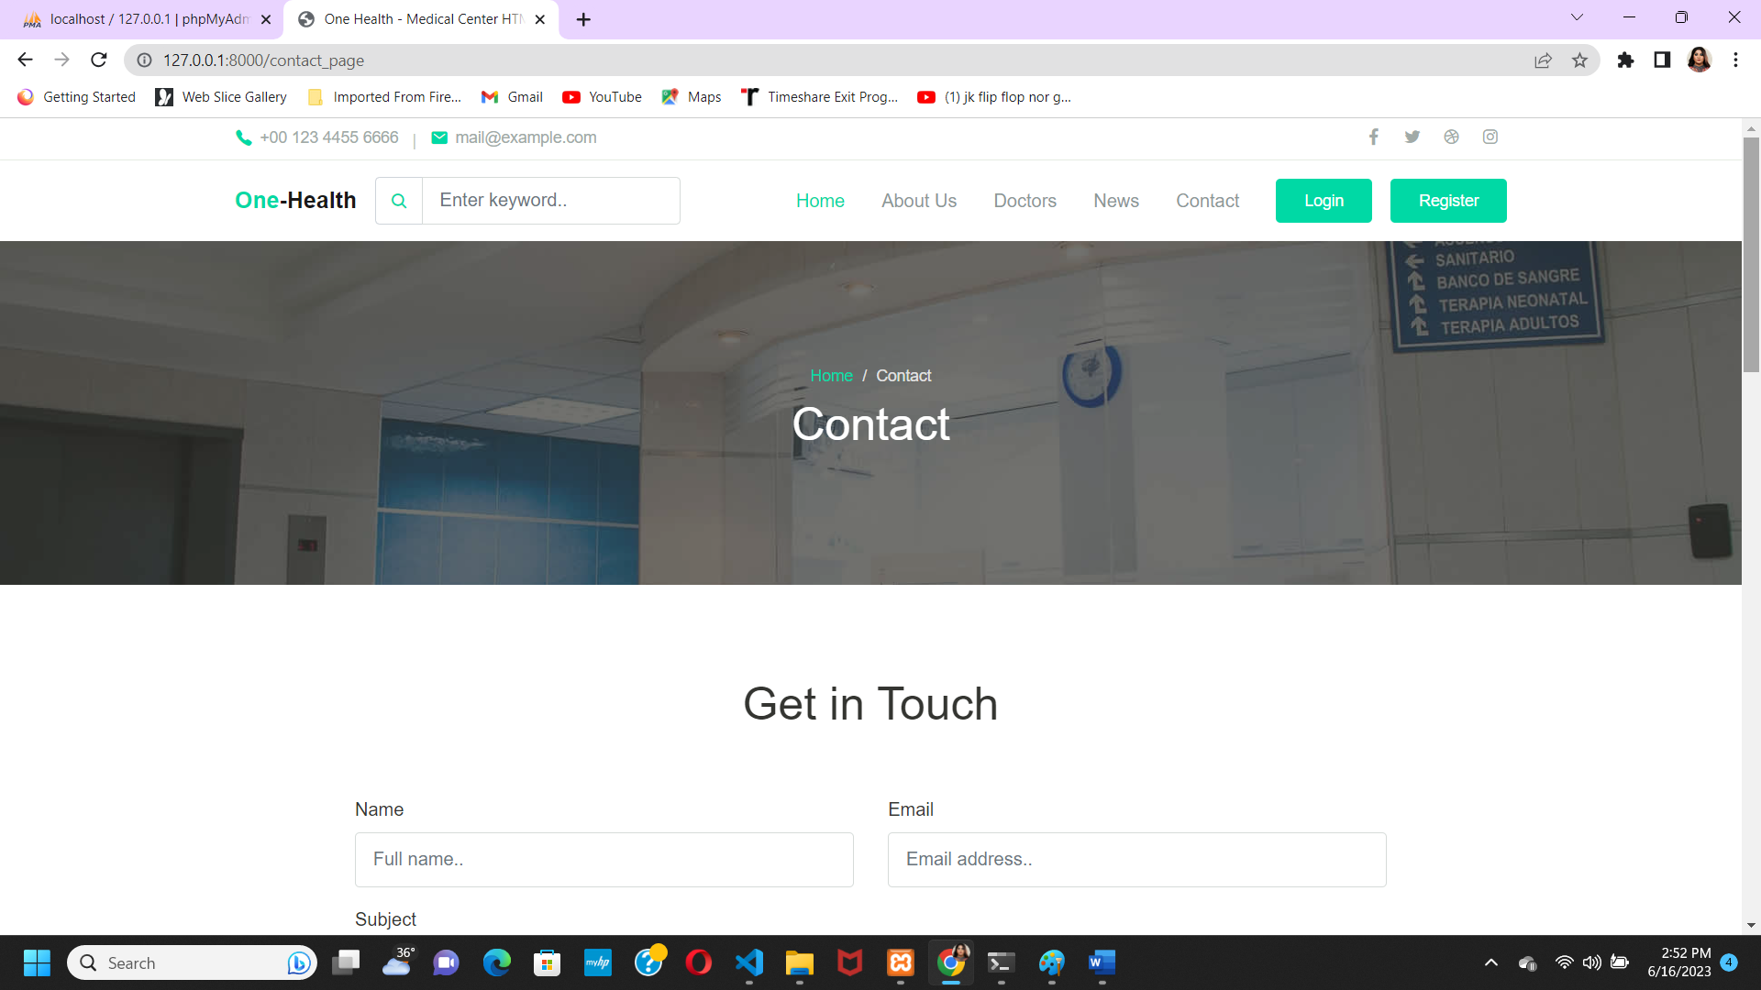
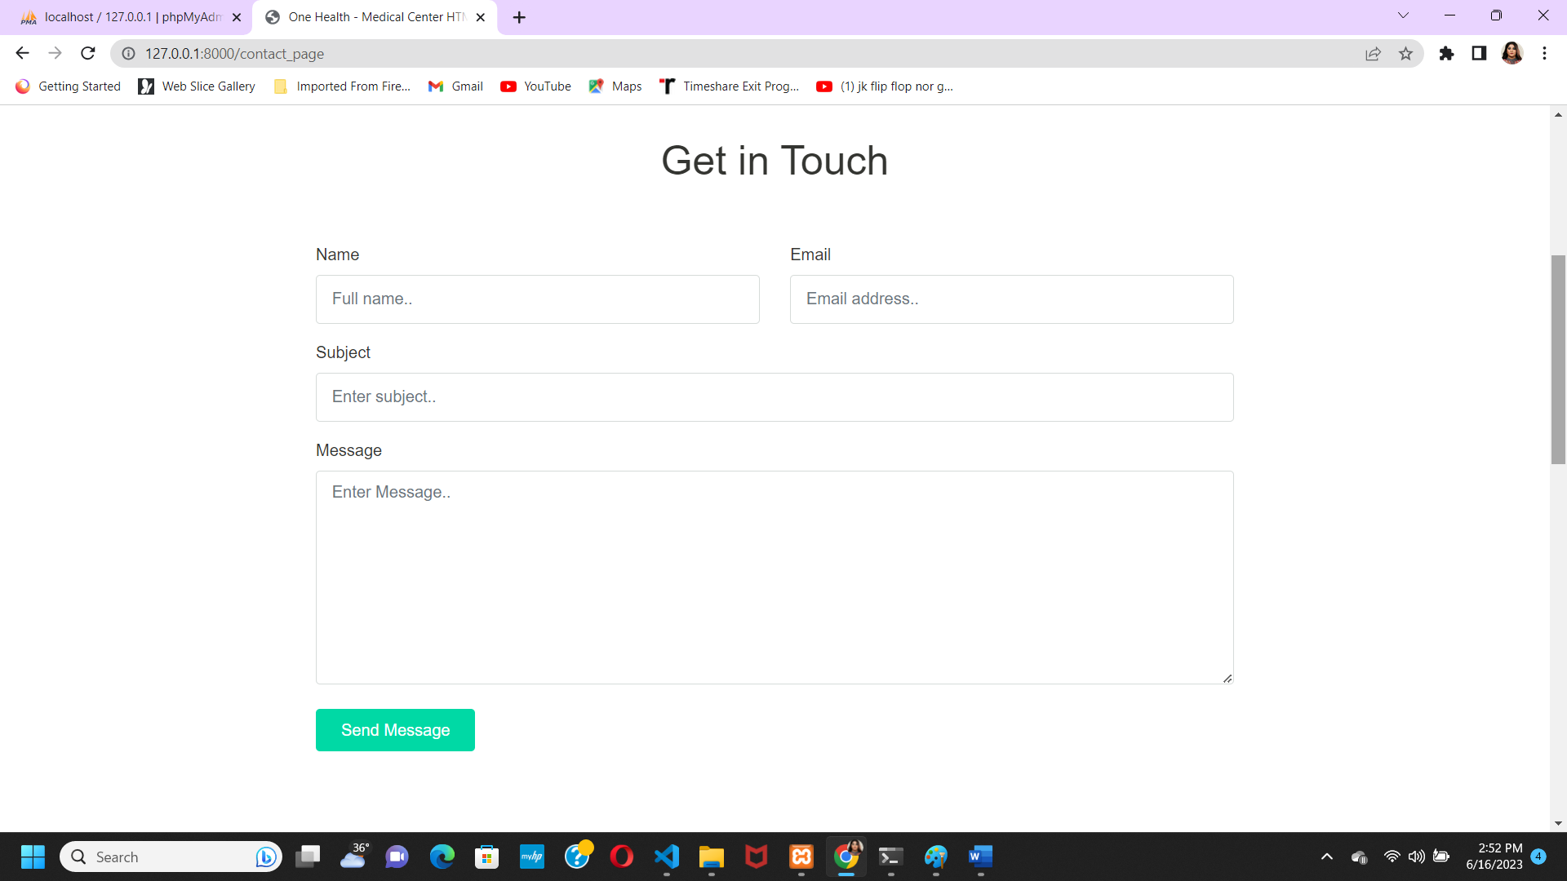

Slide 26
Conclusion
By using our website, Digital Hospital Management Project into play , the work at the hospitals would be seamless and efficient.

Slide 27
Reference
1] Z. Liu, "Design and Implementation of Hospital Emergency Nursing Information Management System," 2016 (ICSCSE),
Hunan, 2016, pp. 218-221. [2] GB. Koyuncu and H. Koyuncu, "Intelligent Hospital Management System (IHMS)," 2015 (CICN), Jabalpur, 2015, pp. 1602-1604.
[3] Healthcare management system and domain search of nearest Medical services by Ruchi Dumbre, Wagh. (JISET ), Vol. 3 Issue 3, March 2016
[4] HOSPITAL MANAGEMENT SYSTEM by Digvijay H. Gadhari, Yadnyesh P. Kadam, Prof. Parineeta Suman Department of Computer Engineering, Saraswati College of Engineering,

Slide 28


Slide 29


