Slide 1


[Second Progress Presentation]
Investigating Emotion Dynamics In Bangla Social Media Text For Improved Emotion Detection
Saturday,17June,2023
Supervised by
Name : MS. SADIA AFROZE
Designation : Assistant Professor
Dept. of CSE, GUB
Presented by
MOSTAK AHMED
ID : 193002018
Dept. of CSE, GUB
17/06/2023 Investigating Emotion Dynamics In Bangla Social Media Text For Improved Emotion Detection

Slide 2
Presentation Outline
◉ Introduction
◉ Motivation
◉ Objectives
◉ Critical Analysis of the Related Works
◉ Problem Description
◉ Proposed Methodology
◉ Software, Apps & Tools
◉ Data Collection
◉ Implementation
◉ Outputs & Result
◉ Limitation &Potential Bias
◉ Gantt Chart
◉ Proposed Budget
◉ Conclusion
◉ References
17/06/2023 Investigating Emotion Dynamics In Bangla Social Media Text For Improved Emotion Detection
2

Slide 3
Introduction
Emotion detection in social media text is crucial for understanding user behavior and sentiment analysis.
Limited research exists on emotion dynamics in bangla social media.
Improved emotion detection algorithms can enhance sentiment analysis and content moderation.
This research aims to fill the research gap and improve emotion detection in bangla social media.
17/06/2023 Investigating Emotion Dynamics In Bangla Social Media Text For Improved Emotion Detection
3

Slide 4
Motivation
The popularity and impact of social media in the bangla-speaking population have increased significantly.
Accurate emotion detection is essential for market research, public sentiment analysis, and personalized user experiences.
Emotion detection algorithms often struggle with accurately identifying emotions in text due to the dynamic and complex nature of emotions
17/06/2023 Investigating Emotion Dynamics In Bangla Social Media Text For Improved Emotion Detection
4

Slide 5
Objectives
The main purpose of this research is trying to develop a method that investigate bangla social media text characteristics to detect emotions.
To reach this goal following objectives must be achieved:
Investigate emotion dynamics in bangla social media text.
Evaluate the effectiveness of the proposed approach through experiments.
To develop a machine learning model for emotion detection in bangla social media text.
To evaluate the performance of the developed model and compare it with existing models.
17/06/2023 Investigating Emotion Dynamics In Bangla Social Media Text For Improved Emotion Detection
5

Slide 6
Critical Analysis of the Related Works (1/5)
Title: labeling emotion in bengali blog corpus – A fine grained tagging at sentence level [1]
Achievement:
In this paper, authors aimed at doing manual annotations of sentence-level text from web-based bengali blog corpus
They used 1200 training instances
The conditional random fields (CRF) classifier gave them an average accuracy score of 58.7%
Support vector machine (SVM) managed to get them to 70.4%.
Limitation:​
Annotate limited class of emotions​
Accuracy was less for CRF and SVM also got unsmart point by 70.4%
They used the single source for collecting dada that affect the experiment as well accuracy.
17/06/2023 Investigating Emotion Dynamics In Bangla Social Media Text For Improved Emotion Detection
6

Slide 7
Critical Analysis of the Related Works (2/5)
Title: document level emotion detection from bangla text using machine learning techniques[2]
Achievement:
The paper proposes a new dataset containing bangla documents with annotation of three emotions- happy, sad and angry.
They used naive bayes classifier, stemmer, POS tagger, n-grams, and word frequency-inverse document frequency analysis (tf-idf) to extract multi-class emotions from bangla text
Using multinomial naive bayes classifier has given the best performance on the test set and and achieve accuracy 68.27%.
Limitation:
Annotate only 3 emotions
Accuracy was not good enough
Use less data-preprocessing method
17/06/2023 Investigating Emotion Dynamics In Bangla Social Media Text For Improved Emotion Detection
7

Slide 8
Critical Analysis of the Related Works (3/5)
Title: emotion detection from bangla text corpus using naïve bayes classifier[3]
Achievement:
Use multinomial naïve bayes (NB) classifier to detect emotion
They were able to gain an overall accuracy score of 78.6% using MNB and 71.6% using SVM
We only considered 4200 comments of three emotion classes - happy, sad and angry.
Limitation::
Limited dataset to conduct the experiment.
Limited dataset affect the prediction and accuracy of the model
System only detect three class of emotion
17/06/2023 Investigating Emotion Dynamics In Bangla Social Media Text For Improved Emotion Detection
8

Slide 9
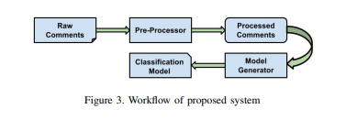
Critical Analysis of the Related Works (4/5)
Title: Sentiment Analysis for Bangla Sentences using Convolutional Neural Network[4]
Achievement:
They used convolutional neural network(cnn) architecture to train the model that can classify positive and negative sentiment
Achieved an accuracy of 99.87%
17/06/2023 Investigating Emotion Dynamics In Bangla Social Media Text For Improved Emotion Detection
9

Slide 10
Critical Analysis of the Related Works (5/5)
Title: Sentiment analysis on bangla and romanized bangla text using deep recurrent models[5]
Achievement:
They proposed a deep learning based model
Recurrent neural network (RNN) architecture was applied to train the model and the accuracy was 78%
Limitation:
Deep learning methods demand more time to produce an output
It process the text set and match it with the library to generate an outputs
They got the accuracy was not impressive enough
17/06/2023 Investigating Emotion Dynamics In Bangla Social Media Text For Improved Emotion Detection
10

Slide 11
Problem Statement
Problems | Solutions | Result
The lack of understanding of the emotional dynamics in bangla social media text Traditional methods are inefficient Manual examinations of emotion is both time consuming & infeable | Features extraction Model selection Train model Test model Detection the emotions | Performance evaluation of the model based on ML metrics: Achieving the accuracy 98%(proposed)
17/06/2023 Investigating Emotion Dynamics In Bangla Social Media Text For Improved Emotion Detection
11

Slide 12
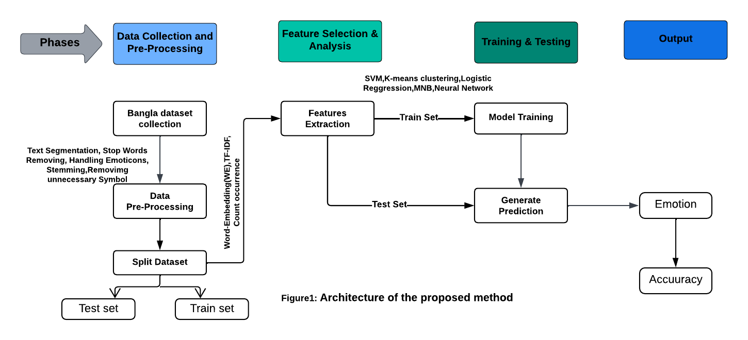
Proposed Methodology
17/06/2023 Investigating Emotion Dynamics In Bangla Social Media Text For Improved Emotion Detection
12

Slide 13





Software, Apps and Tools
17/06/2023 Investigating Emotion Dynamics In Bangla Social Media Text For Improved Emotion Detection
13

Slide 14
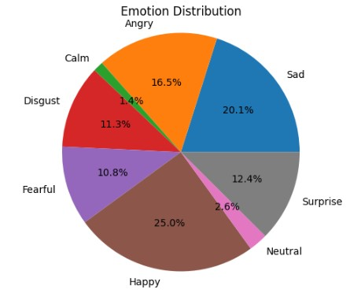
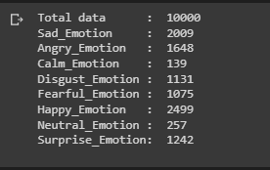
Data Collection
The data for this research will be collected from various social media platforms, including facebook, twitter, and youtube.
Preprocessed the data to clean noise and irrelevant information.
17/06/2023 Investigating Emotion Dynamics In Bangla Social Media Text For Improved Emotion Detection
14

Slide 15
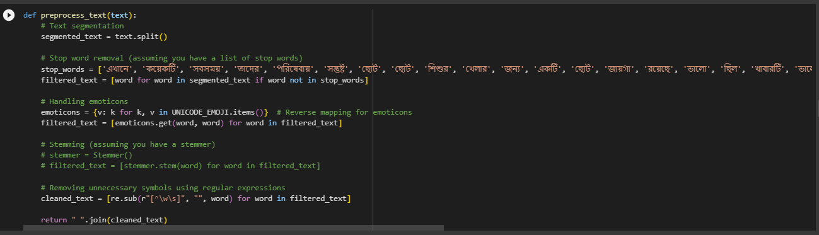
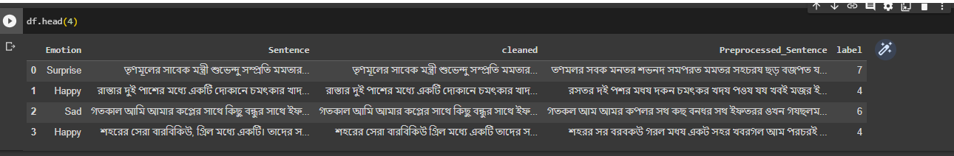
Implementation(cont.)
Pre-processing dataset:
17/06/2023 Investigating Emotion Dynamics In Bangla Social Media Text For Improved Emotion Detection
15

Slide 16
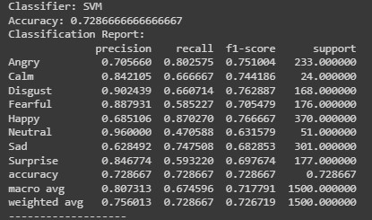
Outputs and results(1)
SVM:
17/06/2023 Investigating Emotion Dynamics In Bangla Social Media Text For Improved Emotion Detection
16

Slide 17
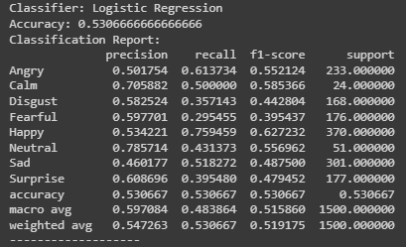
Outputs and results(2)
LR:
17/06/2023 Investigating Emotion Dynamics In Bangla Social Media Text For Improved Emotion Detection
17

Slide 18
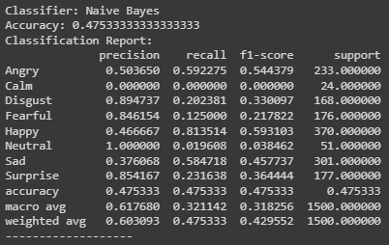
Outputs and results(3)
NB:
17/06/2023 Investigating Emotion Dynamics In Bangla Social Media Text For Improved Emotion Detection
18

Slide 19
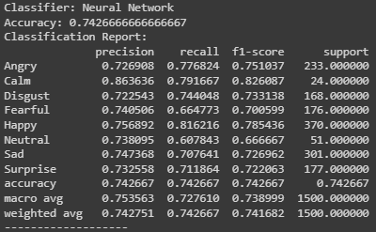
Outputs and results(4)
NN:
17/06/2023 Investigating Emotion Dynamics In Bangla Social Media Text For Improved Emotion Detection
19

Slide 20
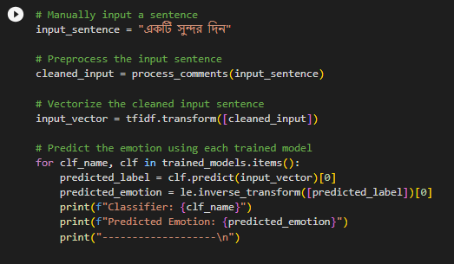
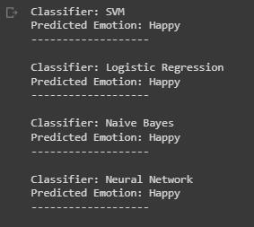
Outputs and results(5)
Real-time prediction of the application:
17/06/2023 Investigating Emotion Dynamics In Bangla Social Media Text For Improved Emotion Detection
20

Slide 21
Limitation & Potential Bias
Limited availability of labeled bangla social media text datasets.
Potential bias due to the demographics of social media users included in the data collection.
Accuracy improved
The machine learning model developed in this research may not generalize well to other languages or cultures.
Potential biases in the data collection process
17/06/2023 Investigating Emotion Dynamics In Bangla Social Media Text For Improved Emotion Detection
21

Slide 22
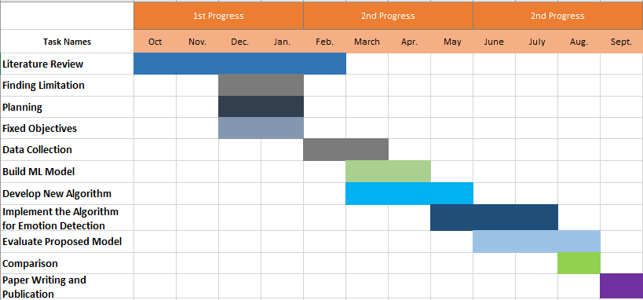
Gantt Chart
17/06/2023 Investigating Emotion Dynamics In Bangla Social Media Text For Improved Emotion Detection
22

Slide 23
Proposed Budget Components
SI. No. | Budget Title | No. Of Units | Per Unit Cost (BDT) | Total Cost (BDT)
1 | Research Supervision | 3 | 6000 | 18000
2 | Data Collection | - | 12000 | 12000
3 | Environment Setup | 2 | 5000 | 10000
4 | Access Researching Websits | - | 1200 | 3000
5 | Implementation & Testing | - | 15000 | 15000
6 | Paper Publication Cost | 2 | 7000 | 14000
7 | Total = |  | 46,200 | 72,000
Total = 72,000(BDT)
17/06/2023 Investigating Emotion Dynamics In Bangla Social Media Text For Improved Emotion Detection
23

Slide 24
Conclusion
Investigated emotion dynamics in bangla social media text.
Developed a novel approach for improved emotion detection.
Evaluated the effectiveness of the proposed approach.
Implications for the field of emotion detection in bangla social media text.
Future directions for further research and improvement.
17/06/2023 Investigating Emotion Dynamics In Bangla Social Media Text For Improved Emotion Detection
24

Slide 25
References (1/2)
[1] D. Das and S. Bandyopadhyay, “Labeling emotion in Bengali blog corpus--a fine grained tagging at sentence level,” in Proceedings of the Eighth Workshop on Asian Language Resouces, 2010, pp. 47–55.
[2] S. A. Purba, S. Tasnim, M. Jabin, T. Hossen and M. K. Hasan, "Document Level Emotion Detection from Bangla Text Using Machine Learning Techniques," 2021 International Conference on Information and Communication Technology for Sustainable Development (ICICT4SD), 2021.
[3] A. Azmin and K. Dhar, "Emotion Detection from Bangla Text Corpus Using Naïve Bayes Classifier," 2019 4th International Conference on Electrical Information and Communication Technology (EICT), Khulna, Bangladesh, 2019, pp. 1-5, doi: 10.1109/EICT48899.2019.9068797.
[4] M. H. Alam, M.-M. Rahoman, and M. A. K. Azad, “Sentiment analysis for bangla sentences using convolutional neural network,” in 2017 20th International Conference of Computer and Information Technology (ICCIT). IEEE, 2017, pp. 1–6.
17/06/2023 Investigating Emotion Dynamics In Bangla Social Media Text For Improved Emotion Detection
25

Slide 26
References (2/2)
[5] A. Hassan, M. R. Amin, A. K. Al Azad, and N. Mohammed, “Sentiment analysis on bangla and romanized bangla text using deep recurrent models,” in 2016 International Workshop on Computational Intelligence (IWCI). IEEE, 2016, pp. 51–56.
[6] D. P. Kingma and J. Ba, “Adam: A method for stochastic optimization,” arXiv preprint arXiv:1412.6980, 2014.
[7] W. McKinney, “Data structures for statistical computing in python,” in Proceedings of the 9th Python in Science Conference, S. van der Walt and J. Millman, Eds., 2010, pp. 51 – 56.
[8] F. Chollet et al., “Keras,” https://github.com/fchollet/keras, 2015. [13] J. D. Hunter, “Matplotlib: A 2d graphics environment,” Computing in Science & Engineering, vol. 9, no. 3, pp. 90–95, 20
[9] N. I. Tripto and M. E. Ali, “Detecting Multilabel Sentiment and Emotions from Bangla YouTube Comments,” in 2018 International Conference on Bangla Speech and Language Processing (ICBSLP), 2018, pp. 1–6.
17/06/2023 Investigating Emotion Dynamics In Bangla Social Media Text For Improved Emotion Detection
26

Slide 27
Thank You !
17/06/2023 Investigating Emotion Dynamics In Bangla Social Media Text For Improved Emotion Detection
27

