Slide 1
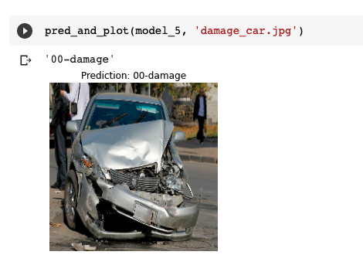
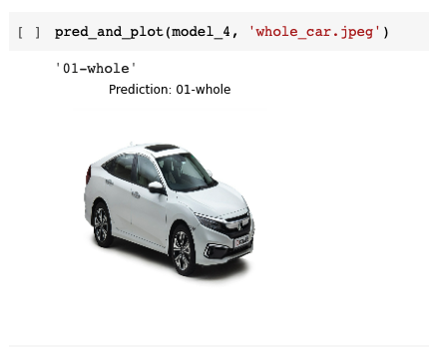
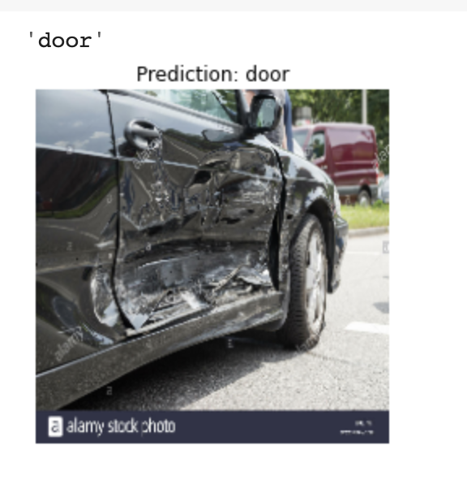
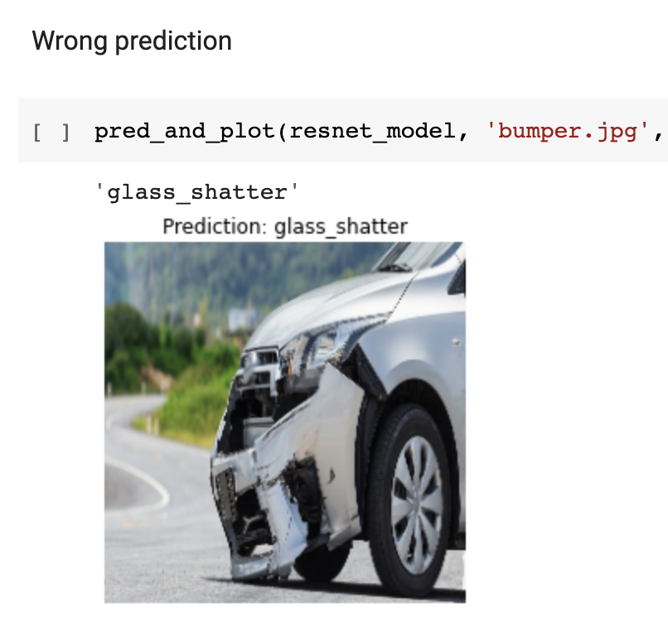
Machine-Learning 101
How we could develop a way to determine which part of a car is damaged?

Slide 2
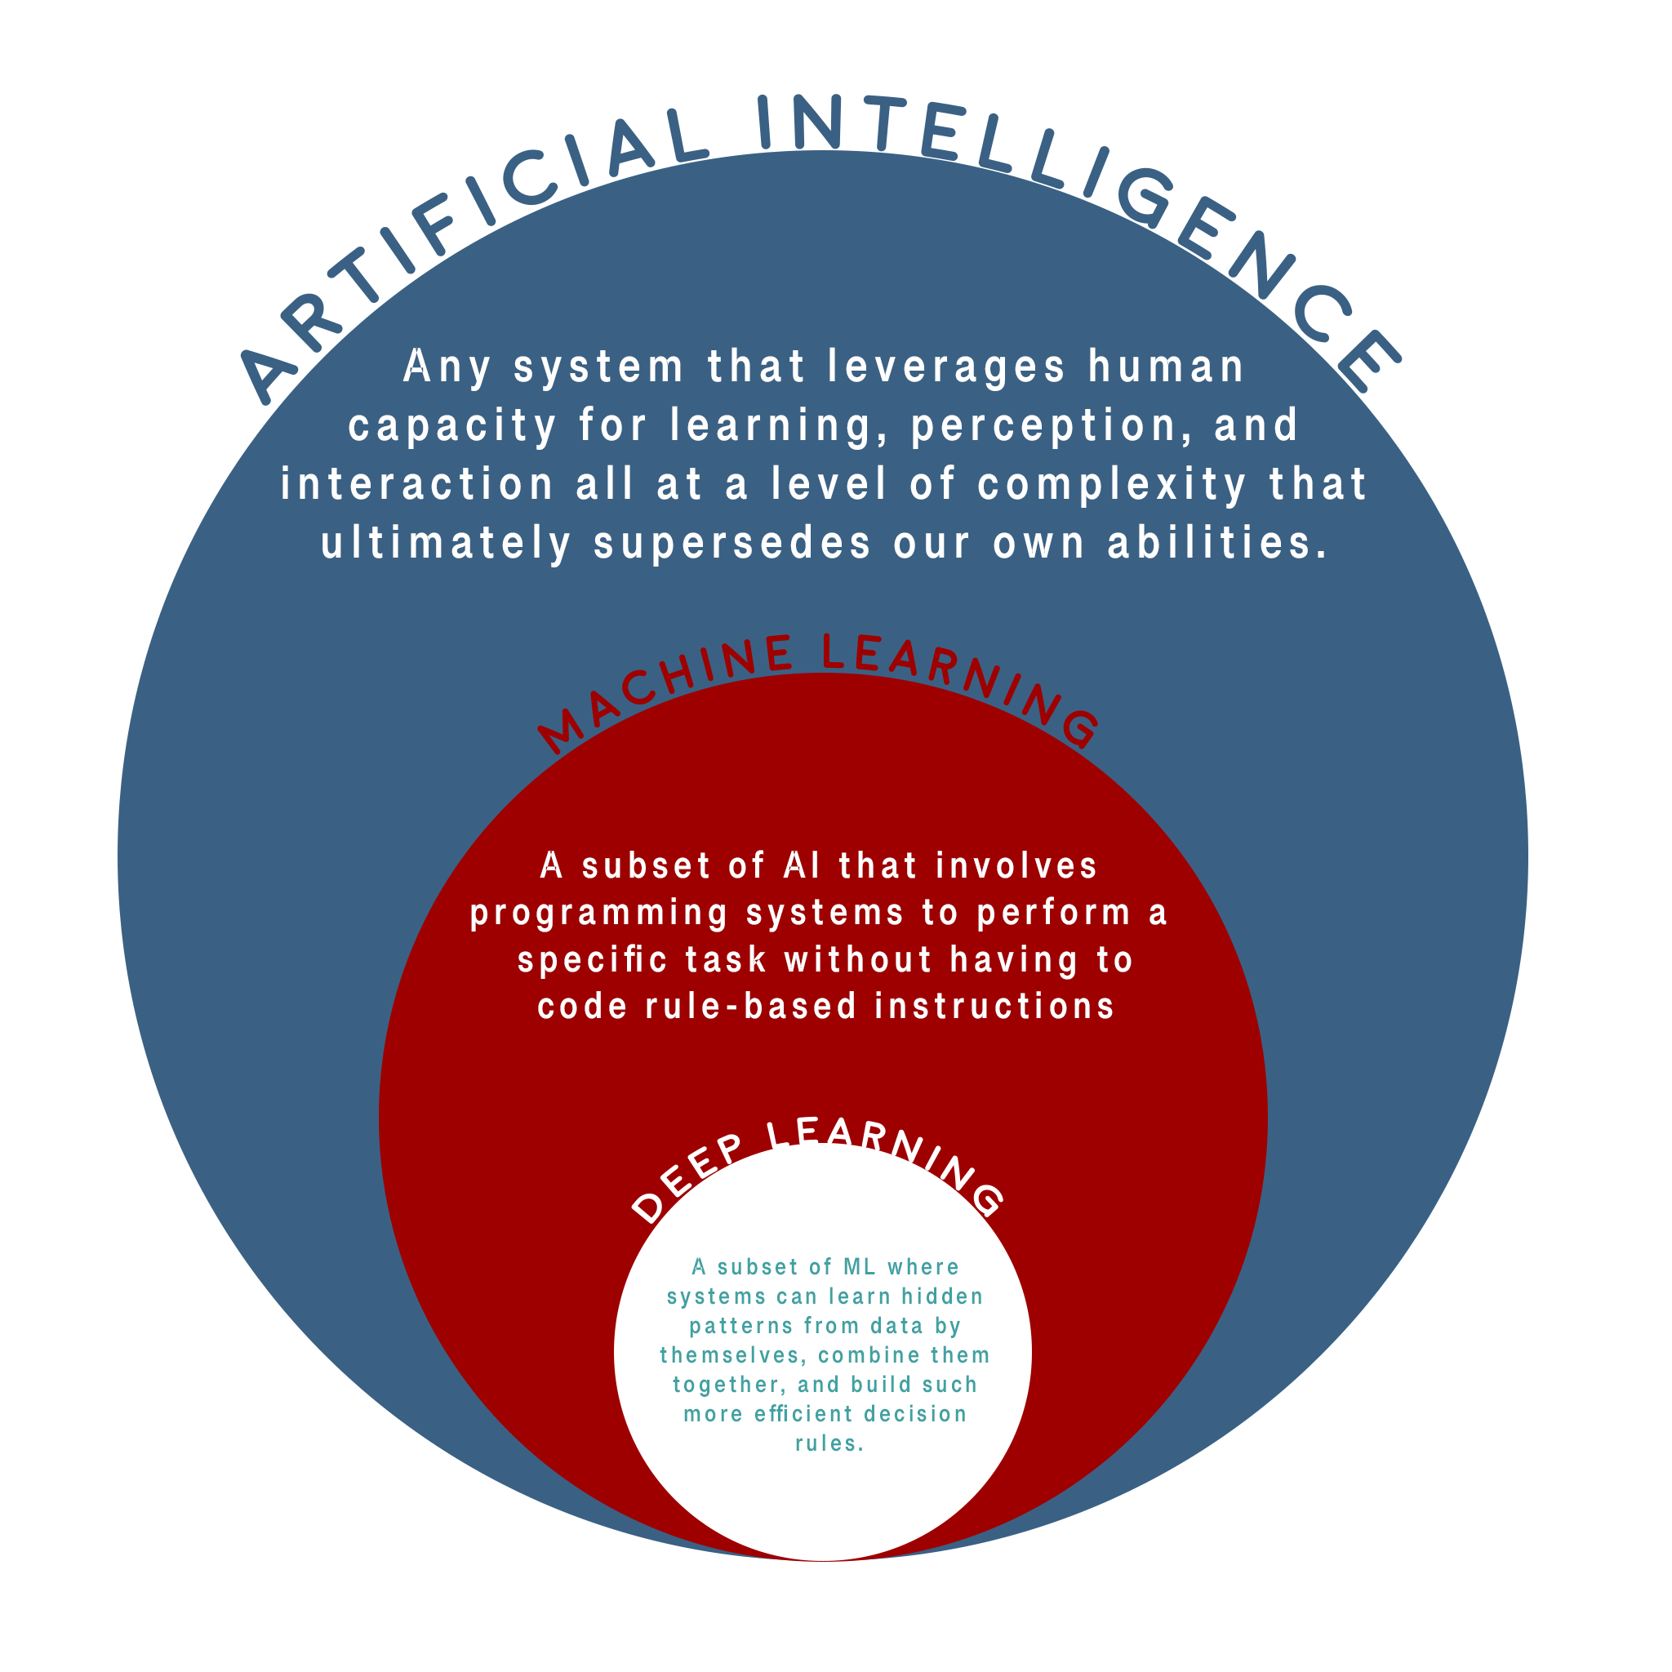
A.I. / Machine Learning / Deep Learning
Artificial Intelligence: Any system that leverages human capacity for learning, perception and interaction all at a level of complexity that ultimately supersedes our own abilities
Machine Learning: A subset of ai that involves programming systems to perform a specific task without having to code rule-base instructions
Deep Learning: A subset of ML where systems can learn hidden patterns from data by themselves, combine them together, and build much more efficient decision rules.

Slide 3
What are ML classification problems
There are many different types of problems that machine learning can solve using a classification algorithm.
Binary Classification: is used when you want to ask a simple true or false question. (ie. Is this a dog or is this a cat, is my card whole or is it damage?)
Multi-class Classification: is used when you’re trying to distinguish between a set of different values. (ie. Checking what color the traffic light is. It could be red, blue or green, or checking the breed of the dog or the cat)
Multi-label Classification: is used when you want to label things in a photo or video, and even being able to use tags to generalize a video or picture. (ie. What items are in this photo or what topics is this Youtube video about)

Slide 4
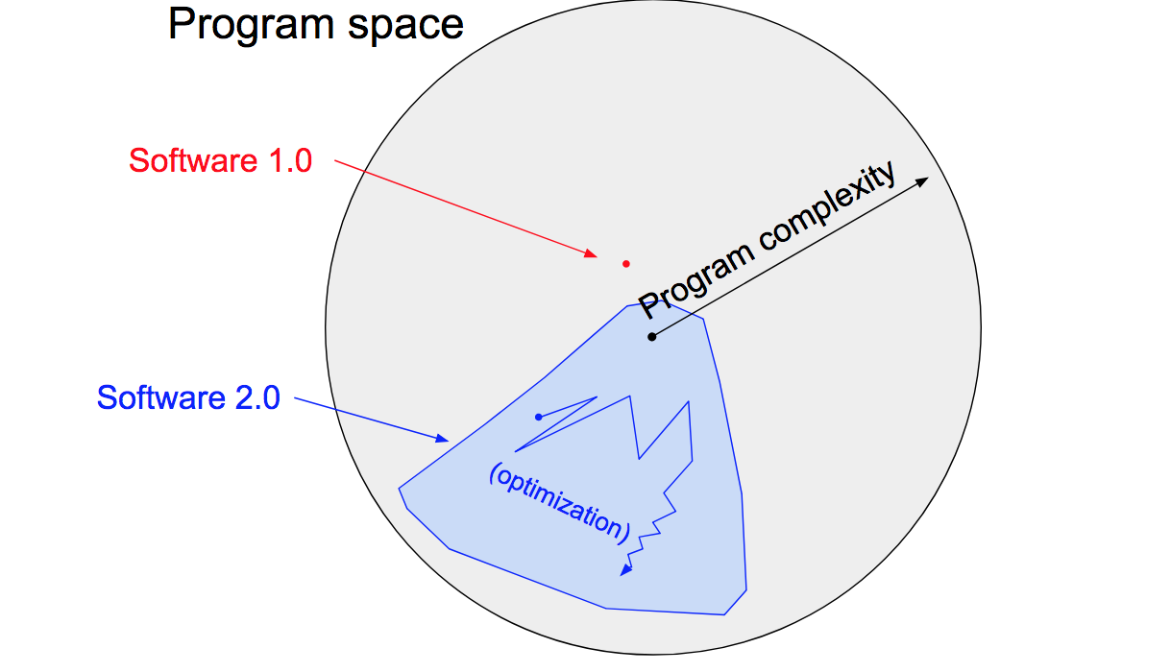
Why using ML is essential in our future projects
We can solve complex problems that traditional programming can’t do
It could be used to find the fastest solution to problems we have. (ie. Great example is the covid-19 vaccine)
We’re saving a lot of valuable time and optimizing areas where there are a lot of user drop offs
Machine Learn can train on any sort of data as long as its converted to numbers.

Slide 5
How we can use AI to our Advantage
1.) Automated Underwriting:
We can speed up the insurance underwriting process and enables to deliver more accurate quotes quicker. It reduces underwriting time of employees usually spend manually searching through documents while minimizing the risk of missing important provisions in their calculation.
2.) Improve Security and Mitigate Risks
Mitigate fraudulent cases in claim processing by analyzing insurance data trends.
Identify whether accidents happened recently or happened a year ago. It would also determine if the accident images are really the same vehicle or not (There were cases of fraud in the past)
3) Chatbot/ Speaking Assistant which also helps the disabled
We can determine what the exact feature customer is mostly using in our app and help them to find shortcuts to finish the job. Also at the same time provide recommendations of other feature that they are not using

Slide 6
ML vs Traditional Programming
A good example would be if you wanted to find a relationship between (9, 18), (5, 14) (2, 11), Machine learning looks for common patterns in data to predict the next output. So if I ask the machine learning model to predict Y given an Input X, it should give me a near accurate result.
Mind Exercise: If X = 12, then what is y?
We know that with traditional programming, if we set X = 12, then y must be _____.
In other words, with tradition programming we know the data and we know the rules so therefore we will be given the answer. However with machine learning we give the machine learning model data and answers then it should be able to come up with a rule to solve the problem. And it takes those rules to predict on data it hasn’t seen yet (ie. X= 12). In this example the model would give you a number close to 9

Slide 7
Machine Learning Obstacles
Finding a proper data set
Training machine learning models requires a sufficient data set of relevant images. The more varied the images are, the better the model will be able to classify images appropriately.
In the context of car damage assessment, obtaining a substantial amount of images is a challenge, since there is little to no public database for images depicting damaged vehicles. While it may be possible to come up with a raw data set through web scraping, working with car insurance companies—which already have numerous images of broken car parts—may also be a feasible option. So, a company needs to evaluate the most optimal way in terms of ROI or time by deciding whether to buy the data set, get it from an industry partner, or to build/collect it from scratch.
Even having obtained a collection of images, one should ensure the pictures satisfy the demands for size, quality, etc.

Slide 8
Machine Learning Obstacles
Underfitting: Happens when your model doesn’t perform as well as you’d like on your data.
Overfitting: Happens when your validation loss (how your model is performing on the validation dataset, fyi lower is better) starts to increase. Or if you don’t have a validation set , happens when the model performs far better on the training set than on the test set (e.g 99% accuracy on the training set, but 67% accuracy on the test set). Fix through various regularization techniques.

Slide 9
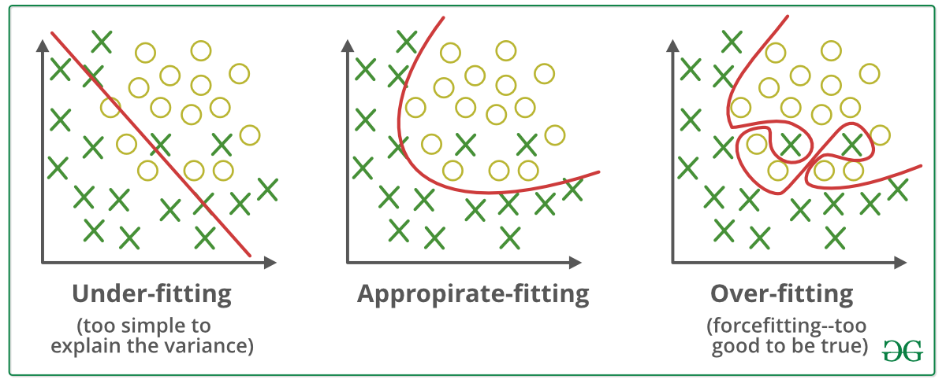
Machine Learning Obstacles
Overfitting is one of the most common issues in ML

Slide 10
Machine Learning Solutions
Dataset: Get a really big but distinguishable dataset. Maybe our model doesn’t have enough data to train on
The model layers: Add more Convolutional2D and MaxPool2D Layers
HyperParameters: Change the optimizers hyperparameters
Transfer Learning: We can utilize the power of transfer learning to get patterns that another model has learned. In this example we will explore using efficientnet_b0 and resnet50V2
Further Finetuning: If we still get poor results we maybe we can further fine tune the transfer learning model
Keep Experimenting!: There is not one size fit all solution so it’s important to test and compare models to see which one performs better

Slide 11
Making Predictions
We will see how to improve our models and explore the world of machine learning using convolutional networks, transfer learning and tweaking hyperparameters

Slide 12
Resources
Notebooks & Presentation: https://git.io/JnxDj
Classification: https://playground.tensorflow.org/
Convolutional Networks: https://poloclub.github.io/cnn-explainer/
Transfer Learning Models: https://tfhub.dev/tensorflow/efficientnet/b0/feature-vector/1

