Slide 1
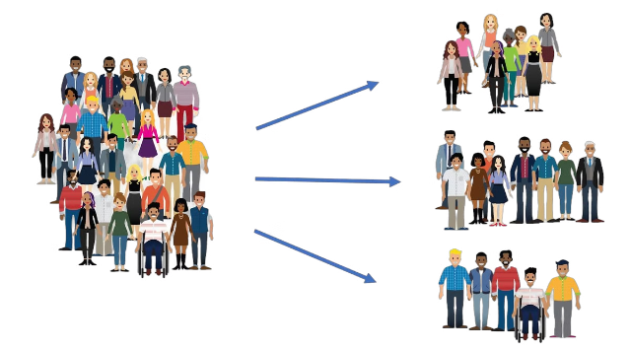
Team Segmentation System
Optimize team formation and task tracking.

Slide 2

Problem Statement
Forming balanced teams with diverse skills.
1
Skill Gap
Lack of consistent skill assessment.
2
Task Overload
Uneven task distribution and workload.
3
Communication Breakdown
Inefficient communication and collaboration.

Slide 3

Solution Overview
Introducing the Team Segmentation System.
Skill-Based Grouping
Grouping workers with similar skills.
Task Management
Streamlined task assignment and tracking.
EDA Page
Provides data-driven insights and analysis.
Contact Page
Facilitates communication and support.

Slide 4
Skill-Based Team Formation
Tailored teams for optimal performance.
Skill Assessment
Algorithm
Team Configuration
Collects and analyzes employee skill sets.
Matches individuals based on skills and team requirements.
Generates balanced teams with diverse skillsets.

Slide 5
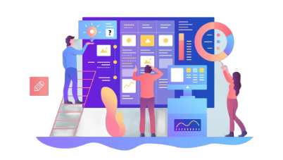



Task Tracking
Efficiently managing and monitoring tasks.
Task Assignment
Assigns tasks to team members.
Progress Monitoring
Tracks task completion and deadlines.
Status Updates
Provides real-time task progress updates.

Slide 6
Exploratory Data Analysis (EDA)
Job Role Distribution
Performance Rating Distribution
Job Roles vs. Performance Rating
Understand the breakdown of job roles across the organization.
Analyze the distribution of performance ratings among employees.
Explore the relationship between job roles and performance ratings.
1
Top Job Roles by Performance Rating
2
Gender Distribution
Identify the top performing job roles in the organization.
Understand the gender breakdown of the workforce.
3
Gender Distribution in Job Roles
4
Gender vs. Performance Rating
Analyze the gender distribution across different job roles.
Explore any potential relationships between gender and performance ratings.
Experience Distribution
Experience vs. Performance Rating
Performance Rating by Years of Experience
Understand the range of experience levels among employees.
Analyze the relationship between experience and performance ratings.
Identify any trends in performance ratings based on years of experience.

Slide 7



Contact Us Page
Facilitating communication and support.
Email
Contact us via email for inquiries.
Support
Access online resources and support documentation.

Slide 8

Conclusion and Future Work
Empowering teams for efficient collaboration.
1
Key Features
Skill-based team formation, task tracking, EDA page, and contact page.
2
Future Improvements
Integrate AI-powered insights, enhance task prioritization, and expand communication features.
3
Feedback Welcome
We value your feedback and suggestions.

Slide 9
Unveiling the Team Roles
Model Makers
Data Detectives
Tech Wizards
Deployment Dynamos
Sourav Chatterjee and Sameekshya Nanda craft the predictive models.
Ipsita, Khushi, Sourav, and Sameekshya bring the Streamlit app to life.
Khushi, Ipsita, and Sameekshya uncover insights from the data.
Ipsita and Sourav are the deployment wizards, ensuring the app is seamlessly implemented.

