Slide 1

Advanced Data Structures
Graphs
Department of Information Technology
SRKR Engineering College, Bhimavaram, AP-534204

Slide 2

Introduction
Graph is a non-linear data structure.
A data Structure that consists of a set of Vertices (nodes) and a set of edges connecting them
The set of edges describes the relationships among the vertices.
A graph G is defined as follows
G=(V,E)
V: set of vertices.
E: set of edges connecting the vertices in V
An edge e=(u ,v) is a pair of vertices
The following is a graph with 5 vertices and 7 edges. This graph G can be defined as G = ( V , E ) Where V = {A,B,C,D,E} and
E = {(A,B),(A,C)(A,D),(B,D),(C,D),(B,E),(E,D)}.

Slide 3
Difference b/w Tree and Graph
Graph | Tree
.A Graph is a non linear data structure | A Tree is also called as a non linear data Structure
It is a collection of vertices and Edges | It is a collection of nodes and edges
In this case , Each node can have any no.of edges | General Tree consists of nodes having any number of child nodes. In case of binary tree it has atmost 2 edges
There is no unique node called Root | There is a unique node called Root
There is a chance of having Cycles | There is no chance of having cycles
Applications:- Graphs are used to find shortest path in networking | Applications:- Used for game tree algorithm and decision tree algorithm

Slide 4
Applications of graphs
Graphs are used to represent many real-life applications
Social Networks-Facebook, LinkedIn, etc.
Google Maps
Flight Network
Product Recommendations

Slide 5
Graph Properties
Connected/Disconnected
Directed/Undirected graph
Weighted graph
Cyclic/Acyclic Graph
Dense/Sparse Graph
Simple Graph
Complete Graph
Strongly connected graph
Subgraph/Components

Slide 6
Connected/Disconnected
A Graph is said to be connected if there exists at least one path between every pair of vertices. Otherwise it is disconnected.
E
E
C
D
C
D
A
B
A
B
Connected Graph
Disconnected Graph

Slide 7
Directed/Undirected Graph
In Directed graph each edge has a direction which determines the traversal order. It is also called as digraph.
In an undirected graph the edges are undirectional, with no direction associated with them. Hence the graph an be traversed in either direction.
E
E
C
D
C
D
A
B
A
B
Directed Graph
Undirected Graph

Slide 8
Weighted Graph
A Graph where each edge has a numerical weight assigned to it.
2
A
B
5
2
C
4
5
5
E
2
D

Slide 9
Cyclic/Acyclic Graph
Cyclic graph- A directed graph containing at least one cycle. A cyclic graph possessing exactly one cycle is called a unicyclic graph.
Acyclic graph(DAG)-A directed graph that is not cyclic.
E
E
C
D
C
D
A
B
A
B
Cyclic Graph
Acyclic Graph

Slide 10
Dense/Sparse Graph
Dense graph is a graph in which the number of edges is close to the maximal number of edges.
Sparse graph is a graph in which the number of edges is close to the minimal number of edges.
D
D
E
C
E
C
A
B
A
B
Dense Graph
Sparse Graph

Slide 11
Simple/Complete Graph
Simple Graph-A graph without loops and without multiple edges between two nodes.
Complete Graph-A undirected graph in which every pair of distinct vertices is connected by a unique edge. A complete graph with n nodes will have n(n-1)/2 edges.
D
D
E
C
E
C
A
B
A
B
Complete Graph
Simple Graph

Slide 12
Strongly Connected Graph
A directed graph is called strongly connected if there is a path in each direction between each pair of vertices of a graph, i.e, a path exists from the first vertex in the pair to the second, and another path exists from the second vertex to the first.
D
C
A
B

Slide 13
Subgraph/Components
Subgraph-A Subgraph g of graph G is a graph such that a set of vertices and edges of g are the proper set of Edges of G.
Components-Sub graphs of a graph is called the components of a graph
1
2
7
8
5
6
3
4
9
10
1
2
7
8
5
6
3
4
9
10

Slide 14
Graph Terminology
Adjacency
Degree
Path
Cycle
Walk

Slide 15
Adjacency
Adjacent Vertices- If there is an edge between the two vertices
Adjacent Edges-If there is a common vertex between the two edges
D
C
Adjacent Vertices-<A,B>,<A,D>
Adjacent edges-<AB,BC> <AD,DC>
A
B

Slide 16
Degree
For undirected graph:
Degree-Number of vertices adjacent to the vertex V.
For directed graph:
Indegree-Number of incoming edges into the vertex V.
Outdegree-Number of outgoing edges from the Vertex V.
E
D
Vertex | Indegree | Outdegree | Degree
A | 1 | 1 | 2
B | 3 | 1 | 4
C | 2 | 0 | 2
D | 1 | 2 | 3
E | 0 | 3 | 3
C
A
B

Slide 17
Path
Path: A path is defined as a sequence of distinct vertices such that two consecutive vertices are adjacent.
A
B
A-B-C-D
A-C-D
A-B-C
D
C

Slide 18
Path
Cycle: A closed path is called a cycle. i.e. a path in which the only repeated vertices are the first and the last vertices
A
B
A-B-C-D-A
A-C-D-A
D
C

Slide 19
Walk
Walk: A walk is a sequence of vertices and edges of a graph i.e. if we traverse a graph then we get a walk. Vertex and edges can be repeated.
A
B
A-B-C-D-E-B-C-D-A
C
E
D

Slide 20
Representations of Graphs
There are two ways of representing digraphs. They are:
• Adjacency matrix.
• Adjacency List.
Adjacency matrix:
In this representation, the adjacency matrix of a graph G is a two dimensional n x n matrix, say A = (ai,j), where a_{i,j} = 1 if there is an edge from vi to vj otherwise 0
0
1
2
3
4
0
1
0
0 | 1 | 0 | 0 | 1
1 | 0 | 1 | 1 | 1
0 | 1 | 0 | 1 | 0
0 | 1 | 1 | 0 | 1
1 | 1 | 0 | 1 | 0
1
2
2
3
4
3
Graph
4
Adjacency Matrix

Slide 21
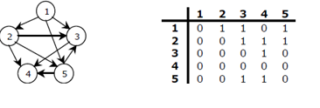
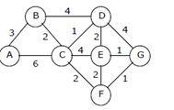
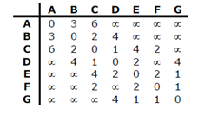
Representations of Graphs
The matrix is symmetric in case of undirected graph, while it may be asymmetric if the graph is directed. This matrix is also called as Boolean matrix or bit matrix.
In case of weighted graph, the entries are weights of the edges between the vertices. The adjacency matrix for a weighted graph is called as cost adjacency matrix.

Slide 22
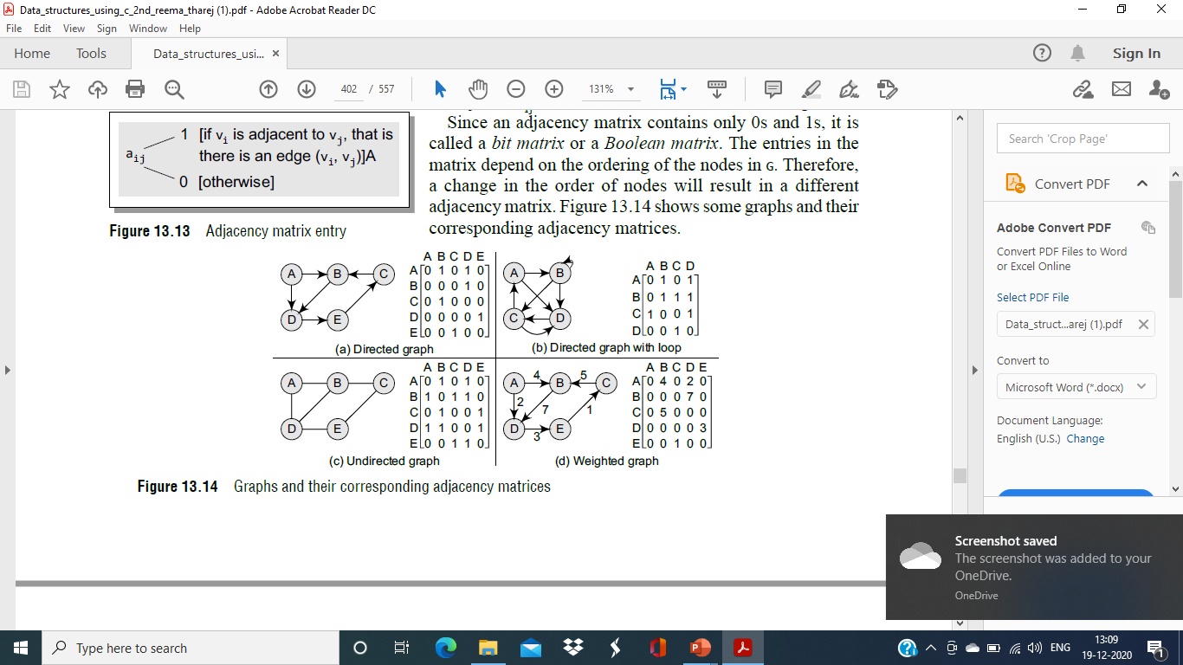
Representations of Graphs
From the above examples, we can draw the following conclusions:
For a simple graph (that has no loops), the adjacency matrix has 0s on the diagonal.
The adjacency matrix of an undirected graph is symmetric.
The memory use of an adjacency matrix is O(n2), where n is the number of nodes in the graph.
Number of 1s (or non-zero entries) in an adjacency matrix is equal to the number of edges in the graph.
The adjacency matrix for a weighted graph contains the weights of the edges connecting the nodes.

Slide 23
Representations of Graphs
Adjacency matrix:
Pros:
Easy to implement
Removing an edge takes O(1) time
Queries like whether there is an edge from vertex ‘u’ to vertex ‘v’ are efficient and can be done O(1)
Cons:
Consumes more space O(V^2)
Adding a vertex is O(V^2) time

Slide 24
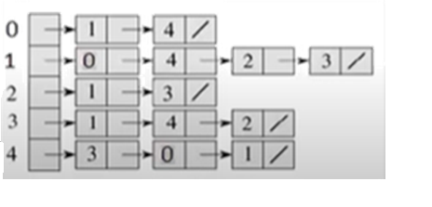
Representations of Graphs
Adjacency list:
In this representation, the n rows of the adjacency matrix are represented as n linked lists. An array Adj[1, 2, . . . . . n] of pointers where for 1 < v < n, Adj[v] points to a linked list containing the vertices which are adjacent to v (i.e. the vertices that can be reached from v by a single edge). If the edges have weights then these weights may also be stored in the linked list elements.
0
1
2
4
3
Graph
Adjacency List

Slide 25
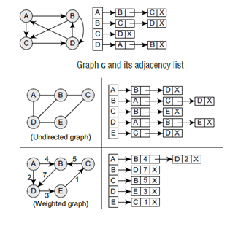
Representations of Graphs
Adding new nodes in graph G is easy and straightforward when G is represented using an adjacency list. Adding new nodes in an adjacency matrix is a difficult task, as the size of the matrix needs to be changed and existing nodes may have to be reordered.
Consider the graph G and see how its adjacency list is stored in the memory. For a directed graph, the sum of the lengths of all adjacency lists is equal to the number of edges in G. However, for an undirected graph, the sum of the lengths of all adjacency lists is equal to twice the number of edges in G because an edge (u, v) means an edge from node u to v as well as an edge from v to u. Adjacency lists can also be modified to store weighted graphs.

Slide 26
Representations of Graphs
Adjacency list:
Pros:
Saves space O(|v|+|E|), worst case O(V^2)
Adding a vertex is easy
Cons:
Queries like whether there is an edge from vertex ‘u’ to vertex ‘v’ are not efficient and can be done O(V)

Slide 27
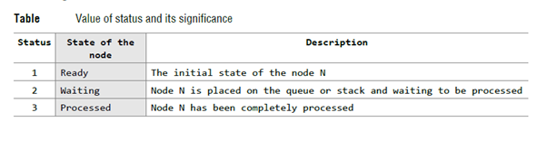
Graph Traversals
By traversing a graph, we mean the method of examining the nodes and edges of the graph. There are two standard methods of graph traversal, They are:
Breadth First Search(BFS)
Depth Frist Search(DFS)
The BFS will use a queue as an auxiliary structure to hold nodes for future processing and the DFS will use a STACK.
During the execution of these algorithms, each node N of G will be in one of three
states, called the status of N, as follows:

Slide 28
Breadth First Search
The general idea behind a breadth first traversal beginning at a starting node A is as
follows.
First we examine the starting node A. Then we examine all the neighbors of A. Then we examine all the neighbors of neighbors of A. And so on. We need to keep track of the neighbors of a node, and we need to guarantee that no node is processed more than once. This is accomplished by using a QUEUE to hold nodes that are waiting to be processed, and by using a field STATUS that tells us the current status of any node.
Breadth first traversal algorithm on graph G is as follows:
This algorithm executes a BFS on graph G beginning at a starting node A.
Initialize all nodes to the ready state (STATUS = 1).
Put the starting node A in QUEUE and change its status to the waiting state
(STATUS = 2).
2. Repeat the following steps until QUEUE is empty:
a. Remove the front node N of QUEUE. Process N and change the status of N
to the processed state (STATUS = 3).
b. Add to the rear of QUEUE all the neighbors of N that are in the ready state
(STATUS = 1), and change their status to the waiting state (STATUS = 2).
3. Exit.

Slide 29
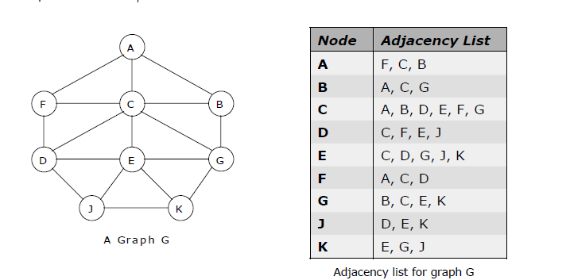
Breadth First Search
Example 1: Consider the graph shown below. Traverse the graph shown below in breadth first order and depth first order.

Slide 30
Breadth First Search

Slide 31
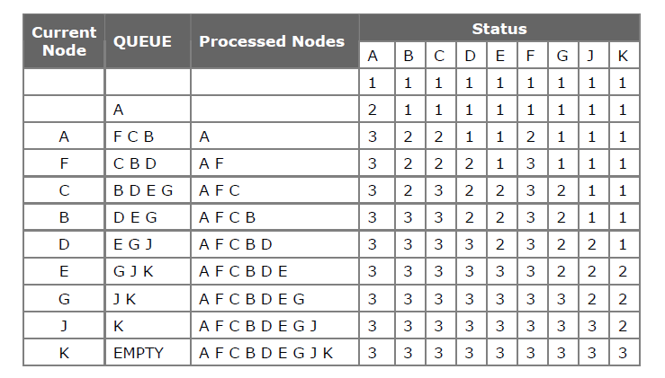
Breadth First Search
The steps involved in breadth first traversal are as follows:
For the above graph the breadth first traversal sequence is: A F C B D E G J K.

