Slide 1
Machine Learning 001
Brief crash course on Machine Learning, seen from 1000ft above
+
How it applies to Sensoft

Slide 2
What is Machine Learning?

Slide 3
What is Machine Learning?

Slide 4
…And why is it such a big deal?

Slide 5
Some Struggles & Challenges
Overfitting: making model too “customized”
And some other bugs.

Slide 6
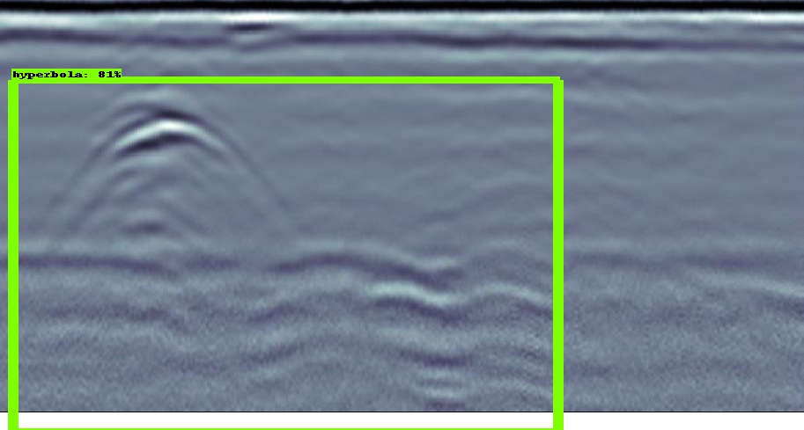
It works! Kind of.

Slide 7
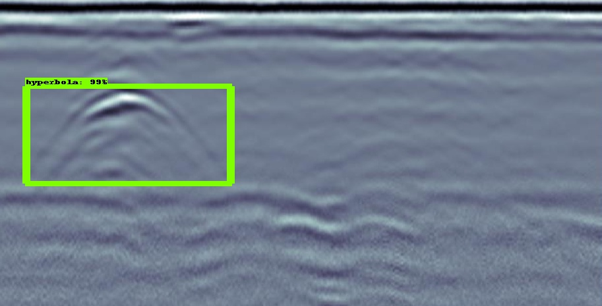
Result of more training

Slide 8
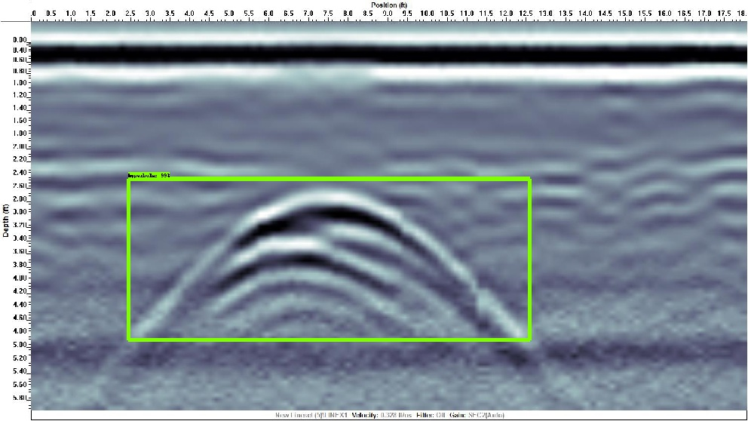
More results: Easy Mode

Slide 9
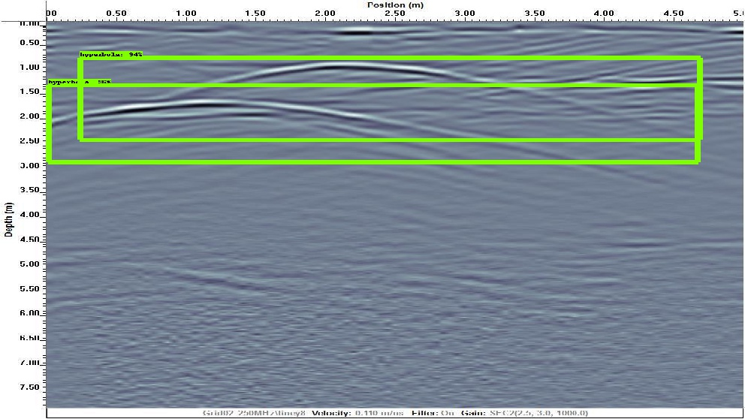
More results: Nice and Clear

Slide 10
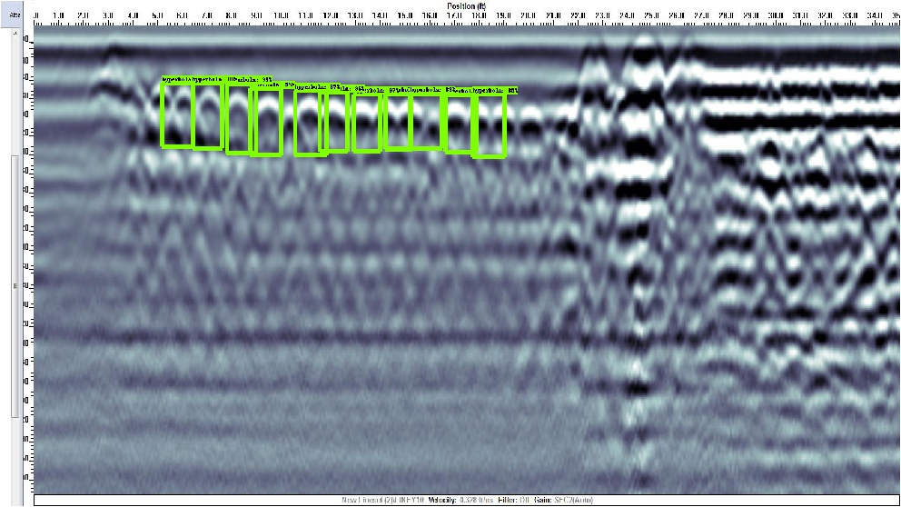
More results: How many can this thing do??

Slide 11
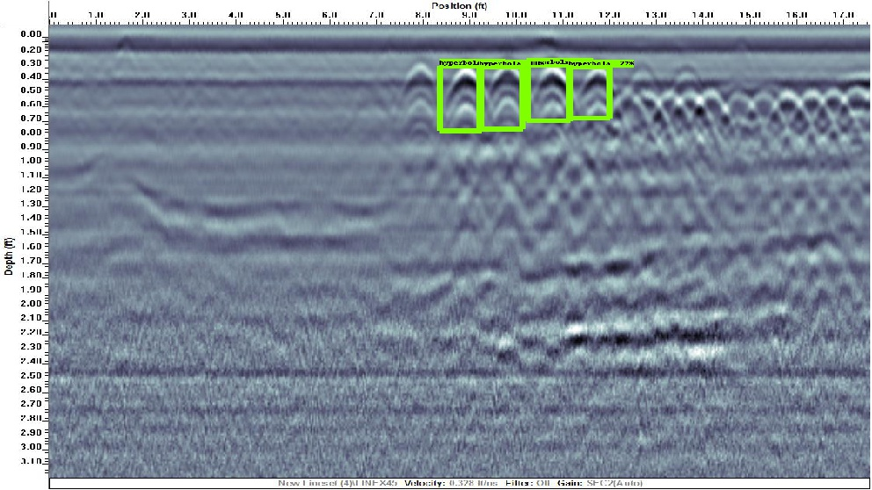
More results: Overlapping?

Slide 12
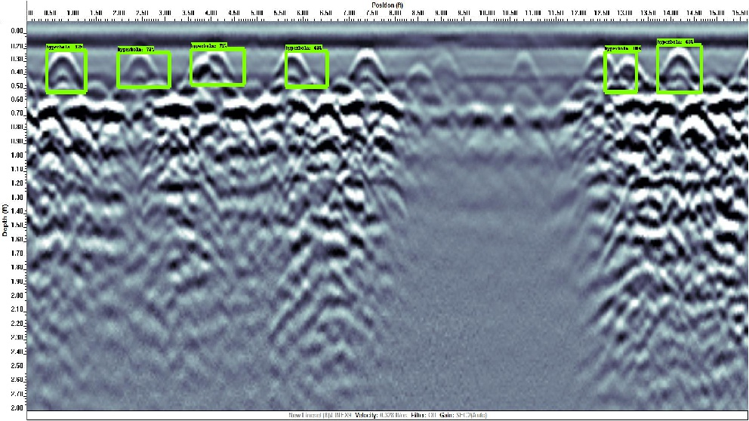
More results: Lots of gain?

Slide 13
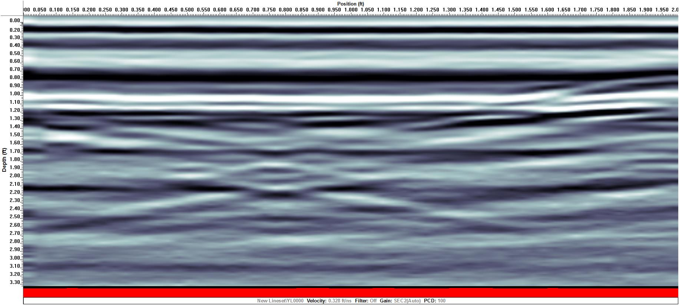
More results: Spot the Hyperbola

Slide 14
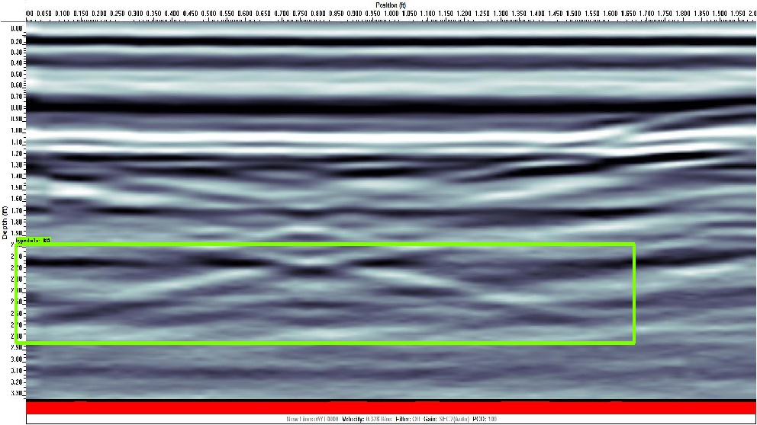
More results: Spot the Hyperbola

Slide 15
More results

Slide 16
More results

Slide 17
Interested in seeing more of my results?
Q:\NoBackup\Irene Chen\ Machine Learning Results
P.S. The 3-day course version of this project is also in there :)

Slide 18
Thanks(?) Steve Jackson and Dylan for the idea…

Slide 19
Expo Agua Peru Canada And Value Information
Conference Phoenix AZ key commitments operations
Mapping utilities delivery as a product
Workshop locating underground storage tanks was very well copyright
Upcoming Educational Events: How my Donut Day

Slide 20
Influences CGA and NULCA support was great!!
Locating throughout the Word PDF files.
Stand out in US at CGA dirt.
SHOW YOU DON’T LISTEN, THINK, PAUSE!

Slide 21
Influences CGA and NULCA support was great!!
Locating throughout the Word PDF files.
Stand out in US at CGA dirt.
SHOW YOU DON’T LISTEN, THINK, PAUSE! LISTEN, THINK, PAUSE, RESPOND :)

