Slide 1
Mapping Mental Health Discussions in a Blog Forum
Project 8
Xin Shu, Sihan Zhu, Jiani Wang

Slide 2
Introduction
Aiming to investigate the mental health discussion taking part in UK health forum.

Slide 3
Introduction
Collecting data
We scrap the dataset and utilize threads containing more than 10 replies. Using web crawler, we downloaded the dataset including thread title, post user ID, reply user ID, post time, and reply time.
Building different networks with different weight assignment methods.
Network 1: basic network
Network 2: network with weights decided by interaction between users
Network 3: network with weights decided by time interval between two replies
Analyzing related network features.
Trace the plot showing the number of threads per user ID.
Test whether the distribution of the number of threats per user follows Power-Law distribution or not.
Conclude how the topics of thread vary for the ten most active users using manualing labels.
Summarize the attributes of three network graphs in terms of given requirements.
Compare the most influential nodes in terms of different centrality.

Slide 4
Data Collection

Slide 5
data acquisition process
Impersonate the client to make a request to the server
Find the right data by using developer tools
Use regular expressions to select the appropriate data and store it

Slide 6
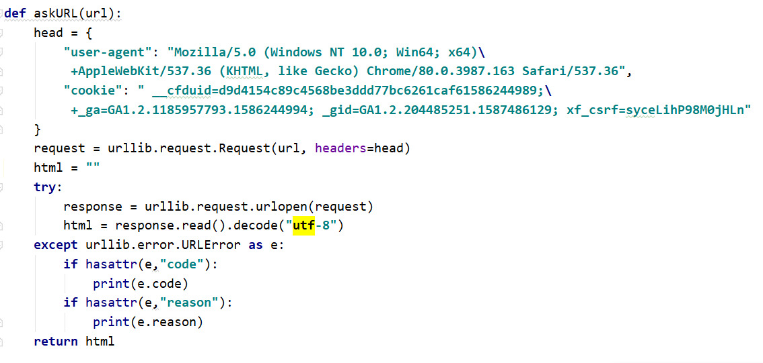
web pages acquirement
method: urllib

Slide 7
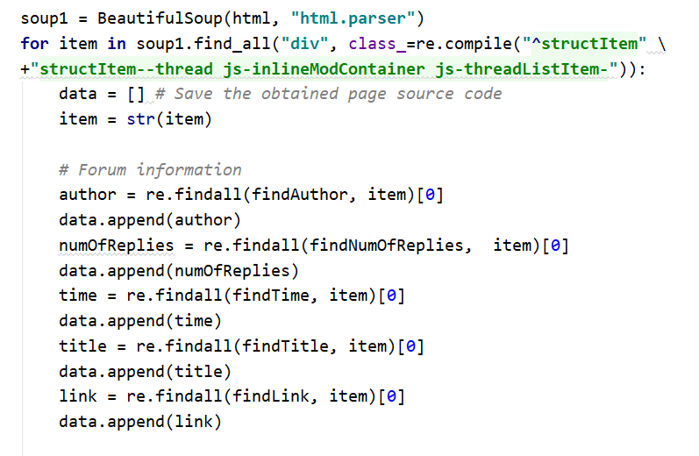
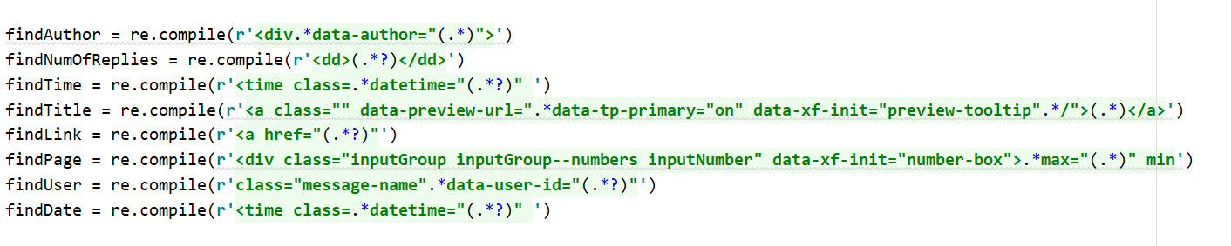
data parser
method:
BeautifulSoup,
Regular Expression

Slide 8
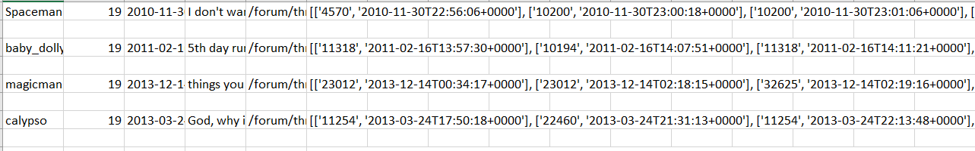
post-user | repliesNum | post-date | title | url | user-content
Structured Database

Slide 9
Constructing the Network

Slide 10
Network 1
Every user in the thread, including the person who initialize the thread, is linked with each other.
The nodes are the user IDs. If two users appeared in the same thread, there is an edge between them.
Find all users under the same thread.
Create graph G, and add all edges under the thread
Repeat with the rest of the threads.

Slide 11
Network 2
Based on network 1
Add the weight of edge(A,B) according to how active they are within the same thread.
If A or B is the one who post the thread, then the weight is maximum (10)
If not, the weight is the total number of replies of A and B
The weight is then added to the edge. And again confirm all weights are less than 10.
Repeat with the rest of the edges
Check A or B for posting
Calculate the weight.
Assign weight to edge.

Slide 12
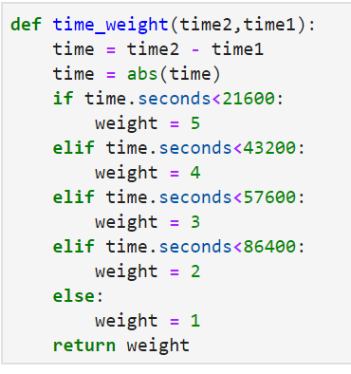
Network 3
Based on network 1
The edge between node A and node B is weighted according to time response taken by A and B to respond to the last message.
The design: 1. “Time score” is a evaluation for the time, of which the maximum is 5. If the reply time is distinct from the time of last message, “time score” for the user will be low. 2. The weight is the sum of time_score(A) and time_score(B) 3. Once the weight gets larger than 10, it will be set to 10, so that the maximum weight is 10.

Slide 13
The full process
Extract user and time data from the dataset
Create 3 empty graphs: G1, G2, G3, each represent one of the three social networks.
Loop a list of threads. For each thread (1) Create an empty graph H1. Find all the unique user-IDs, which are then used as the nodes of graph H1. Add all edges for users in the same thread so that each user has a connection to the rest of the users. (2) Construct H2 based on H1. (Corresponding to network 2) (3) Add the nodes and edges of H1, H2 to G1, G2 respectively
Loop a list of thread. For each thread (1) Create H1 as mentioned above. (2) Construct H3 based on H1. (Corresponding to network 3) (3) Add the nodes and edges of H1, H3 to G1, G3 respectively

Slide 14
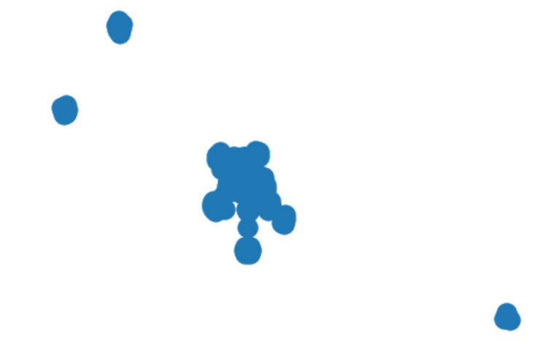
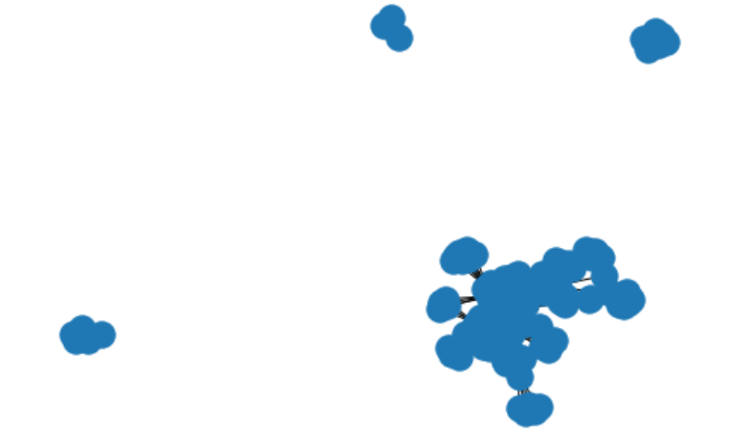
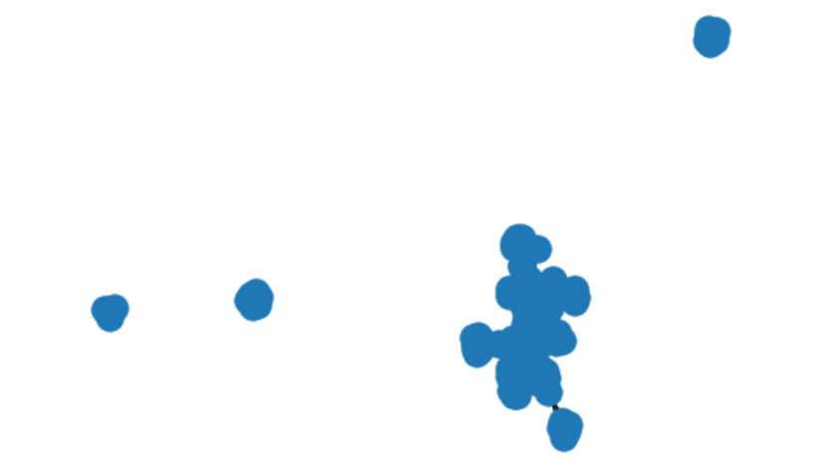
Graph - 25 threads
Network 2
Network 1
Network 3

Slide 15
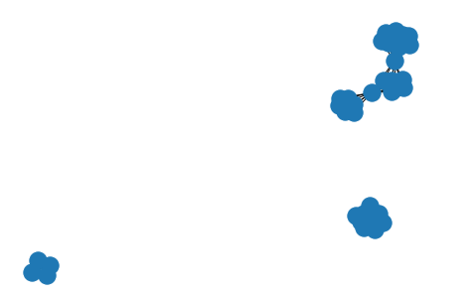
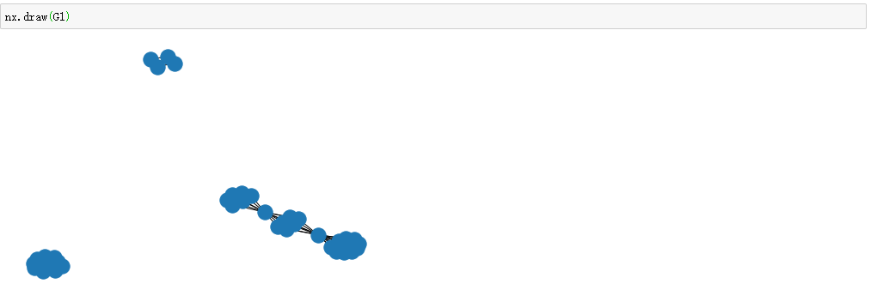
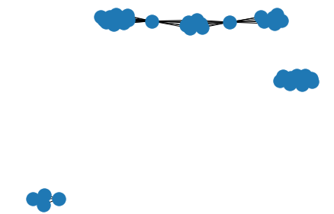
Graph - 125 threads
Network 2
Network 1
Network 3

Slide 16
Results analysis

Slide 17
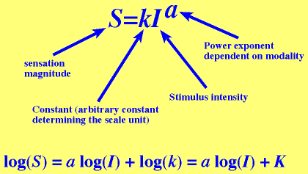
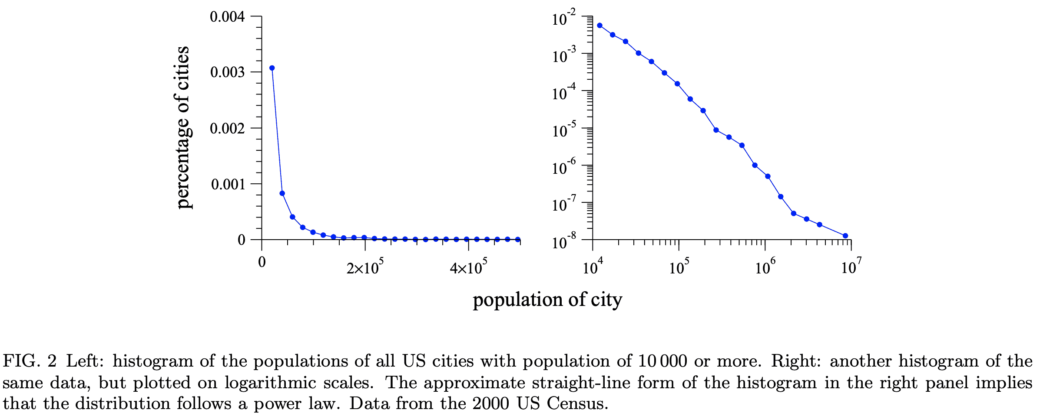
Power-Law distribution test of the number of threads per user
Plot histogram to show the number of threads per user ID;
transfer the corresponding values into log form;
Apply Least Squares method to do linear regression;
Justify the answer with mean squared error.

Slide 18
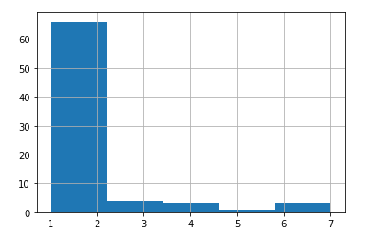
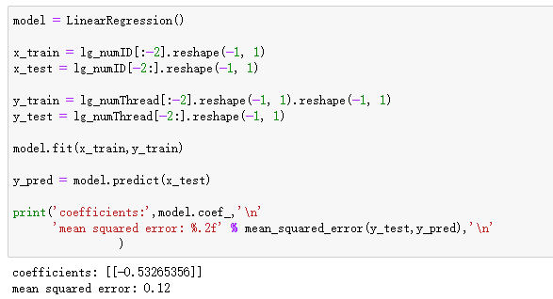
Results:
Power-Law distribution test of the number of threads per user

Slide 19
(2) Top 10 active users and their topics
Select all user ID in each thread;
Count the times of each ID appearing in all threads;
Find the most common 10 elements of the times;
Find the corresponding thread title they replied or posted.
tags:
romance; symptoms; depressed; experience; need advice; medication; positive; mood; suicide

Slide 20
Results:
(2) Top 10 active users and their topics
rank | user | topic | rank | user | topics
1 | 24395 | need advice; depressed; experience; suicide;mood | 6 | 1379 | depressed; need advice; experience;
2 | 10457 | depressed; mood | 7 | 5526 | symptoms; depressed; need advice; medication; suicide
3 | 11254 | need advice; experience; suicide; need advice; | 8 | 11318 | depressed; experience; need advice;
4 | 11882 | romance; need advice; suicide; need advice; | 9 | 10470 | need advice; depressed
5 | 12260 | romance; experience; depressed; | 10 | 5579 | need advice; experience; depressed;

Slide 21
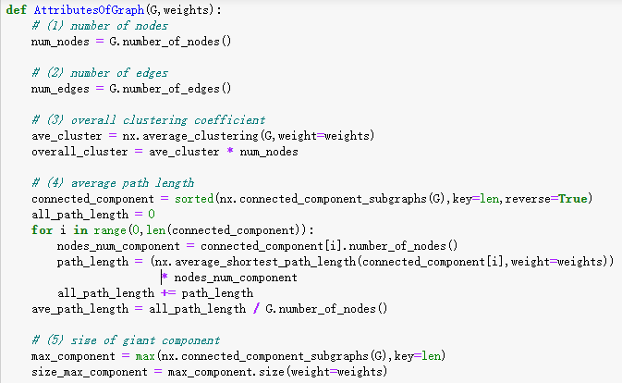
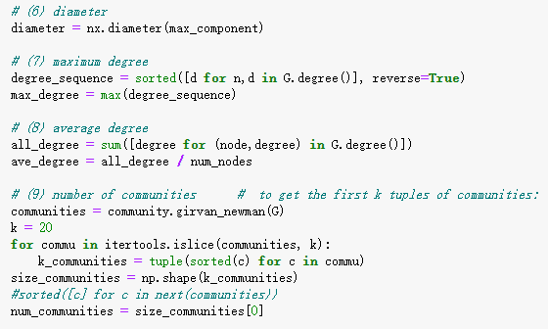
(3) Attributes of Network Graph
weight = str or None：
overall clustering coefficient
average path length
size of giant component

Slide 22
(3) Attributes of Network Graph
 | network 1 | network 2 | network 3
number of nodes | 40 | 40 | 40
number of edges | 176 | 176 | 176
overall clustering coefficient | 38.96 | 34.33 | 34.69
average path length | 1.53 | 14.62 | 13.40
size of giant component | 115 | 1024 | 1034.83
diameter | 3 | 3 | 3
maximum degree | 18 | 18 | 18
average degree | 8.8 | 8.8 | 8.8
number of communities | 13 | 13 | 13

Slide 23
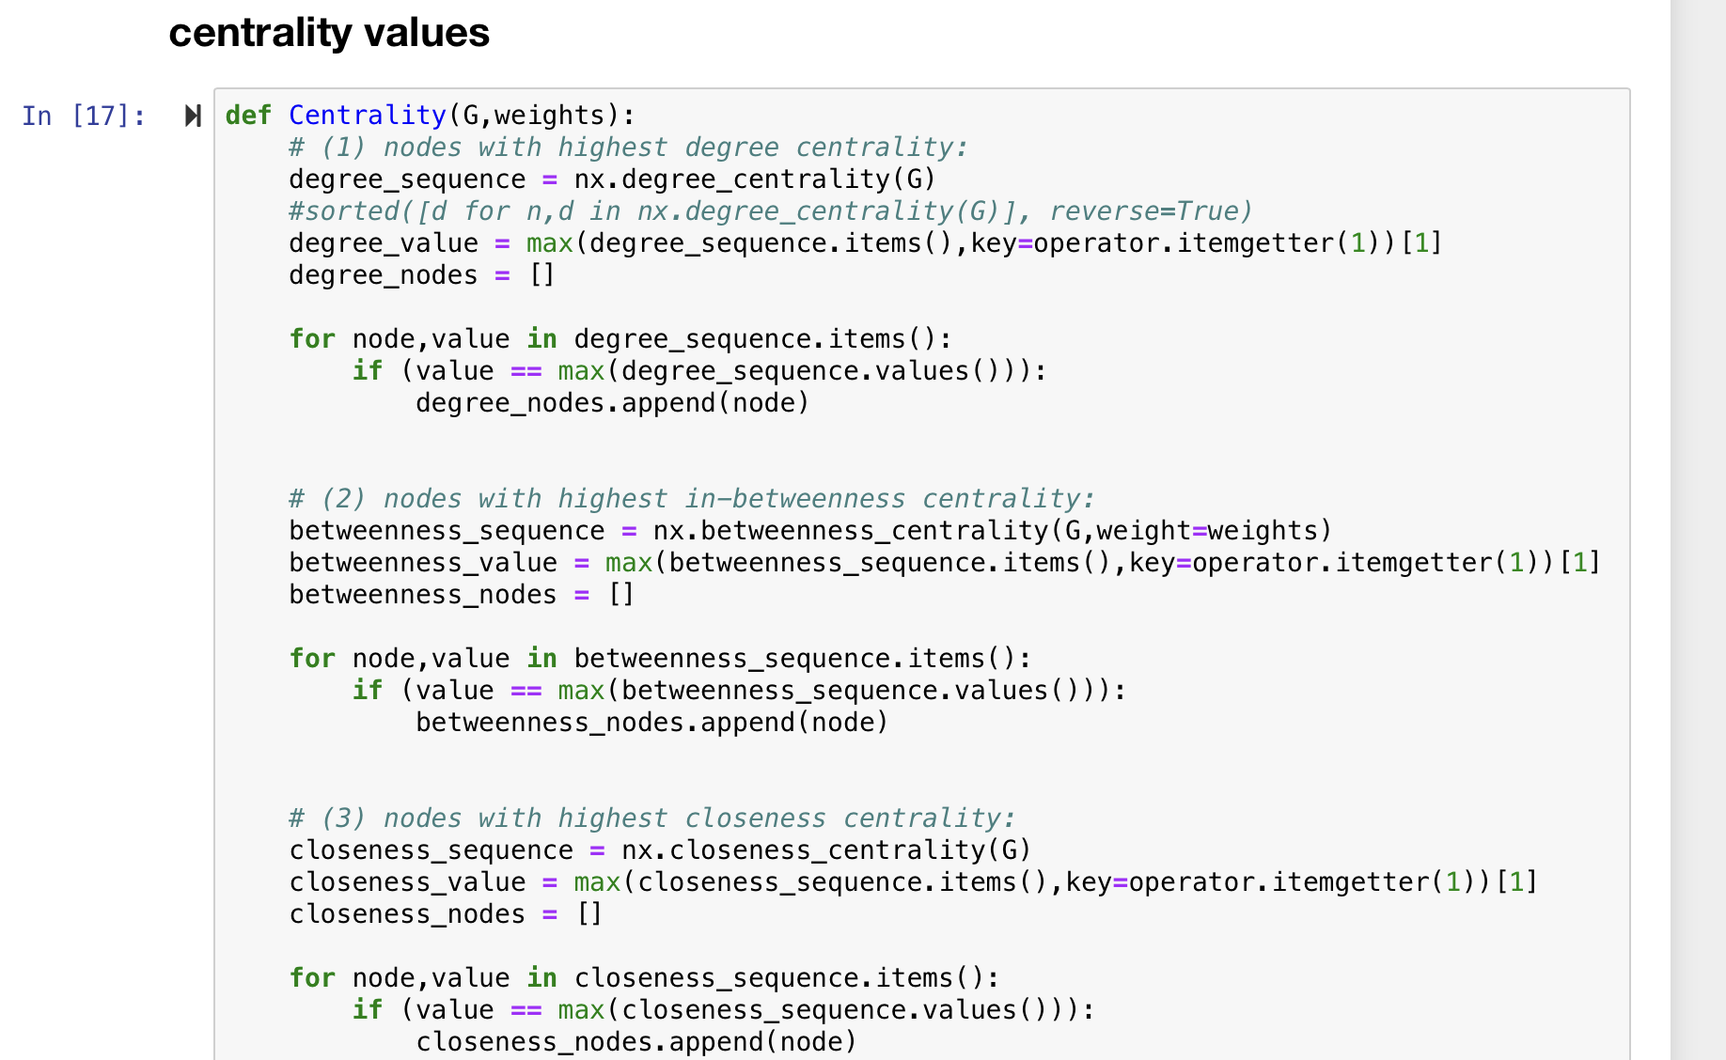
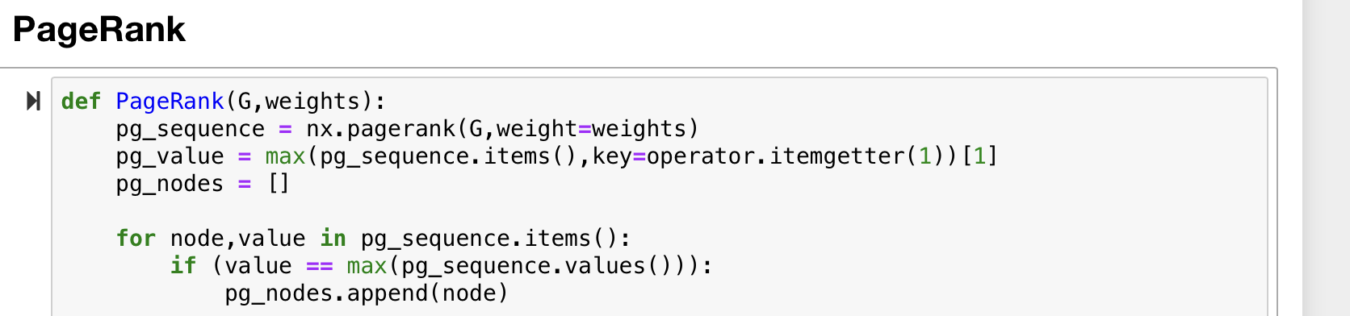
(4) Centrality value
weight = str or None：
in-betweenness centrality
Pagerank centrality

Slide 24
(4) Centrality value
 |  | network 1 | network 2 | network 3
degree centrality | Nodes | 11254 | 11254 | 11254
 | Value | 0.46 | 0.46 | 0.46
in-betweenness centrality | Nodes | 11254 | 11254 | 11254
 | Value | 0.19 | 0.19 | 0.19
closeness centrality | Nodes | 11254 | 11254 | 11254
 | Value | 0.49 | 0.49 | 0.49
Pagerank centrality | Nodes | - | - | 11254
 | Value | - | - | 0.04

Slide 25
Conclusion
We have fulfilled 95% requirements of the project up to now;
We assigned the work equally and keep discussing during the process;
However, we had some difficulties visualizing clearer graphs and exploring deeply the potential relationship and conclusions.

Slide 26
THANKS！

