Slide 1
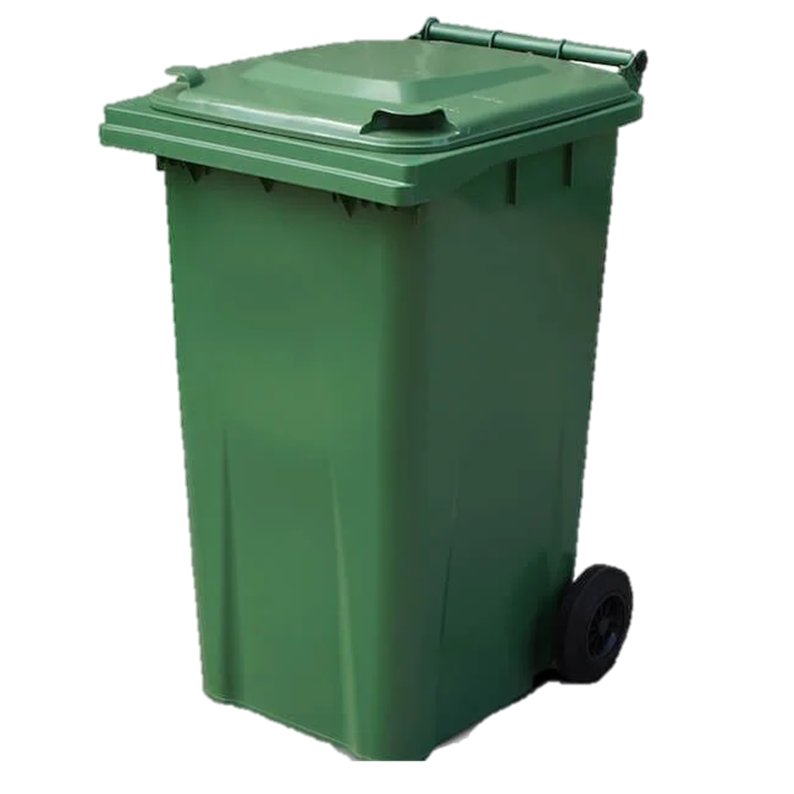
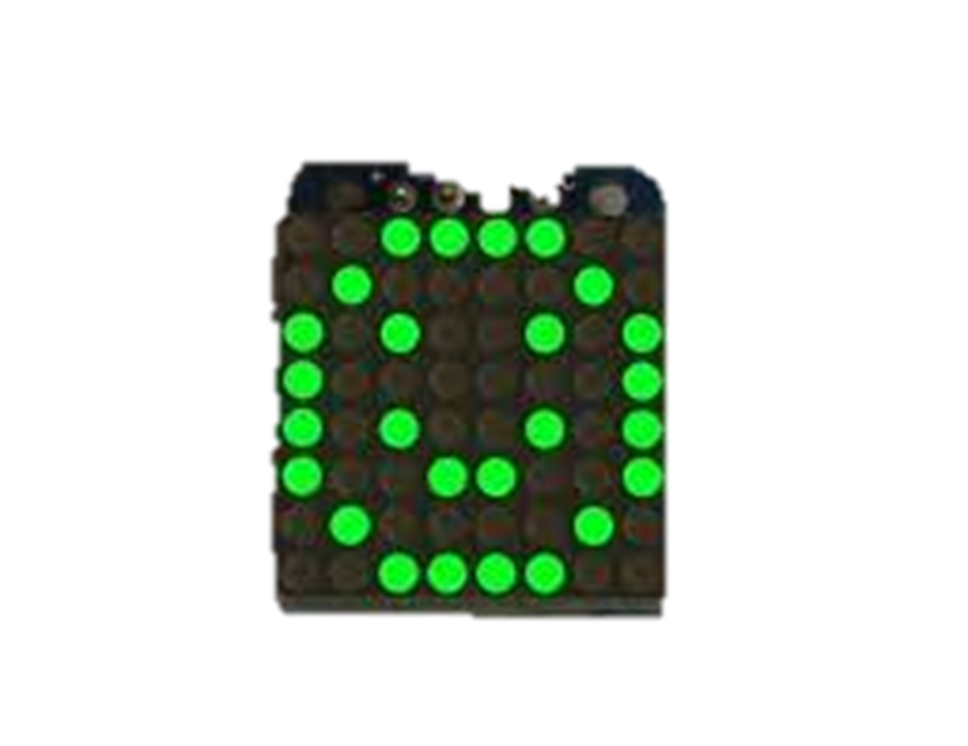



Bindicator
Is forgetting bin days a common problem in your household? Say hello to Bindicator , your new bin pal, here to make your life easier!
Feature:
Friendly Reminder: It helps you remember when to take out the bins, ensuring you never miss a collection day again
Time Conscious: But be warned! It will gets upset if you forget to put the bins out by 7 p.m. night before. It will remind you with a sad face and an alerts.
Attentive Observer: it will keep an eye on your bins. As soon as they're out for collection, it will cheerfully acknowledge your effort.
Why I Chose This Project: Living in a house where remembering bin days is an issues and is something that we do often. When we forget it, it is then two more weeks we have to fit into one bin which normally an issues
Pal will ask a website API to find out if tomorrow is bin day
Bin will have a server that pal can connect to and ask it which location the bin is it.
ESP32(pal)
Using bins website, you can set each location (collect and store)
ESP32(bin)
Speaker
It will send pules of BLE, this will be used to find it’s distance between these devices
Website API
8x8 led display
Phone
8x8 led matrix display and speaker will be wired up to the board
BLE Ibeacon
Connections:
Green: HTTP
Black: Wire
Blue: Bluetooth low Energy
Issues/Development:
The Bin ESP32 will need to be have both a server and ble Ibeacon connectivity which might be tight on memory – will need to do testing on how to fit both on one board.
Will look into different protocols for communication between the two ESP32 and if there is always to send WIFI login to an ESP32 so that you do not need to connect both to a network.

