Slide 1
THE donor Smart App for donation food, books and clothes Team –Tm000144
Problem ID SCHR036
SCHR036 Smart App for donation food, books AND clothes

Slide 2
Introduction
194.4 million people i.e. 14.5% of our population is undernourished
20.8% of children under 5 are underweight
Hunger Kills more people than AIDS, malaria and tuberculosis combined
One- third food on the globe gets wasted
60 lakh children in India are still out-of-school.
India is ranked at 123 out of 135 countries in female literacy rate.
Reference:-
https://www.indiafoodbanking.org/hunger
https://www.oxfamindia.org/featuredstories/10-facts-illiteracy-india-you-must-know

Slide 3
Challenges people face
No Awareness about NGO’s
No Universal platform
Trust problems on Ngo’s
People don’t have time for distribution of food, clothes.

Slide 4
Challenges NGO face
No Funds
Volunteers
Food quality test
Absence of networking
Lack of maintenance
Regularity in Donations
Trust on Ngo

Slide 5
Existing Solution
Uday Foundation www.udayfoundation.org
HBE - Donate Food Cloths Books android application
Zomato’s philanthropist trust www.feedingindia.org

Slide 6
Approach to solve the problem
Universal Platform Creation
Create User friendly platform
Encouraging them to use our platform

Slide 9
Challenges/Risk
Ngo verification
Food Quality test
Create awareness
Fake request
Motivate NGO’s to become part of our platform

Slide 10
solution to the problem-
Ngo can request for any requirement and user can see to it and full fill it if possible.
User can donate food , clothes and books from his account .The Ngo accept if they think it is useful to them
Volunteer System

Slide 11
Features of our application
Show statistics in graph format.
Ngo Rating
Food donation blocked during late night
Multiple languages supported(English, Hindi, Gujarati)
Ngo documentation verification before registration
Offline database connectivity
Light weight application (supported on low-end devices):-10.07mb

Slide 12
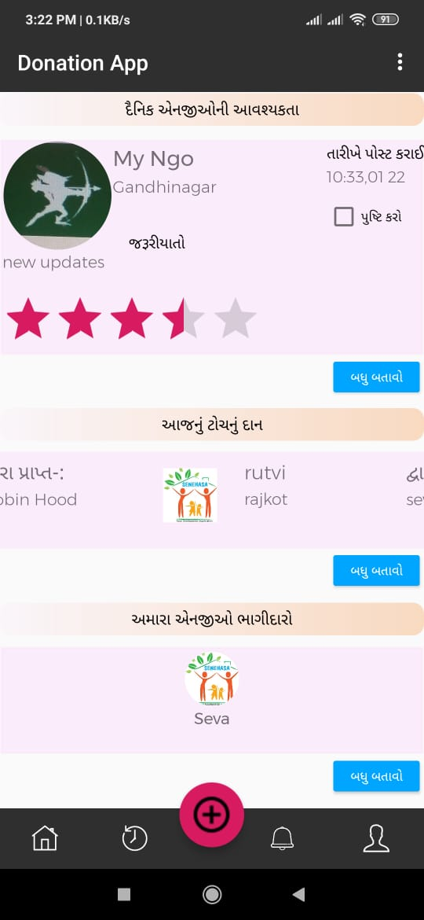
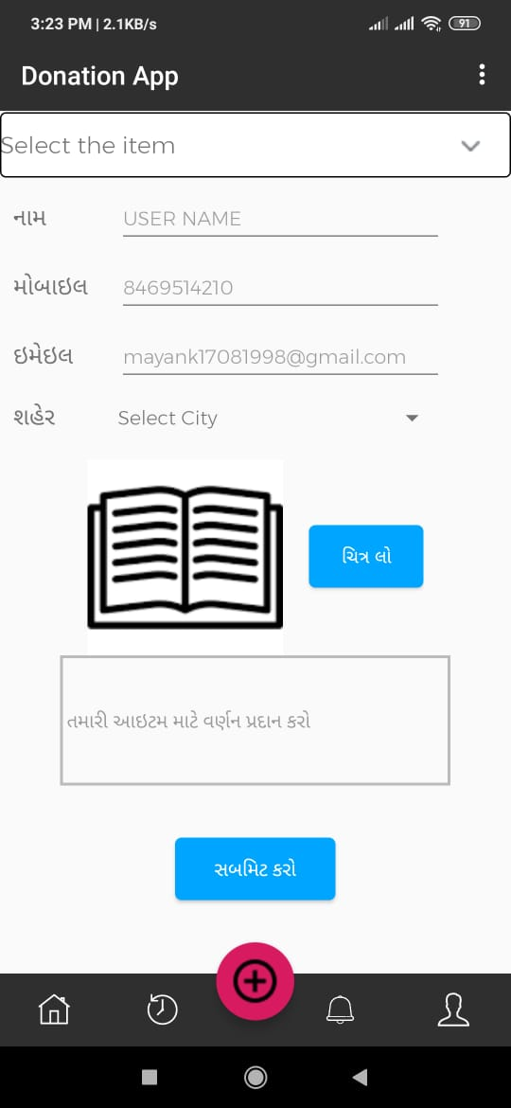
Screenshots

Slide 13
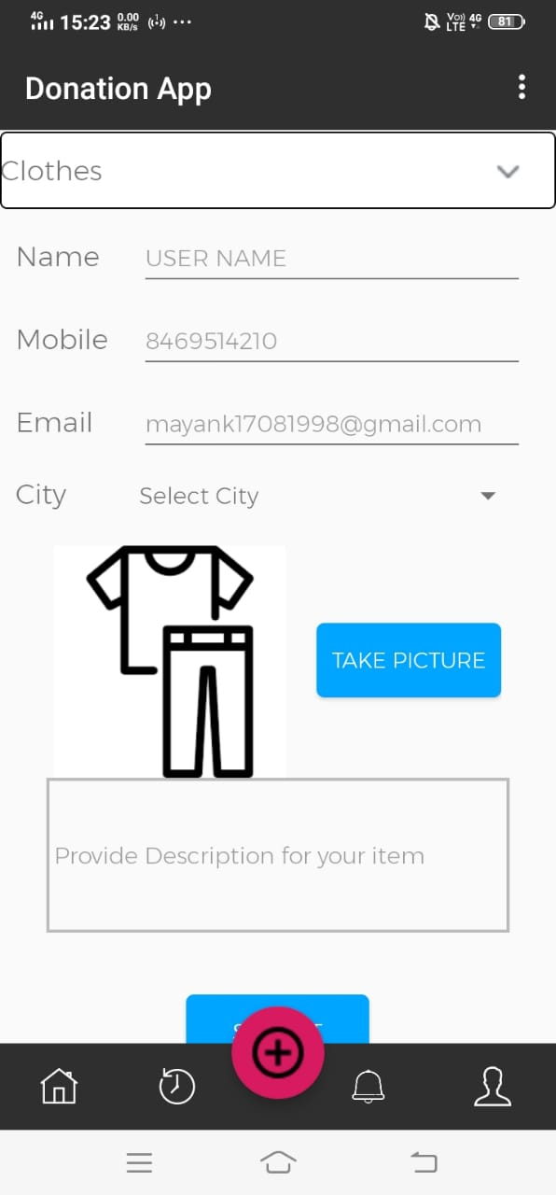
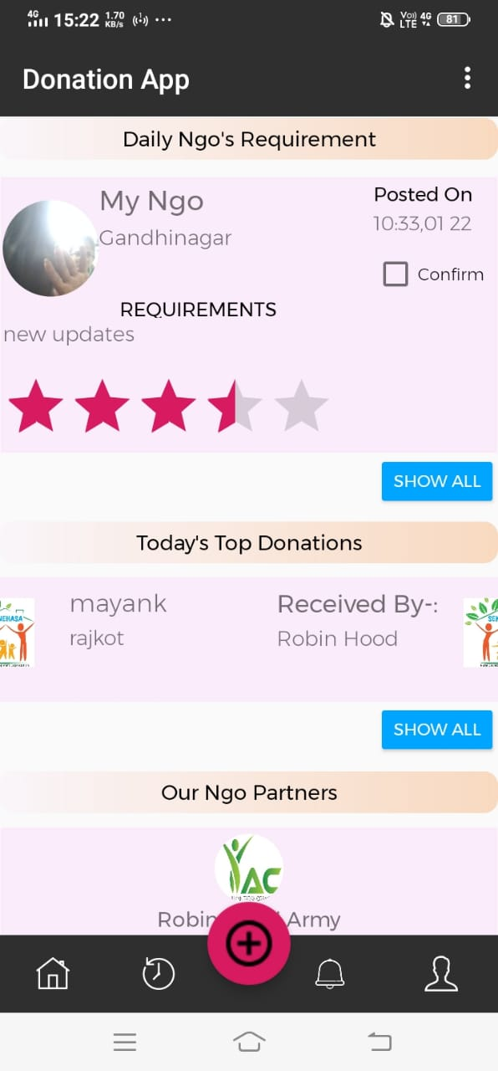
Screenshots

Slide 14
Team Members
Umesh Agarwal
Mayank Singh
Ayuj Asthana
Rutvi Kumawat
Mentor:-Snehal B. Sathwara

Slide 15
Thank You

