Slide 1

UC10 — Healthcare Data Pipeline Reliability
From Claims + Pharmacy Data → Features → Hybrid Anomaly Detection

Slide 2
Our Core Healthcare Data
1. Beneficiary
2. FFS Inpatient Claims
3. PDE
Purpose: Provides common identity and demographic backbone. Key concept: • BENE_ID
Purpose: Represents healthcare service activity. Key concepts: • Claim / Claim line • Service date • Provider • Claim amount
Purpose: Represents prescription drug events. Key concepts: • Prescription event • Beneficiary • Service date • Drug & Cost fields

Slide 3
The Relationship Between the Datasets
BENEFICIARY (BENE_ID)
│
┌─────────┴─────────┐
│ │
▼ ▼
FFS CLAIMS PDE
(Claim Lines) (Drug Events)
Verified Facts:
• Claims → Beneficiary = 100% match
• PDE → Beneficiary = 100% match
• 5,098 beneficiaries have overlapping activity
IMPORTANT: We do NOT force Claims ↔ PDE directly. We connect both through the common Beneficiary layer.

Slide 4
Why Each Dataset Matters
Beneficiary → "WHO"
Claims → "WHAT MEDICAL ACTIVITY"
PDE → "WHAT PHARMACY ACTIVITY"
These three pillars allow us to monitor the holistic patient journey and immediately detect when a specific pipeline (medical vs. pharmacy) stops delivering expected data.
Beneficiary
FFS Claims
PDE
Identity & Relationship
Claims Volume & Behavior
Pharmacy Volume & Behavior

Slide 5

Turning Healthcare Records into Monitoring Signals
Examples of the 18 Curated ML Features (Aggregated Daily):
• Claims: claim_count, unique_beneficiary_count
• PDE: pde_count, unique_provider_count
• Data Quality: null_rate, duplicate_rate, dq_violation_rate
• Cross-Dataset: claim_pde_ratio, cross_dataset_mismatch_rate
• Behavior: volume_change_pct
• Operational*: processing_duration, throughput, failure_rate, backlog
* Note: Operational metrics are currently simulated for the MVP prototype.

Slide 6
Which Features Support Which Detection?
DATA QUALITY
BEHAVIOR
RELATIONSHIP
null_rate duplicate_rate dq_violation_rate ↓ RULES "Is the data invalid?"
volume_change pde_count claim_count ↓ Rolling Median + MAD "Is today's behavior unusual?"
claim_pde_ratio mismatch_rate beneficiary_links ↓ ISOLATION FOREST "Is the combination unusual?"

Slide 7
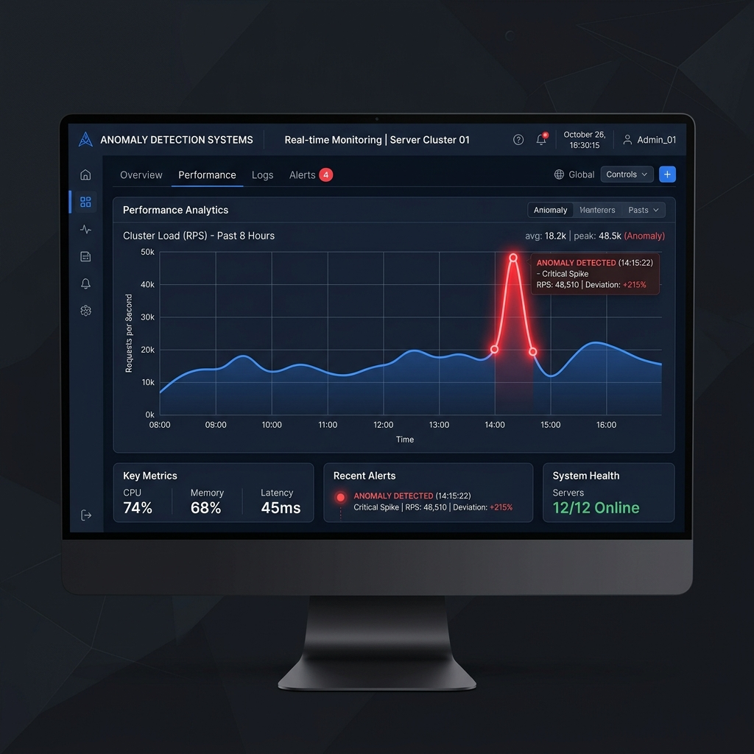
Why a Hybrid Detection Approach?
1. Rule-Based DQ
Detects explicit violations (Missing values, Duplicates, Invalid dates, Referential failures).
2. Rolling Median + MAD
Detects unusual temporal behavior (Volume drops/spikes, unusual rates).
3. Isolation Forest
Detects unusual combinations (e.g. Volume ↑ AND Throughput ↓).
Explicit errors + Statistical deviation + Multivariate behavior = Stronger evidence.

Slide 8

Example: How One Anomaly Travels Through the System
Normal: PDE volume ≈ historical baseline
↓
Today: PDE volume drops 40%
↓
Rolling Median + MAD → Statistical anomaly detected
↓
Cross-dataset metrics → Additional context added
↓
Evidence Fusion → HIGH-SEVERITY EVENT triggered
↓
RCA → Impact → SLA Risk evaluated
* We flag this as a 'Potential RCA' without confirming root cause until verified.

Slide 9
From Healthcare Data to an Actionable Anomaly
CMS Beneficiary / Claims / PDE → Preprocessing → Data Quality → Feature Engineering
↓
┌───────────────────────┐
│ HYBRID DETECTION │
│ • DQ Rules │
│ • MAD │
│ • Isolation Forest │
└─────────┬─────────────┘
↓
Verification ← Recommended Action ← RCA + Impact + SLA ← Anomaly Assessment ← Evidence Fusion

Slide 10
Current Status & Next Step
COMPLETED
CURRENT & NEXT
✓ Dataset Validation (100% matches, 5,098 overlapping BENE_IDs) ✓ Feature Engineering (2,922 daily windows, 18 curated ML features) ✓ Rule-Based DQ (0 clean-baseline violations) ✓ Statistical Detection (Successfully detected controlled volume anomaly)
CURRENT: → Isolation Forest NEXT: → Evidence Fusion → RCA / Impact / SLA → RAG Assistant → Remediation / Verification

