Slide 1

Tor 101
An introduction into Tor

Slide 2
Whoami ?
Name:Dan
Worked in pentesting for 4 years. Doing web application and infrastructure assessments.
Degree in computer networks and security
Overall nerd can find me on twitter @Little_Security
This is my first talk !
Notes:
Talk about yourself here a bit not to long perhaps a min.

Slide 3
What is Tor?
Tor is short for The Onion Router. Onion Routing was first developed in 1990s
The Tor Browser was launched in 2008.
A whole network created by thousands of relays that are hosted by volunteers all over the world.
Main purpose is to conceal a user's location and usage from anyone performing network surveillance or traffic analysis.
Tor's intended use is to protect the personal privacy of its users
Notes:
Give an overview of what Tor is what its original purpose was. What it has evolved into and what its current state is in the year 2022. Remember keep it brief.
The core principle of Tor, onion routing, was developed in the mid-1990s

Slide 4
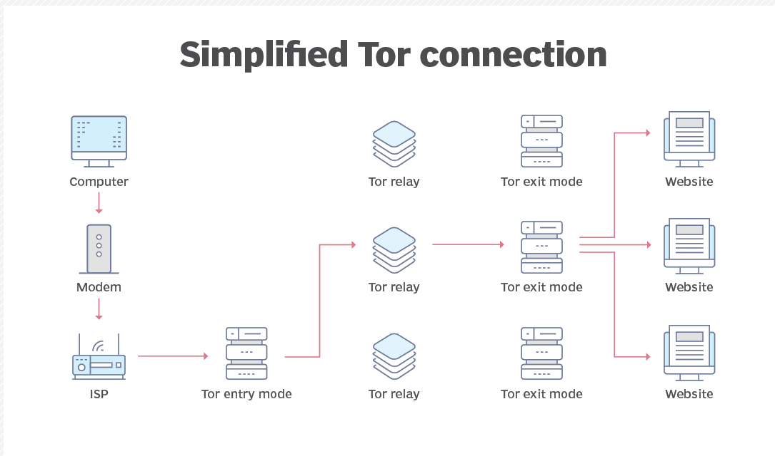
Tor network itself.
When we think of Tor we often think of the Tor browser that is used to connect to the Tor network. However Tor itself is a whole network.
Notes:
Explain how tor overall works here. Explain how one may first connect to Tor and what the first connection is like.
The Tor browser works by using a technology known as onion routing. The onion router is a peer-to-peer (P2P) overlay network that enables users to browse the internet anonymously. Onion routing uses multiple layers of encryption to conceal both the source and destination of information sent over the network.

Slide 5
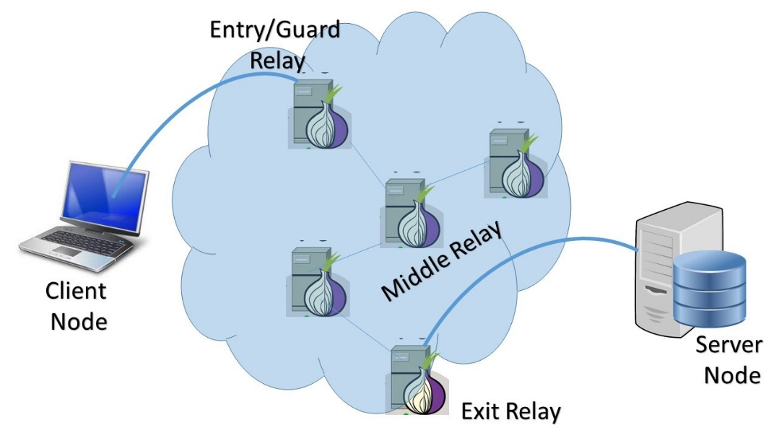
Tor Entry node
This is the first point of entry into the Tor network and is the first node in a chain of 3.
This is also called a guard node.
This node sees your originating IP address. (Public IP address
This node
Notes:
What is a known anonymity-breaking attack. For Tor this is were an attacker has control over the incoming entry node and exit node and can perform traffic analysis on your traffic between the nodes to identify the user.
A guard relay is the first relay in the chain of 3 relays building a Tor circuit. A middle relay is neither a guard nor an exit, but acts as the second hop between the two. To become a guard, a relay has to be stable and fast (at least 2MByte/s) otherwise it will remain a middle relay.

Slide 6
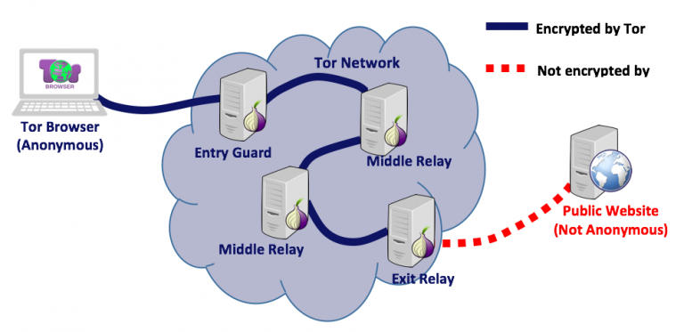
Middle relays
These relays make up the large Marjory of the Tor infrastructure.
Middle relays do not see any of the data that is being encrypted
The middle relays job is to accept data from incoming Tor entry nodes. Then re-encapsulate the data and send it to an exit node.
These types of nodes are considered safe to be hosted within home lab environments or from home.

Slide 7
Exit nodes
This is the final stop in the Tor connection.
This node sends the data to the intended destination
It is possible to host your own exit node. It is NOT recommended to do this from home.
Any malicious traffic sent via Tor will have a source address of an exit node which can cause issues if you are the one hosting the exit node.

Slide 8
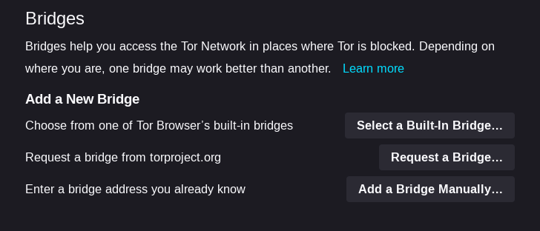
Tor Bridges
A final important piece of the Tor network. The Tor bridge
This is just another Tor relay that is not listed publicly.
Using a bridge is recommended if you are in a location that actively blocks Tor.
Runs a slightly different configuration than a normal Tor relay. Can be hosted by anyone.
Notes:
The design of the Tor network means that the IP address of Tor relays is public. However, one of the ways Tor can be blocked by governments or ISPs is by blocklisting the IP addresses of these public Tor nodes. Tor bridges are nodes in the network that are not listed in the public Tor directory, which makes it harder for ISPs and governments to block them.
Bridges are useful for Tor users under oppressive regimes or for people who want an extra layer of security because they're worried somebody will recognize that they are contacting a public Tor relay IP address. Several countries, including China and Iran, have found ways to detect and block connections to Tor bridges. Pluggable transports, a special kind of bridge, address this by adding an additional layer of obfuscation.

Slide 9
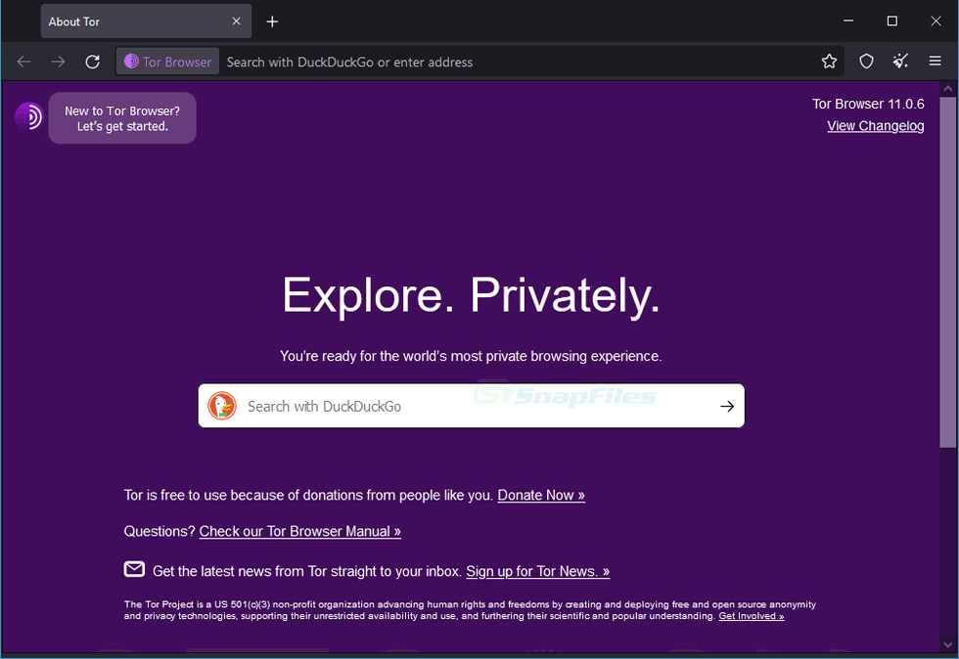
Tor Browser
Originally was an application called Vidalia.
In 2008 the Tor project realised the Tor browser bundle. The new Tor browser was a forked version of Firefox. This included a Tor button to automatically connect to the Tor network.
This browser only needs to be extracted to run does not need to be installed. Can be ran from a flash drive if needed.
Notes:
Talk about the Browser bundle and its fork to firefox and how the browser was designed for ease of use in mind.

Slide 10
What is Tor used for
Tor is used by a large range of different people from all over the world.
Most people use Tor to protect their privacy when using the internet generally speaking.
Tor is used a lot by activists and journalists to get information out of a potentially censored part of the world. A prime example of this is the recent Hong Kong protests. People used Tor for communication.
It is also used by bad threat actors to perform attacks on targets.
Criminals looking to buy and sell illegal goods. Through onion marketplaces. Such as the famous silk road.
Notes:
Mention who uses Tor the different types of people that use Tor and why Tor gets a bad rap at times.
Give examples of the different types of people who use tor and examples.

Slide 11
Onion services
These are services that are only accessible over the Tor network.
Onion services offer location hiding end to end authentication and encryption.
Runs on the onion services protocol
Onion services are accessed by an onion address that looks something like this. vww6ybal4bd7szmgncyruucpgfkqahzddi37ktceo3ah7ngmcopnpyyd.onion
Traffic to and from the user and host is encrypted.
Notes:
Mention the fact Opinion services also use HTTPs.
Mention the different types of services offer touch on the good and bad.
More info here- https://community.torproject.org/onion-services/overview/#:~:text=The%20Onion%20Service%20connects%20to,been%20relayed%20through%20the%20service).

Slide 12
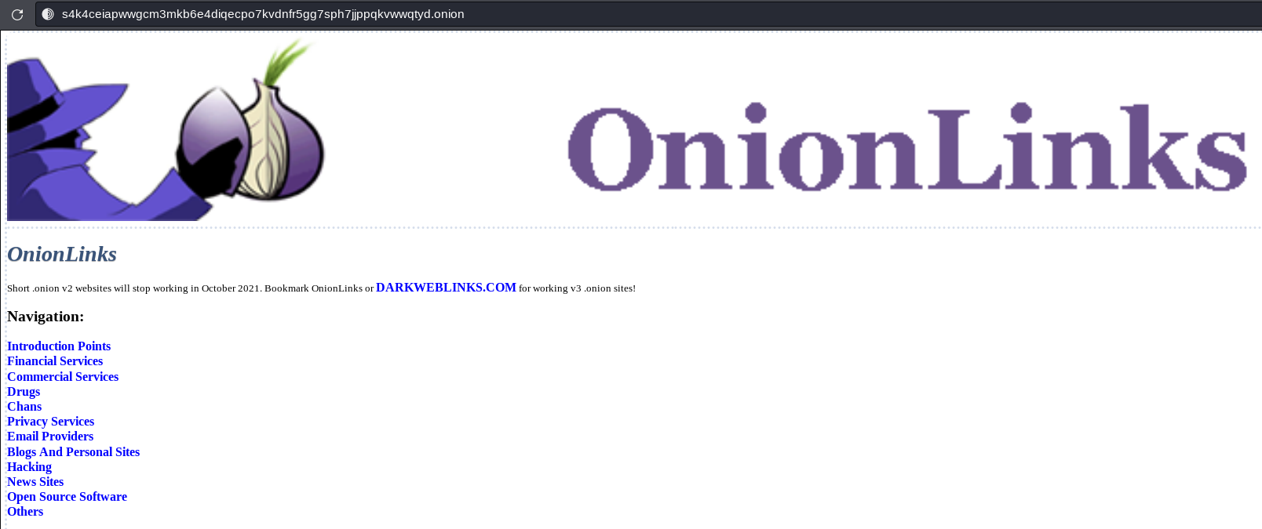
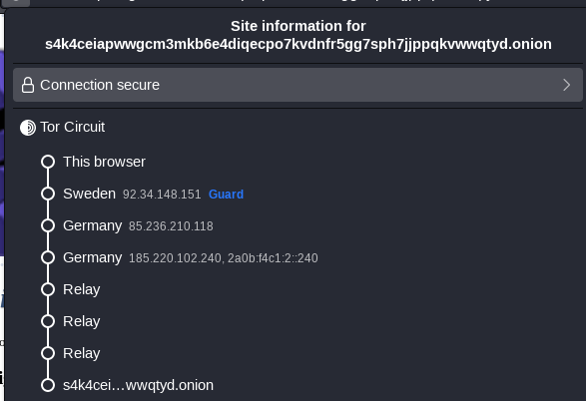
Example of an Onion site
Notes:
Talk about the onion address and how if tried to access using a normal browser it will not connect.

Slide 13
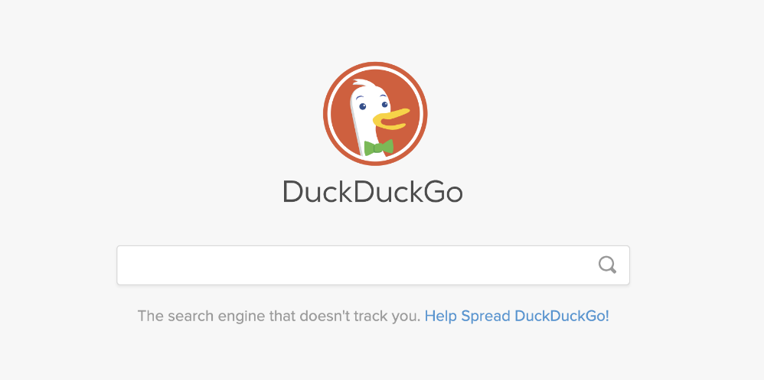
Tor Search engines
DuckDuckGo (Default Tor browser search engine)
Metager
Torch
Each of these have their own .onion address and focus on privacy and protection of the user.
Google and other normal search engines are not recommended due to tracking features.

Slide 14
Tor vulnerablities
Traffic analysis of exit nodes. This is performed across multiple exit nodes and traffic analysis is performed.
SSL-stripping where HTTP to HTTPS redirects are removed in order to gain access to the unencrypted HTTP traffic without displaying any warnings to the user
Unique identifying traffic within data packets could be analysed from exit nodes.
Tor is not a one stop shop for privacy it is a good tool but does not 100% guarantee privacy at all times.
Notes:
Speak about exit nodes set up by bad threat actors here.
Speak about ways in which APT or Gov agencies can analysis traffic from an exit node and perform correlation attacks on the network.

Slide 15
Helping out the Tor network
The Tor network is ran mostly by volunteers.
Donate to the Tor project.
To help the Tor network you can set up middle relay nodes or exit nodes and even bridges!
It is recommended to have a high bandwidth connection when running these nodes.
Things to be wary of when doing this though…
Quick personal story time around this.
Notes:
Speak about helping out the Tor network what you can do to help. Mention the exit nodes and your story here.

Slide 16
Research sources
https://research.torproject.org/
https://en.wikipedia.org/wiki/Tor_(network)
https://blog.insiderattack.net/deep-dive-into-tor-the-onion-router-6de4c25beba7
https://portswigger.net/daily-swig/tor-security-everything-you-need-to-know-about-the-anonymity-network
https://www.techtarget.com/whatis/definition/TOR-third-generation-onion-routing

Slide 17
Any Questions?
I hope you enjoyed the Talk!

