Slide 1
From Scratch to Python
Learn to program like the big boys / girls!

Slide 2
Starter
Please open your Python program from last lesson
You should have at least 3 inputs, 3 variables and 3 outputs (print statements)
You have the first 5 minutes of the lesson to finish or make improvements

Slide 3
Lesson Objectives
Lesson Objectives
Understand which data type a variable is.
Understand why a computer needs to know what the data type is for a given input/variable.
Learn how to change the data type of a variable.
Lesson Outcomes
Carry out a number of programming tasks to practice programming simple arithmetic.
Literacy – Key Words
Input | Values which get sent from the user into the computer
Variable | The place where inputs get stored by the program
Output | The values which get sent from the computer to the user

Slide 4
Review of last few lessons

Slide 5

Hands up if you can tell me the following…
The python code needed to display a word on the screen
The python code needed to ask the user for an input
The way python can store user inputs

Slide 6
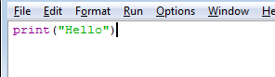
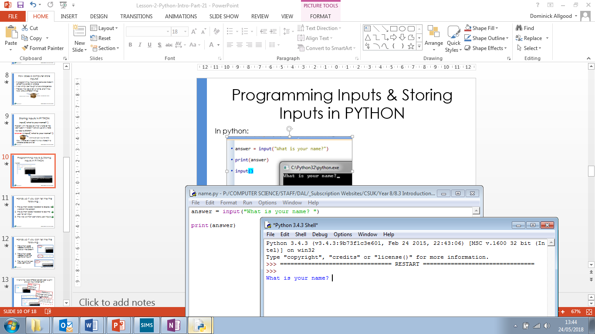
Hands up if you can tell me the following…
The python code needed to display a word on the screen?
The python code needed to ask the user for an input?
The way python can store user inputs?

Slide 7
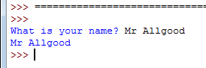
Programming Inputs & Storing Inputs in PYTHON
In python:

Slide 8
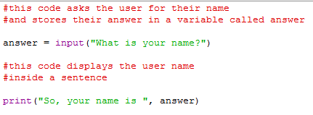
Commenting
#Starting a line with a hash will turn your text into a comment.
(It will be ignored by the program)

Slide 9
Today:
Data Types and Arithmetic

Slide 10
What is a data type
What different types of data are there?
String
This means any combination of keyboard characters (letters, numbers symbols)
Real
This means any decimal (fractional) number
Integer
This means any whole number. If the computer knows the data is an integer it can do maths with the data

Slide 11
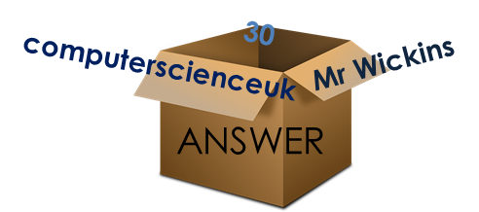
The need to tell the computer what data type the variable will store
Computers store values in variables
In order for the computer to understand our inputs, it needs to know what type of data our input is.
If a variable is to hold a word, we must tell the computer that the variable is to contain a string.
If a variable is to hold a whole number, we must tell the computer that the variable is to contain an integer – so it can do calculations.
If we don’t do this the program will not work.

Slide 12
Doing Arithmetic
If we want our program to work with numbers we must tell the program that certain variables will hold numbers.
When we input a number into our program
num1 = input(“please enter a number”)
python automatically sets the variable as a string (a word, for example twenty instead of 20)
If we want to do maths with the ‘inputs’ we need to tell the computer that the variable contains a number (integer)

Slide 13
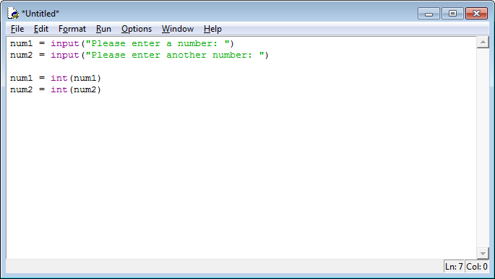
Converting Data Types
To do this we need to convert the variable to an ‘integer’ or ‘real’ data type.
Above you can see that two numbers have been entered and stored in variables num1 and num2.
As python stores inputs as strings we need to convert these variables into integers.

Slide 14
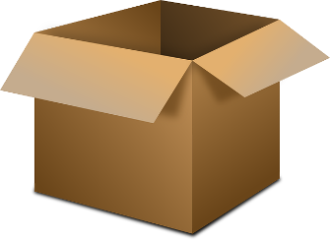

What’s going on?
Twenty Nine
Num1
I’m telling the computer that this variable contains a number not a word!
29
29
Twenty Nine
Variable
Variable
Mr Int.

Slide 15

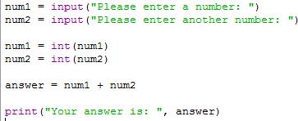

Once they have been converted we’re ready to do maths!
Five
Nine
Num1
Num2
5
9
Five
Nine
Num1
Num2
14
Answer
5
+
9
14
14
Answer

Slide 16
Tasks
Work your way through the arithmetic tasks in OneNote
Comment as you work through the tasks using the #
Place screen shots of your work into OneNote as you go.

