Slide 1
From Scratch to Python
Learn to program like the big boys / girls!

Slide 2
Lesson Objectives
Lesson Objectives
Remember how we program inputs/outputs/variables
Remember what a variable’s data type means
Remember how to tell the computer which data type a variable is
Learn how programs make decisions in Python
Lesson Outcomes
Carrying out a number of programming tasks.
Literacy – Key Words
Data Type | The type of data being used by the program
Variable | The place where inputs get stored by the program
Integer | “Whole Number” data type
Selection | A control structure which allows programs to make decisions

Slide 3
Starter On your white boards, write a program which asks the user for two numbers, adds then together, then displays the result.

Slide 4

Can you tell me the following…?
The python code needed to display a word on the screen
The python code needed to ask the user for an input
The way python can store user inputs

Slide 5
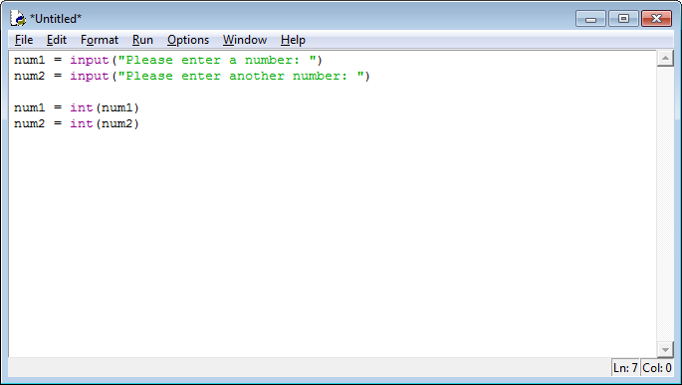
Dealing with numbers in Python The need to convert “Data Types”
Above you can see that two numbers have been entered and stored in variables num1 and num2.
As python stores inputs as strings we need to convert these variables into integers and to do this we have applied the int() function

Slide 6


What’s going on?
Twenty Nine
Num1
I’m telling the computer that this variable contains a number not a word!
29
29
Twenty Nine
Variable
Variable
Mr Int.

Slide 7

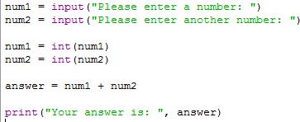

Once they have been converted we’re ready to do maths!
Five
Nine
Num1
Num2
5
9
Five
Nine
Num1
Num2
14
Answer
5
+
9
14
14
Answer

Slide 8
Decisions (Selection)

Slide 9
Decisions in Python Programs
The Virtual Barman
What would be needed to make a program which:
Acted like a barman, who had to make the decision on whether or not to serve the customer based on their age?

Slide 10
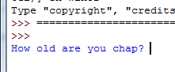
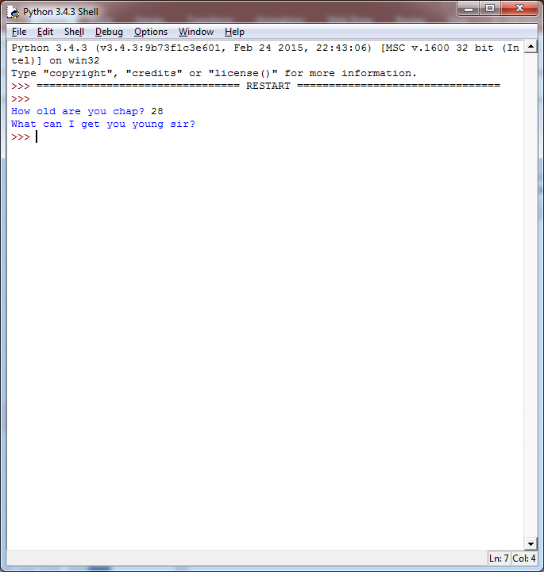
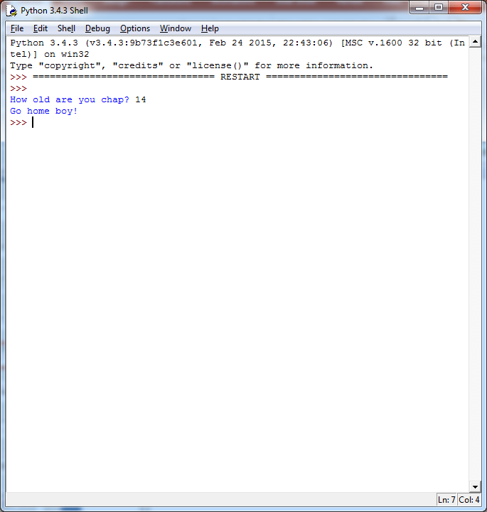
The Program At Work…
?
How

Slide 11
How would we start?
What would the barman do?
Ask the customer for their age
What must our program do?
Ask the user for their age!
How?
age = input(“What is your age?”)

Slide 12
Python and Integers?
age = input(“What is your age?”)
If python is to work with numbers what must we do to the input?
Convert the variable (age) to an integer data type!
How?
age = int(age)

Slide 13
What next?
If the real barman was told the customers age what would the barman do next?
MAKE A DECISION!

Slide 14
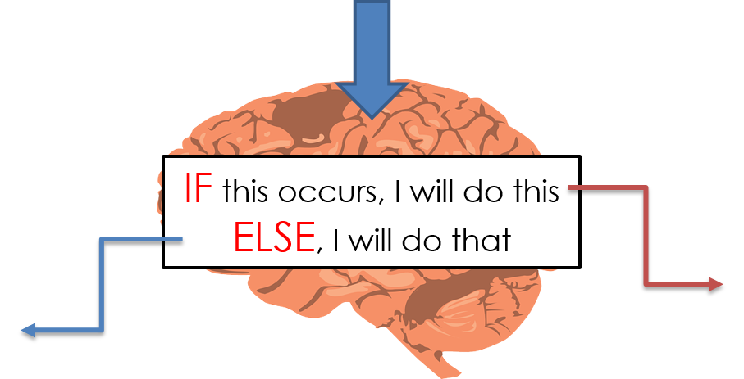
Selection
If we want the computer to make a decision based on our input we use “selection”.
Selection uses If – Else statements
Outcome 1
Outcome 2

Slide 15
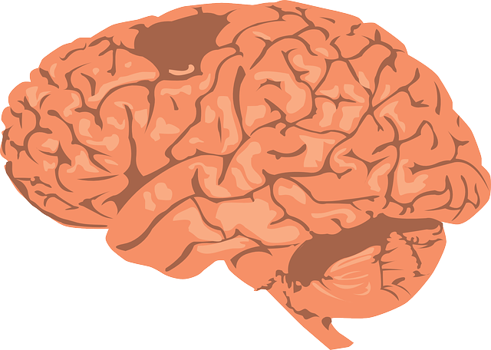
Our Program
What is your age?
IF age > 17 do this
ELSE, do that
“What can I get you?”
“Go home boy!”
IF – ELSE statements allow programs to make decisions based on certain conditions occurring.

Slide 16
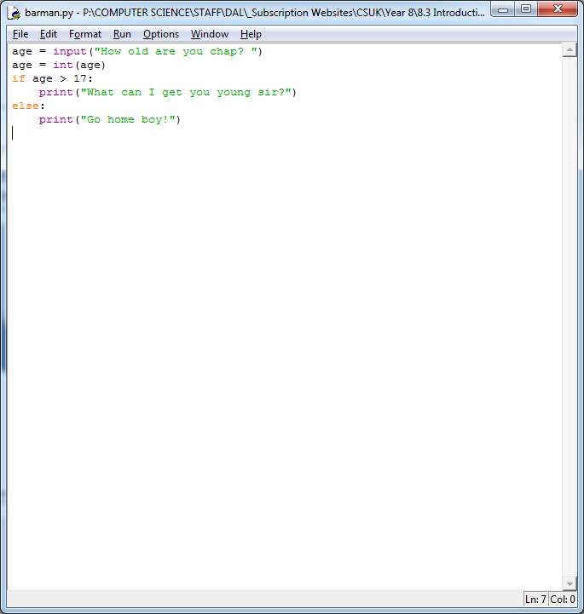
How are decisions programmed in Python?
Colons are needed at the end of each IF and ELSE statement
When you use selection statements you must indent accordingly.

Slide 17
So how can we program our Barman Program?
Write down your code on a whiteboard!
A Flowchart to Help!
START
A Solution:
Age?
Convert to Integer
IF Age > 17
DISPLAY “What can I get you young sir?”
DISPLAY “Go home boy!”

Slide 18
Comparison Operators
In IF statements we will be looking to compare some data.
We might want to see if a variable is equal to a number or a piece of text.
We might want to see if a variable contains a number greater than another
Or contains a number smaller than another.
In python we use certain symbols to compare data.
To see if something is mathematically equal to another we use a double equals sign (==)
To see if a variable contains a number greater than another we use the greater than symbol (>)
To see if a variable contains a number smaller than another we use the less than symbol (<)

Slide 19
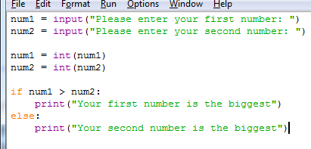
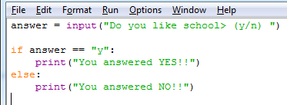
How do these two pieces of code differ?

Slide 20
Tasks
Create your own BARMAN program using IF Statements
Comment your code!! Using # comments
Have a go at the challenges in OneNote.
Work through the worksheet producing

