Slide 1
Python

Slide 2
brief history of Python
It was created in 1990 by Guido van Rossum,
Python 3.0 was released in 2008 with subsequent releases such as 3.1, 3.2 and so on.
When developed by Guido van Rossum, was specifically designed as an easy to use language with a very high focus on readability of code.

Slide 3
why would you want to choose Python?

Slide 4
IDLE – AN INTERPRETER FOR PYTHON
IDLE stands for Integrated Development and Learning Environment.
Python IDLE comprises Python shell and Python Editor.
While Python shell is an interactive interpreter, Python Editor works in script mode.
using Python shell
type Python code at the >>> prompt
>>> print('hello world')
Python shell will display:
hello world
>>> 18 + 5 23

Slide 5
Python operator //
In Python, all forms of data are called values or objects.
For example, 18, 5, and 23 are objects.
18 + 5 23.
27 / 5 5.4.
the result is real number. In Python, result of division is always a real number.
However, if you wish to obtain an integer result
floor(5.4)) or
Python operator //
27 // 5 5
However, while using the operator //, if one of the two operands is a real number; the result is a real number, for example, the expression 27.0 // 5 5.0.

Slide 6
% modulus, yields the remainder of the division
27% 5 2
exponentiation operator (**)
3 ** 2 9
2 ** -1 0.5

Slide 7
Associativity of operators
6 / 3 / 2 1.0 (= (6 / 3) / 2)
2 ** 3 ** 2 512 (= 2 ** (3 ** 2)).
This is so because whereas the operator / (as also +, -, *, //, %) is evaluated left to right,
the exponentiation operator is evaluated right to left.
the operators, +, -, *, /, //, and %, are left associative operators and the operator ** is right associative.

Slide 8
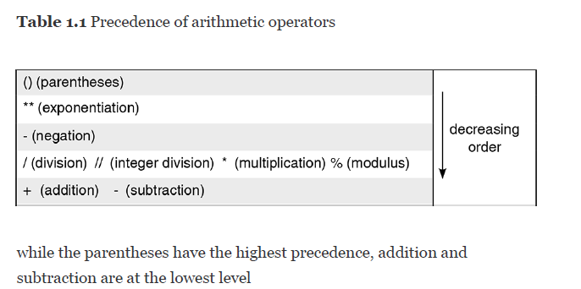
10 * -5 multiplies 10 and -5 yielding -50
7 + 4 * 3 yeilds 19 7 + (4* 3)
because the operator * has higher precedence than +.

Slide 9
(7 + 3) * 10 / 5 ?

Slide 10
PYTHON STRINGS
A string is a sequence of characters.
may enclose a sequence of characters between single, double, or triple quotes.
single quotes may include double quote marks and vice versa.
A string enclosed in triple quotes ( docstring, documentation string) may include both single and double quote marks and may extend over several lines,

Slide 11
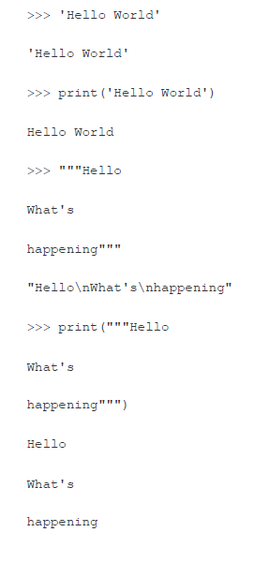

Slide 12
basic operations on strings
Let us begin with the concatenation operator (+), which is used to produce a string by concatenating two strings;
'hello ' + '!!' yields 'hello !!'.
Similarly,
'how' + ' are' + ' you?' yields 'how are you?'
>>> 'hello ' + '!!' 'hello !!'
>>> 'how' + ' are' + ' you?‘ 'how are you?'
escape sequence \n marks a new line

Slide 13
The operator * (multiplication) is used to repeat a string a specified number of times;
for example,
'hello' * 5 yields the string 'hellohellohellohellohello':
>>> 'hello' * 5 'hellohellohellohellohello'

Slide 14
Relational operators
used for comparing two expressions and yield True or False.
the arithmetic operators have higher precedence than the relational operators.

Slide 15
23 < 25 True
23 != 23 False
23 - 2.5 >= 5 * 4 True
23 - 2.5 >= 5 * 4 is evaluated as if it were (23 - 2.5) >= (5 * 4).
When the relational operators are applied to strings, strings are compared left to right, character by character, based on their
ASCII codes,
For example, ASCII codes of 'A'- 'Z', 'a'-'z', and '0'-'9' lie in the range [65, 90], [97, 122], and [48, 57], respectively.
Thus, 'h' > 'H' yields True as ASCII value of 'h' > ‘H’
‘hi’ > 'hello' is True because the first character in the two strings is identical and ASCII code of 'i' is greater than ASCII code of 'e‘
Also, if a string is a prefix of another string, the longer string will be considered larger.

Slide 16
Precedence of logical operators

Slide 17
short-circuit evaluation of Boolean expression.
While evaluating an expression involving an and operator, the second sub-expression is evaluated only if the first sub-expression yields True.
For example, in the expression (10 < 5) and ((5 / 0) < 10),
(10 < 5) yields False, Python does not evaluate the second sub-expression.
However, the expression (10 > 5) and ((5 /0) < 10) yields an error since the first sub-expression yields True, and Python attempts to evaluate the second sub-expression
((5 / 0) < 10) that yields an error because division by zero is an illegal operation:

Slide 18
Similarly, while evaluating an expression involving an or operator, the second sub-expression is evaluated only if the first sub-expression yields False
(10 > 5) or ((5 / 0) < 10) True,
the expression (10 < 5) or ((5 / 0) < 10) error.

Slide 19
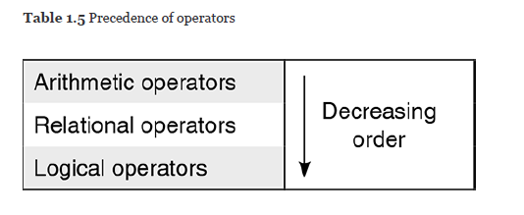
To evaluate an expression comprising arithmetic, relational, and logical operators, the operators are applied according to precedence order for the operators given in Table 1.5.

Slide 20
not 9 == 8 and 7 + 1 != 8 or 6 < 4.5 is evaluated
(True and ((7 + 1) != 8)) or (6 < 4.5)
(True and (8 != 8)) or (6 < 4.5)
(True and False) or (6 < 4.5)
False or (6 < 4.5)
False or False
False

Slide 21
Bitwise operators
Bitwise operators are the operators that operate on integers interpreted as strings of binary digits 0 and 1, also called bits.

Slide 22
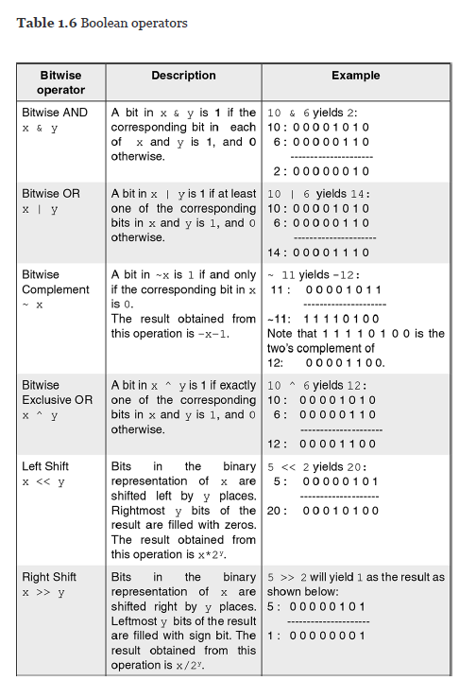

Slide 23
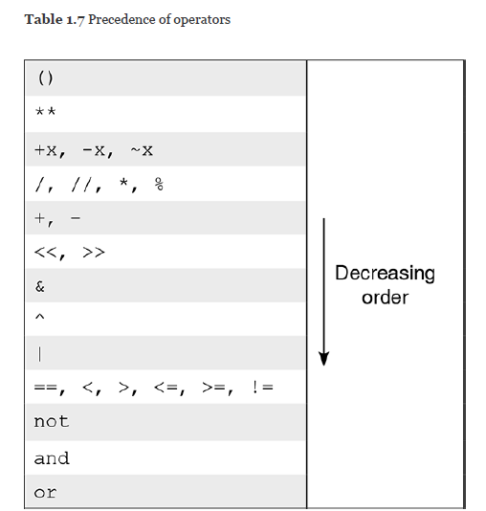

Slide 24
Variables
In Python style (often called Pythonic style, or Pythonic way), variables are called names, and an assignment is called an association or a binding. Thus, we say that the name english has been associated with the data object
>> english = 57
Thus, we say that the name english has been associated with the data object 57, or that the variable english has been bound to the data object 57.
>>> english 57

Slide 25
rules for naming variables
A variable must begin with a letter or _ (underscore character)
A variable may contain any number of letters, digits, or underscore characters. No other character apart from these is allowed.
marks name
max_marks _emp
maxMarks n1
max_of_3_numbers are valid variables.

Slide 26
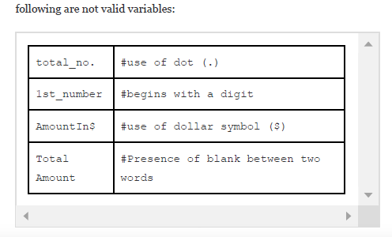

Slide 27
total_marks TotalMarks
totalMarks TOTAL_MARKS
always use meaningful variable names
we prefer to use the lowerCamelCase style in which the first letter of every word is capitalized, except the first word which begins with a lowercase letter,
for example, totalMarks. important to note that Python is case-sensitive.
age and Age are different variables.

Slide 28
a shorthand notation
>> a = a + 5
Alternatively, we can write the above statement as
>>> a += 5
Thus, the operator += serves as shorthand notation in assignment statement.
>>> a = a + b + c
>>> a += b + c
>>> a = a ** (b + c)
>>> a **= b + c

Slide 29
multiple assignments in a single statement
for example, the following sequence of three assignment statements
>>> msg = 'Meeting'
>>> day = 'Mon'
>>> time = '9'
may be replaced by a single statement:
>>> msg, day, time = 'Meeting', 'Mon', '9'
Formally, the syntax for an assignment statement may be described as follows:
<name1>, <name2>, ..., <nameK> = <expr1>, <expr2>,
..., <exprK>

Slide 30
common value to multiple variables, for example, the assignment statement
>>> totalMarks = count = 0

Slide 31
Suppose we wish to swap values of two variables, say, num1 and num2.
>>> num1, num2 = 10, 20
>>> temp = num1
>>> num1 = num2
>>> num2 = temp
>>> print(num1, num2) 20 10
Alternatively, we can use the following statement to swap the values of two variables:
>>> num1, num2 = num2, num1

Slide 32
SCRIPT MODE
So far, we have done all work using Python shell, an interactive environment of IDLE.
Python provides another way of working called script mode. Create file called a source file script, program, source code, or a module.
Python requires that such a file must have extension .py or .pyw.

