Slide 1
CONTROL STRUCTURES

Slide 2
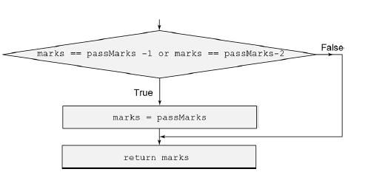
if Conditional Statement
To pass the examination, a student must secure pass marks (say, 40).
Before announcing the results, the teacher decides to moderate the results by giving maximum of two grace marks.
Thus, if the student has scored 38 or 39 marks, he or she would be declared to have scored 40 marks.

Slide 3
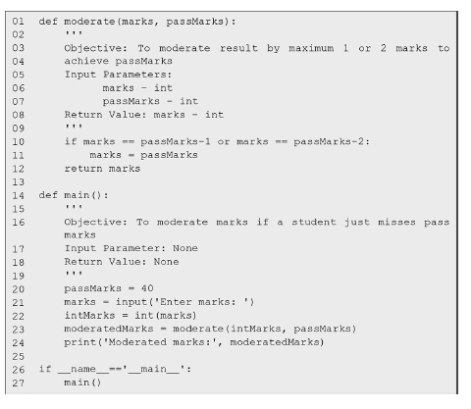

Slide 4
set passMarks equal to 40
The next statement user enters the marks obtained by a student which will be of type str, we transform it to an integer quantity intMarks using the function int.
In line 23, we invoke the function moderate defined in lines 1–12 With the arguments intMarks and passMarks.
Inside the function moderate (line 10),
Next, the function moderate returns marks to the main function.
The value returned by the function moderate is assigned to the variable moderatedMarks (line 23).
Finally, we print moderatedMarks in line 24.

Slide 5
The general form of if conditional statement is as follows:
if < condition >:
< Sequence S of statements to be executed >

Slide 6
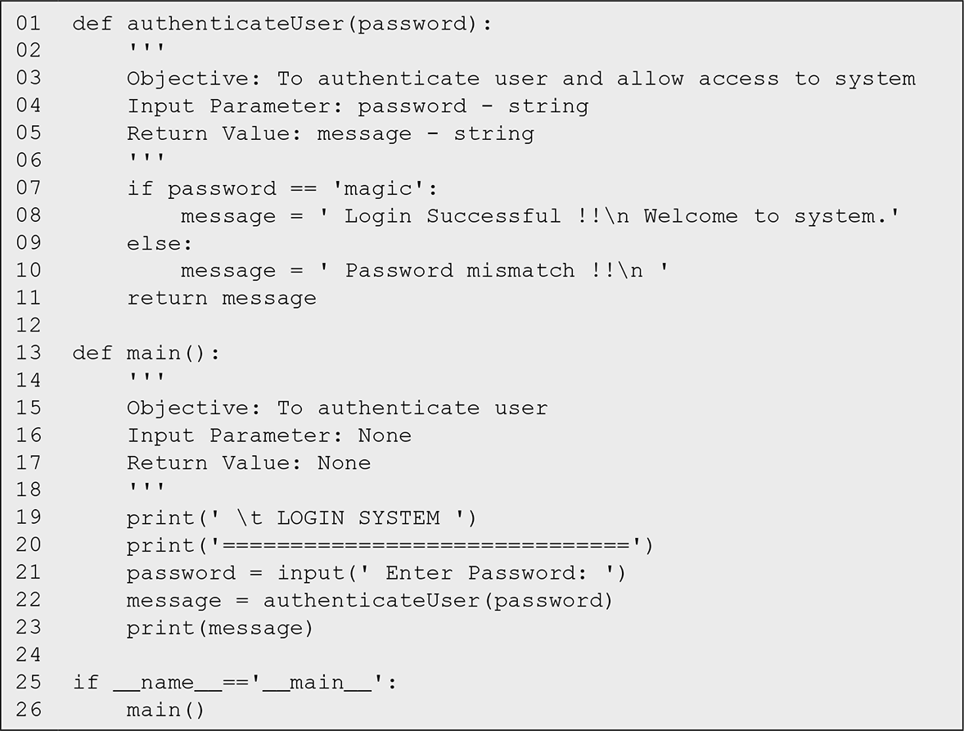

Slide 7
<expression1> if <condition> else < expression2>
If the condition holds True, the conditional expression yields the value of expression1, otherwise, it yields the value of expression2.
For example, the following piece of code
if password == 'magic':
message = ' Login Successful !!\n '
else:
message = ' Password mismatch !!\n '
may be replaced by
message = ' Login Successful !!\n ' if password == 'magic' else ' Password mismatch !!\n '

Slide 8
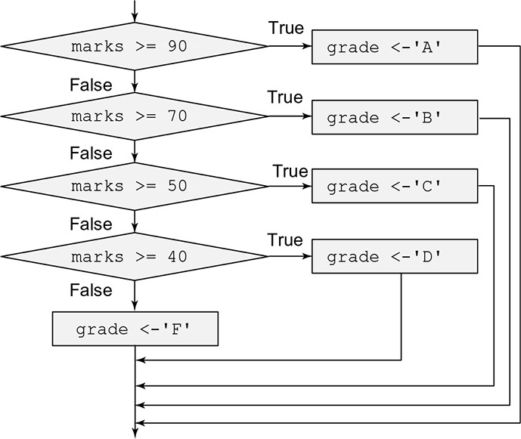

Slide 9
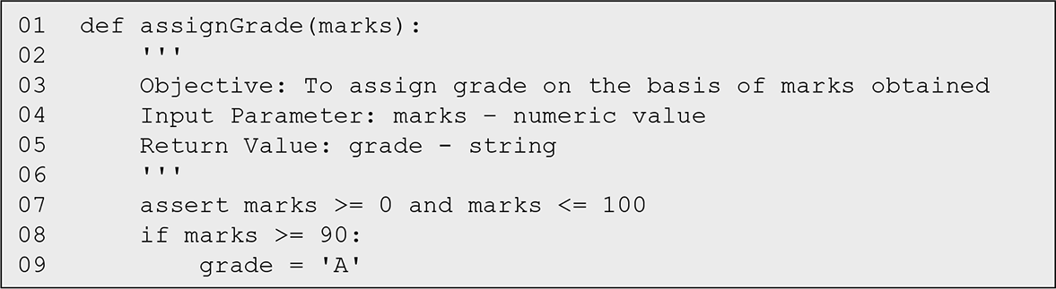
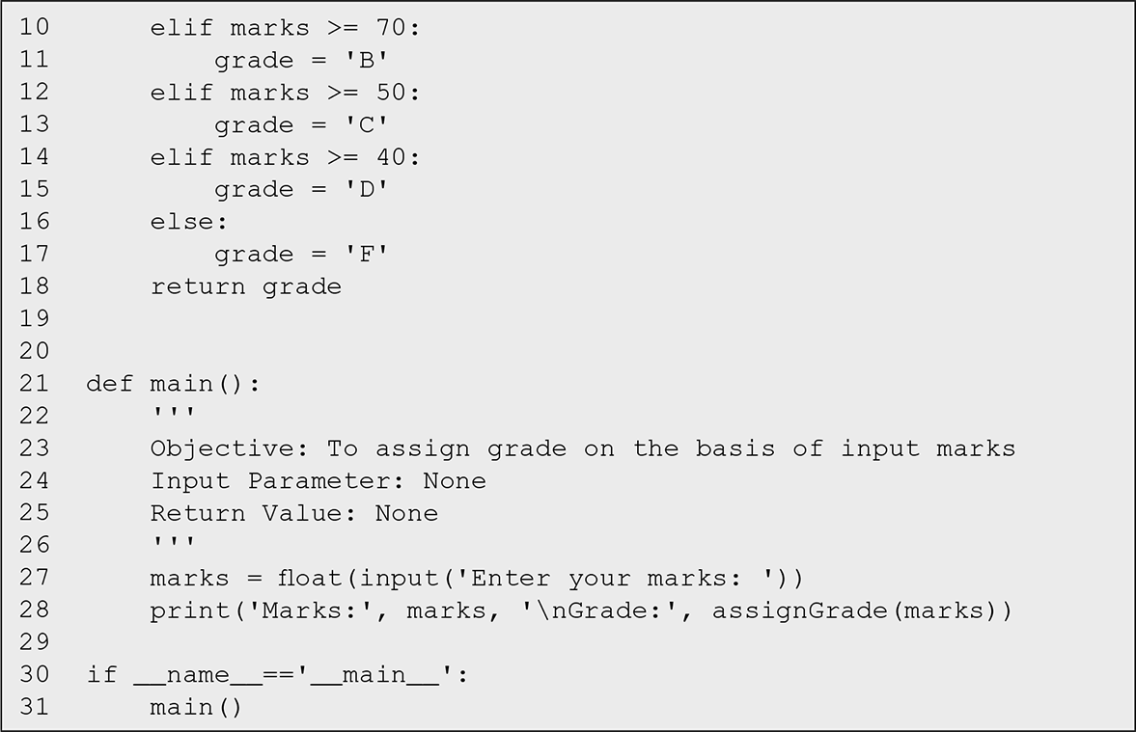

Slide 10
General Form of if-elif-else Conditional Statement
The general form of if-elif-else statement is as follows:
if < condition1 >:
< Sequence S of statements to be executed >
elif < condition2 >:
< Sequence S2 of statements to be executed >
elif < condition3 >:
< Sequence S3 of statements to be executed >
.
.
.
else:
< Sequence Sn of statements >

Slide 11
Nested if-elif-else Conditional Statement
finds the maximum of three numbers using nested structure.

Slide 12
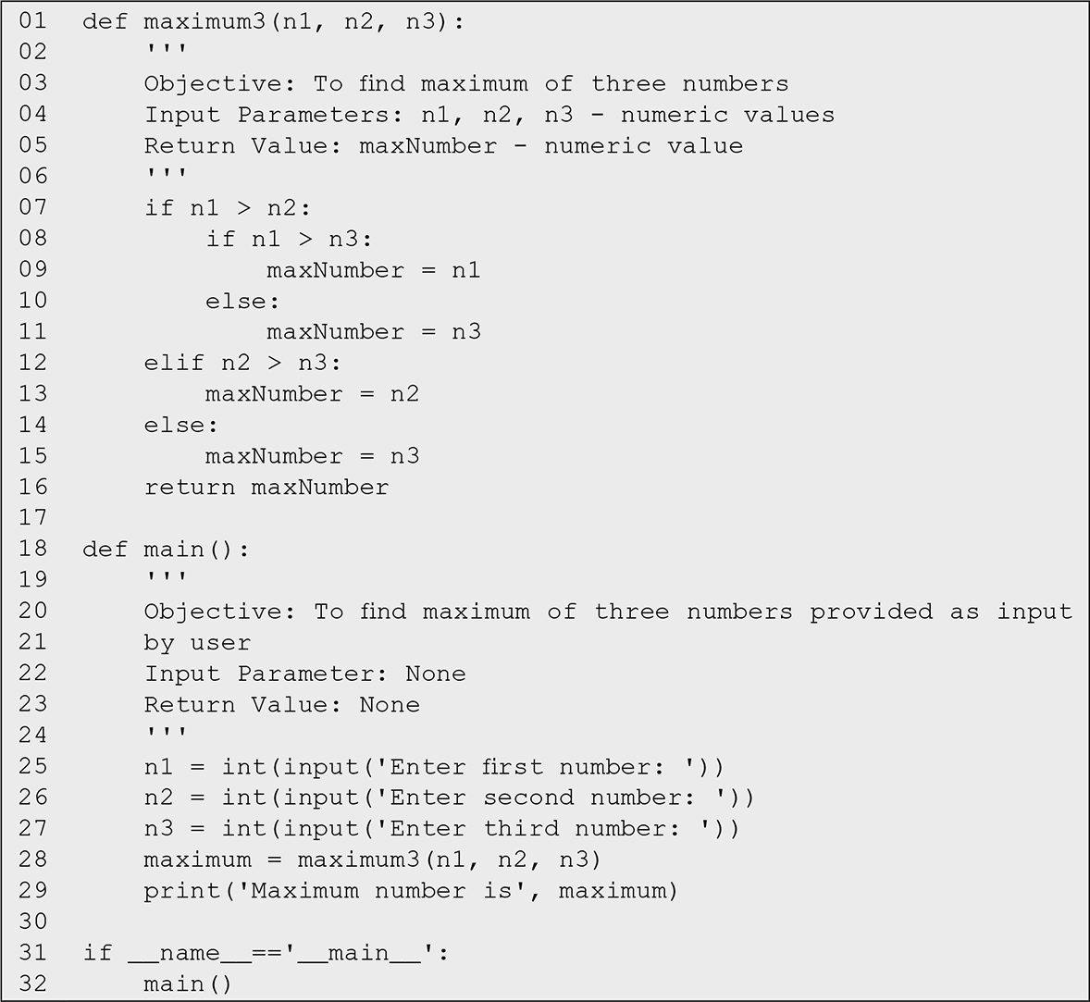

Slide 13
We can simplify the above program using nested function approach. We define a function max2 that takes two numbers as an input and computes their maximum. Next, we make use of max2 to define the function max3 that finds the maximum of three numbers. We say that the function max2 is nested within the function max3. The functions max2 and max3 are known as inner function and outer function, respectively.

Slide 14
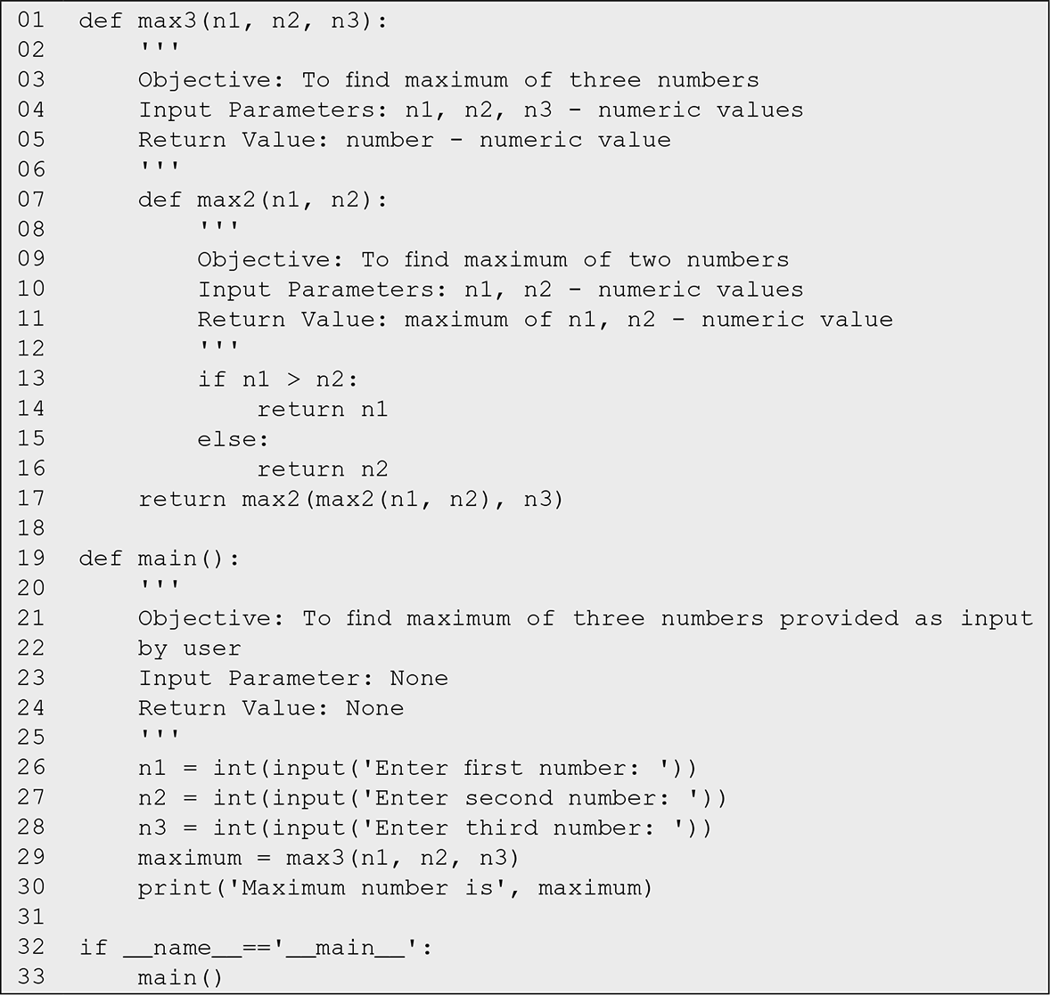

Slide 15
ITERATION (FOR Loop STATEMENTS)

Slide 16
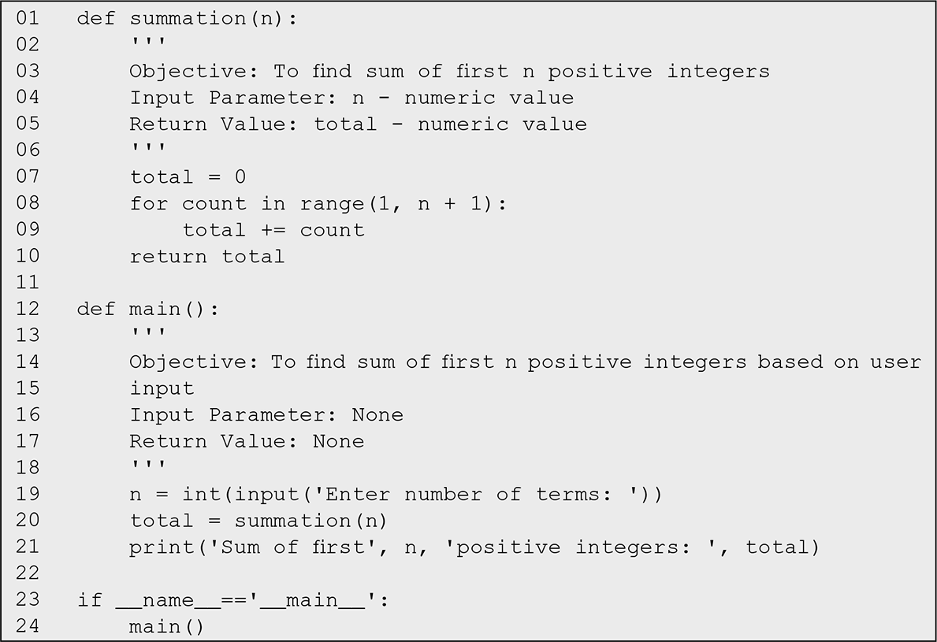

Slide 17
for loop: used to execute a sequence of instructions a fixed number of times
In the function summation the variable total is initialized to zero. Next, for loop is executed. The function call range(1,n + 1) produces a sequence of numbers from 1 to n. This sequence of numbers is used to keep count of the iterations. In general,
range(start, end, increment)
range function generates a sequence of integers
returns an object that produces a sequence of integers from start up to end (but not including end) in steps of increment.
If the third argument is not specified, it is assumed to be 1. If the first argument is also not specified, it is assumed to be 0.
Values of start, end, and increment should be of type integer. Any other type of value will result in error. Next, we give some examples of the use of range function:

Slide 19
we develop a program to read and add the marks entered by the user in n subjects, and subsequently use the total marks so obtained to compute the overall percentage of marks

Slide 20
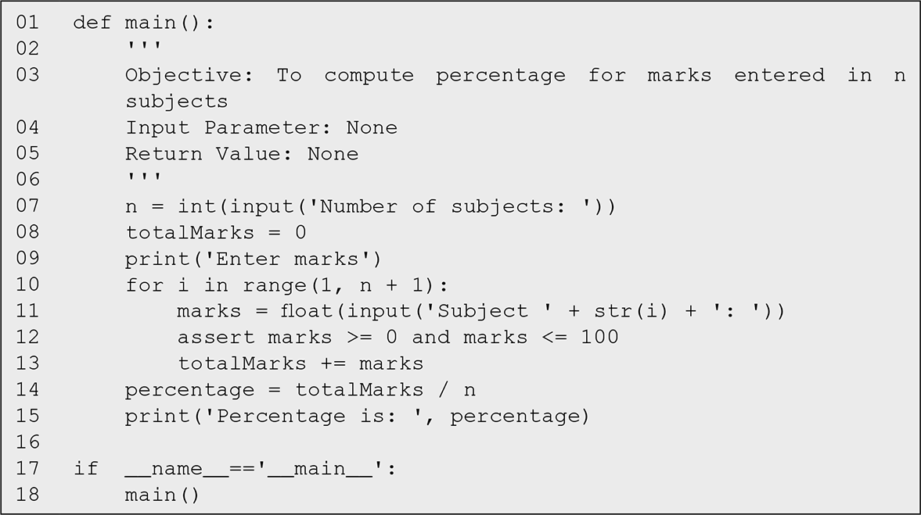

Slide 21
Right aligning the output
By default Python output is aligned on the left-hand side,
>>> print(7)
7
>>> print(100)
100
However, the numeric output looks good, if aligned on the right-hand side.
For this purpose, we need to specify how many places we would like to reserve for printing a value, for example, the format string '%5d' may be used to indicate that at least five positions are to be reserved for an integer value.
>>> '%5d'% 45
' 45‘
>>> print('%5d'% 45)
45
>>> print('%5d'% 12345)
12345

Slide 22
develop a function to print a multiplication table for a given number.

Slide 23
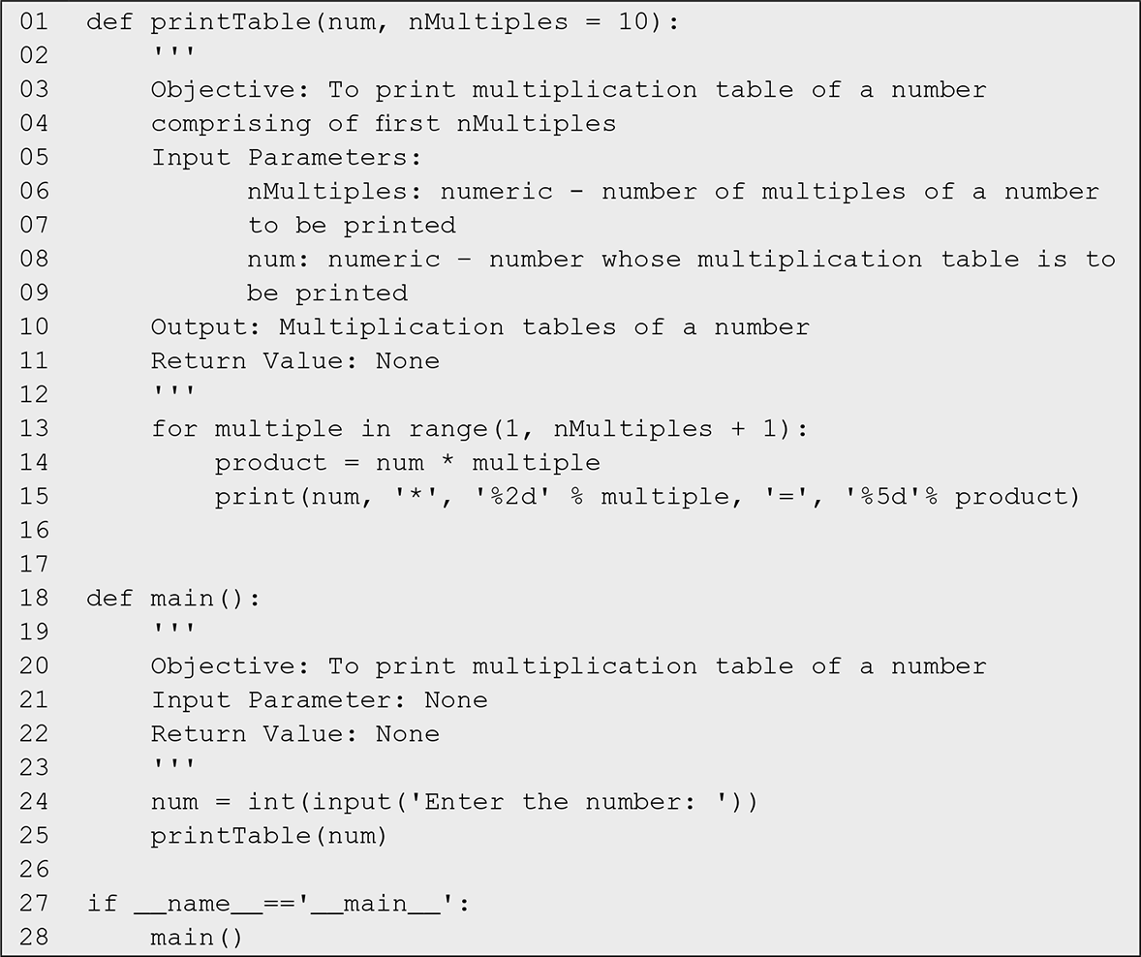

Slide 24
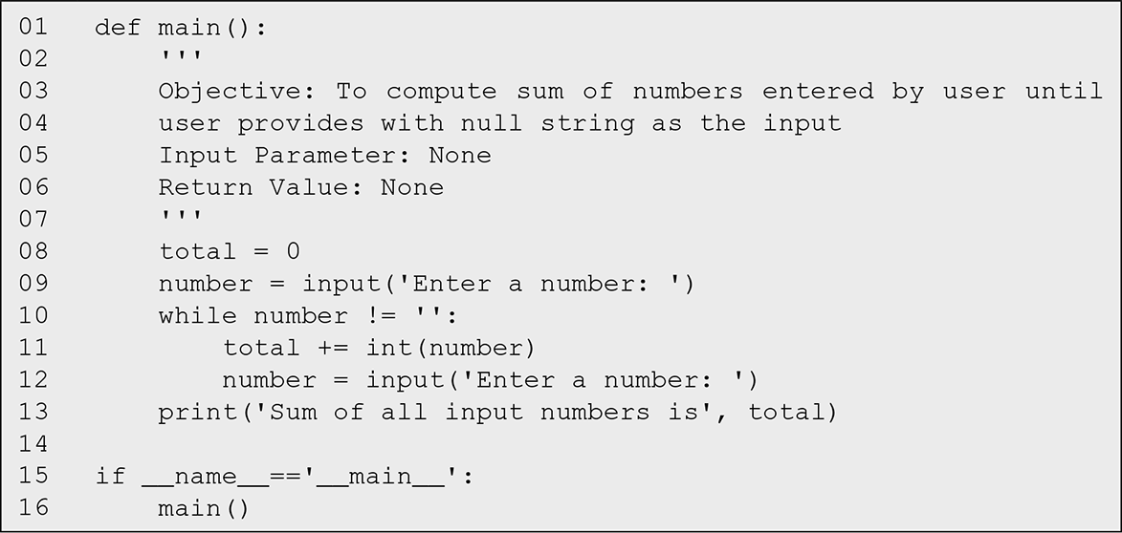
while Loop

Slide 25
while Statement vs. for Statement
for count in range(1, n + 1):
total += count
count = 1
while count < n+1:
total += count
count += 1
not a wise idea: rewriting for loop using while

Slide 26
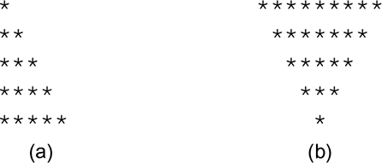
the script triangle that serves this purpose. In this program, the user needs to enter his/her choice of figure 1 or 2 depending on whether he or she wants to print a right triangle or an inverted triangle.

Slide 27
However, we may make the above program more general by printing the figures made using a character provided by the user. For this purpose, the function rightTriangle may be modified as follows

Slide 28
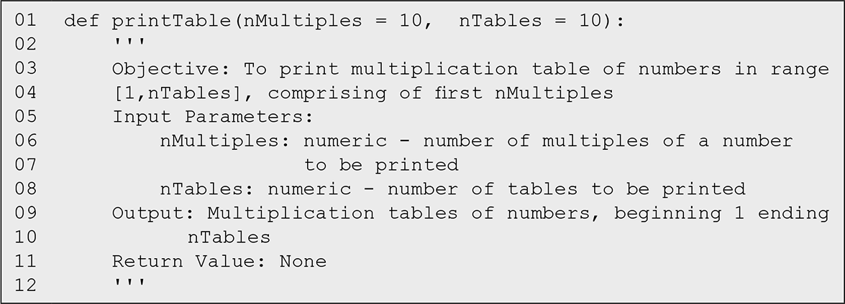
develop a function to print multiplication tables

Slide 29
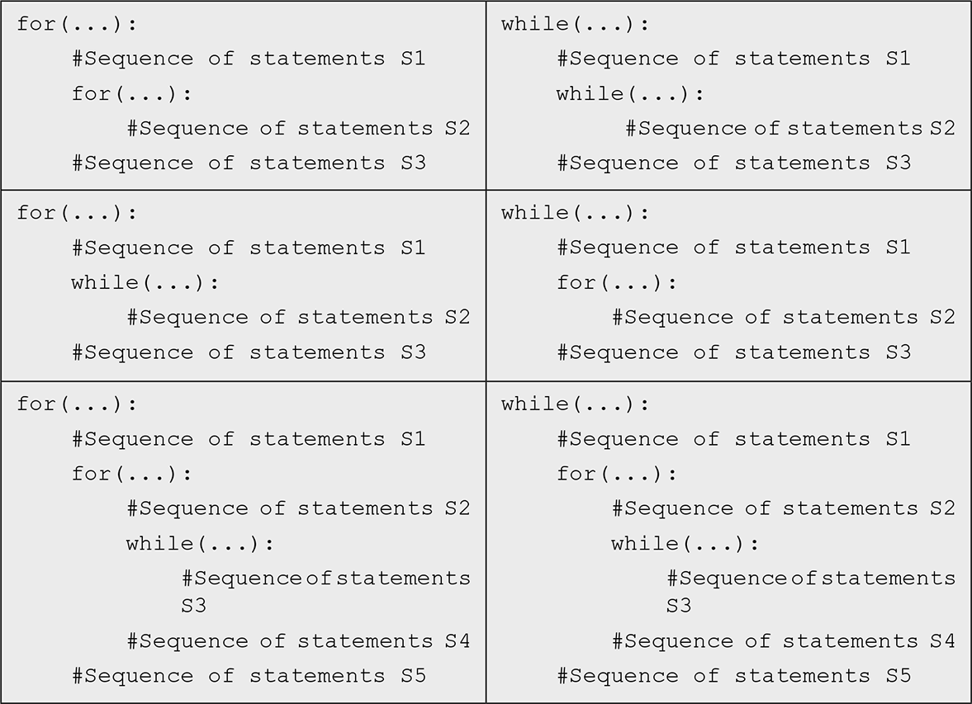

Slide 30
TestBooleanOperators.py
1 # Receive an input
2 number = eval(input("Enter an integer: "))
3
4 if number % 2 == 0 and number % 3 == 0:
5 print(number, "is divisible by 2 and 3")
6
7 If number % 2 == 0 or number % 3 == 0:
8 print(number, "is divisible by 2 or 3") 9
10 if (number % 2 == 0 or number % 3 == 0) and \
11 not (number % 2 == 0 and number % 3 == 0) :
12 print(number, "is divisible by 2 or 3, but not both")
In line 4, number % 2 == 0 and number % 3 == 0 checks whether the number is divisible by 2 and 4. number % 2 == 0 or number % 3 == 0 (line 7) checks whether the number is divisible by 2 or 4. The Boolean expression in lines 10–11
(number % 2 == 0 and number % 3 == 0) and
not (number % 2 == 0 and number % 3 == 0)
checks whether the number is divisible by 2 or 3 but not both.

Slide 31
not (condition1 and condition2) is the same as
not condition1 or not condition2
not (condition1 or condition2) is the same as
not condition1 and not condition2
So, line 11 in the preceding example,
not (number % 2 == 0 and number % 3 == 0)
can be simplified by using an equivalent expression:
(number % 2 != 0 or number % 3 != 0)
As another example,
not (number == 2 or number == 3)
is better written as
number != 2 and number != 3

