Slide 1
序列推荐
sequence-aware recommendation
汇报人：杨扬
导师：张明卫

Slide 2
01
研究背景
02
基本概念
Research Background
Basic Conception
目录
CONTENTS
03
算法描述
04
参考文献
Algorithm Description
References

Slide 3
PART
ONE
研究
背景

Slide 4
研究背景
随着当今技术的飞速发展，数据量也与日俱增，人们越来越感觉在海量数据面前束手无策。正是为了解决信息过载(Information overload)的问题，人们提出了推荐系统（与搜索引擎对应，人们习惯叫推荐系统为推荐引擎）。当我们提到推荐引擎的时候，经常联想到的技术也便是搜索引擎。这两者都是为了解决信息过载而提出的两种不同的技术，一个问题，两个出发点。
推荐引擎倾向于人们没有明确的目的，或者说他们的目的是模糊的，通俗来讲，用户连自己都不知道他想要什么，这时候正是推荐引擎的用户之地，推荐系统通过用户的历史行为或者用户的兴趣偏好或者用户的人口统计学特征来送给推荐算法，然后推荐系统运用推荐算法来产生用户可能感兴趣的项目列表[1]。
[1] https://zhuanlan.zhihu.com/p/27502172

Slide 5
研究背景
传统的推荐系统使用协同过滤和基于内容的过滤，与之不同的是，序列推荐系统试图去理解和构建一个序列模型，这个序列中包括了使用者行为习惯，用户与商品的交互，用户偏好的发展，商品流行的时间。序列推荐系统包含了以上几个方面，以便更加精确地描述用户的信息、意图和目标以及商品的消费趋势等特征，从而进行更加准确、个性化和动态地推荐。

Slide 6
PART
TWO
基本
概念

Slide 7
基本概念
Inputs
Timestamped list of past user actions
The inputs can be considered as a sort of enriched clickstream data
User information
Outputs
The outputs are similar to those of a traditional “item-ranking” recommendation setup

Slide 8


基本概念
Computational Tasks
Sequential pattern; Reason about order constraints
Abstract Characterization
Main task
Set of users
Set of possible lists

Slide 9
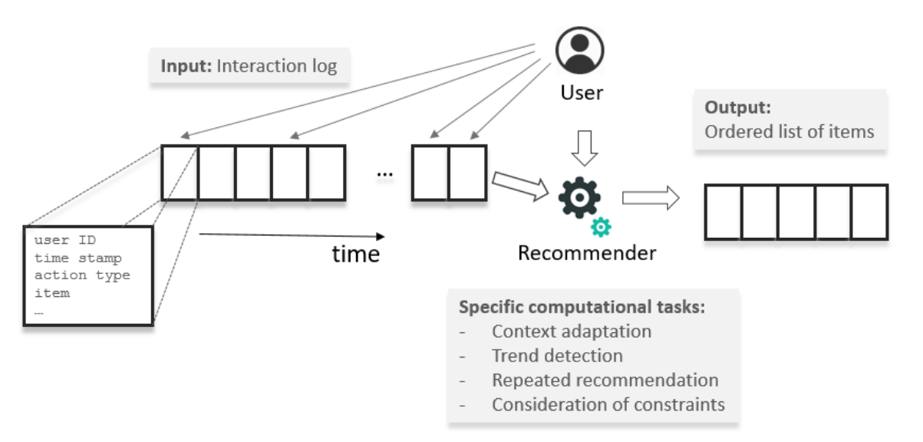
基本概念
High-level Overview of Sequence-Aware Recommendation

Slide 10
基本概念
CATEGORIZATION OF TASK
Context Adaptation
Trend Detection
Repeated Recommendation
Consideration of Order Constraints and Sequential Patterns

Slide 11
基本概念
1. Context Adaptation
Not only use the users’ general preferences, but also use their current situation and their short-term intents and interests.
Not directly observable
have to be derived from the users most recent actions and eventually on behavioral patterns of the user and the community as a whole
Understanding the users’ situation and goals and making context-adapted recommendations from past interaction data

Slide 12
基本概念
1.1 Last-N interactions based recommendation
Only the last N user actions are considered
Predict the next location
1.2 Session-based recommendation
Only the last sequence of actions of a user is known and this sequence of actions is limited to a session
a limited period of time when the user interacted with the site
News recommendation; Advertisement recommendation

Slide 13
基本概念
1.3 Session-aware recommendation
We have knowledge both about the users’ actions in the last session and about their past behavior
Customers can be identified
App recommendation

Slide 14
基本概念
2. Trend Detection
The detection of trends in a given sequence dataset is another potential, but less explored, goal that can be accomplished by sequence-aware recommenders.
2.1 Community Trends
Considering the popularity of items within a user community
2.2 Individual Trends
Changes in the interest in certain items can also happen at an individual level

Slide 15
基本概念
3. Repeated Recommendation
In some application domains, recommending items that the user already knows or has purchased in the past can be meaningful
3.1 Identifying repeated user behavior patterns
Past interaction logs can be used by sequence- aware recommenders to identify patterns of repeated user behavior
Consumables; individual users; community
3.2 Repeated recommendations as reminders
Remind users of things they found interesting in the past
Proper time

Slide 16
基本概念
4. Consideration of Order Constraints and Observed Sequential Patterns
Besides the identification of sequential patterns from past data to select and rank items, an additional task for the recommender is to ensure that such strict and weak order constraints are respected in the resulting lists
Learning courses; movie

Slide 17
基本概念
ALGORITHMS FOR SEQUENCE-AWARE RECOMMENDER SYSTEMS
Sequence Learning
Frequent Pattern Mining (FPM)
Sequence modeling
Distributed Item Representations
Supervised Learning with Sliding Windows
Sequence-aware Matrix Factorization
Hybrid methods
Other methods
Graph-based methods
Discrete optimization methods

Slide 18
PART
THREE
算法描述

Slide 19



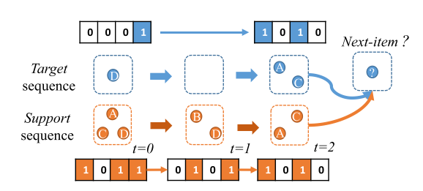
Algorithm Description——Twin network(Next Item)
Definition about sequence data
Set of items
a basket of items “adopted” at time step t
Data
Basket vectors
Target sequence
Support sequence
Example representations of target and support sequences

Slide 20
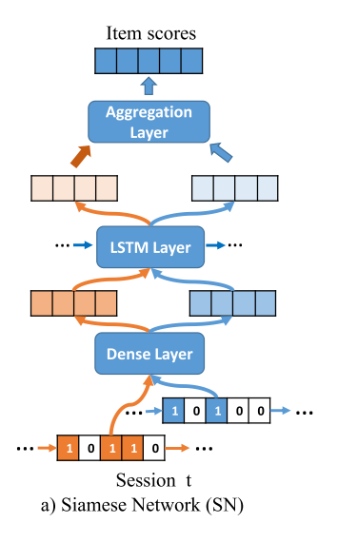





Algorithm Description——Twin network
CBS with Siamese Networks (CBS-SN)
CBS(Contemporaneous Basket Sequences)
Aggregation layer
Softmax function
recurrent encoder
Basket encoder
map a basket’s binary vector Xt into its hidden representation bt

Slide 21
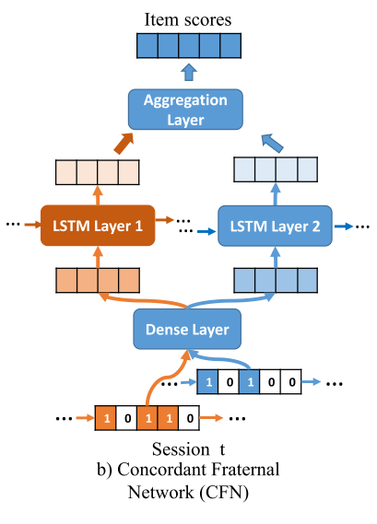

Algorithm Description——Twin network
CBS with Concordant Fraternal Networks (CBS-CFN)
Different weights
Click is low-cost while purchase require a larger commitment of resources

Slide 22
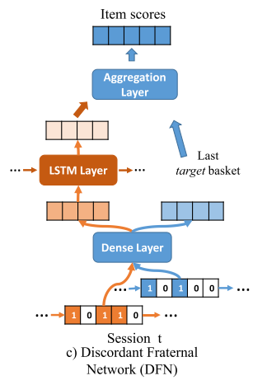

Algorithm Description——Twin network
CBS with Discordant Fraternal Networks (CBS-DFN)
Browsing and clicking may have longer-term dependency than purchases

Slide 23


Algorithm Description——Personalized top-N sequential recommendation via CNN
Definition about Algorithm
Set of users
Universe of items
Set of items about user u
ConvolutionAl Sequence Embedding Recommendation Model
Caser
1.Embedding look-up 2. Convolutional Layers 3. Fully-connected Layers

Slide 24
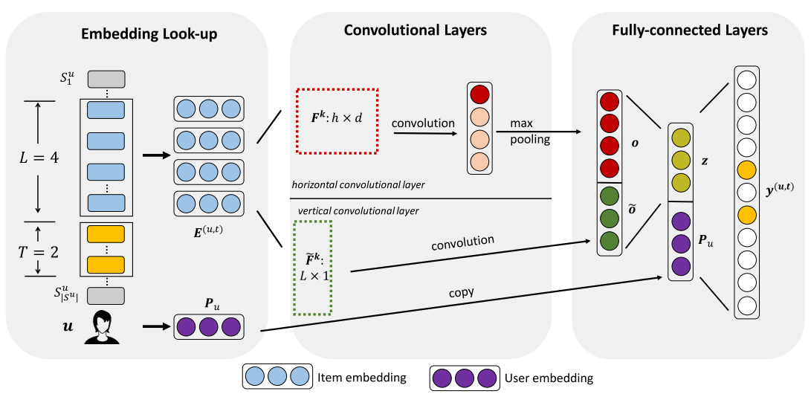
Algorithm Description——Personalized top-N sequential recommendation via CNN
The network architecture of Caser

Slide 25
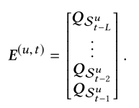
Algorithm Description——Personalized top-N sequential recommendation via CNN
Embedding Look-up

Slide 26






Algorithm Description——Personalized top-N sequential recommendation via CNN
Horizontal Convolutional Layer
N horizontal filters
Vertical Convolutional Layer
N vertical filters

Slide 27
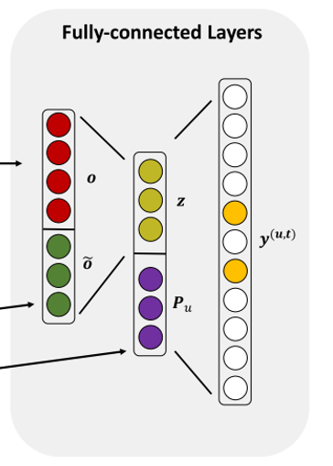


Algorithm Description——Personalized top-N sequential recommendation via CNN
Fully-connected Layers

Slide 28

Algorithm Description——Exploiting music play sequence for music recommendation
Loss Function
Set of music play sequence
P(si+j|si) denotes the probability of observing a neighboring song si+j given the current song si

Slide 29

Algorithm Description——Exploiting music play sequence for music recommendation
Loss Function
Set of music play sequence
P(si+j|si) denotes the probability of observing a neighboring song si+j given the current song si

Slide 30



Algorithm Description——Exploiting music play sequence for music recommendation
Objective Function
similarity between song i and song j
predicts ratings for a user u on item I, µ is the average rating

Slide 31
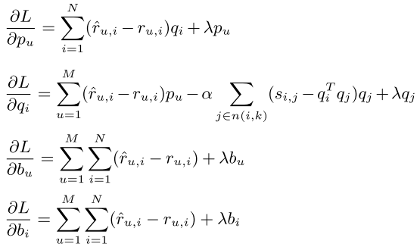
Algorithm Description——Exploiting music play sequence for music recommendation
Optimization

Slide 32
PART
FOUR
参考文献

Slide 33
References
[1] https://zhuanlan.zhihu.com/p/27502172
[2] Quadrana, M., Jannach, D., & Cremonesi, P. (2019). Tutorial: Sequence-aware recommender systems. The Web Conference 2019 - Companion of the World Wide Web Conference, WWW 2019,1(1),1316.https://doi.org/10.1145/3308560.3320091
[3] Le, D. T., Lauw, H. W., & Fang, Y. (2018). Modeling contemporaneous basket sequences with twin networks for next-item recommendation. IJCAI International Joint Conference on Artificial Intelligence, 2018-July, 3414–3420. https://doi.org/10.24963/ijcai.2018/474
[4] Tang, J., & Wang, K. (2018). Personalized top-N sequential recommendation via
convolutional sequence embedding. WSDM 2018 - Proceedings of the 11th ACM
International Conference on Web Search and Data Mining, 2018-Febua, 565–573.
https://doi.org/10.1145/3159652.3159656
[5] Cheng, Z., Shen, J., Zhu, L., Kankanhalli, M., & Nie, L. (2017). Exploiting music play sequence for music recommendation. IJCAI International Joint Conference on Artificial Intelligence, 0, 3654–3660. https://doi.org/10.24963/ijcai.2017/511

Slide 34
THANKS

