Slide 1
图神经网络
Graph Neural Networks
汇报人：杨扬
导师：张明卫

Slide 2
01
研究背景
Research Background
目录
02
算法描述
CONTENTS
Algorithm Description
03
参考文献
references

Slide 3
PART
ONE
研究
背景

Slide 4
研究背景
随着计算资源的发展（GPU）、数据集的增多以及深度学习算法效率的提升，深度学习算法被用于各个领域，例如：图像分类、视频处理、语音识别以及自然语言处理等。
更多的图数据的应用需求开始增加，例如在电子商务里需要提取用户与商品的联系来做更精确的推荐；在化学领域里，分子的构成组成了一张图，需要进行生物活性分析来发现新的药品；在引文网络中，论文通过引用来相互联系，组成了图数据，需要进行分析并分成不同的组
随着计算随随着着资源的发展
PART ONE
PART TWO
PART THREE
深度学习算法的效率提高
图数据的增多
因此，近年来，更多的研究者致力于扩展深度学习算法来处理图数据。
Zonghan Wu, Shirui Pan等人在2019年根据深度学习算法的框架将图神经网络分为了四大部分，分别为：recurrent graph neural networks，convolutional graph neural networks，graph autoencoders，spatial-temporal graph neural networks(时空图神经网络)[1]
[1] Wu Z , Pan S , Chen F , et al. A Comprehensive Survey on Graph Neural Networks[J]. IEEE Transactions on Neural Networks and Learning Systems, 2019.

Slide 5
PART
TWO
算法描述

Slide 6




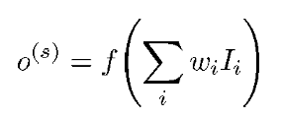
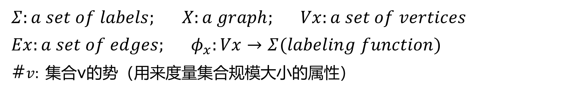
Recurrent Graph Neural Networks——Recursive Neuron
Definition About Graph
$$Σ:a set of labels; X:a graph; Vx:a set of vertices$$
$$Ex:a set of edges; φ_{x}:Vx→Σ(labeling function)$$
#$v: 集合$v的势（用来度量集合规模大小的属性）
(1)
(2)
图的价
(3)
(4)
Standard Neuron

Slide 7
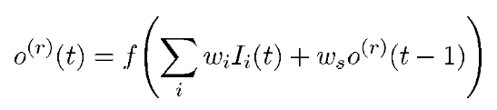
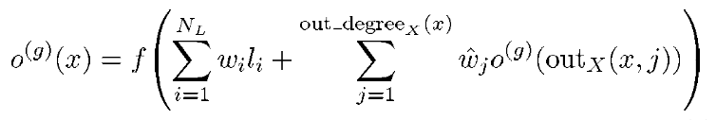
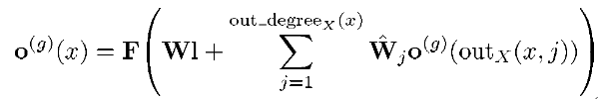
Recurrent Graph Neural Networks ——Recursive Neuron
Recurrent Neuron
consider the outputs of the unit for all the vertices which are pointed by the current input vertex[2]
Generalized Recursive Neuron
向量表示形式
[2] A. Sperduti and A. Starita, “Supervised neural networks for the classification of structures,” IEEE Transactions on Neural Networks, vol. 8, no. 3, pp. 714–735, 1997.

Slide 8
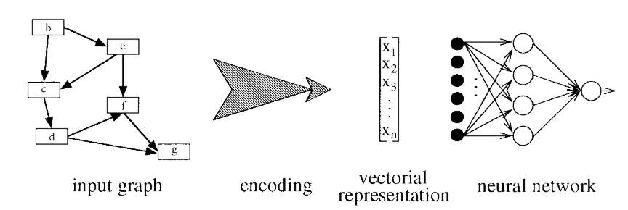
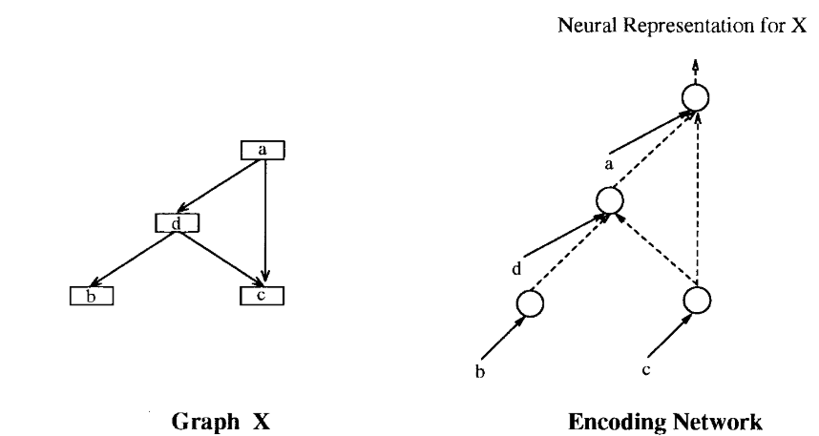
Recurrent Graph Neural Networks ——Recursive Neuron
Common Neural Networks For Classification
Encoding Network

Slide 9
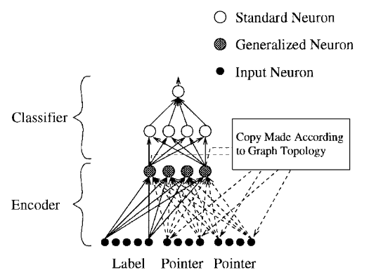
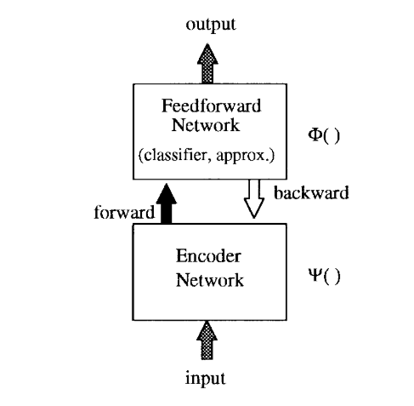
Recurrent Graph Neural Networks ——Recursive Neuron
Architecture For The Classification Of Structures

Slide 10




Recurrent Graph Neural Networks ——Recursive Neuron
Backpropagation Model

Slide 11

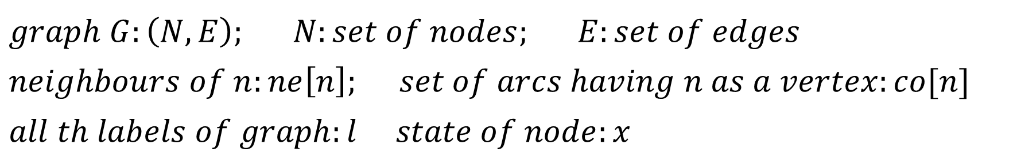
Recurrent Graph Neural Networks——GNN
Definition About Graph
$$graph G:\left(N,E\right); N:set of nodes; E:set of edges$$
$$neighbours of n:ne\left[n\right]; set of arcs having n as a vertex:co[n]$$
$$all th labels of graph:l state of node:x$$
Learning Set
set of graphs
the desired target associated to nij

Slide 12
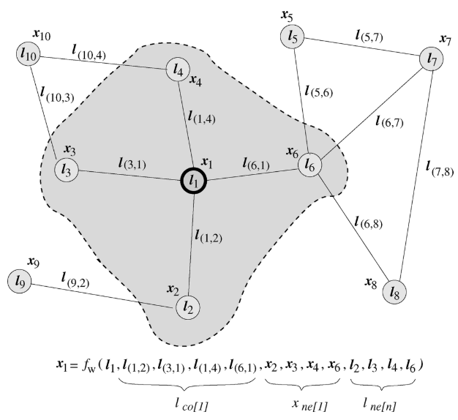
Recurrent Graph Neural Networks——GNN
Graph And a Neighborhood Of a Node

Slide 13


Recurrent Graph Neural Networks——GNN
Local Transition Function(Positional Or Nonpositional)
label
state
may contain positional information
Local Output Function

Slide 14



Recurrent Graph Neural Networks——GNN
A Simpler Expression
Let x, l, o and lN be the vectors constructed by stacking all the states, all the outputs, all the labels, and all the node labels,
Local Transition Function(Nonpositional graphs)

Slide 15
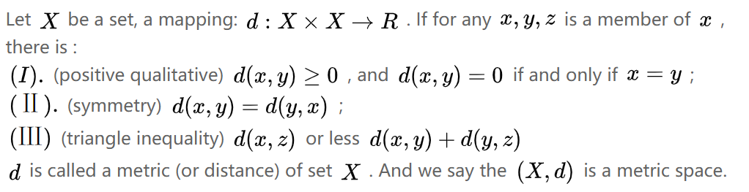
Recurrent Graph Neural Networks——GNN
Banach fixed-point theorem(巴拿赫不动点定理)
[3]https://zhuanlan.zhihu.com/p/96685696

Slide 16
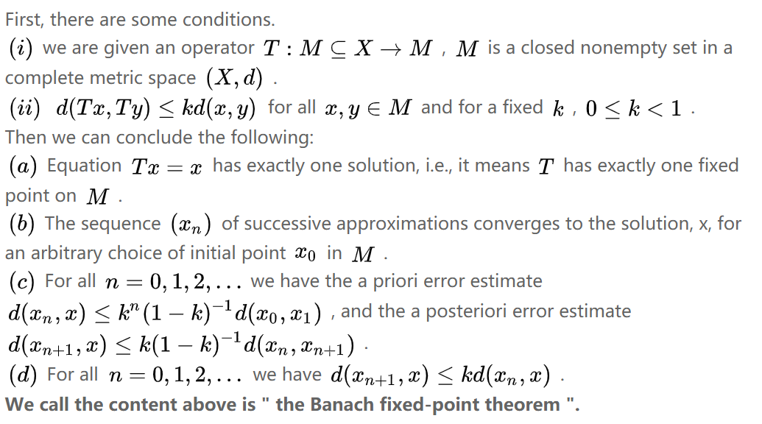
Recurrent Graph Neural Networks——GNN
Banach fixed-point theorem(巴拿赫不动点定理)

Slide 17



Recurrent Graph Neural Networks——GNN
Computation Of The State
Fw或者fw只要是压缩函数就能满足巴拿赫不动点定理
contraction map
Computation Of The Output

Slide 18
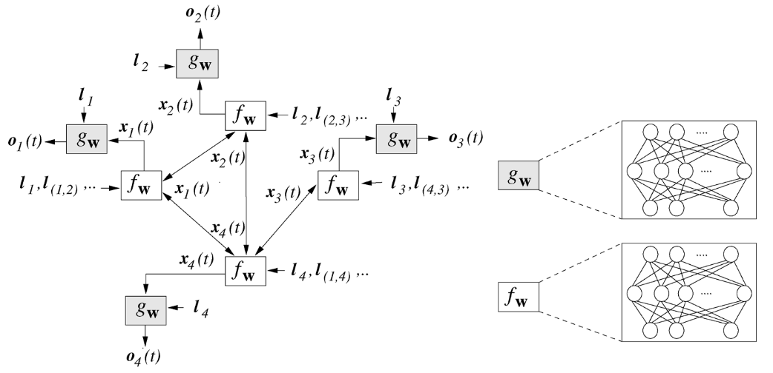
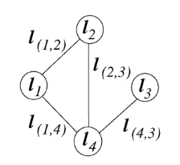
Recurrent Graph Neural Networks——GNN
From Graph to Encoding Network
encoding

Slide 19
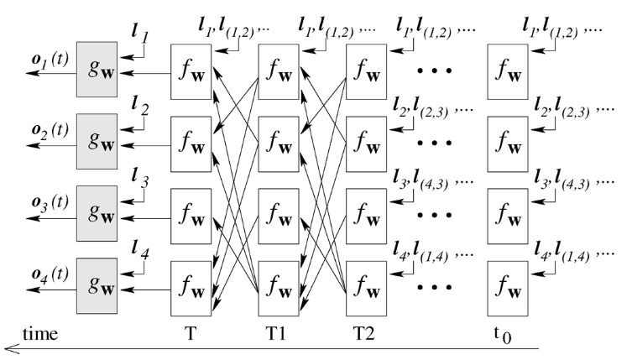
Recurrent Graph Neural Networks——GNN
From Graph to Encoding Network

Slide 20
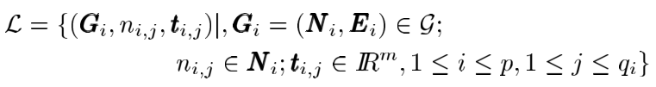

Recurrent Graph Neural Networks——GNN
Learning Dataset
Quadratic Cost Function
how to ensure it is differentiable

Slide 21




Recurrent Graph Neural Networks——GNN
Implicit Function Theorem
设f：$R→R$为一个连续可微函数，对其上任意一点（a，b）使得f(a，b)=0，则在(a,b)附近定义一个y关于x的函数g，使得只要f(x,y)=0，就有y=g(x)
Proof$：φ_{ω}$ is continuous differentiable
$$F_{w} is continuous differentiable and{ G}_{w }is continuous differentiable$$
g
即$x=\overline{ψ}\left(w\right)$
返回节点n的计算结果
continuous differentiable

Slide 22
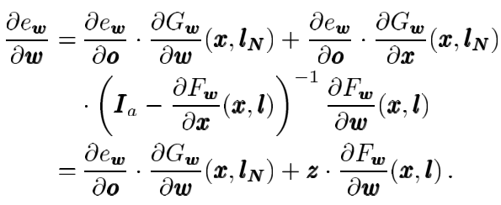



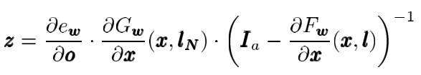


Recurrent Graph Neural Networks——GNN
Backpropagation

Slide 23
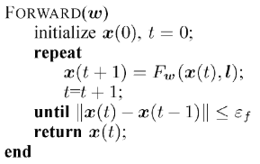
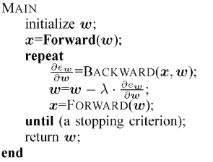
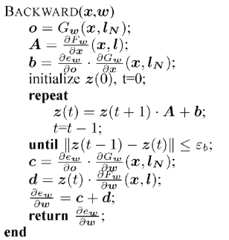
Recurrent Graph Neural Networks——GNN
Learning Algorithm

Slide 24



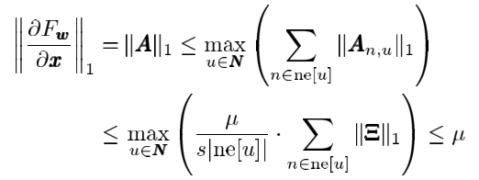
Recurrent Graph Neural Networks——GNN
Transition and Output Function Implementations
Linear (nonpositional) GNN
Nonlinear (nonpositional) GNN

Slide 25
PART
THREE
参考文献

Slide 26
References
[1] Wu Z , Pan S , Chen F , et al. A Comprehensive Survey on Graph Neural Networks[J]. IEEE Transactions on Neural Networks and Learning Systems, 2019.
[2] A. Sperduti and A. Starita, “Supervised neural networks for the classification of structures,” IEEE Transactions on Neural Networks, vol. 8, no. 3, pp. 714–735, 1997.
[3]https://zhuanlan.zhihu.com/p/96685696
[4]Scarselli F , Gori M , Tsoi A C , et al. The Graph Neural Network Model[J]. IEEE Transactions on Neural Networks, 2009, 20(1):61.

Slide 27
THANKS

