Slide 1


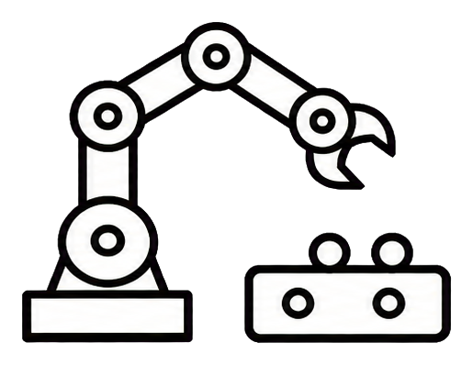
TurboVLA Split-Inference Framework
Observations and control on Orin · Complete neural inference on Thor
Jetson Orin Nano
8 GB
Jetson Thor
128 GB
Complete TurboVLA neural inference
Receive · Decompress · Validate
LIBERO environment
HTTP/1.1 · Keep-alive
Dual-view RGB · 8-D state · Instruction
DINOv3
BERT
State projection
Vision encoder
Online text encoder
State embedding
Snapshot and normalize
RGB: 2 × 3 × 256 × 256
Normalized tensors + instruction
…
…
State: 8
V–L Interaction
Encode and compress tensors
Visual → Instruction
Instruction → Visual
N ×
BF16 / FP32 · Codec negotiation
Action timeline
…
Action-ready features
async (replace)
blend
sync
Align by executed control steps
12 × 7 action chunk
Action Chunk Decoder (ACT)
Request ID · Timings
Control execution
One request in flight
Action denormalization
No model weights on Orin
Checkpoint · DINOv3 · BERT · Statistics
Metrics: success rate · control-interval p95 · hold_steps · stage timings
Defaults: H=12 / R=4 / B=3. Control is capped at 20 Hz; performance is measured.

Slide 2
Three Collaborative Inference Pipelines
Orin Nano 8GB: action execution Thor 128GB: complete-model inference
H=12 / R=4 / B=3. Inference takes 2 illustrative units; timings are not measured.
Illustrative wall time →
0
2
4
6
8
10
12
14
16
18
ASYNC
Thor
Infer A
Infer B
Infer C
Infer D
Async replacement
CLI: replace
Orin
Wait
Wait
A0
A1
A2
A3
A4
A5
B2
B3
B4
B5
C2
C3
C4
C5
D2
D3
s=4 → t=6: discard B0/B1; apply B2 onward
BLEND
Thor
Infer A
Infer B
Infer C
Infer D
Async blending
Orin
Wait
Wait
A0
A1
A2
A3
A4
A5
A6/B2
A7/B3
A8/B4
B5
B6/C2
B7/C3
B8/C4
C5
C6/D2
C7/D3
1/3
2/3
1
1/3
2/3
1
1/3
2/3
Blend six pose dimensions; switch gripper at α ≥ 0.5
SYNC
Thor
Infer A
Infer B
Blocking execution
Orin
Wait
Wait
A0
A1
A2
A3
A4
A5
A6
A7
A8
A9
A10
A11
Wait
Wait
B0
B1
Request after chunk exhaustion; no control steps while waiting
Old actions
New actions
Blend window
Blocking wait
H=12 / R=4 / B=3. Inference takes 2 illustrative units; timings are not measured.
Trim by executed steps. Empty buffer: zero arm increments, retain gripper. No depletion in this example.

