Slide 1
DATA SCIENCE / FINANCIAL TIME SERIES
PROJECT
NOTE
YES BANK
Exploratory analysis &
regime-aware forecasting
01
EDA
02
MACHINE
LEARNING
A transparent, leakage-aware study of monthly OHLC data
03
VALIDATION
A measured conclusion
beats an inflated claim.
Prepared by Rahul
SOURCE WINDOW | JUL 2005 — NOV 2020
YES BANK / MONTHLY STOCK FORECASTING STUDY
01

Slide 2
00 / EXECUTIVE SUMMARY
The strongest result is a finding, not a victory lap.
The available OHLC history does not show that a more complex model beats the simple persistence benchmark.
185
22
3
0 / 3
monthly observations
EDA visualizations
forecast horizons
ML holdout wins
Jul 2005 — Nov 2020
UBM-organized notebook output
1, 3 and 6 months ahead
against best simple benchmark
THE PROJECT’S CENTRAL QUESTION
Does engineered monthly OHLC history add predictive value beyond a naïve forecast?
Answer from this experiment: not yet. The project demonstrates careful validation, model comparison and diagnostics—and documents where the signal is insufficient.
YES BANK / MONTHLY STOCK FORECASTING STUDY
02

Slide 3
01 / DATA FOUNDATION
A small, regular monthly dataset defines the limits of the study.
All figures below come from the executed ML notebook’s data-validation and descriptive-statistics cells.
SOURCE DATA
WHAT THE FILE DOES NOT CONTAIN
Coverage
Jul 2005 – Nov 2020
No volume, market index, sector series, corporate-action history or fundamental variables are supplied.
Observations
185 monthly rows
Source fields
Date, Open, High, Low, Close
This is important: the model is asked to forecast a changing stock using only five monthly columns. A strong validation design cannot manufacture information that is absent from the source.
Cadence
184 consecutive 1-month steps
Missing values
0 across all source fields
Duplicate rows
0
Source validated
Monthly cadence confirmed
Price range
₹5.55 low to ₹404.00 high
YES BANK / MONTHLY STOCK FORECASTING STUDY
03

Slide 4
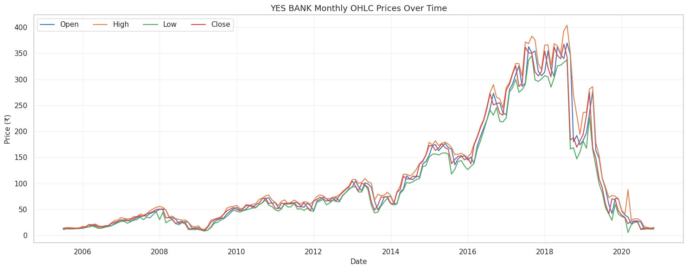
02 / EDA — PRICE BEHAVIOUR
The price history has a clear expansion phase and a sharp reversal.
Original chart output from the EDA notebook; monthly OHLC series, not a recreated illustration.
READING THE SERIES
• Prices rose substantially through the mid-to-late 2010s, reaching their highest levels around 2017–2018.
• The series then fell sharply, with closing prices reaching low levels by 2020.
• Open, High, Low and Close trace the same broad regime changes; the price-level trend is not stable across the full sample.
Source: EDA notebook, Chart 7 — OHLC Prices Over Time.
YES BANK / MONTHLY STOCK FORECASTING STUDY
04

Slide 5
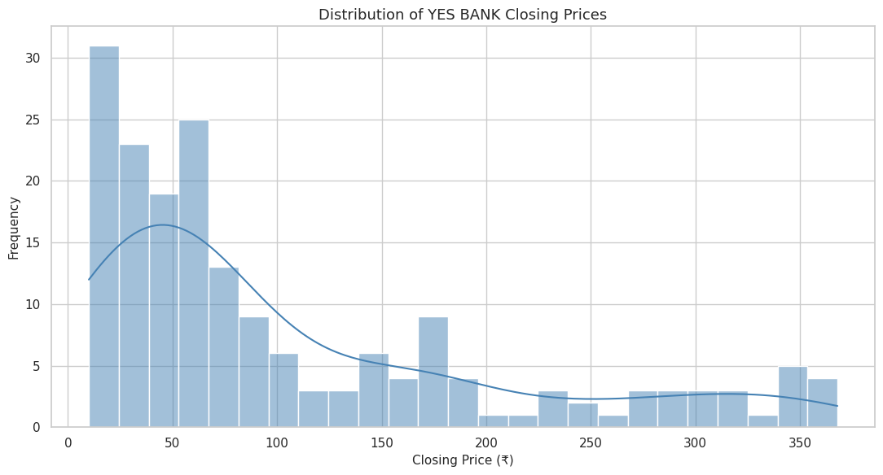
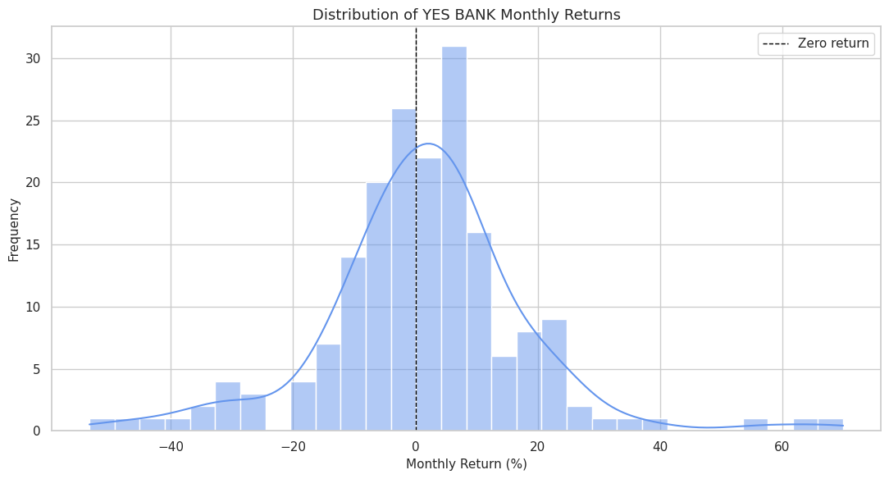
03 / EDA — DISTRIBUTIONS
Closing prices and returns are not symmetric, stationary-looking quantities.
Two original notebook plots are shown as exported from the EDA notebook.
Closing-price levels
Monthly simple returns
Right-skewed: many lower price observations, fewer high-price observations.
Most observations cluster near zero, with both positive and negative tail events.
YES BANK / MONTHLY STOCK FORECASTING STUDY
05

Slide 6
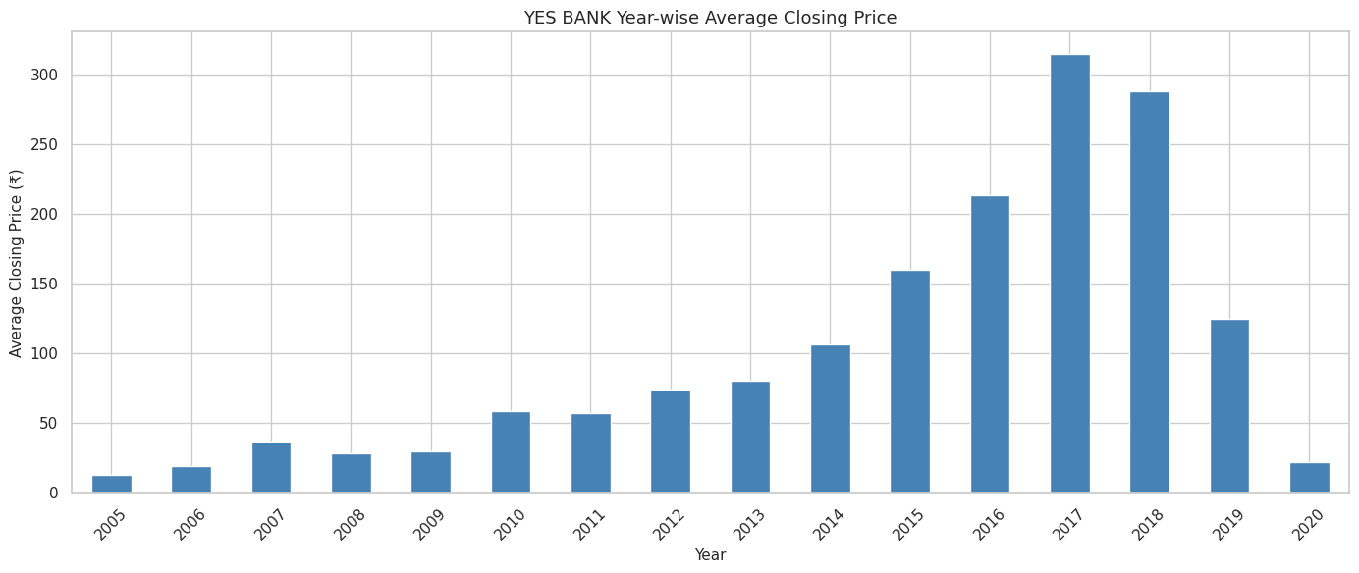
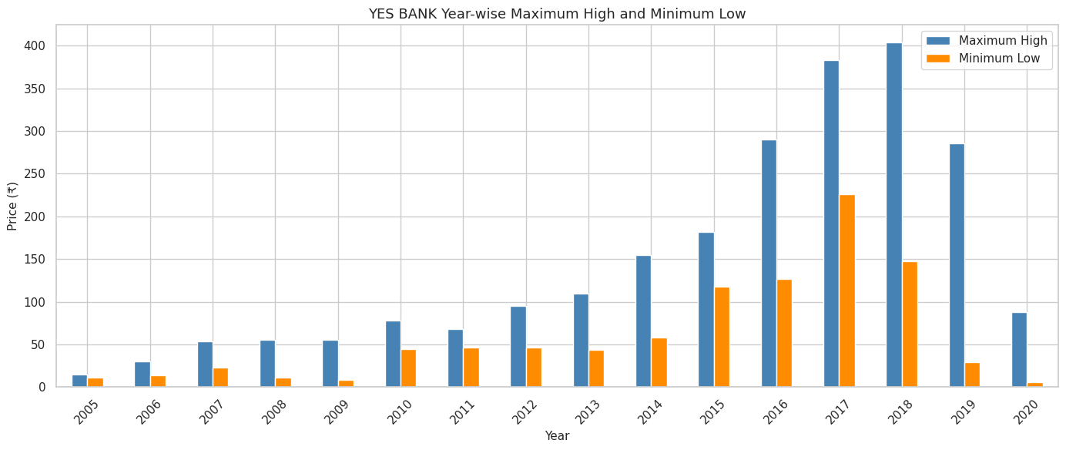
04 / EDA — ANNUAL PERSPECTIVE
The annual summaries make the 2018–2020 repricing visible.
Original annual summary charts from the executed EDA notebook.
Average close by year
Yearly high / low envelope
The annual mean peaks in 2017, then falls steeply in 2019 and 2020.
Annual ranges are wide; 2019–2020 show the lower price regime.
YES BANK / MONTHLY STOCK FORECASTING STUDY
06

Slide 7
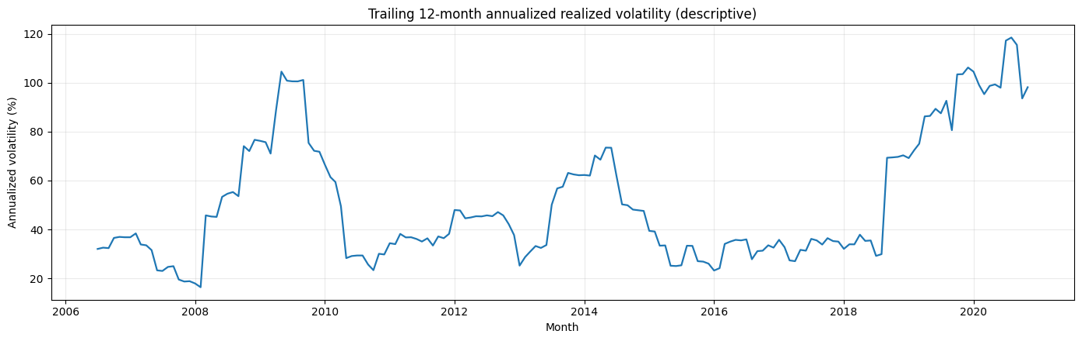
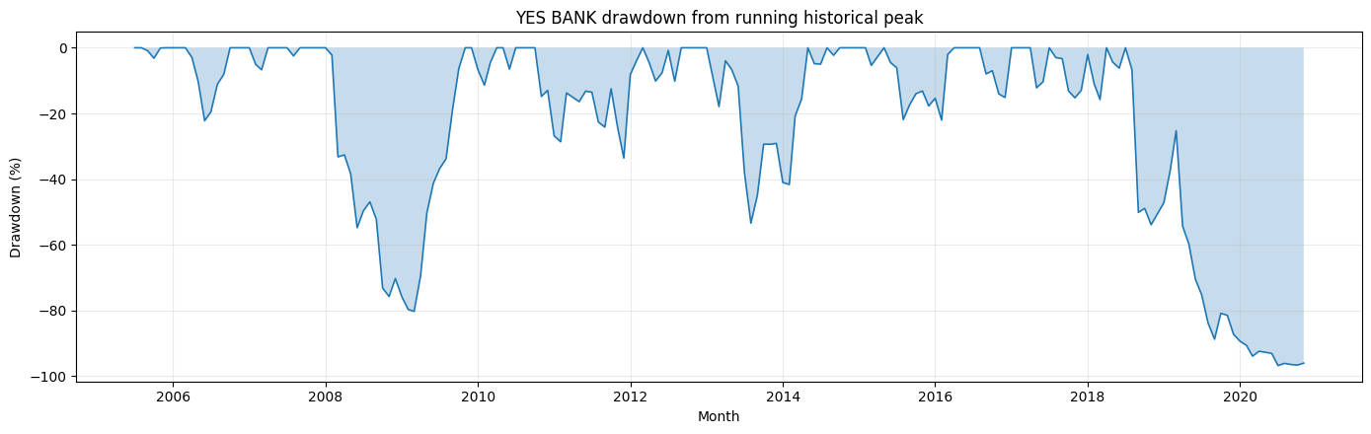
05 / EDA — RISK THROUGH TIME
Volatility rises sharply in stressed periods; drawdown exposes downside depth.
Original ML notebook diagnostics: trailing realized volatility and drawdown from the prior peak.
Trailing 12-month realized volatility
Drawdown from prior peak
The later sample shows much higher realized volatility than several mid-sample years.
The fall from the prior peak was severe; a price-only trend chart understates the depth of loss.
YES BANK / MONTHLY STOCK FORECASTING STUDY
07

Slide 8
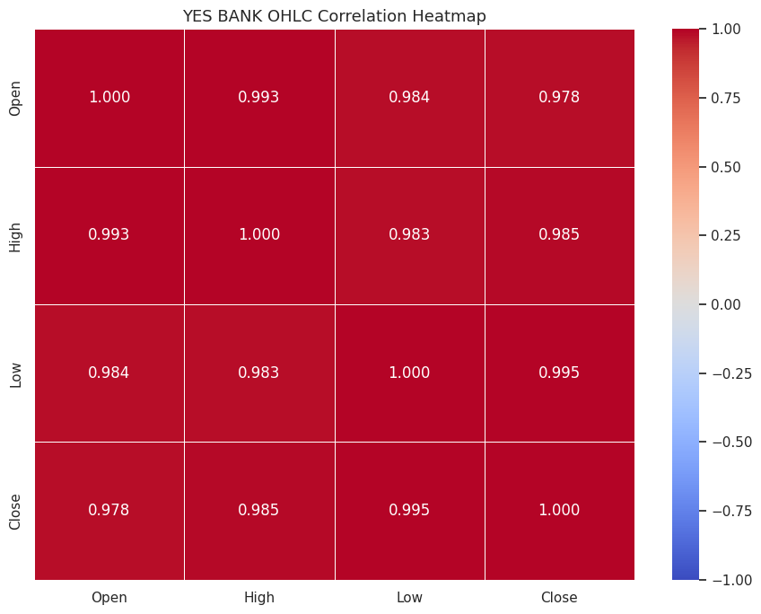
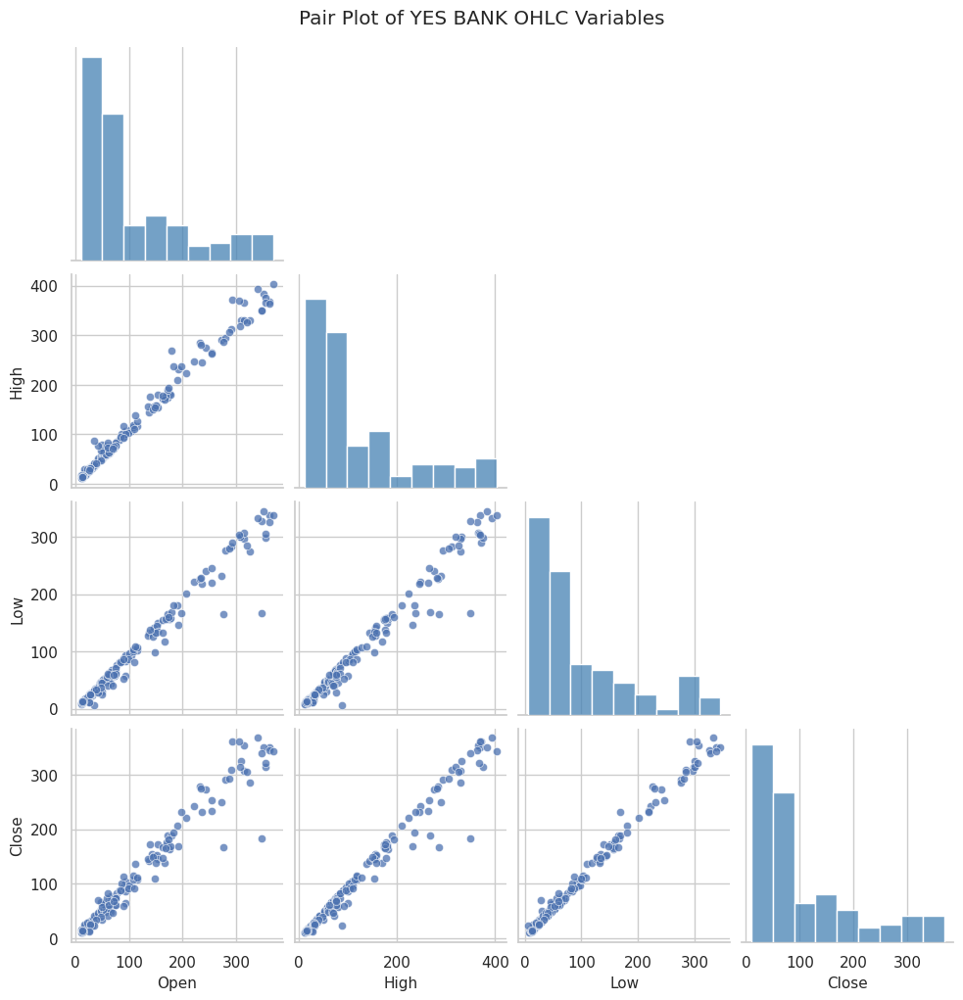
06 / EDA — RELATIONSHIPS
OHLC features move together, but correlation is not independent predictive signal.
Original notebook output: correlation heatmap and pair plot. Contemporaneous OHLC correlations are descriptive.
Correlation coefficients round to roughly 0.98–1.00 across the four OHLC fields.
These values partly reflect that all four fields describe the same monthly price level; they do not establish causation.
YES BANK / MONTHLY STOCK FORECASTING STUDY
08

Slide 9
07 / STATISTICAL DIAGNOSTICS
The diagnostics point to non-stationary levels and changing return behaviour.
Test statistics and p-values copied from the executed ML notebook outputs.
QUESTION / TEST
RESULT
INTERPRETATION AT 5%
ADF: log closing price
p = 0.5662
Fail to reject unit-root null; level appears non-stationary under this test.
ADF: log returns
p < 0.0001
Reject unit-root null for the return series under this ADF specification.
Mann–Whitney: |return|
pre-2018 vs 2018 onward
p = 0.000474
Reject equal-distribution null; median absolute log return rises from 0.0698 to 0.1271.
Ljung–Box: squared returns
p = 0.0309 (lag 6)
p < 0.0001 (lag 12)
Evidence of dependence in return magnitude; consistent with volatility clustering.
These are statistical diagnostics, not causal explanations. Small samples and structural breaks limit inference.
YES BANK / MONTHLY STOCK FORECASTING STUDY
09

Slide 10
08 / MODELLING DESIGN
A chronological split protects the test from future information.
The experiment keeps model selection inside the development period and evaluates on later observations.
DEVELOPMENT HISTORY • 148 rows
HOLDOUT
Nov 2017
185 monthly observations
HOLDOUT FORECAST ORIGINS
Forecast origin and target are kept distinct. For horizon h, only training labels whose target month has already arrived are eligible at a given origin.
36
34
31
1 month
3 months
6 months
TimeSeriesSplit uses a gap equal to the forecast horizon so overlapping target information cannot leak across a CV boundary.
YES BANK / MONTHLY STOCK FORECASTING STUDY
10

Slide 11
09 / MODEL DEVELOPMENT
Five ML families were tuned against transparent forecasting baselines.
Model selection used expanding-window cross-validation on development data only.
ML CANDIDATES
BENCHMARKS
• Ridge regression
• Elastic Net
• Random Forest
• Extra Trees
• Histogram Gradient Boosting
• Persistence: future close = latest known close
• Expanding drift: mean matured return
• Seasonal naïve: same calendar month one year earlier
• ARIMA(1,1,0): fixed statistical comparator
Selection rule
CV chooses a candidate; the untouched chronological holdout decides whether it adds value.
YES BANK / MONTHLY STOCK FORECASTING STUDY
11

Slide 12
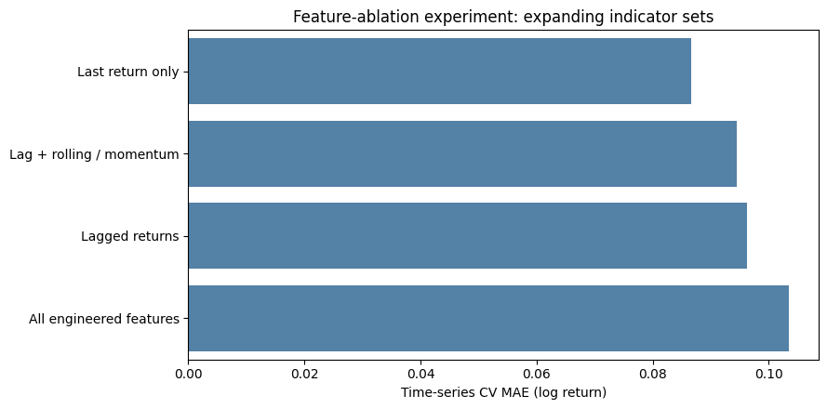
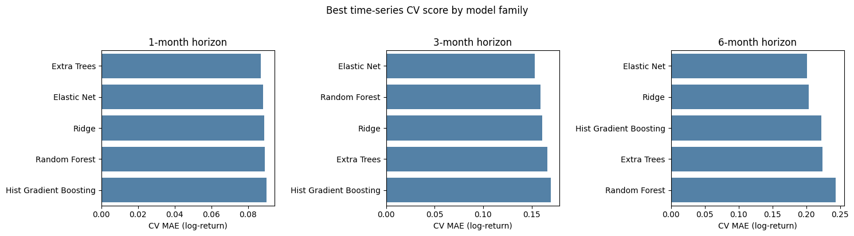
10 / DEVELOPMENT EVIDENCE
Feature engineering did not automatically improve the model.
Both graphics are original outputs from the ML notebook: cross-validation comparison and feature ablation.
CV-selected family
Ablation result
Extra Trees (1M); Elastic Net (3M and 6M).
Ridge CV MAE: last return only 0.0866 vs all engineered features 0.1034 (lower is better).
YES BANK / MONTHLY STOCK FORECASTING STUDY
12

Slide 13
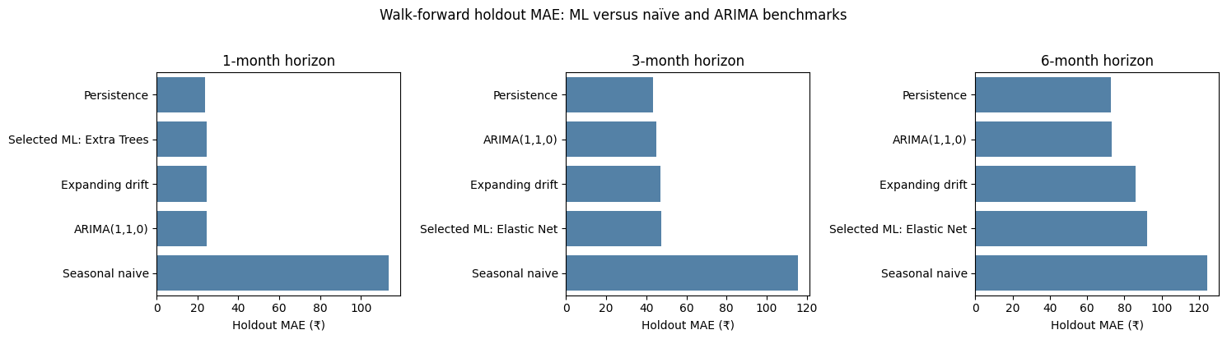
11 / OUT-OF-TIME EVALUATION
The persistence benchmark wins on holdout MAE at all three horizons.
Holdout begins at Nov 2017; all models evaluated on identical target dates within each horizon.
HORIZON
SELECTED ML
PERSISTENCE
1 month
₹24.30
₹23.80
3 months
₹47.42
₹43.23
6 months
₹92.20
₹72.70
MAE in ₹ • lower is better
No ML candidate beats persistence on holdout MAE.
YES BANK / MONTHLY STOCK FORECASTING STUDY
13

Slide 14
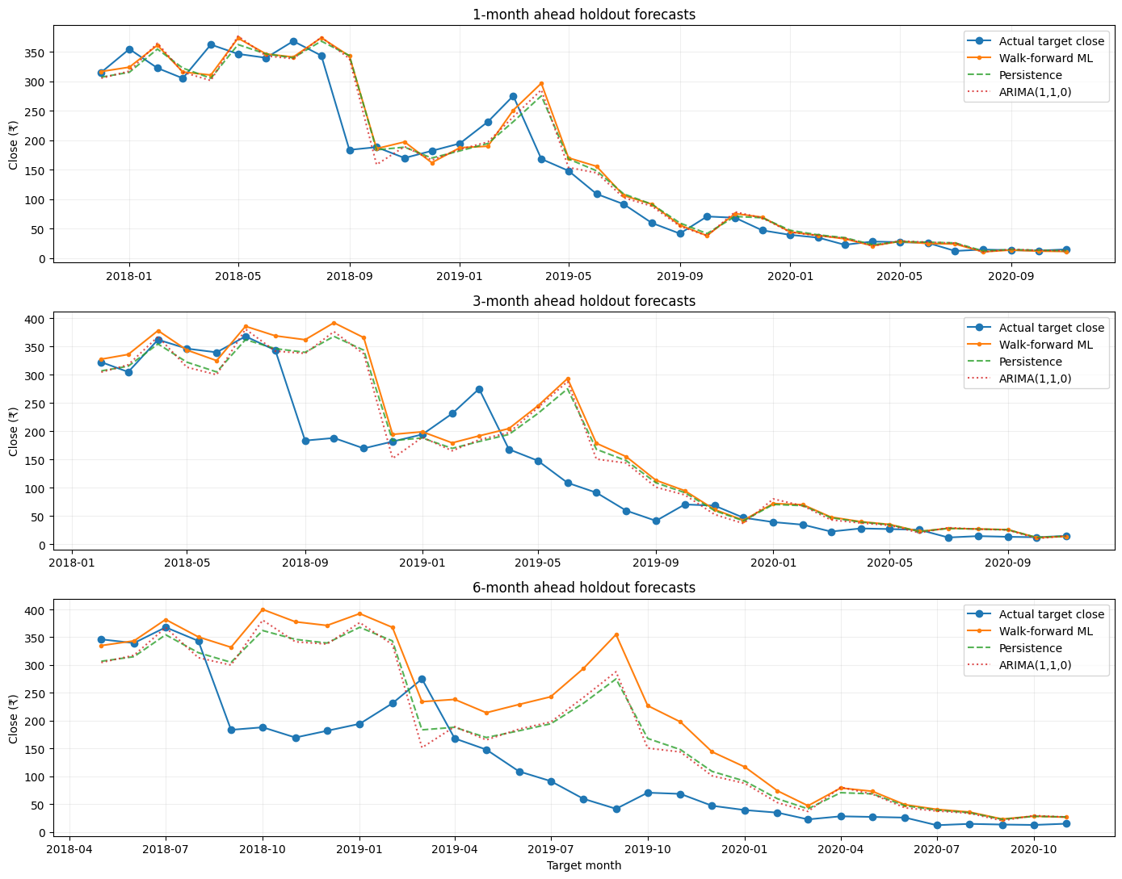
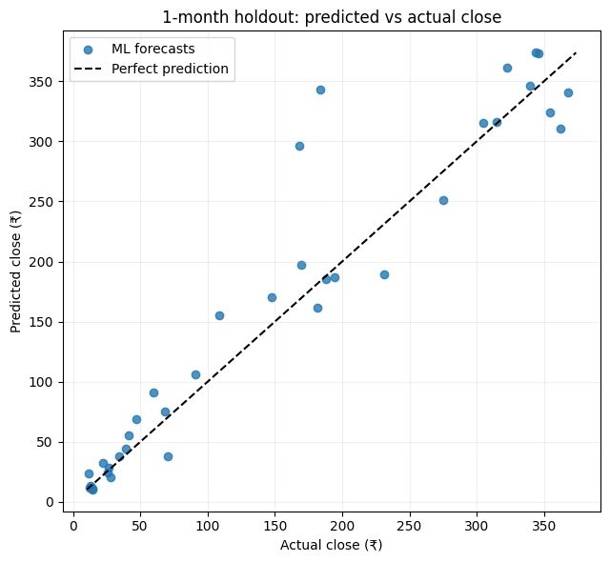
12 / FORECAST INSPECTION
Forecast paths track the broad level, but miss key turns and magnitude.
Original notebook outputs: walk-forward actual-vs-forecast paths and 1-month predicted-vs-actual scatter.
One-month scatter
Wide deviations from the 45° line mark forecast misses.
The horizon plots show the ML estimate alongside realized target closes for 1, 3 and 6 months.
YES BANK / MONTHLY STOCK FORECASTING STUDY
14

Slide 15
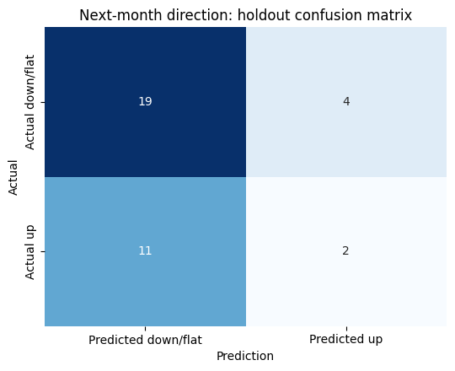
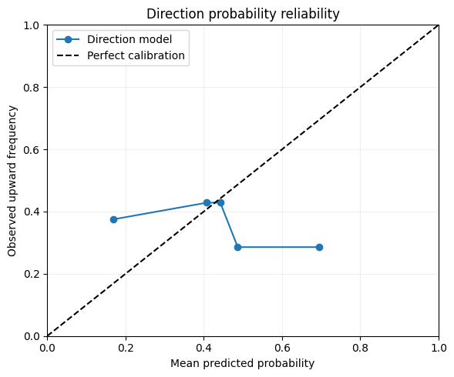
13 / SECONDARY EXPERIMENT
Direction classification did not show a reliable edge.
The direction classifier is a secondary test, not the project’s primary forecasting target.
58.3%
holdout
accuracy
63.9%
majority
baseline
ROC-AUC = 0.431
Accuracy is below the majority-class baseline; probabilities are not suitable for trading use.
YES BANK / MONTHLY STOCK FORECASTING STUDY
15

Slide 16
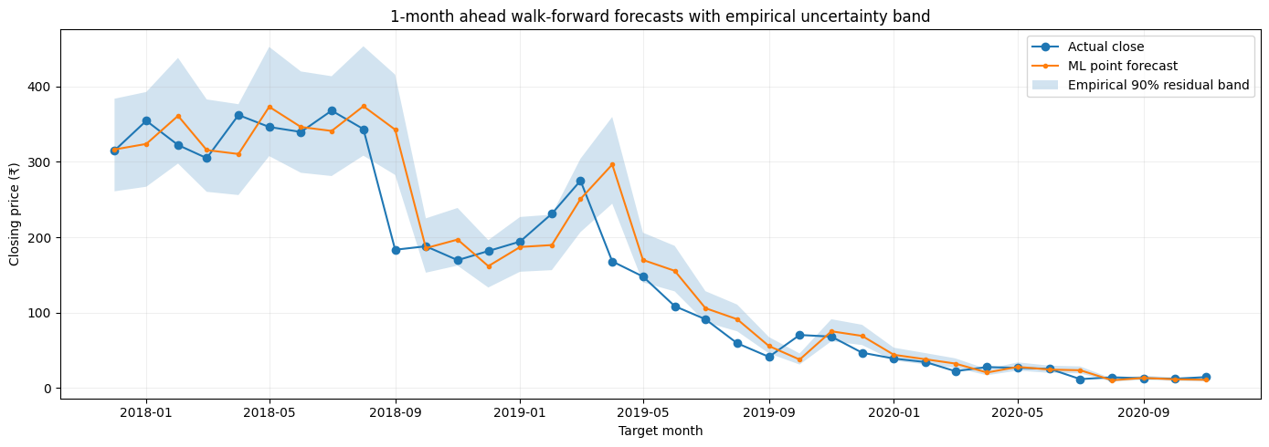
14 / UNCERTAINTY
The empirical “90%” bands under-cover the holdout—especially at longer horizons.
Original notebook forecast-band chart; coverage figures are the measured holdout coverage.
NOMINAL BAND
90%
1 month
63.9%
3 months
50.0%
6 months
22.6%
Band calibration is not reliable on this holdout; do not present these ranges as guaranteed confidence intervals.
YES BANK / MONTHLY STOCK FORECASTING STUDY
16

Slide 17
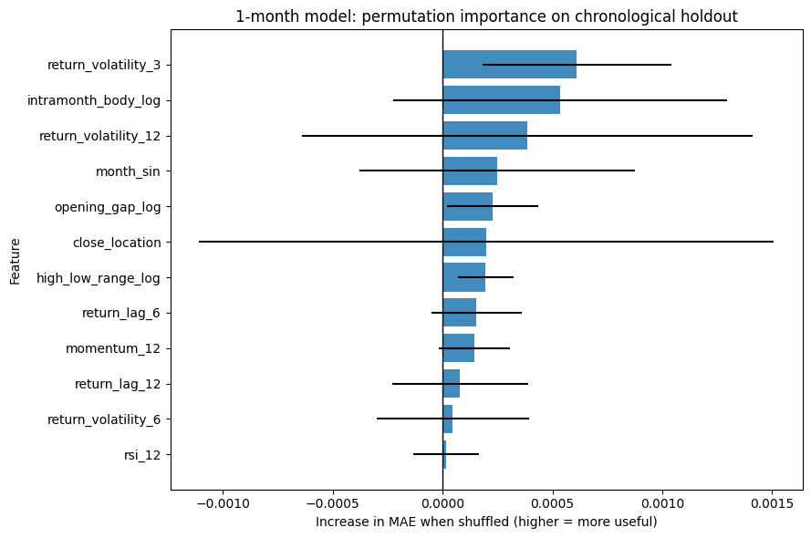
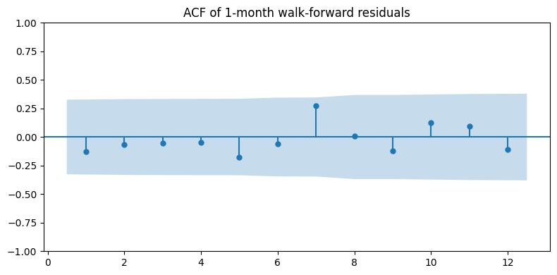
15 / MODEL DIAGNOSTICS
Errors are time-varying; feature importance is weak and distributed.
Original notebook outputs: residual autocorrelation and holdout permutation importance.
Residual ACF
Permutation importance
Ljung–Box p-values: 0.8556 (lag 6), 0.7175 (lag 12); no evidence of residual autocorrelation at these lags.
The largest mean contribution is small; importance should be read cautiously with correlated engineered inputs.
YES BANK / MONTHLY STOCK FORECASTING STUDY
17

Slide 18
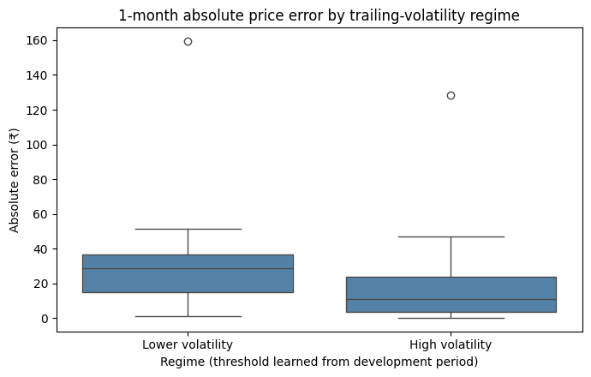
16 / STABILITY REVIEW
Error size differs across volatility regimes in this small holdout.
Original notebook output with regime threshold derived only from pre-holdout data.
HOLDOUT ABSOLUTE PRICE ERROR
Lower volatility
₹38.30
n = 10 observations
High volatility
₹18.91
n = 26 observations
This split is descriptive, not causal. The regime sample is small and one unusual period can change the averages.
YES BANK / MONTHLY STOCK FORECASTING STUDY
18

Slide 19
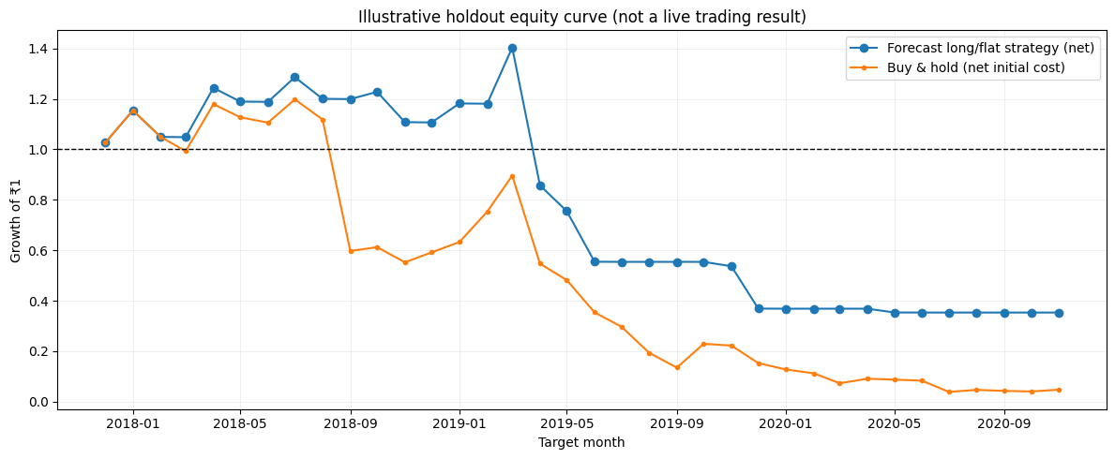
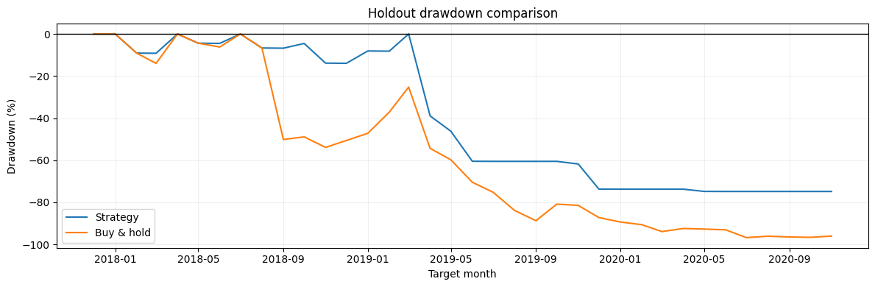
17 / DECISION EXPERIMENT
The illustrative strategy loses money; relative outperformance is not profitability.
Original notebook outputs: long/flat equity curve and drawdown over the chronological holdout.
Long/flat cumulative return −64.7%
Buy & hold −95.2%
Max drawdown: −74.8% vs −96.8%
Educational historical simulation only; small holdout, assumed costs and simplified execution. It is not a live trading result.
YES BANK / MONTHLY STOCK FORECASTING STUDY
19

Slide 20
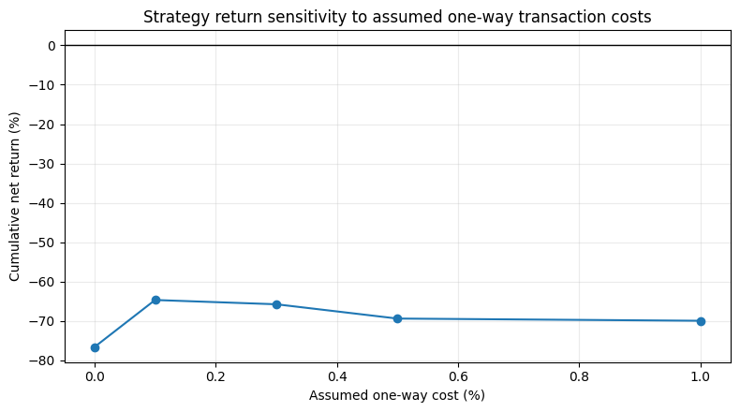
18 / TRANSACTION-COST SENSITIVITY
The backtest remains deeply negative across every tested cost assumption.
Original ML notebook output: the same historical long/flat rule re-evaluated at five one-way cost assumptions.
ONE-WAY COST
CUMULATIVE STRATEGY RETURN
0.0%
−76.6%
0.1%
−64.7%
0.3%
−65.8%
0.5%
−69.4%
1.0%
−69.9%
Even the zero-cost assumption does not make the strategy profitable. Costs change the outcome, but weak forecasts are the central limitation.
This is an illustrative historical simulation, not a live strategy; it omits several real execution frictions.
YES BANK / MONTHLY STOCK FORECASTING STUDY
20

Slide 21
19 / CONCLUSION & NEXT STEPS
The honest next step
is better information.
What the evidence supports
What would make the next version stronger
• Keep persistence as the reference forecast; no selected ML horizon beat it on holdout MAE.
• Treat directional classification and empirical bands as exploratory, not operational signals.
• Retain the time-aware evaluation design for future model comparisons.
• Add a longer, refreshed daily or weekly history and properly adjusted prices.
• Include volume, market index and sector returns, corporate actions and fundamentals where licensed.
• Repeat rolling-origin tests across multiple cutoffs; recalibrate uncertainty and include realistic spreads, slippage and taxes.
The contribution is a reproducible test of predictive value—not a claim that stock prices can be reliably predicted from this file alone.
Thank you • Questions
YES BANK / MONTHLY STOCK FORECASTING STUDY
21

