Slide 1

NAME | ROLL NO.
ANKIT VISHWAKARMA | 71
TABREZ SHAIKH | 60

Slide 2
PROJECT DETAILS :-
* THIS PROJECT BASED ON STUDENT ADMISSION FORM
* IN THIS PROJECT WE ARE USING ASP.NET
* WE ARE USING VALIDATOR IN

Slide 3
PROJECT NAME :
STUDENT ADMISSION FORM

Slide 4
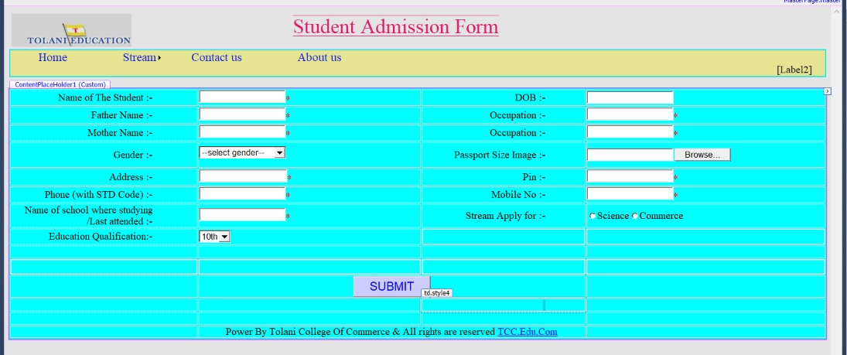

Slide 5
THE COMPONENT USE IN ADMISSION FORM
1) MASTER PAGE
2) NAVIGATE (MENU BAR)
3) MYSQL DATABASE
4) REQUIREDFIELD VALIDATOR
5) GLOBAL CLASS APPLICATION

