Slide 1

Healthcare Analytics for Doctor Visits
Om Rajendrakumar Koli
Adarsh Institute of Technology and Research Centre, Vita
AICTE STU ID : STU66d3ee81eb4b21725165185

Slide 2

PROBLEM STATEMENT
Healthcare utilization — how often people visit a doctor — is shaped by factors like age, income, insurance coverage, chronic illness and general health. However, raw survey data does not clearly show which of these factors actually drive doctor visits or how strongly. This project analyzes health survey data from 5,190 individuals to identify the key patterns and relationships behind doctor visit frequency, and to understand which groups have the highest healthcare needs.

Slide 3
Project Description
This project performs an end-to-end Data Analytics study on the Australian Health Survey (1977-78) dataset, covering 5,190 individuals and 12 attributes including demographics (age, gender, income), health indicators (illness count, reduced-activity days, general health score) and insurance/chronic-condition status. The workflow includes data cleaning (missing values, duplicate investigation, data type correction, outlier analysis), feature engineering, univariate, bivariate and multivariate analysis, correlation analysis, and storytelling insights for every chart — concluding with evidence-based recommendations for healthcare planning.

Slide 4

WHO ARE THE END USERS?
Healthcare providers and clinics planning appointment capacity and staffing
Health insurance companies assessing risk and coverage design
Government health departments and policymakers for resource allocation
Public health researchers studying healthcare utilization patterns
Hospital administrators identifying high-need patient groups for preventive care programs

Slide 5

Technology Used
  Python 3 (Google Colab / Jupyter Notebook)
  Pandas & NumPy - data cleaning and analysis
  Matplotlib & Seaborn - data visualization
  Statistical methods - IQR outlier detection, correlation analysis
  GitHub - version control and submission

Slide 6
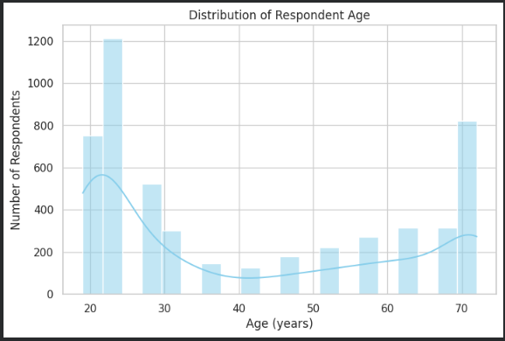
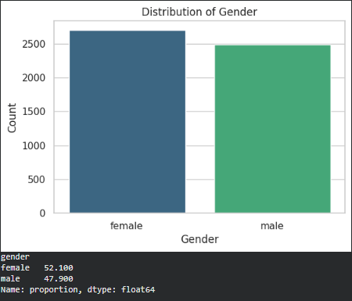
RESULTS
Demo Link

Slide 7
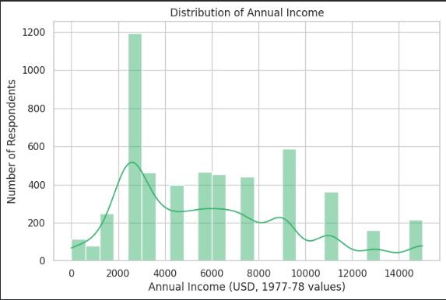
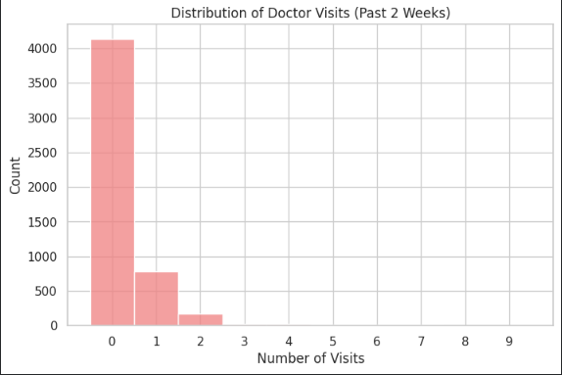
RESULTS
Demo Link

Slide 8
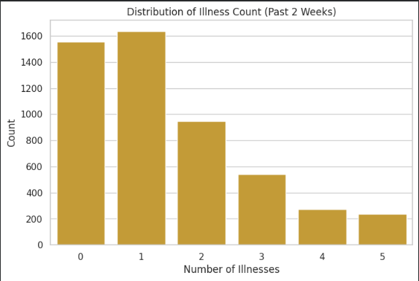
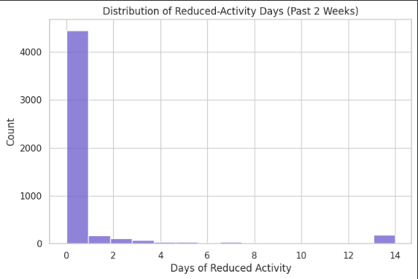
RESULTS
Demo Link

Slide 9
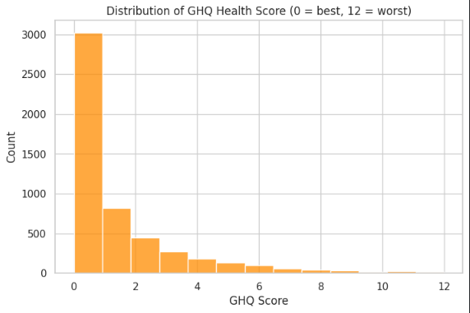
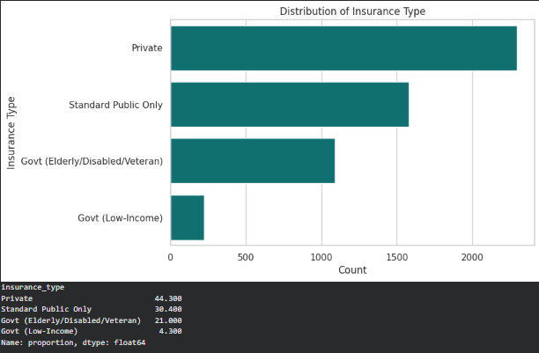
RESULTS
Demo Link

Slide 10
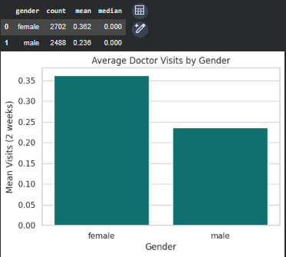
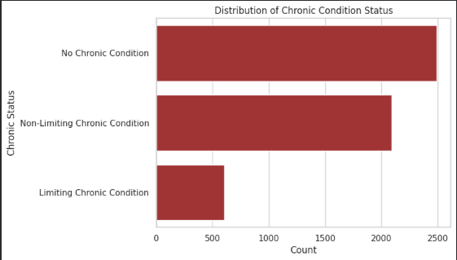
RESULTS
Demo Link

Slide 11
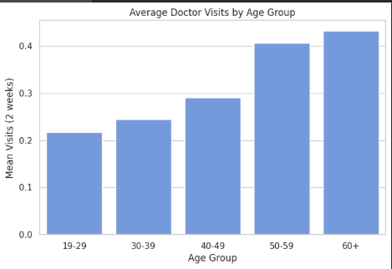
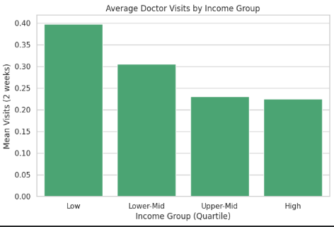
RESULTS
Demo Link

Slide 12
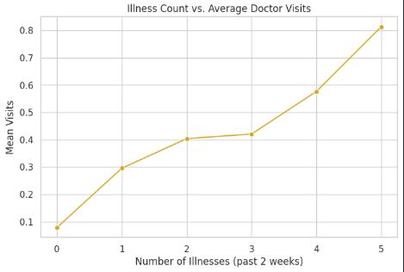
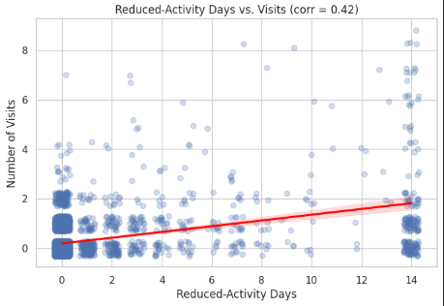
RESULTS
Demo Link

Slide 13
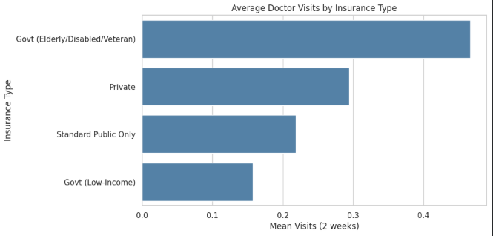
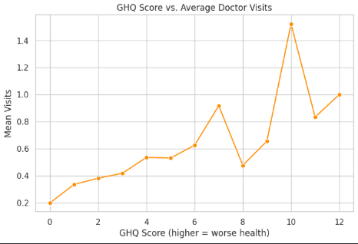
RESULTS
Demo Link

Slide 14
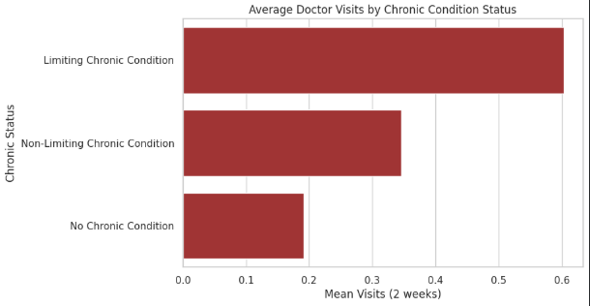
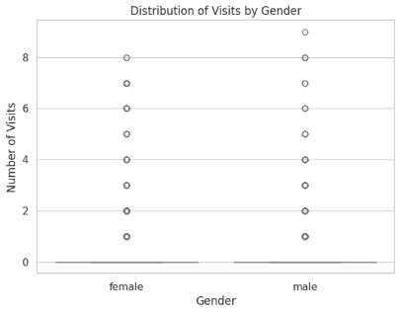
RESULTS
Demo Link

Slide 15
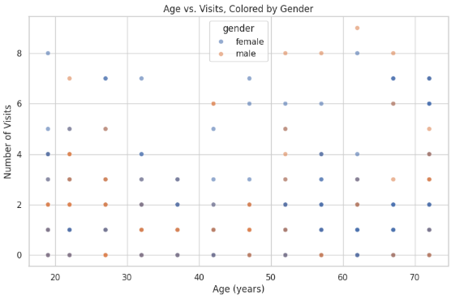
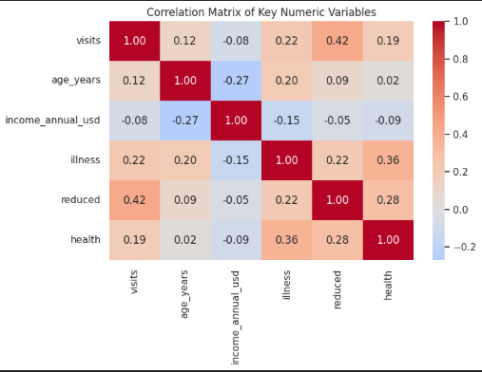
RESULTS
Demo Link

Slide 16
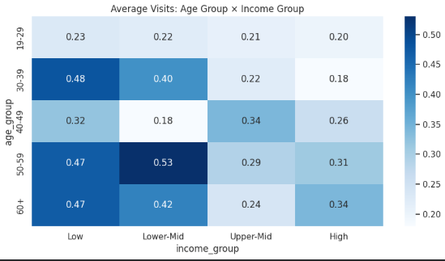
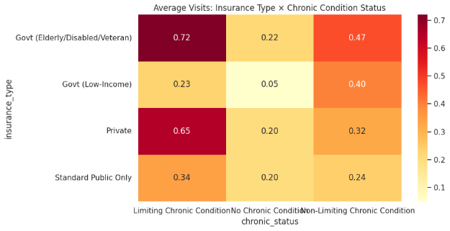
RESULTS
Demo Link

Slide 17
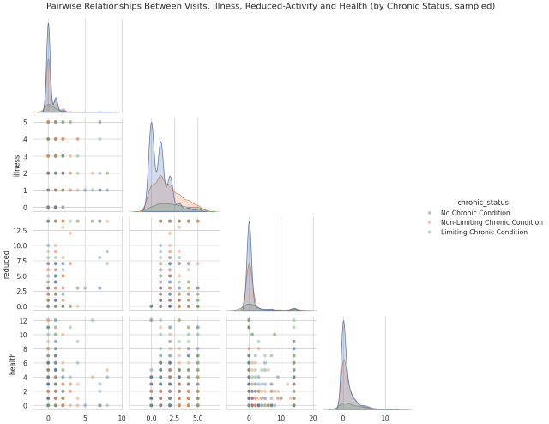
RESULTS
Demo Link

Slide 18
Thank you

