Slide 1

Seasonal_Agriculture_Performance_Data_Analytics
Om Rajendrakumar Koli
Adarsh Institute of Technology and Research Centre, Vita
AICTE STU ID : STU66d3ee81eb4b21725165185

Slide 2

PROBLEM STATEMENT
Agricultural activities are influenced by seasonal variations in environmental conditions, farming practices, resource availability and market conditions. As a result, agricultural performance may differ from one season to another. However, raw agricultural data does not clearly explain how agricultural performance changes across seasons or what patterns can be observed in different seasonal conditions. The problem is to analyze the given agricultural dataset and investigate seasonal differences in agricultural performance by identifying meaningful patterns, trends, relationships and variations within the available data.

Slide 3
Project Description
This project analyzes 4,000 farm records across three seasons — Kharif, Rabi, and Zaid — covering multiple states, crops, environmental conditions, farming inputs, and economic outcomes (yield, cost, revenue, profit).
Using Python (Pandas, NumPy, Matplotlib, Seaborn) in Jupyter Notebook, the project performs data cleaning, outlier handling, and univariate/bivariate/multivariate analysis, along with four original research questions on irrigation, disease risk, water efficiency, and input impact on yield.
The goal is to uncover how agricultural performance varies by season and turn these patterns into clear, evidence-based insights for better seasonal planning.

Slide 4

WHO ARE THE END USERS?
Farmers and agricultural producers — to plan crop choice, irrigation method, and input usage by season
Agricultural policymakers and government bodies — to design season-specific support schemes and water-management policy
Agri-business and supply chain companies — to forecast production and manage procurement across seasons
Agricultural researchers and extension officers — to identify patterns worth deeper investigation
Financial institutions and crop insurers — to assess seasonal risk (e.g., disease/pest risk, profit volatility) when pricing loans or insurance

Slide 5

Technology Used
Language: Python
Environment: Jupyter Notebook (Google Colab)
Data Handling: Pandas, NumPy
Data Visualization: Matplotlib, Seaborn
Techniques: Data cleaning & imputation, IQR-based outlier detection, descriptive statistics, univariate/bivariate/multivariate analysis, correlation analysis, pivot tables & heatmaps

Slide 6
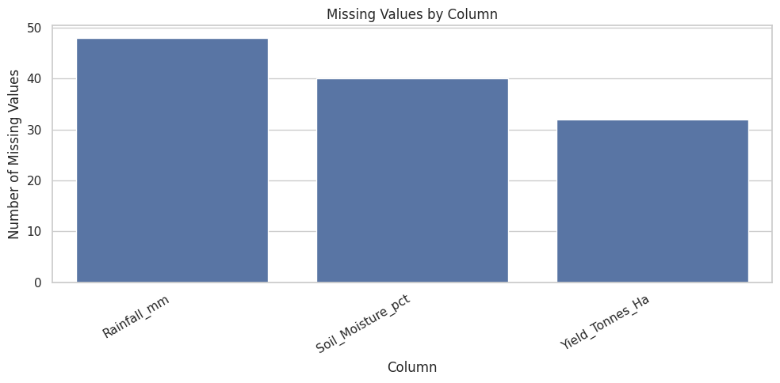
RESULTS
Data Cleaning and Preparation

Slide 7
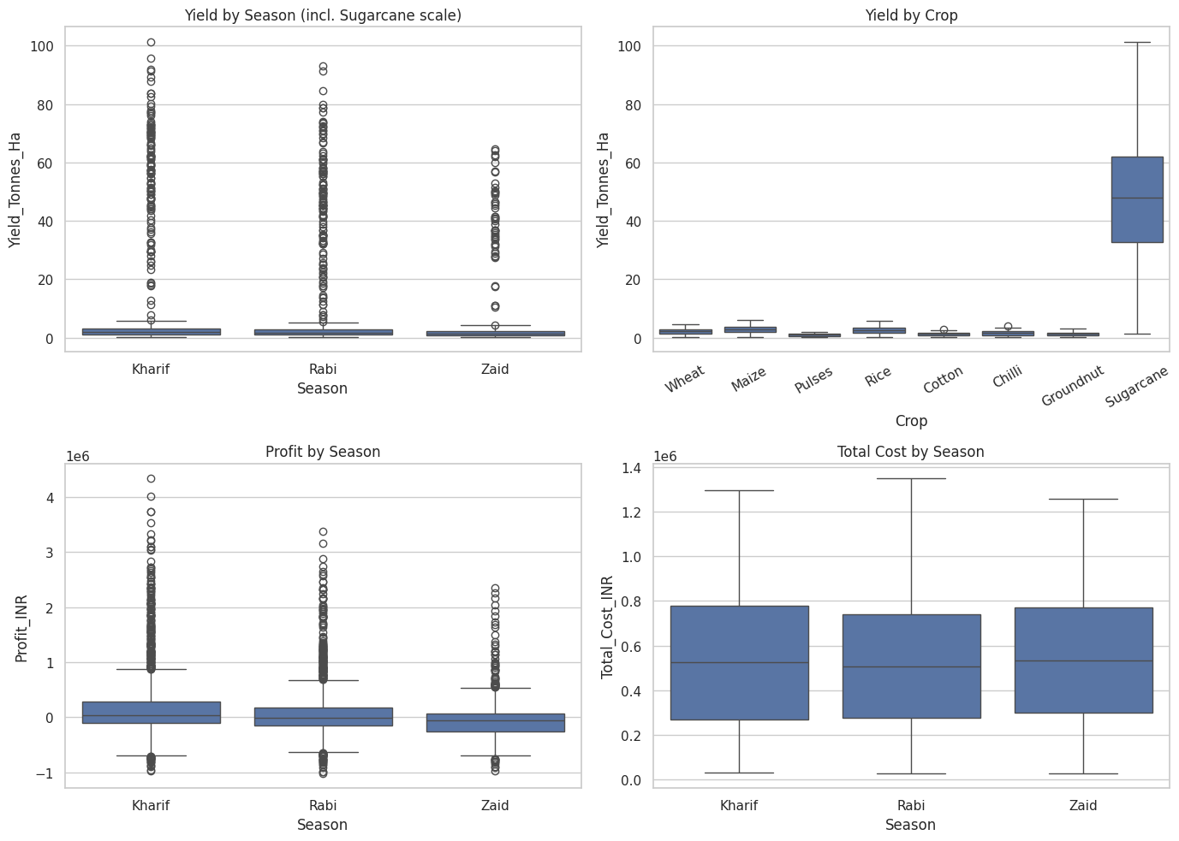
RESULTS
Outlier Investigation (Visual)

Slide 8
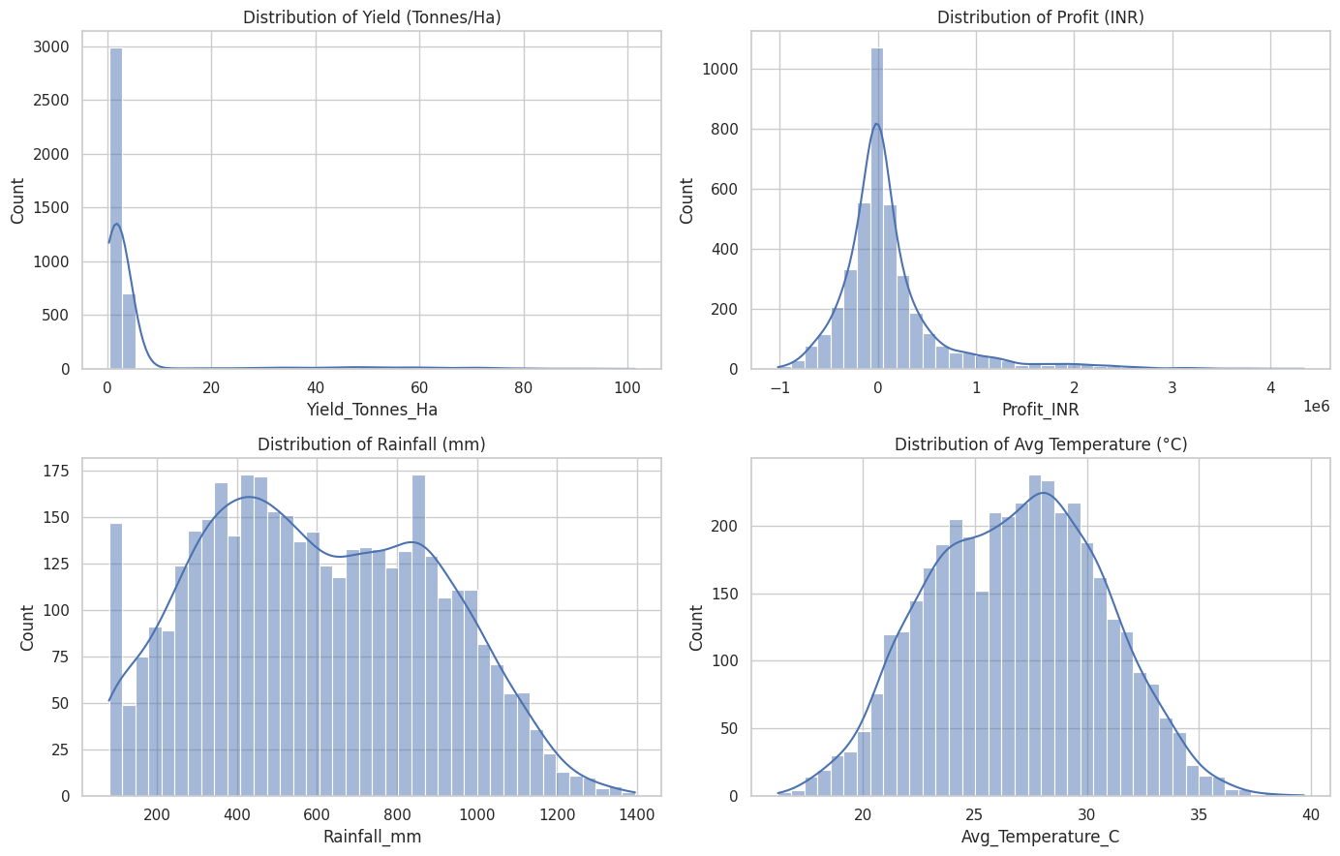
RESULTS
Distribution of Key Numeric Variables

Slide 9
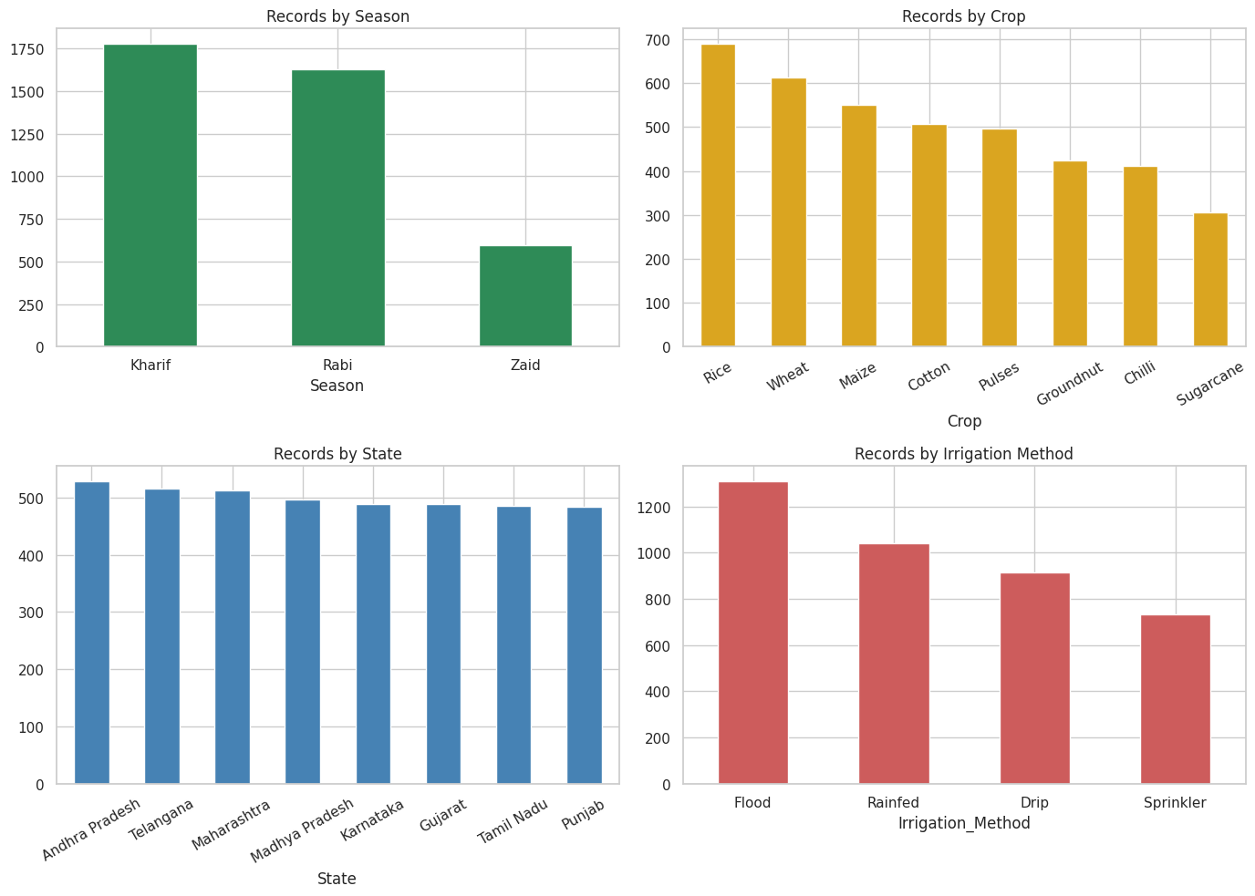
RESULTS
Distribution of Categorical Variables

Slide 10
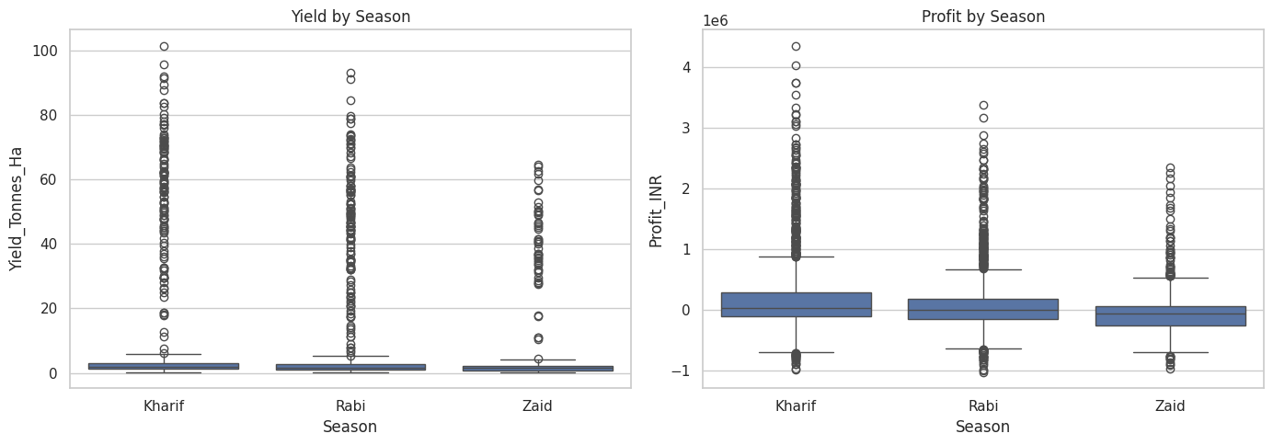
RESULTS
Season vs. Yield and Profit

Slide 11
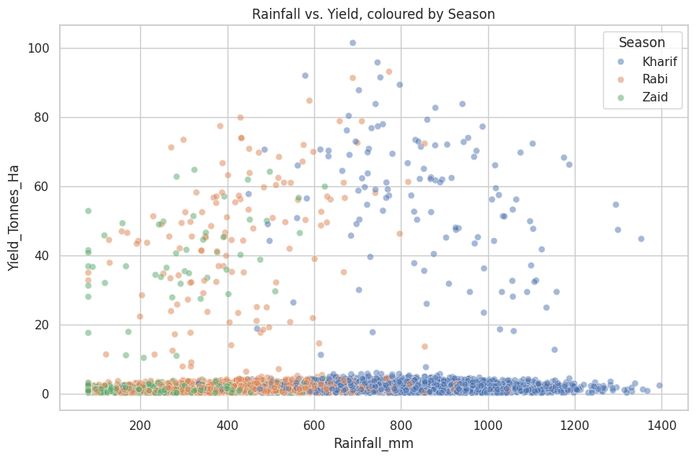
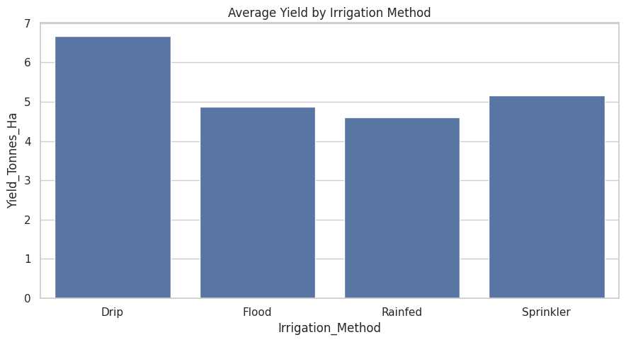
RESULTS
Rainfall vs. Yield
Irrigation Method vs. Yield

Slide 12
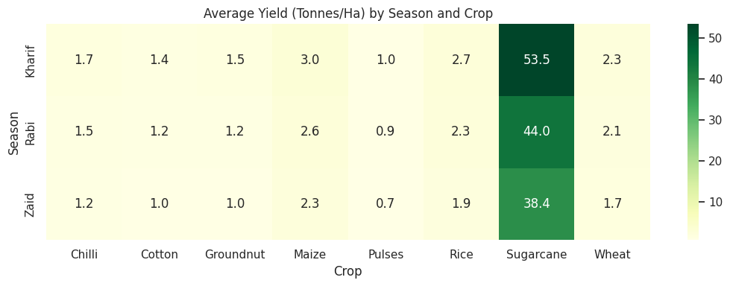
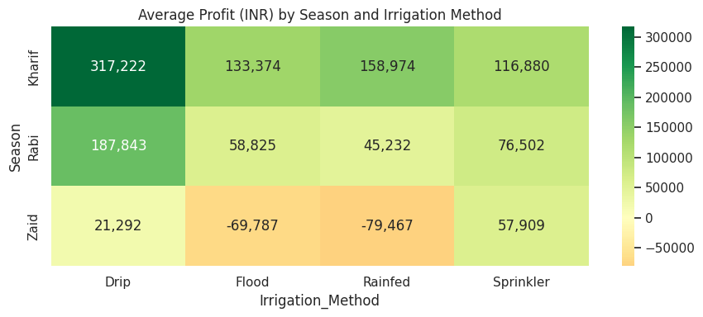
RESULTS
Season × Crop Average Yield (Heatmap)
Season × Irrigation Method Average Profit (Heatmap)

Slide 13
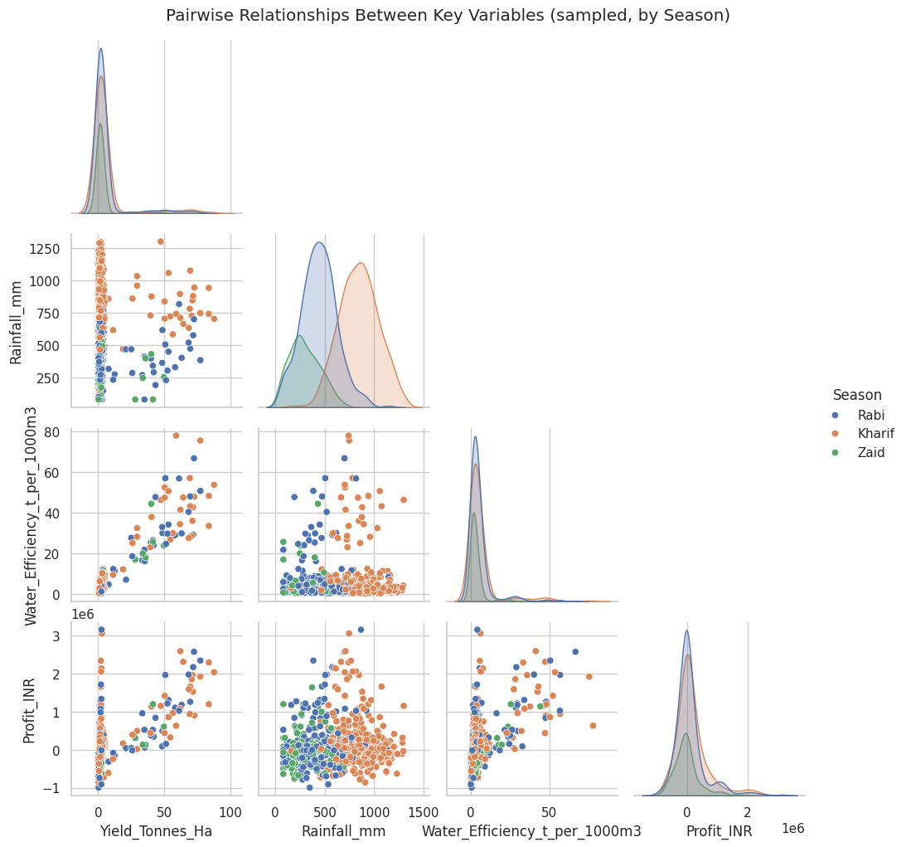
RESULTS
Pairwise Relationships (Key Variables, by Season)

Slide 14
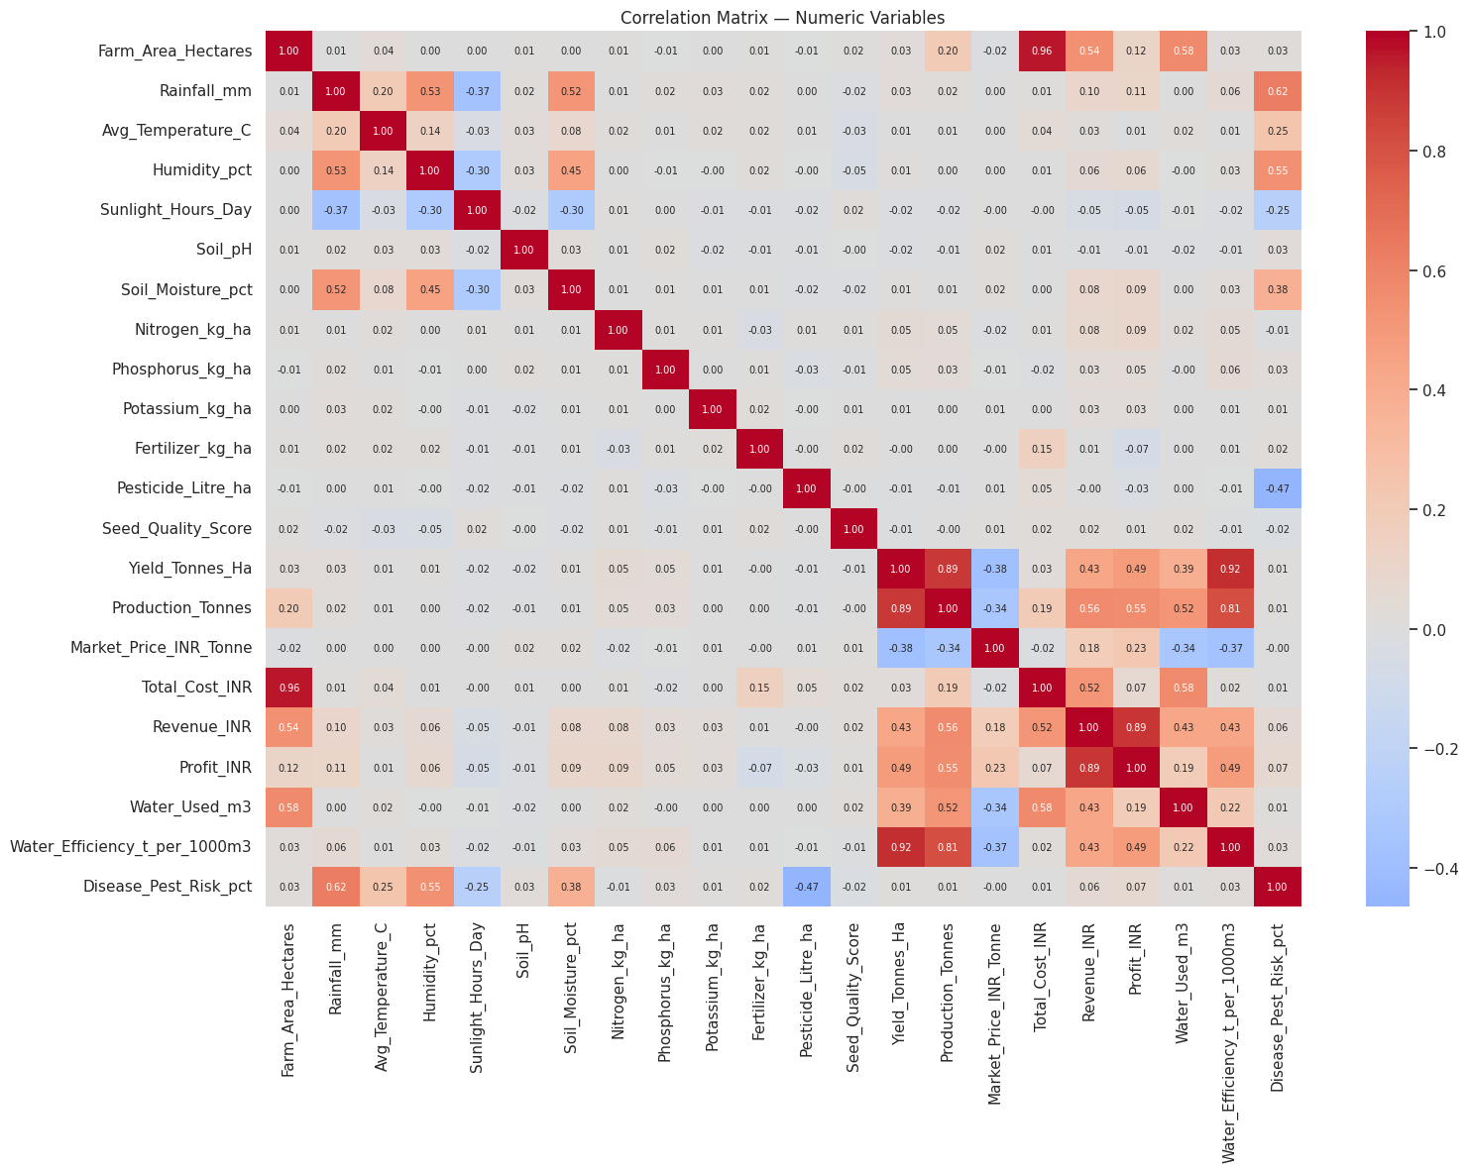
RESULTS
Correlation Analysis

Slide 15
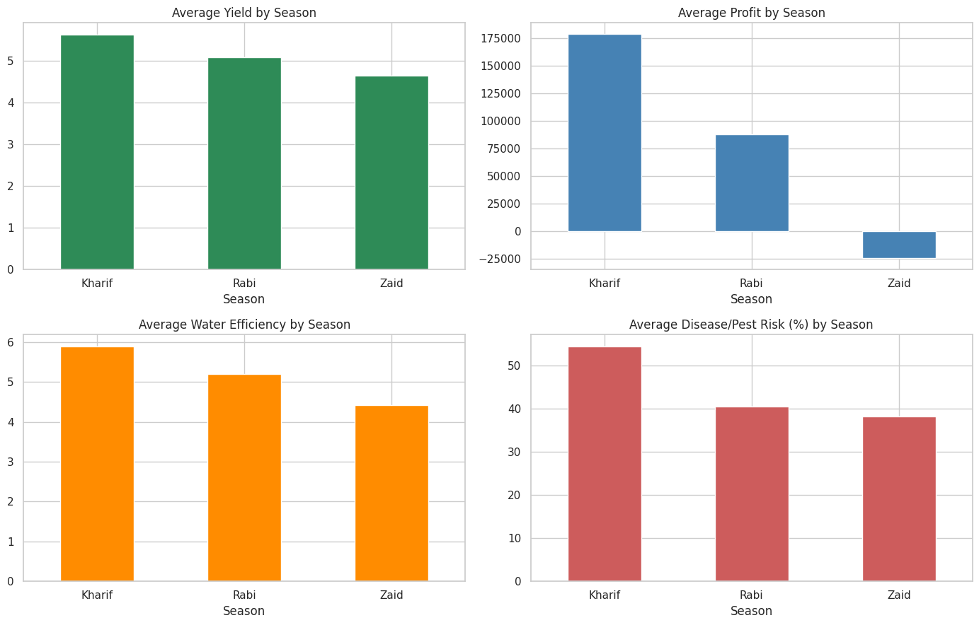
RESULTS
Seasonal Comparison Summary

Slide 16
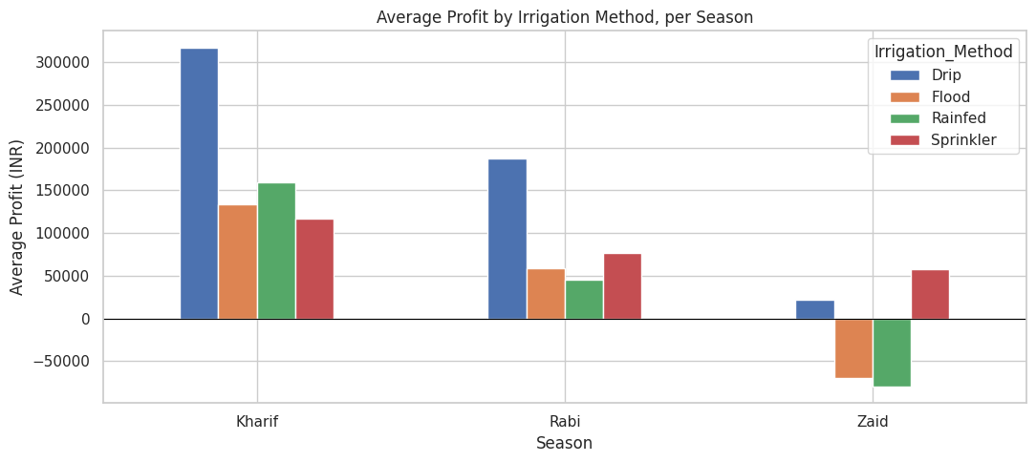
RESULTS
Q1. How does irrigation method affect profitability, and does the best method change by season?

Slide 17
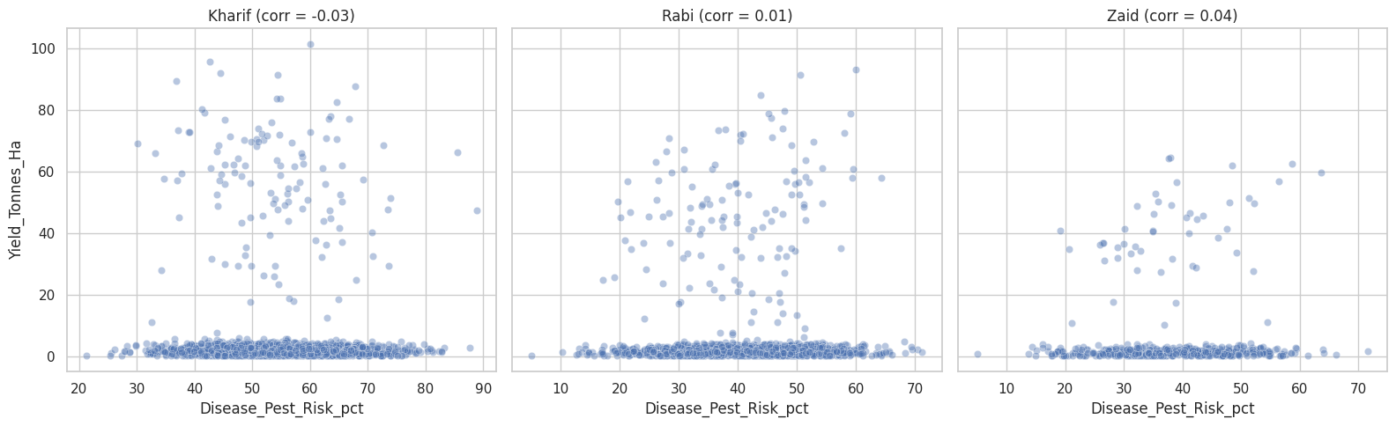
RESULTS
Q2. Is there a relationship between disease/pest risk and yield, and does it differ by season?

Slide 18
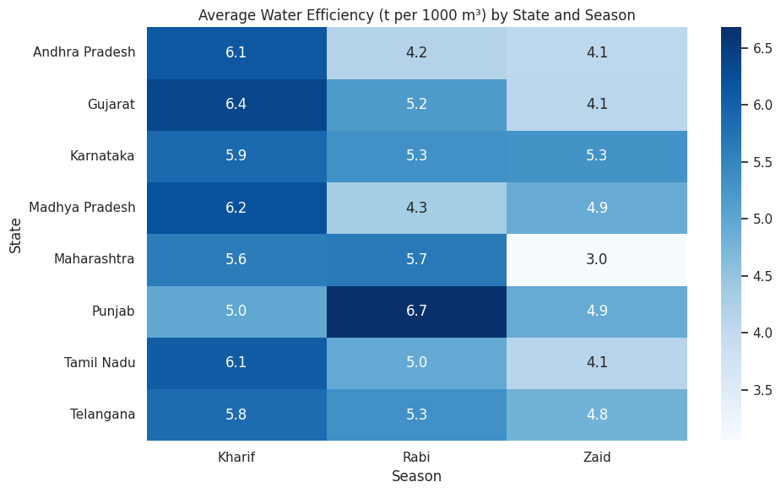
RESULTS
Q3. Which state achieves the best water efficiency in each season, and is the leader consistent across seasons?

Slide 19
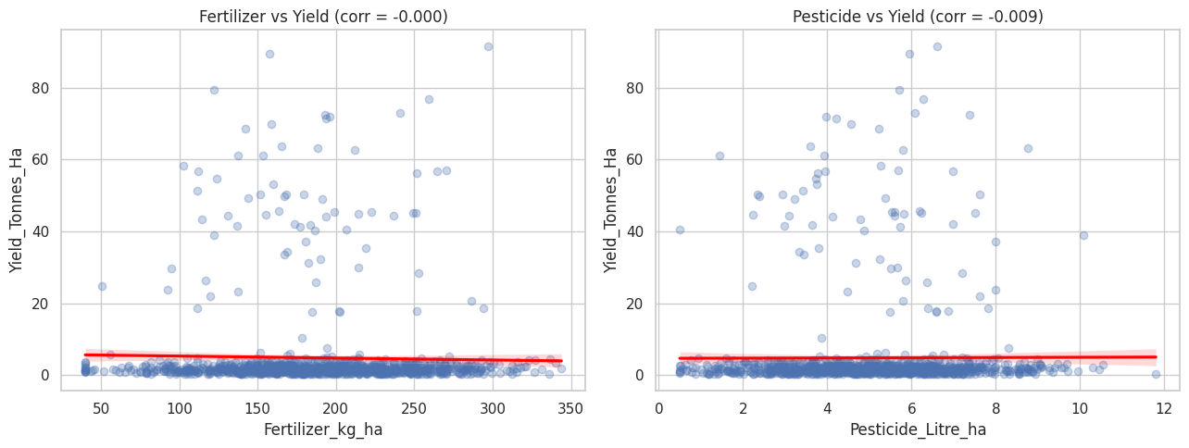
RESULTS
Q4. Do higher fertilizer/pesticide inputs actually translate into higher yield?

Slide 20
Future scope
Build a predictive model (regression/ML) to forecast yield or profit using seasonal and environmental features
Extend the analysis with real-time weather and satellite data for more dynamic seasonal forecasting
Develop an interactive dashboard (e.g., Power BI/Streamlit) for farmers and policymakers to explore seasonal trends
Incorporate additional years of data to study year-over-year seasonal trends, not just a single-cycle snapshot
Add region-specific recommendation systems suggesting optimal crop and irrigation choices per season and state

Slide 21
GitHub Link
https://github.com/Mr007ok/Seasonal_Agriculture_Performance_Data_Analytics-VOIS-Project

Slide 22
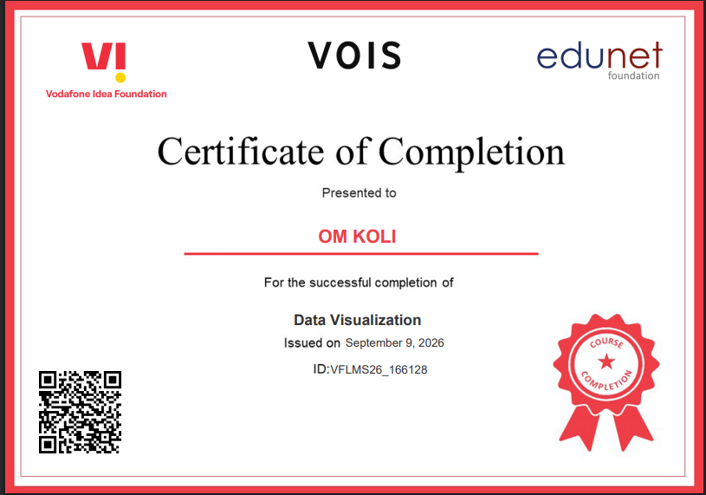
VOIS Course completion certificate -
Course name- Data Visualization

Slide 23
Thank you
.
.

