Slide 1

FLOOD DETECTION FROM
AERIAL IMAGERY USING
DEEP LEARNING
TEAM GALAXY GUARDIANS
Pavithran S 24uad056
BalaYoghi V 24uad045
Vishal K 24uad010
III ADS
2024 – 2028 Batch
MobileNetV2 transfer learning with Grad-CAM evidence
AI2304 — Deep Learning Laboratory

Slide 2
CONTENTS
1. PROBLEM STATEMENT
2. OBJECTIVES
3. REQUIREMENT SPECIFICATION
4. SYSTEM DESIGN
5. RESULTS
6. CONCLUSION
6
SECTIONS

Slide 3
Problem Statement
Floods are among the most frequent and destructive natural disasters, and the speed of the emergency response depends on how quickly the flooded areas are located. Drones and aircraft now capture far more aerial imagery than human operators can inspect in time, so the bottleneck is no longer taking the pictures but reading them.
This project automates that reading step. It classifies an aerial image as flood or no flood and, because a wrong verdict either costs lives or wastes rescue effort, it also shows the visual evidence behind every decision, so an operator can tell whether the model looked at flood water or at something irrelevant.
4,916
AIDER aerial images
2
classes: flood / no flood
228
held-out test images
1
flood missed of 78

Slide 4
Objectives
Build a flood / no-flood classifier for aerial images using MobileNetV2 transfer learning.
Audit the dataset for shortcuts, so accuracy measures flood content and not capture artefacts.
1
2
Compare a frozen feature extractor against a fine-tuned backbone over three random seeds.
Tune the decision threshold on validation data under a precision floor of 0.85.
3
4
Explain every prediction with Grad-CAM and verify it with a size-controlled deletion test.
Deploy the model as a Streamlit application and export TFLite builds for edge devices.
5
6

Slide 5
Requirement Specification
HARDWARE
SOFTWARE
DATASET
▪ Apple silicon M-series or x86-64 CPU (built on Apple M4)
▪ 8 GB RAM minimum, 16 GB recommended
▪ 5 GB free storage; GPU optional (Metal)
▪ Python 3.11, TensorFlow 2.16.2, Keras 3.15.1
▪ tensorflow-metal 1.2.0, NumPy, scikit-learn, OpenCV
▪ Streamlit 1.60 demo app, TFLite runtime
▪ AIDER aerial dataset, CC BY 4.0 (Zenodo)
▪ flooded_areas → flood, normal → no_flood
▪ 224 × 224 RGB, de-duplicated
DATA SPLIT
Stratified 70 / 15 / 15 per class, after removing 200 near-duplicates
Split
no_flood
flood
Total
1,525
images used
Train
700
368
1,068
Validation
150
79
229
Test
150
78
228

Slide 6
System Design
DATA PIPELINE
AIDER dataset
4,916 aerial images
Audit + de-duplicate
200 near-copies removed
Subsample + split
70 / 15 / 15 stratified
Random-resized crop
224×224 + augment
MODEL
MobileNetV2
ImageNet weights
Phase 1: frozen
Adam 1e-3
Phase 2: fine-tune
from block_13_expand
Dense 1, sigmoid
P(flood)
DECISION + DELIVERY
Threshold 0.30
tuned on validation
Grad-CAM on Conv_1
visual evidence
Streamlit app
single + batch
TFLite export
4.57 MB, 7.3 ms

Slide 7
Model Architecture and Training
Input image
224 × 224 × 3 RGB, 0..255
Phase 1 — frozen backbone
Adam 1e-3, up to 15 epochs
Phase 2 — fine-tuning
unfreeze from block_13_expand, Adam 1e-5; BatchNorm stays frozen
Class weights
0.763 no_flood / 1.451 flood
Callbacks
early stopping on val AUC (patience 5); LR halved on val-loss plateau
Repeats
seeds 42, 43, 44 — variant chosen on mean validation AUC
Test set
never used for any choice; deployed run is seed 43
Augmentation
flip, ±18°, brightness/contrast — training only
MobileNetV2 preprocess
scales pixels to −1..1
MobileNetV2 backbone
ImageNet weights — 7×7×1280 maps
GlobalAveragePooling2D
1280 features
Dropout 0.3 → Dense 128 ReLU → Dropout 0.2
classification head
Dense 1, sigmoid
P(flood)
Fig. 1 One flat functional model — Conv_1 stays reachable for Grad-CAM

Slide 8
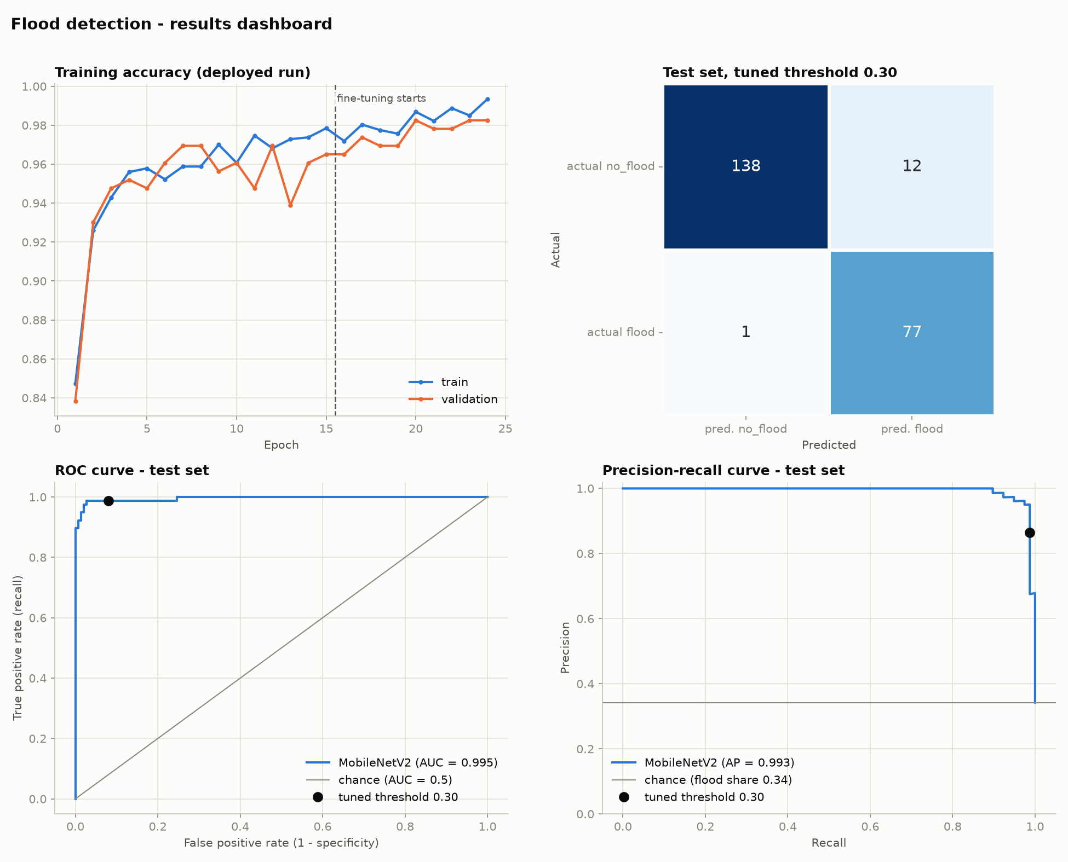
Results — Test Set Performance
0.987
RECALL 77 of 78 floods found
0.865
PRECISION 12 false alarms in 150
0.922
F1 SCORE threshold 0.30, tuned on val
0.9955
ROC AUC average precision 0.9932
Fine-tuning beats the frozen backbone
Test accuracy 0.9649 ± 0.0044 against 0.9474 ± 0.0494 over seeds 42–44. The threshold 0.30 was chosen as the lowest whose validation precision stays ≥ 0.85 — a missed flood costs lives, a false alarm costs an inspection.
Fig. 2 Training curves, confusion matrix, ROC and PR curves (test set)

Slide 9
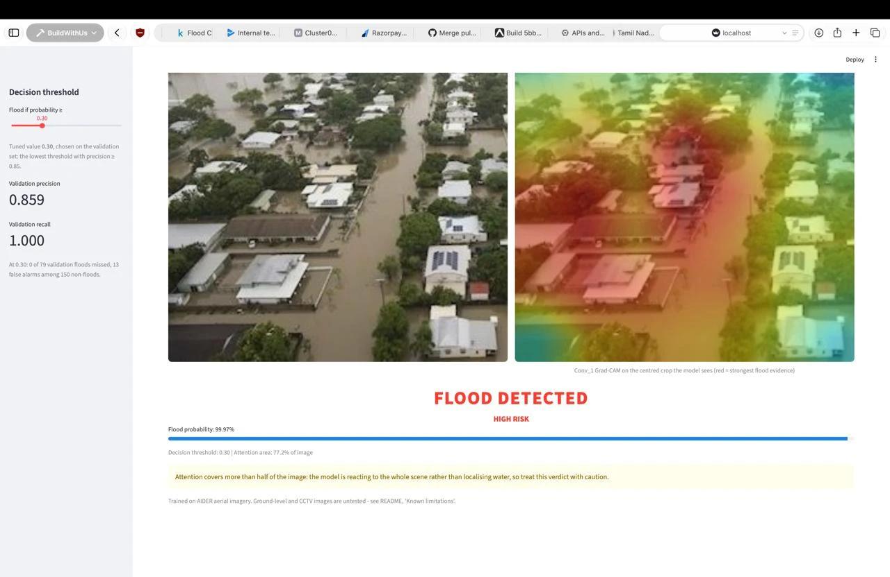
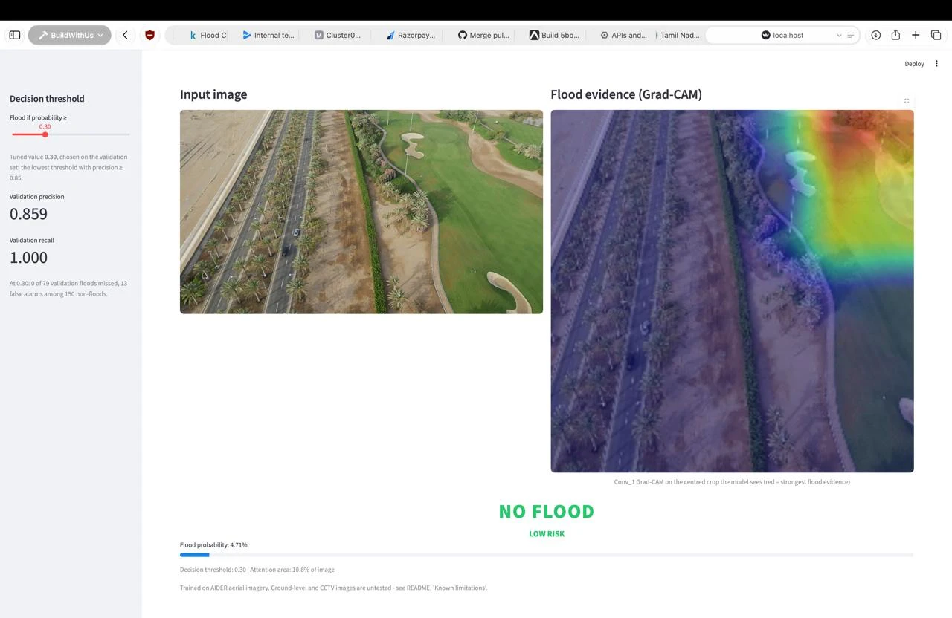
Results — Streamlit Application
Upload an image to get the verdict, the flood probability and the Grad-CAM evidence; the sidebar slider re-scores the decision threshold live.
Fig. 3 Flood detected — P(flood) = 99.97 %
Fig. 4 No flood — P(flood) = 4.71 %

Slide 10
Results — Evidence and Deployment
GRAD-CAM DELETION TEST
DEPLOYMENT EXPORTS
Detected floods (77)
Mean P
Still flood
Export
Size
Latency
Δ decisions
Original image
0.992
100 %
Keras (.keras)
9.81 MB
14.1 ms
—
Top 25 % removed
0.848
88.3 %
TFLite int8
2.54 MB
4.4 ms
2 of 228
Bottom 25 % removed
0.987
100 %
TFLite float16
4.57 MB
7.3 ms
0 of 228
Greying out the quarter of pixels Grad-CAM ranks highest drops the flood probability far more than removing the quarter it ignores, so the evidence really is where the heatmap points.
The float16 build is under half the size of the Keras file, runs in 7.3 ms on a CPU and reproduces every Keras decision — the safe choice for a drone or a phone.
Attention area 62.0 % of the frame on true floods against 7.5 % on true non-floods; 77 % of real floods exceed the 50 % warning line, so the app flags whole-scene reactions for the operator.

Slide 11
Conclusion
Delivered a flood classifier that finds 77 of the 78 test floods (recall 0.987) at precision 0.865, ROC AUC 0.9955.
Showed that fine-tuning beats a frozen backbone across three seeds, and chose both the variant and the 0.30 threshold on validation data only.
Confirmed with a deletion test that the model's evidence is concentrated where Grad-CAM points, not spread over the whole scene.
Exported a 4.57 MB float16 TFLite model that runs in 7.3 ms on a CPU and reproduces every Keras decision.
Reported the limits honestly: aerial views only, a subsampled no-flood class, and residual source differences the crop cannot remove.

Slide 12
THANK YOU
Team Galaxy Guardians · III ADS

