Slide 1
Playing Doom Using Reinforcement Learning
Muhammad Abdullah Abu Bakar
P15-6043

Slide 2
What is Doom?
Doom is an action-packed, first-person-perspective game from Id Software.
It was first released as Shareware on December 1st, 1993.
Being a first-person shooter, Doom is experienced through the eyes of the main character.
Highly Popular game of the 90's and a hallmark of First Person Video Games.

Slide 3
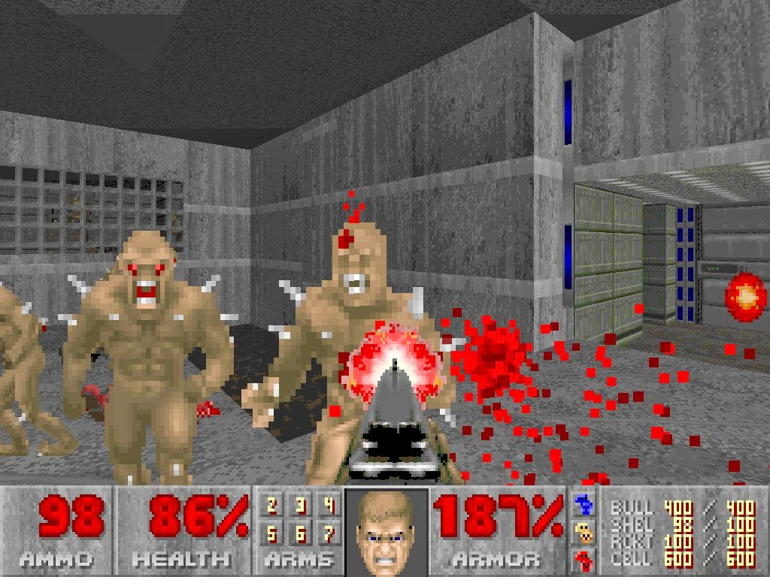
Screenshot from Doom

Slide 4
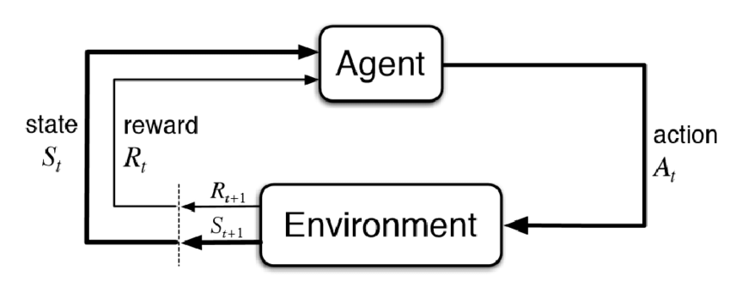
So What is Reinforcement Learning?
It is semi-supervised form of machine learning.
The algorithm learns a policy of how to act in a given environment.
Every Action of the agent has some impact on the environment, and the environment provides some reward which guide the learning algorithm.

Slide 5
Enter Q-Learning
STATE:
Given a state S in a game.
That may some configuration of a chess-board or frames from a video-game.
ACTION:
The Player decides to take an action A.
In Chess that maybe moving a figure or in a video game that maybe pushing a button to move left, right, shoot, jump etc.

Slide 6
Enter Q-Learning (Part-2)
REWARD:
As a result, there will be some reward R.
That maybe better score in a video-game or a checkmate in chess.
NEW STATE:
Thus we will reach a new state in the game called new state S’.
That maybe another configuration of the chess board or another frame(set) of a game or maybe another level of the game!

Slide 7
The Little, Tiny and Very Small Problem with Rewards
SPARSE DISTRIBUTION OF REWARD
In Chess or in any video-game, you may not directly get a reward by performing an action!
That is Rewards directly do not appear after an action.
So most of the time, the reward stays zero, that is why this it is called Sparse Distribution of Reward.
CREDIT ASSIGNMENT PROBLEM
When there is a reward, it may not be due to the action executed immediately before it.
Some Action taken long ago might have caused the reward.
Figuring out which action is responsible for reward, we call it Credit Assignment Problem.

Slide 8
Expected Future Rewards
Rewards are delayed in real life.
Good Chess Players do not chose their plays judging only the immediate reward.
For example, they do not only think about whether they can eliminate an opponent’s figure in the next move.
They also consider how taking a certain action now will help them in the long run.
Same goes in Video-games.

Slide 9
THE Q VALUE : THE SOLUTION
We find the maximum expected future reward using the "Q-Function".
It takes the Current State(of the game) S, and a given action A
Q(state, action)

Slide 10
THE Q VALUE : THE FUNCTION
Q( S , A ) = R + γ * max Q( S’ , A’ )
Q( Current_State, Given_Action ) = Immediate_Reward + Discount_Factor * MAX Q( Next_State, Optimal_Action_of_Next_State)

Slide 11
THE Q VALUE : THE INTIUTION
While in state S, we estimate the future reward for each possible action A.
We assume that after we have taken action A and moved to the next state S'
The expected future reward Q(S,A) for a given a state S and action A is calculated as the immediate reward R.
Plus the expected future reward thereafter Q(S',A'). We assume the next action A' is optimal.
Because there is uncertainty about the future, we discount Q(S’,A’) by the factor gamma γ, plus to make the sum finite.

Slide 12
THE "DEEP" in DEEP-Q-Learning
Good chess players are very good at estimating future rewards in their head. In other words, their Q-function Q(S,A) is very precise.
But how can a machine estimate a good Q-function? This is where neural networks come into play.

Slide 13
REGRESSION AFTER ALL!
When playing a game, we generate lots of “experiences”. These experiences consist of:
the initial state, S
the action taken, A
the reward earned, R
and the state that followed, S’
These experiences are our training data. We can frame the problem of estimating Q(S,A) as a regression.
Where there is regression, you will always find a wild neural NN there.

Slide 14
REGRESSION AFTER ALL!(Part-2)
Given an input vector consisting of S and A.
The ANN is supposed to predict the value of Q(S,A) equal to the target: R + γ * max Q(S’,A’)
If we are good at predicting Q(S,A) for different states S and actions A, we have a good approximation of the Q-function.
Note that we estimate Q(S’,A’) through the same neural net as Q(S,A).

Slide 15
THE ALGORITHM:
Given a batch of experiences < S, A, R, S’ >, the training process then looks as follows:
For each possible action A’ (left, right, shoot), predict the expected future reward Q(S’,A’) using the ANN.
Choose the highest value of the three predictions as max Q(S’,A’)
Calculate r + γ * max Q(S’,A’). This is the target value for the neural net
Train the neural net using a loss function.
This calculates how near or far the predicted value is from the target value.

Slide 16
Experience Replay Memory
During gameplay, all the experiences are stored in a replay memory.
This acts like a simple buffer in which we store < S, A, R, S’ > pairs.
We then feed random batches of replay memory to the ANN, this is called Experience Replay, instead of iterating over all the Q-values.
WHY EXPERIENCE REPLAY?
The reason why experience replay is helpful has to do with the fact that in reinforcement learning, successive states are highly similar.
This means that there is a significant risk that the network will completely forget about what it’s like to be in state it hasn’t seen in a while. Replaying experience prevents this by still showing old frames to the network.

Slide 17
N-Step Q learning ( Simplified by me )
Instead of getting the reward and calculating the deep Q values for one step.
We will take a series of steps that are N steps.
Then based on those N-steps we will decide whether those were good or not.
To prove whether it is better is beyond my scope, I learned it and implemented it via a Udemy course ( amazing course linked below )
To me the logic is simple, which guy will get the better grade ? The one who plans for the quiz, or the one who plans for the semester ?

Slide 18
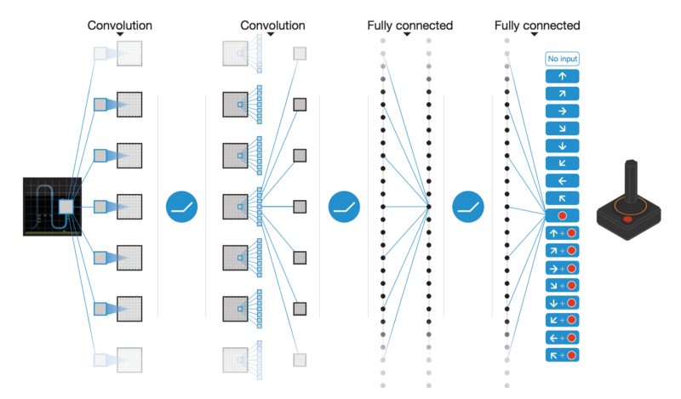
How my Model Works in Doom

Slide 19
Improvements that can be made:
Using Double DQN
Using Prioritized Experience Replay
Implementing Huber-Loss
Dueling DQN's ( No absolute idea )
More Networks, More Training, More Memory for Exp Replay
P.S
DO NOT QUESTION ME IN THESE, AS I DO NOT HAVE STRONG KNOWLEDGE OF THESE, ONLY A VAGUE IDEA. MANANA!

Slide 20
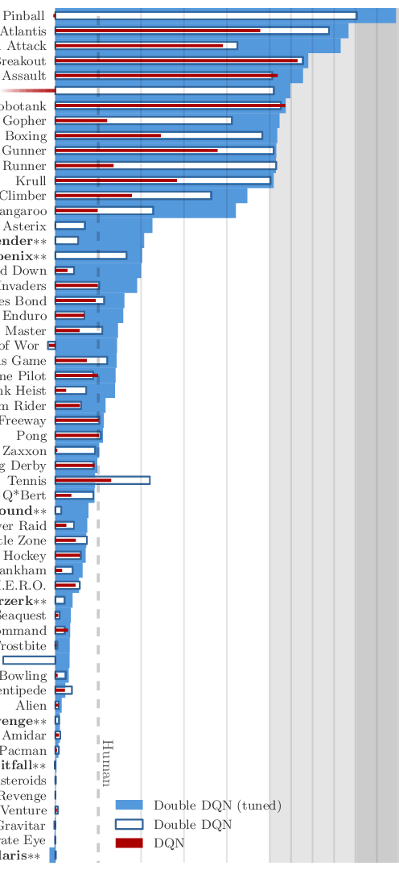
Results of DQN,DDQN and Tuned_DDQN

Slide 21
Profound Gratitude to the following resources
https://becominghuman.ai/lets-build-an-atari-ai-part-1-dqn-df57e8ff3b26
https://becominghuman.ai/lets-build-an-atari-ai-part-0-intro-to-rl-9b2c5336e0ec
http://hunch.net/~beygel/deep_rl_tutorial.pdf
https://jaromiru.com/2016/09/27/lets-make-a-dqn-theory/
https://jaromiru.com/2016/10/21/lets-make-a-dqn-full-dqn/
https://gym.openai.com/docs/
http://mnemstudio.org/path-finding-q-learning-tutorial.htm
https://medium.com/@dhruvp/how-to-write-a-neural-network-to-play-pong-from-scratch-956b57d4f6e0
http://karpathy.github.io/2016/05/31/rl/
http://vizdoom.cs.put.edu.pl/
https://www.udemy.com/artificial-intelligence-az/
http://www.ai-forum.org/
http://forums.fast.ai/
https://www.reddit.com/r/learnmachinelearning/
https://www.reddit.com/r/MLQuestions/
https://www.reddit.com/r/datascience/
https://www.edx.org/micromasters/data-science
AND MY OLD LAPTOP WITH A GPU, we will never forget you.

