Slide 1
Video Game Sales
Group 4
Dane, Kiana
Gomes, James
Martin, Avery
Whitaker, Johnny
Notes:
James

Slide 2
Road Map
Video Game Industry
Our Goal
The Data Source
Tools
Methods
Results
Conclusion
Notes:
James

Slide 3
Video Game Industry
U.S. video game sales reach record breaking $43.4 Billion in 2018. Experiencing 18% growth
Video game market expected to be worth over $90 Billion by 2020. $78.61 Billion in 2017
64% of American households are home to at least one person who plays video games regularly (3 hours a week).
60% of Americans play video games daily
45% of U.S. gamers are women
All data provided by the Entertainment Software Association (ESA)
Notes:
James

Slide 4
Our Goal
The end goal of this analysis is to be able to predict performance, and global sales of a new video game across four markets
Upon the completion of our goal we can better predict which games will have success by region, genre, and platform
Notes:
James
Especially R&D and marketing since we will be able to target where most of the sales would come from and to which console

Slide 5
The Data Source
Analysis was performed on a dataset from Kaggle.com, which contains sales data of over 16,500 games organized by:
United States
Japan
Europe
The rest of the world
Total worldwide sales
Data includes categories such as:
Global Rank
Name
Platform
Year
Genre
Publisher
Notes:
Our dataset from Kaggle contains over sixteen and a half thousand games organized by United States, European, and Japanese regions, “other,” and cumulative worldwide sales.

Slide 6
Benefits of a comprehensive dataset
Games from this dataset were released between 1980 and 2016
Representative of modern global video game market
Enables interpretation of evidence-based marketing decisions
Analysis provides strong ability to estimate sales performance of a new game
Notes:
Games like pac-man and tetris were introduced in the early 80’s, when video games first became popular household commodities
Comprehensive nature of dataset is representative of the modern global market, which enables our research to be extremely relevant for marketing decisions and sales forecasting

Slide 7



Tools

Slide 8


Tools

Slide 9
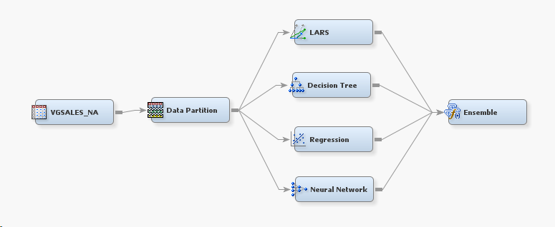
Methods - SAS

Slide 10
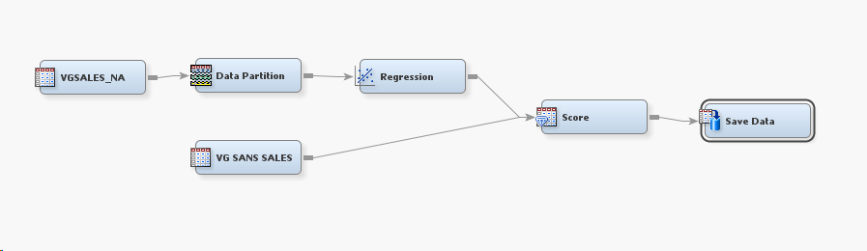
Methods - SAS

Slide 11
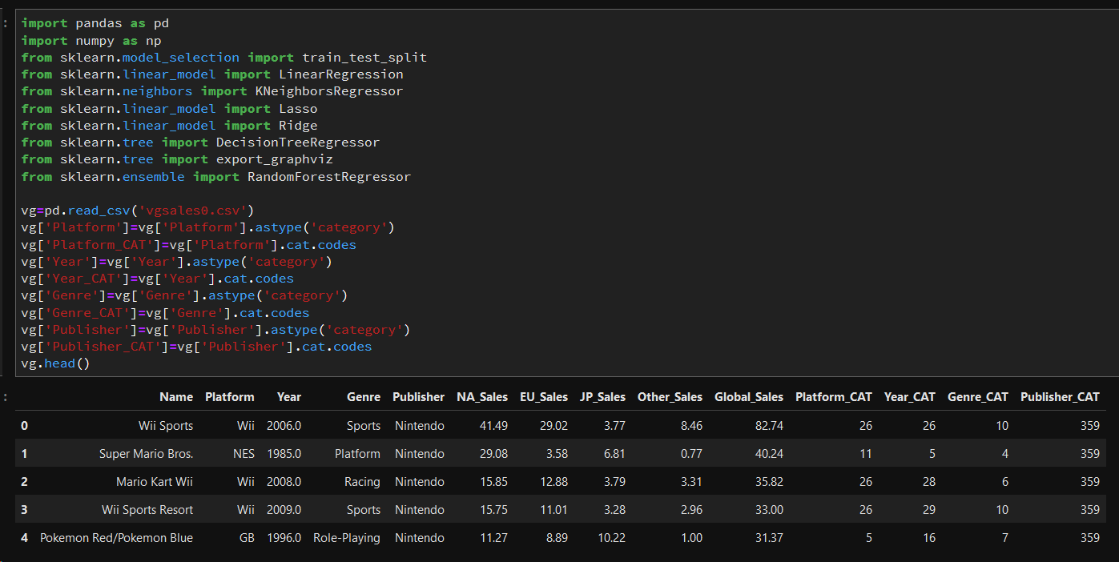
Methods - Python

Slide 12
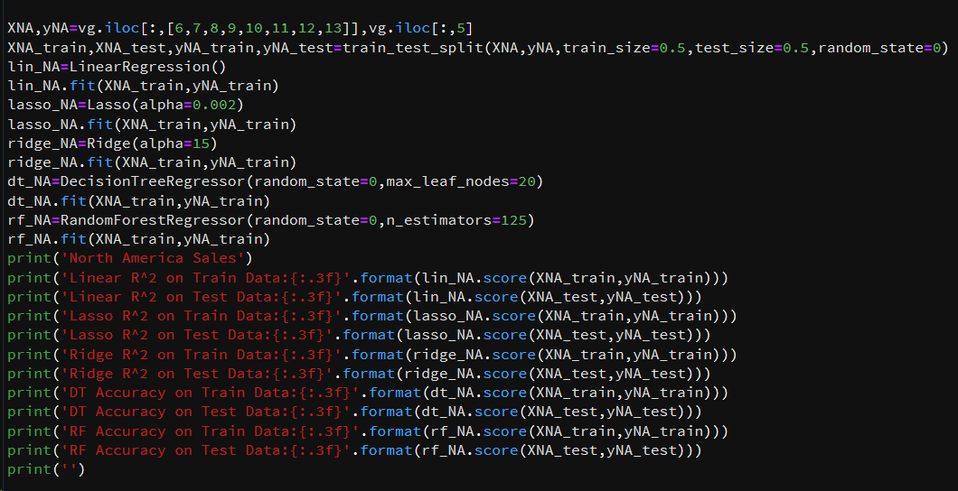
Methods - Python

Slide 13
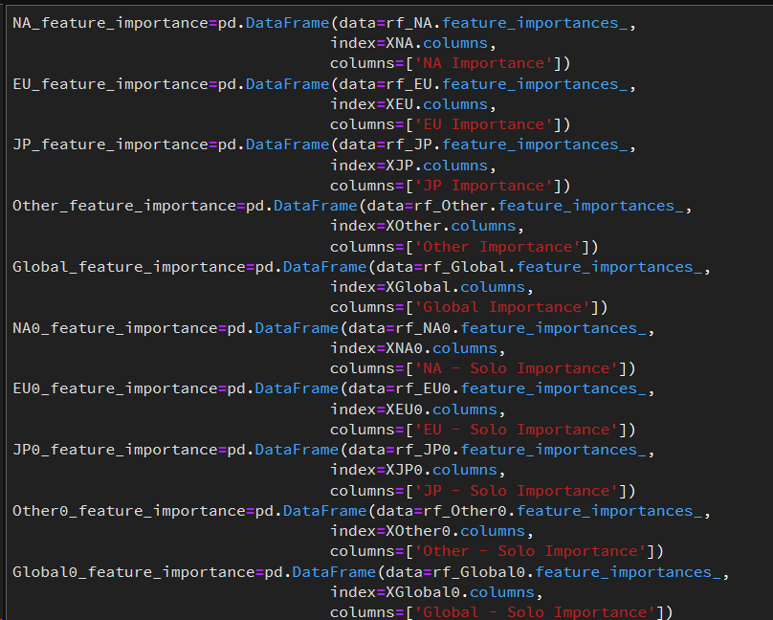
Methods - Python

Slide 14
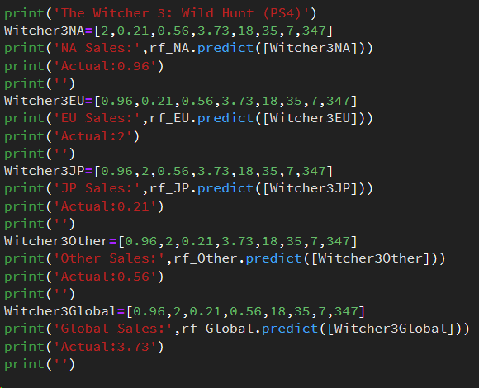
Methods - Python

Slide 15
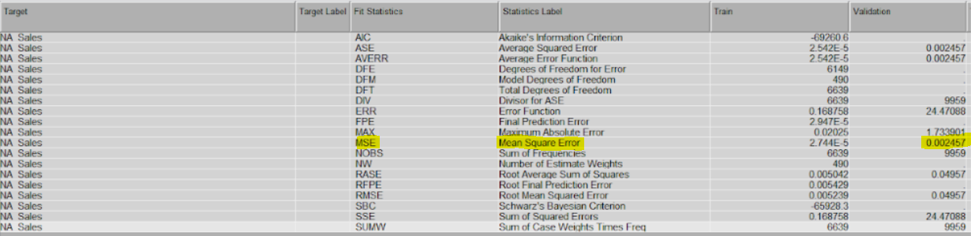
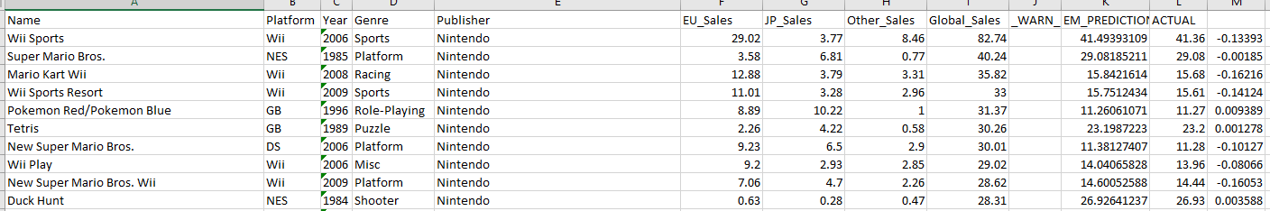
NA Sales Results - SAS
After Running Model Node:
MSE = .002457
After Running Score Node:
MSE = 0.087
Notes:
Farther years more sales, console preferences,

Slide 16
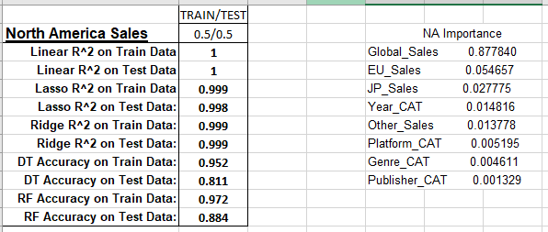
NA Sales Feature Importance - Python
Notes:
At least within 85% Accuracy - Random Forest
Random Forest - Feature Importance

Slide 17
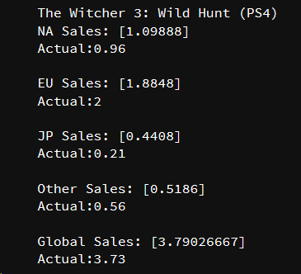
The Witcher 3: Wild Hunt - Python
Notes:
Originally in the database - took out of the database for xbox, ps, pc
At least 85% confident

Slide 18
Conclusion
Huge growth (18%, 2018; 16%, 2017)
Data Tools:
SAS Enterprise
Python (Jupyter Notebook)
SAS Mean Square Error:
Validation: 0.002457
Score: 0.087
Other Opportunities:
Japan Console Preferences
More In-Depth Regions
Notes:
Japan Sales - looking at console exclusivity (Playstation), remove JP sales from python models (a lot better scores)

