Slide 1
Pygame 101 by Mr H
Inspired by Tech with Tim

Slide 2
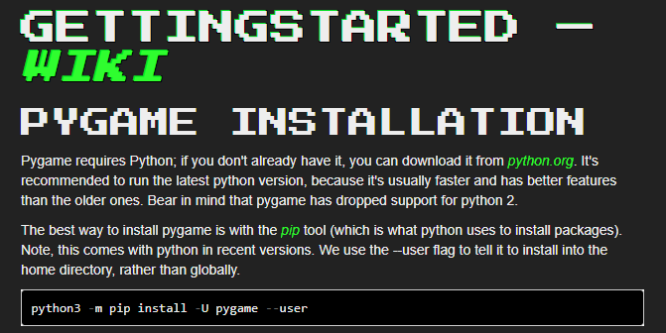
Install Pygame :https://www.pygame.org/wiki/GettingStarted
python3 -m pip install -U pygame --user

Slide 3
Basic Window With Exit Click - Procedural Top Level
#-------------------------------------------------------------------------------
# Name: pygame-tut01
# REF : https://youtu.be/i6xMBig-pP4?list=PLzMcBGfZo4-lp3jAExUCewBfMx3UZFkh5
# REF2: https://www.pygame.org/docs/ref/pygame.html#pygame.init
#-------------------------------------------------------------------------------
import pygame
def start(width,height,caption)->pygame.Surface:
def main_loop(delay_ms):
def stop():
def main():
win = start(800,600,"title") #SVGA : 800x600
main_loop(100)
stop()
if __name__ == '__main__':
main()

Slide 4
Basic Window With Exit Click - Procedural - start & stop
def start(width,height,caption)->pygame.Surface:
#initi pygame
pygame.init()
size_tuple = (width,height)
win = pygame.display.set_mode(size_tuple)
pygame.display.set_caption(caption)
return win
def stop():
pygame.quit()

Slide 5
Basic Window With Exit Click - Procedural - main_loop
def main_loop(delay_ms):
run = True
while run:
pygame.time.delay(delay_ms)
#event handler loop here
for event in pygame.event.get():
if event.type == pygame.QUIT:
run = False

Slide 6
Switching to OOP version
OOP is a far better paradigm for a game.
We can use classes to abstract components.
We can use encapsulation (bundling states + behaviour) to better decompose componentes and keep the name space cleaner.
We can use inheritance and instantiation to re-use quickly code.
While the final oop version is a lot more code it is far more reusable and dynamic!

Slide 7
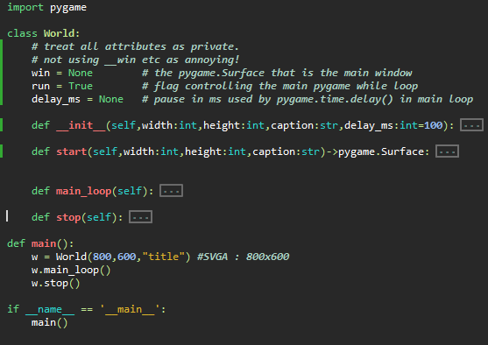
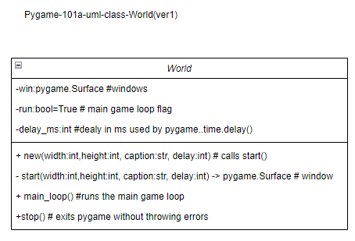
Basic Window With Exit Click - OOP Top Level
Instantiate the world as “w”

Slide 8
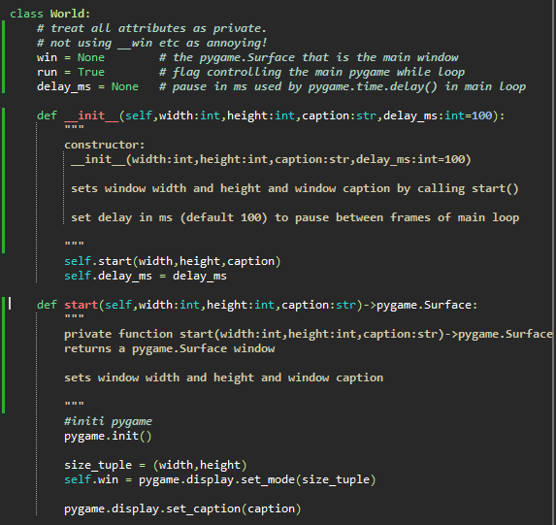
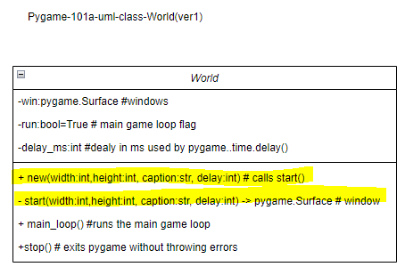
Basic Window With Exit Click - oop- __init__ & start

Slide 9
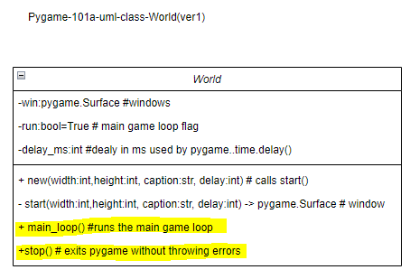
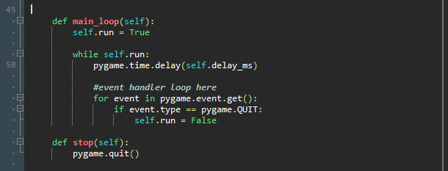
Basic Window With Exit Click - OOP- main_loop & stop

Slide 10
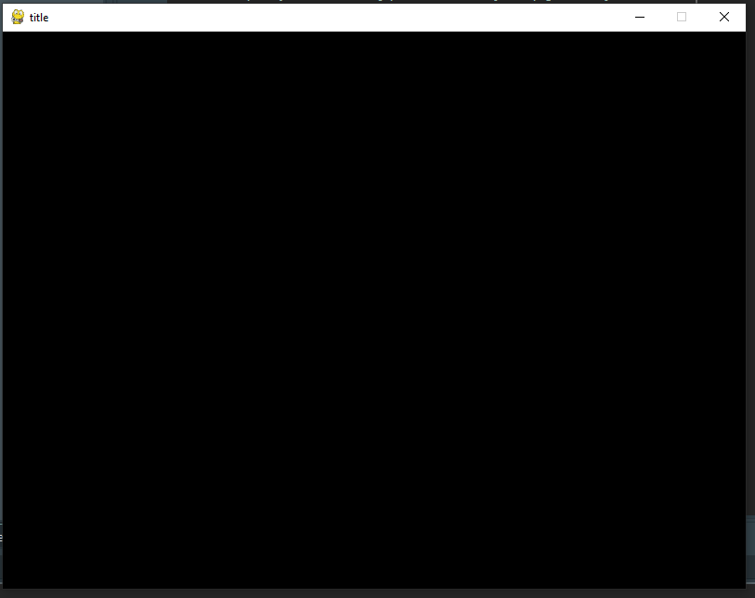
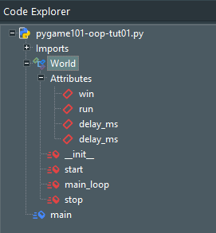

Developmental Run
Pygame 800x600
Window created
Program exited without error when windows X pressed…

Slide 11
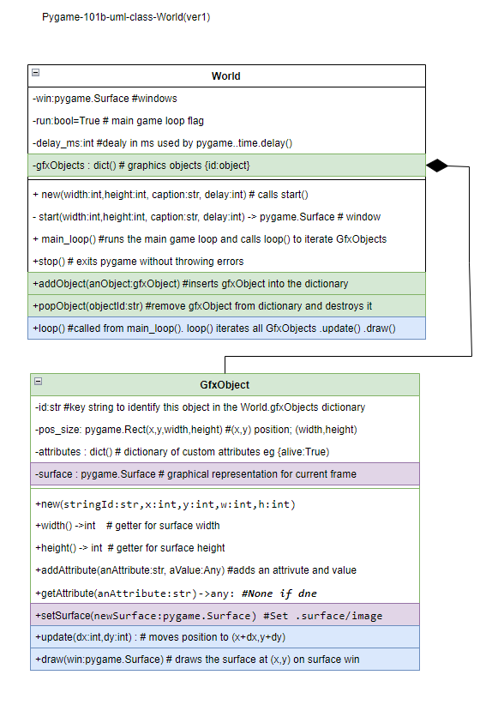
101 Oop Version 1B - UML Diagram
Explanation & Justification
In order to create a scalable Object Orientated system, gfxObjects (dictionary) was added as an attribute of the World class.
This dictionary will hold all graphical objects (that are essentially Surfaces with other attributes) visible in the World.
A GfxObject is instantiated and must have the standard pygame (x-pos,y-pos,width,height) tuple to control its position.
The stringId parameter must be unique and is used as its key index value within the gfxObjects dictionary that World contains.
The World.addObject() method inserts a GfxObject into this dictionary.
The method World.loop() iterates over all GfxObjects calling their: GfxObject.update(dx,dy) methods - to move the objects
GfxObject.draw(win) method to draw it on the “win” surface
In this example move increments x so the redFig object moves right each frame. In the next iteration 101c, the method GfxObject.handleKeyMovement() will manage movement (displacement) by dx and dy
The surface that is to be drawn must be added to each GfxObject using its
.setSurface() method.
Ref: uml composition

Slide 12
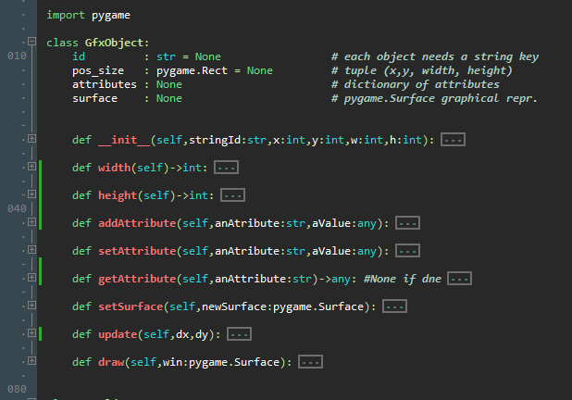
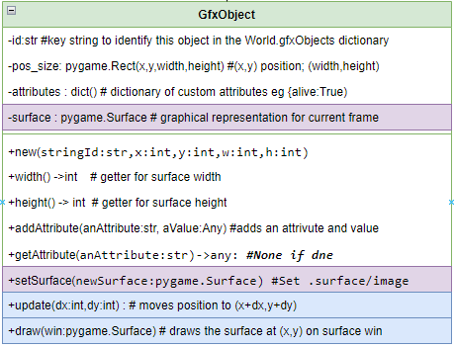
PyGame OOP101B - class GfxObject

Slide 13

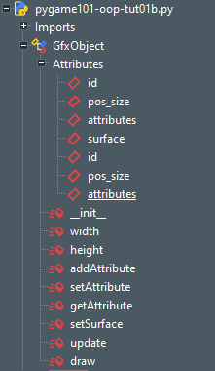

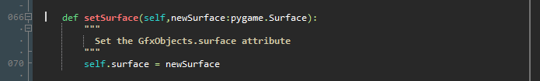
PyGame OOP101B - class GfxObject - Constructor & setSurface

Slide 14
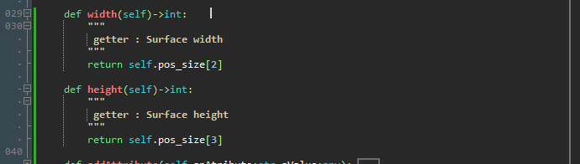
PyGame OOP101B - class GfxObject - getters width() height()

Slide 15
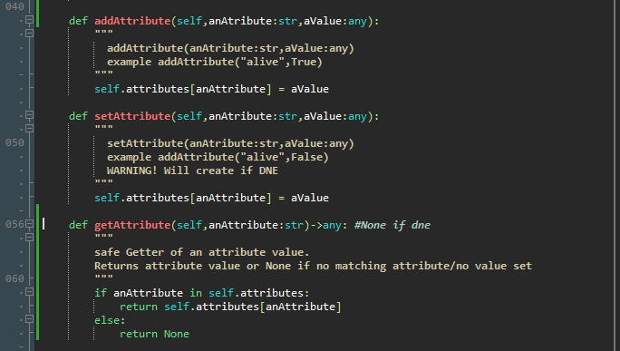
PyGame OOP101B - class GfxObject - addAttribute() & getAttribute()
This will be refactored when being applied.
setAttribute should be made safer like get…

Slide 16
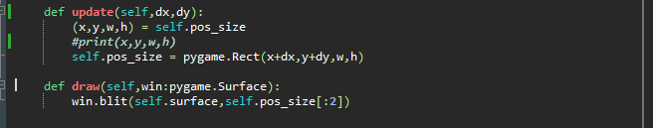
PyGame OOP101B - class GfxObject - update() & draw()
These two methods are called by World.loop() when all GfxObjects are iterated over each frame.
(x,y) = (pos_size[0],
pos_size[1])

Slide 17
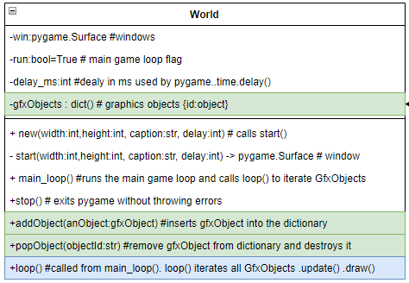
PyGame OOP101B - class World - additional methods & fields
Dictionary of GfxObjects with key=GfxObject.id
Data = GfxObject
i.e.
{id1:GfxObject1,
id2: GfxObject2,
…}
addObject() injects a GfxObject into the gfxObjects container dictionary
To be implemented later .. requires a call after the iterable dictionary loop has been run.
Iterates over all gfxObjects each frame calling their methods .update() and .draw()

Slide 18
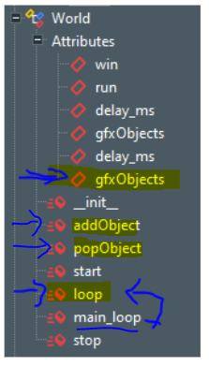
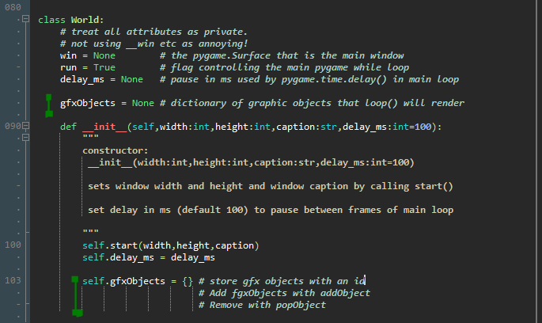
PyGame OOP101B - class World - alterations to constructor

Slide 19
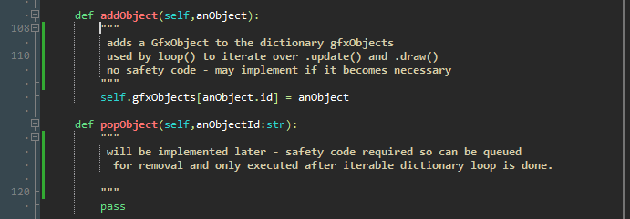
PyGame OOP101B - class World - the method addObject

Slide 20
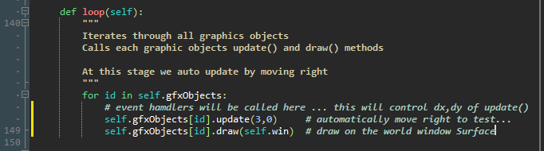
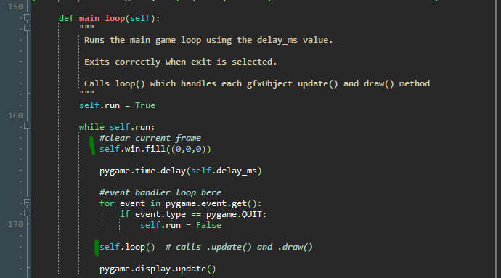
PyGame OOP101B - class World - loop() & alterations to main_loop()
Fill background with black
Loop through all gfxObjects

Slide 21
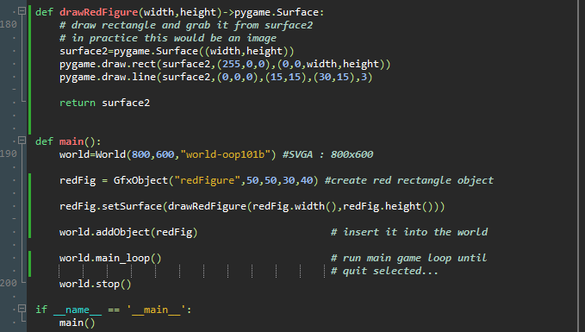

Oop101B Main program adjustments
To generate a Surface you must draw on a surface and return that!
Step1: Create a GfxObject
Step2: Draw it with drawRedFigure. Use the width and height already set on redFig. Could load an image instead…
Step3: add your object into the world gfxObjects dictionary

Slide 22
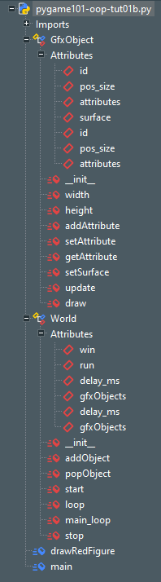
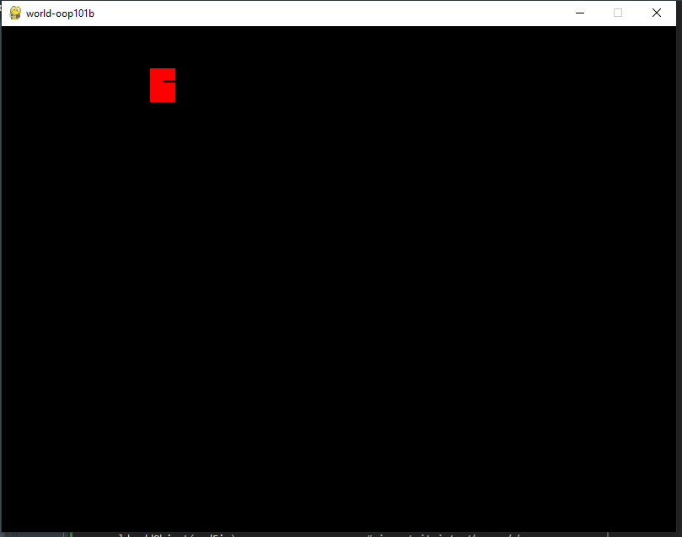
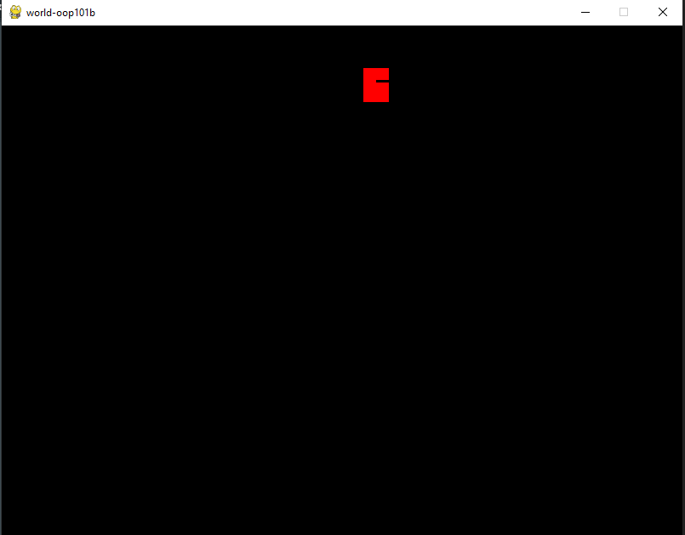
Testing oop101-tut1B
Image rendered correctly - move adjust dx by 3 each frame…

Slide 23
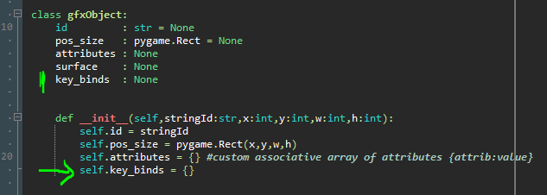
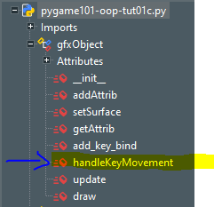
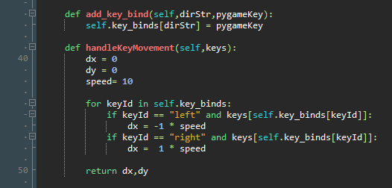
OOp101-1C … Saved as pygame101-oop-tut01c.py
Keybind dictionary will bind a key like “left” to a key stroke that pygame can detect. This will allow multiple binds such as “left” to “a” or “left arrow”
Proof of concept code. Will make this abstract so the Player class will need to do keybind and act on presses.

Slide 24
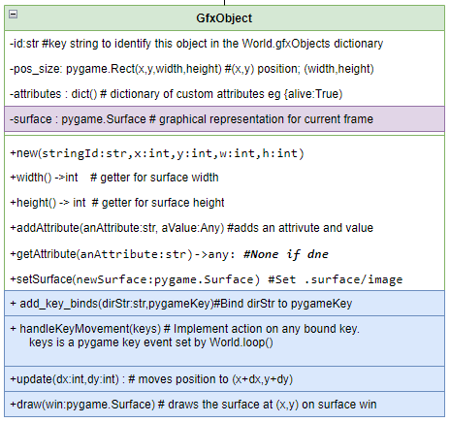
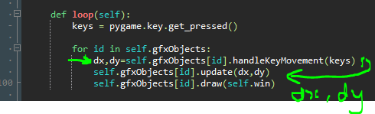
OOp101-1C … Saved as pygame101-oop-tut01c.py
The gfxObject calls its handleKeyMovements every frame.
This sets the displacement as dx and dy
The dy and dy values are used to update the objects position before drawing it.
See: UML/pygame-101c-uml-class-world(ver3a)

Slide 25
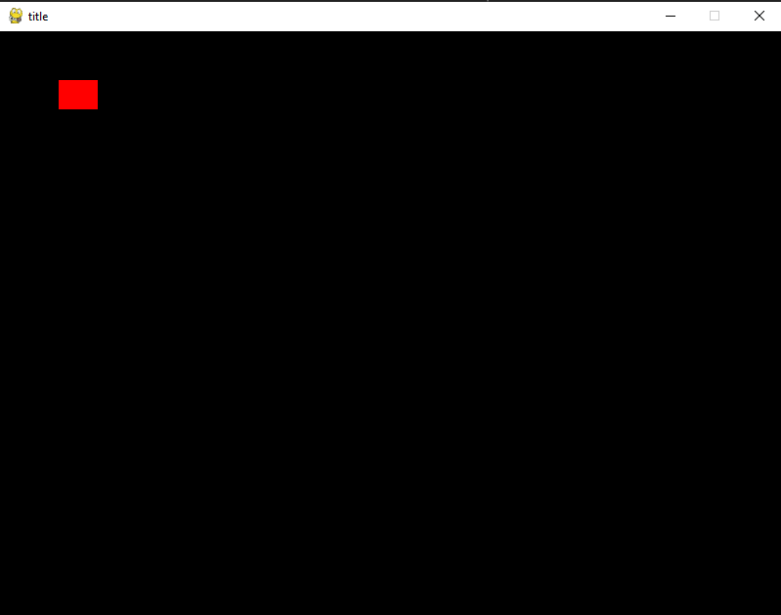
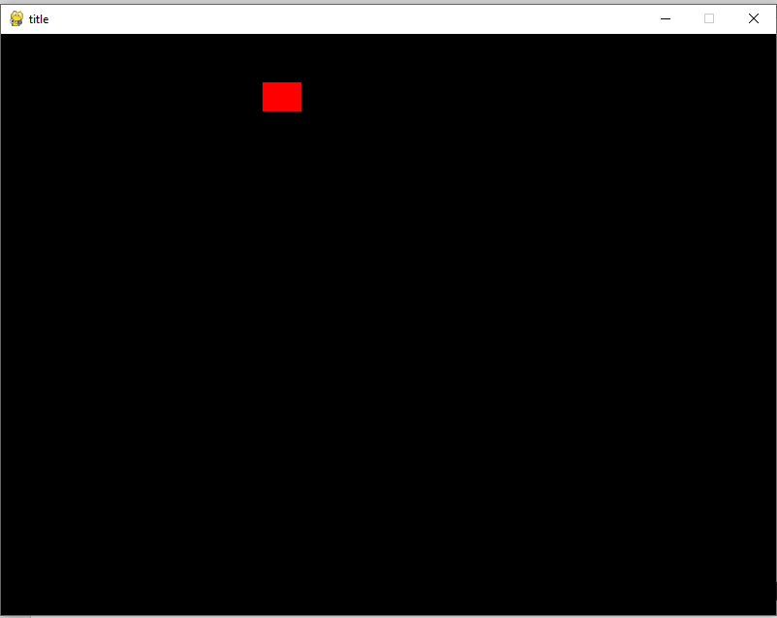
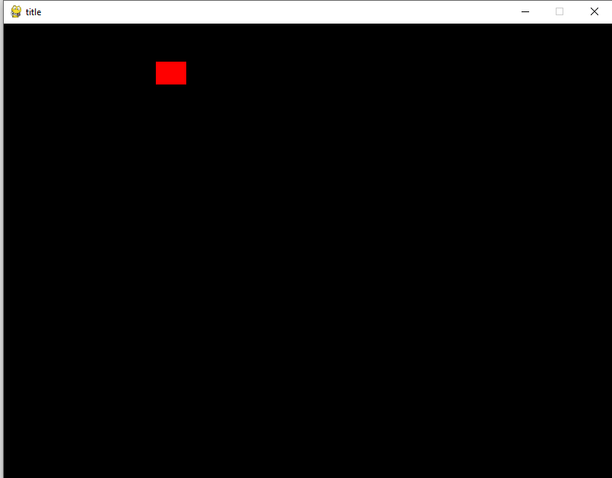
OOp101-1C … Saved as pygame101-oop-tut01c.py
Developmental Testing…
On launch
After pressing “d” several times
After pressing “a” several times

Slide 26
OOp101-1C2 … Saved as pygame101-oop-tut01c2.py
gfxObject alterations:
Added getters and setters for position.
Changed key_binds dictionary to be of the format {keyString : [pygameKeys]}
i.e. a list of keys so multiple keys
Helper methods to manage this:
getKeyIdStrings() : list of key strings to bind to : ["left", "right", "up", "down", "jump", "fire", "fire2", "use", "duck"]
wasPressed(keyIdString, keys:pygame.key) -> bool :
returns True if a keyBindString and matching pygame key was prepressed

Slide 27
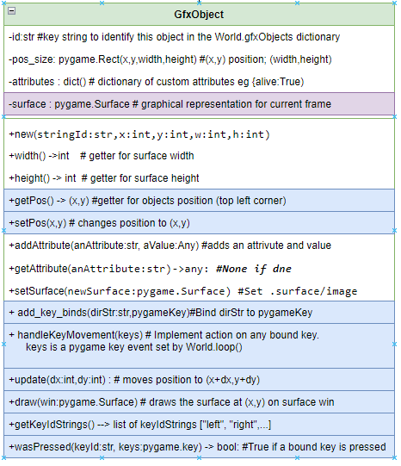
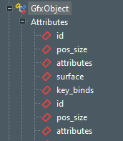
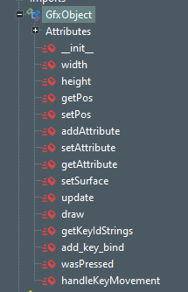
Class GfxObject UML updated
See: UML/pygame-101c-uml-class-world(ver3b)
new
refactored

Slide 28
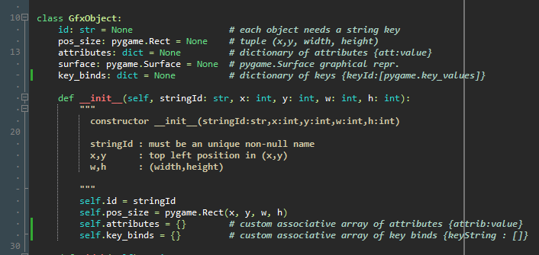
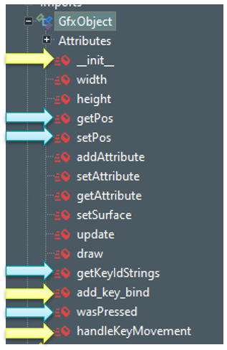
OOp101-1C2 - __init__ refactored

Slide 29
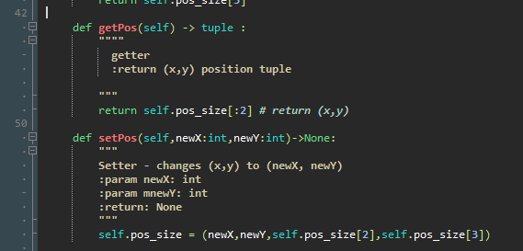
OOp101-1C2 – Getter & Setter for position

Slide 30
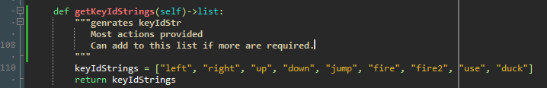
OOp101-1C2 – helper method : getKeyIdString

Slide 31
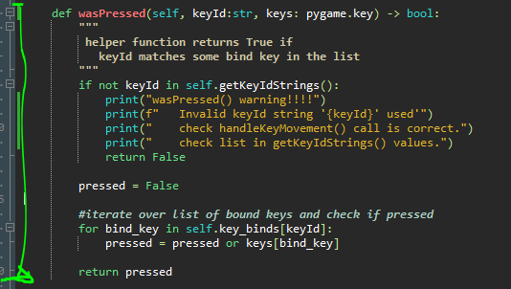
OOp101-1C2 – helper method : wasPressed
Returns True if a matching KeyId (eg “left”) from getKeyIdStrings
matches a pygame.key keybind set by add_keybind()
Helpful warning messages explaining how to correct a mismatched keyIdString

Slide 32
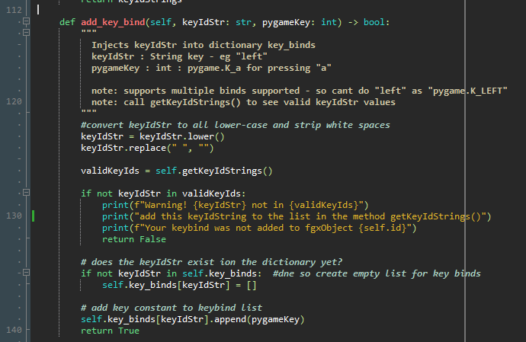
OOp101-1C2 – refactored add_key_bind()

Slide 33
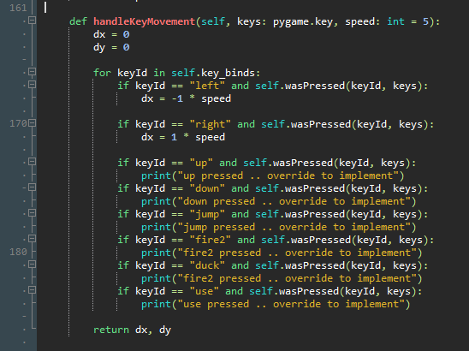
OOp101-1C2 – refactored handleKeyMovement()
This is CONCEPT code so when
implementing a Player Object
as a descendant of GfxObject
how to do this is easier…

Slide 34
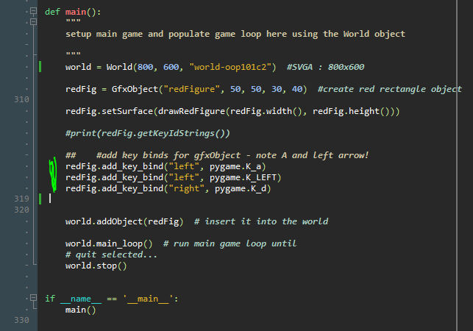
Adding keybinds in main()
Note its now possible to have multiple
key-binds onto one action
In this case we have
“left” bound to both “a” and “left arrow”

Slide 35
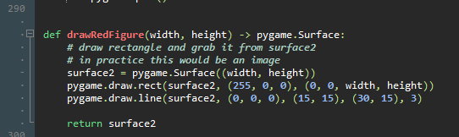

OOp101-1C2 – main function refactored drawRedFigure
Changed rectangle to look more like a player

Slide 36
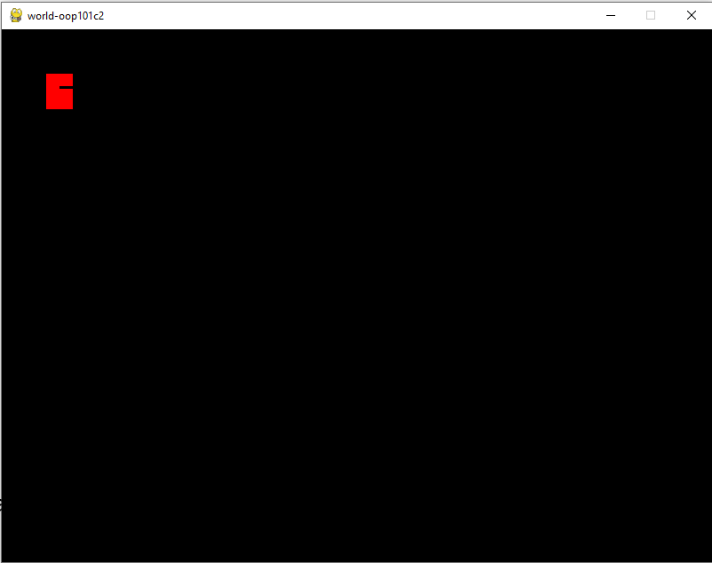
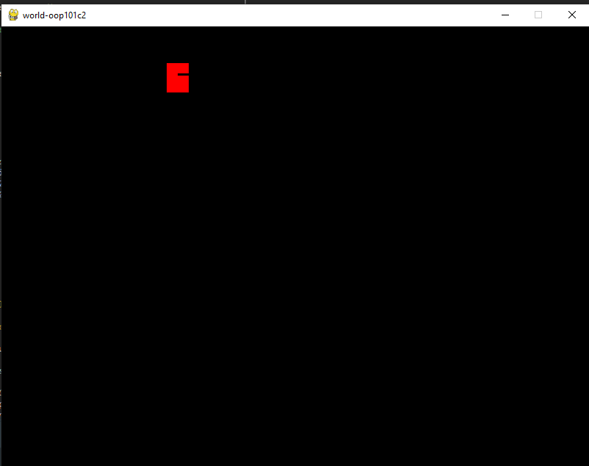
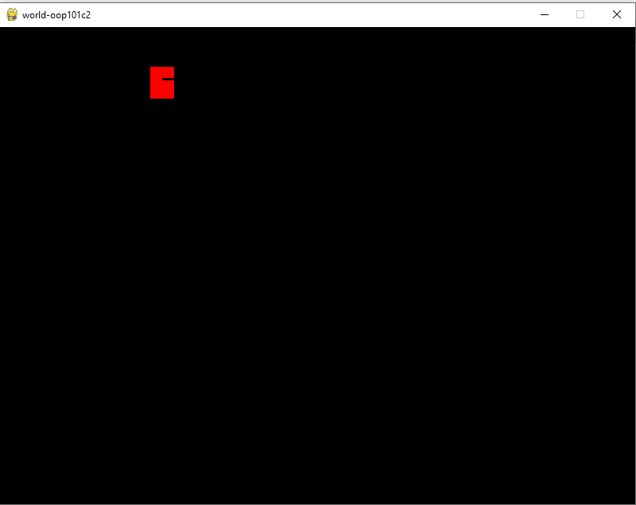
OOp101-1C2 – developmental Testing of redFigure
On launch
After pressing “d” several times
After pressing “a” or “left arrow”
several times

