Slide 1

Intelligent Speed Bump Alert System

Slide 2

Executive Summary
The Smart Bump Alert System aims to enhance road safety through a compact device in cars. It includes a tiny computer, GPS, SIM card, and a user-friendly screen, alerting drivers about upcoming speed bumps. Our project focuses on careful research and harnessing public support for data collection. In the future, we envision collaborating with the government to enhance road safety using our collected data. Additionally, potential partnerships with map companies could involve sharing our data to improve their maps. Our ultimate objective is to contribute to safer roads for everyone.

Slide 3

Project Scope
Project Objectives:
Acquire Equipment: Procure microcontroller, GPS module, SIM card, and necessary elements.
Java Code Development: Write Java code for the Smart Bump Alert System.
Data Collection Strategy: Plan how to collect both initial and real-time data.
Digital Elements Integration: Connect and integrate digital components for seamless functionality.
Code Installation: Install Java code onto the Smart Bump Alert Device.
First Prototype Assembly: Assemble hardware components for the initial prototype.
Prototype Testing: Test the prototype thoroughly for effective operation.
Iterative Refinement: Review feedback and refine both hardware and software.
Data Collection Implementation: Implement the real-time data collection strategy.
Final Prototype Development: Develop the finalized Smart Bump Alert Device.
Project Deliverables:
Smart Bump Alert Device:
Fully functional hardware device with integrated microcontroller, GPS, SIM card, and user-friendly display.
Collected Data:
Comprehensive dataset, including both initial and real-time data, gathered through the Smart Bump Alert System.

Slide 4

Mile stones
Equipment Procurement Complete (Week 1):
Acquired microcontroller, GPS module, SIM card, and necessary components.
Java Code Development Completed (Week 2):
Developed, tested, and finalized the Java code for the Smart Bump Alert System.
Data Collection Strategy Defined (Week 3):
Documented and finalized the strategy for initial and real-time data collection.
Digital Elements Integrated (Week 6):
Successfully connected and integrated all digital components.
Java Code Installed on Device (Week 7):
Completed the installation of Java code onto the Smart Bump Alert Device.
First Prototype Assembled and Tested (Week 11):
Assembled hardware components into the initial prototype and conducted comprehensive testing.
Iterative Refinement Completed (Week 15):
Reviewed feedback, made necessary refinements to both hardware and software components.
Data Collection Implemented (Week 17):
Operational integration of the real-time data collection strategy.
Finalized Device Ready for Production (Week 20):
Completed version of the Smart Bump Alert Device ready for manufacturing.

Slide 5

Technical Requirements and limits and exclusions
Technical Requirements:
Microcontroller:
Select and integrate a reliable microcontroller for system control.
GPS Module:
Incorporate a GPS module for accurate location tracking.
SIM Card:
Integrate a SIM card for network access and real-time data updates.
User-Friendly Display:
Include an intuitive display for driver alerts and interactions.
Other components like wires ,etc.
Limits and Exclusions:
1- Data Collection and Update:
Inclusion of Government Assistance: Collaboration with the government will be considered to aid in data collection, acknowledging the challenging nature of this task.
2- Restricted Data:
Exclusion of Hole Detection: The system will not have the capability to detect road holes or similar features. It is specifically designed for speed bump detection.
Random Road Geographies: Given that road geographies are created by random individuals, the system's focus is on speed bumps, and it does not account for variations in road conditions such as holes or other irregularities.

Slide 6

Project priorities
Driver Safety:
Priority: High
Explanation: The primary goal is to enhance driver safety by providing timely and accurate alerts for speed bumps.
Clear Display in Sunlight:
Priority: High
Explanation: Ensuring the display's visibility in bright sunlight is crucial for effective communication with the driver.
Real-Time Data:
Priority: High
Explanation: The capability to collect and respond to real-time data is a key priority for the system's accuracy and relevance.
Real-Time Response:
Priority: High
Explanation: Achieving a real-time response to speed bump detection is essential for immediate driver awareness and safety.
Adaptability:
Priority: Moderate
Explanation: While important, adaptability to various car models is a secondary priority compared to the core objectives of safety and real-time functionality.

Slide 7
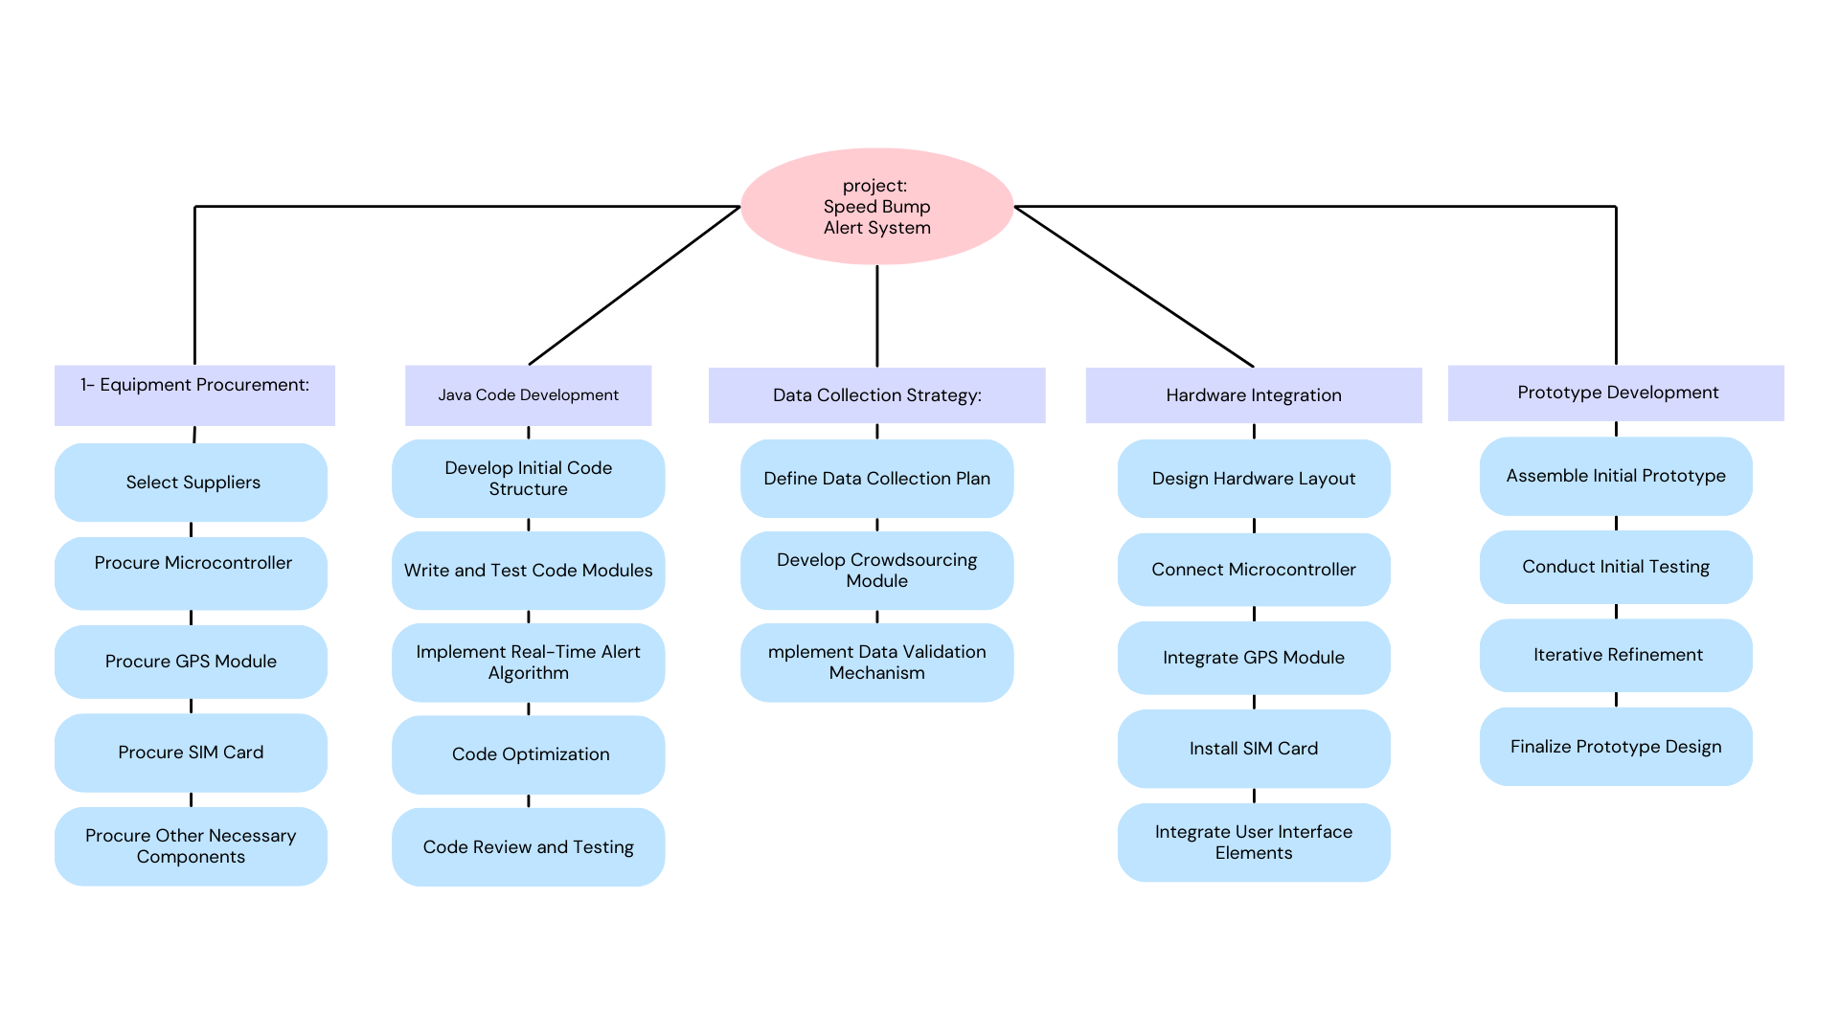
Work Breakdown structure

Slide 8
Times and Costs
 | Equipment procurement | Java Code Development | Data Collection Strategy | Hardware and software Integration | Prototype Development
Time | 1 week: 3 days to find suppliers 4 days to purchase equipment | 1 week: 5 days to develop structure 2 days to test code | 6 weeks Initial data collection will be Distributed among workers 3 weeks to data collection 3 weeks to define method | 4weeks 1 week GPS integration 1 week SIM integration 1 week display integration 1week code installation | 4 weeks to test the device
Cost | Raspberry Pi 4 kit: $160 GPS module: $12 Hologram IoT SIM: $55 LCD Display:$10 | Programmer to write the structure: $300 Code tester to test the algorithm: $100 | $1 per 1 location Initial required locations: 1000 location $1000 | Computer Engineer will be working on this $300 per successful integration | Testing will be held by a specialized tester who will get $400 and have to handle a report.
Total time : 16 week + 4 weeks (feed back updates ) = 20 weeks
Total cost : $3237 + $400 as spare if any component lost = $3637

