Slide 1

DBMS COURSE PROJECT · PROJECT 07
Canteen Food Ordering and
Billing Management System
Design and implementation of a relational database with a working web application
Abhiuday Singh 25WU0101006
Aryaman Jain 25WU0101017
Harsh Jha 25WU0101046
Faculty Mentor: Dr. Kiran Mayee
Database Management Systems
School of Technology, Woxsen University
Notes:
Introduce the team and the project. One line: a database-driven system where students order ahead and canteen staff run orders, stock and billing from one place.

Slide 2
Problem, objectives and users
The problem Paper orders, long queues, no order status, hand-made bills and ingredients running out unnoticed.
Student STUDENT
S
Browse menu, order and pay, track the token, view the bill, cancel before preparation
Objectives
Canteen staff STAFF
Design the ER model for the canteen system
Convert the ER model into a 3NF relational database.
Maintain data integrity and consistency.
Manage orders, billing, payments, and inventory.
Provide a web interface for students, staff, and admins.
Generate SQL-based reports for canteen operations.
C
Move orders through the kitchen, collect cash, update stock, view bills and reports
Administrator ADMIN
A
Everything staff can do, plus add, edit and delete menu items and categories
Notes:
Manual canteens mean queues, paper orders, repeated entry, no order status, billing mistakes and stock running out unnoticed. We built one database as the single source of truth. Three roles use it: student, staff, admin.

Slide 3
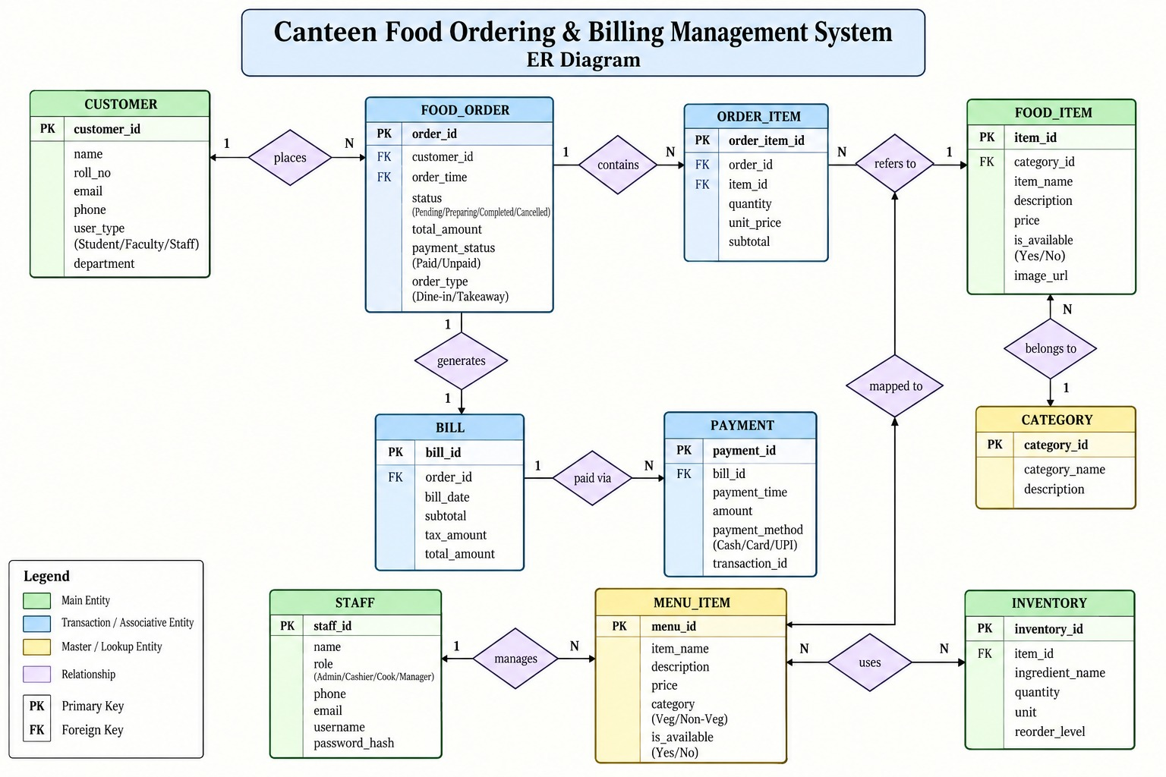
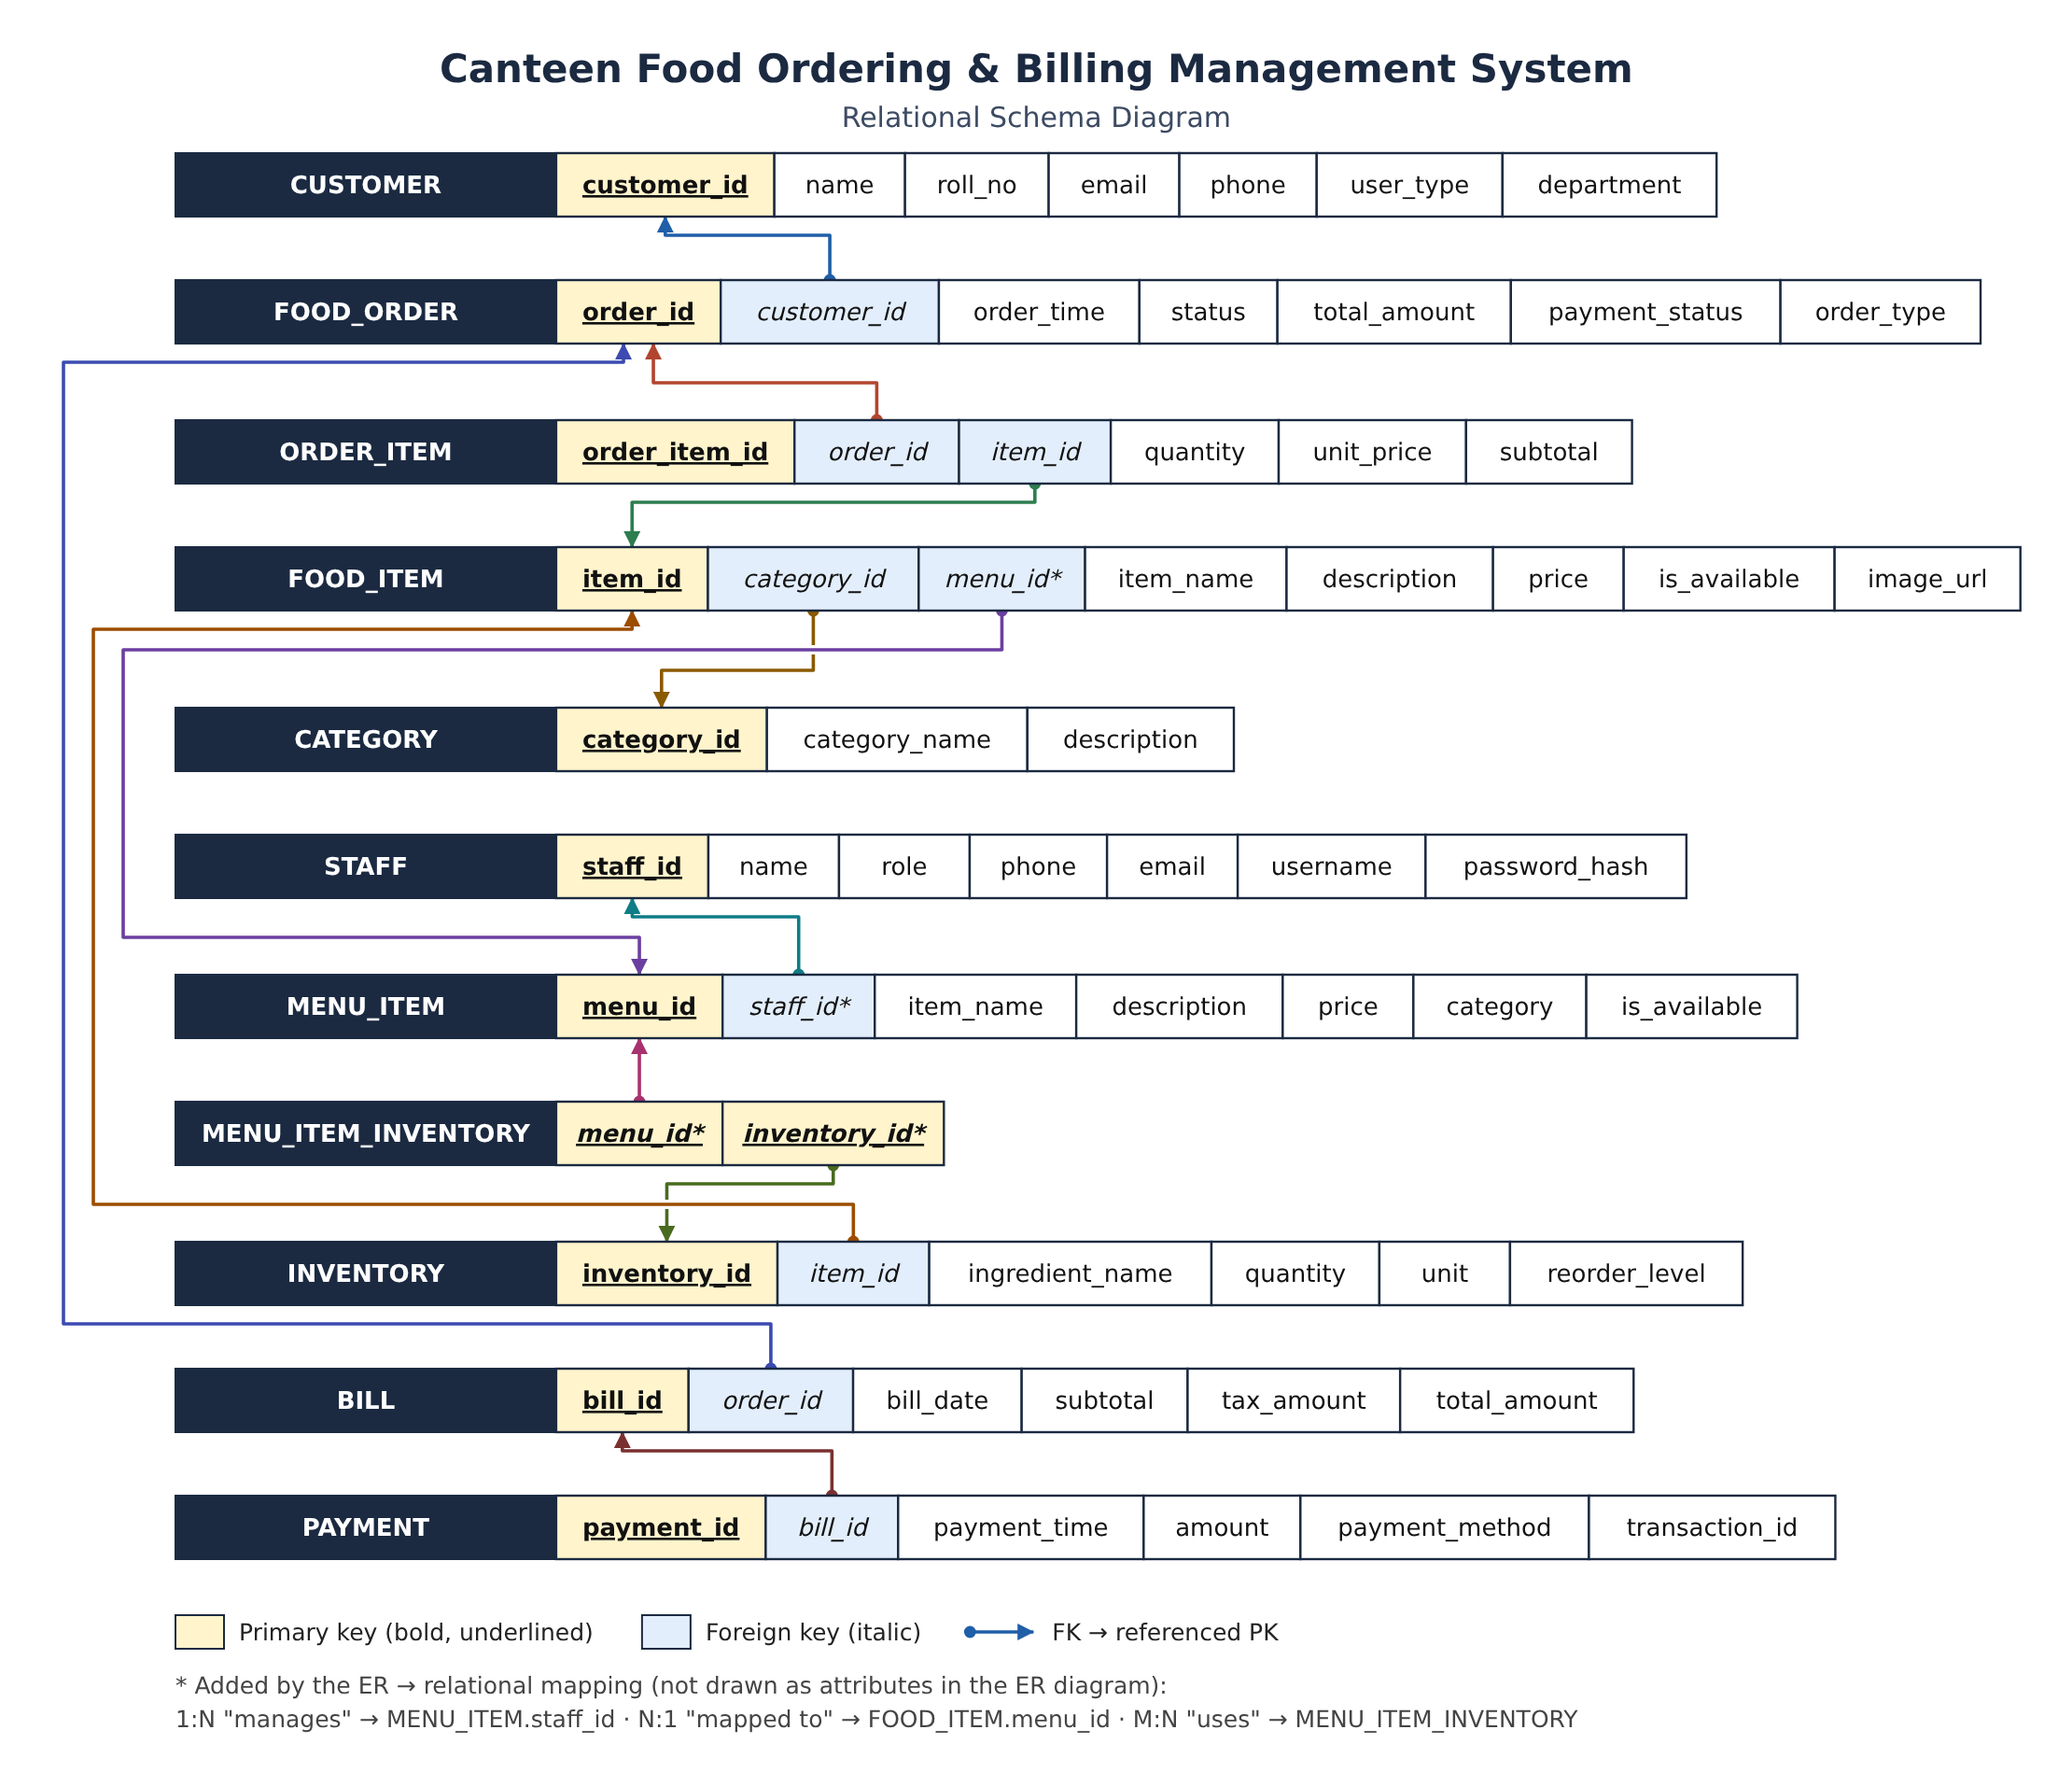
From ER design to relational schema
ER diagram: 10 entities, 9 relationships
Relational schema: PK bold, FK italic
Order lines keep the price at order time · one order → one bill → many payment attempts · M : N links use junction tables
Notes:
Left: the ER diagram, ten entities and nine relationships, with ORDER_ITEM resolving orders and food items and a junction table for the many-to-many "uses". Right: the relational schema mapped from it. Bold underlined are primary keys, italic are foreign keys.

Slide 4
Normalized to 3NF, enforced in MySQL
1NF
2NF
3NF
10
9
Atomic values
No partial dependencies
No transitive dependencies
tables + view
foreign keys
Each item in an order is its own ORDER_ITEM row.
Only the junction table has a composite key.
Customer, category and stock data live in their own tables.
17
9
CHECKs
UNIQUE keys
Referential
Domain
Business rules
RESTRICT protects users, orders, bills, payments and ordered items
ENUM roles and statuses; price ≥ 0, quantity > 0, rating 0–5
One bill per order; UPI needs a reference; bill total must add up
Notes:
Walk through 1NF, 2NF, 3NF. Derived values: line total is computed, bill total is protected by a CHECK, unit_price is stored on purpose to freeze the price at order time. The counts come from database.sql.

Slide 5
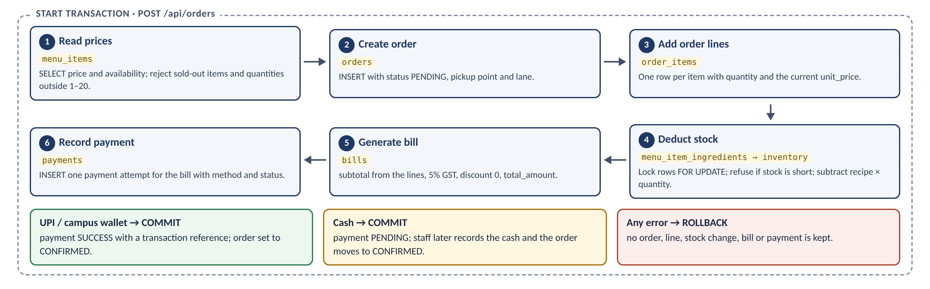
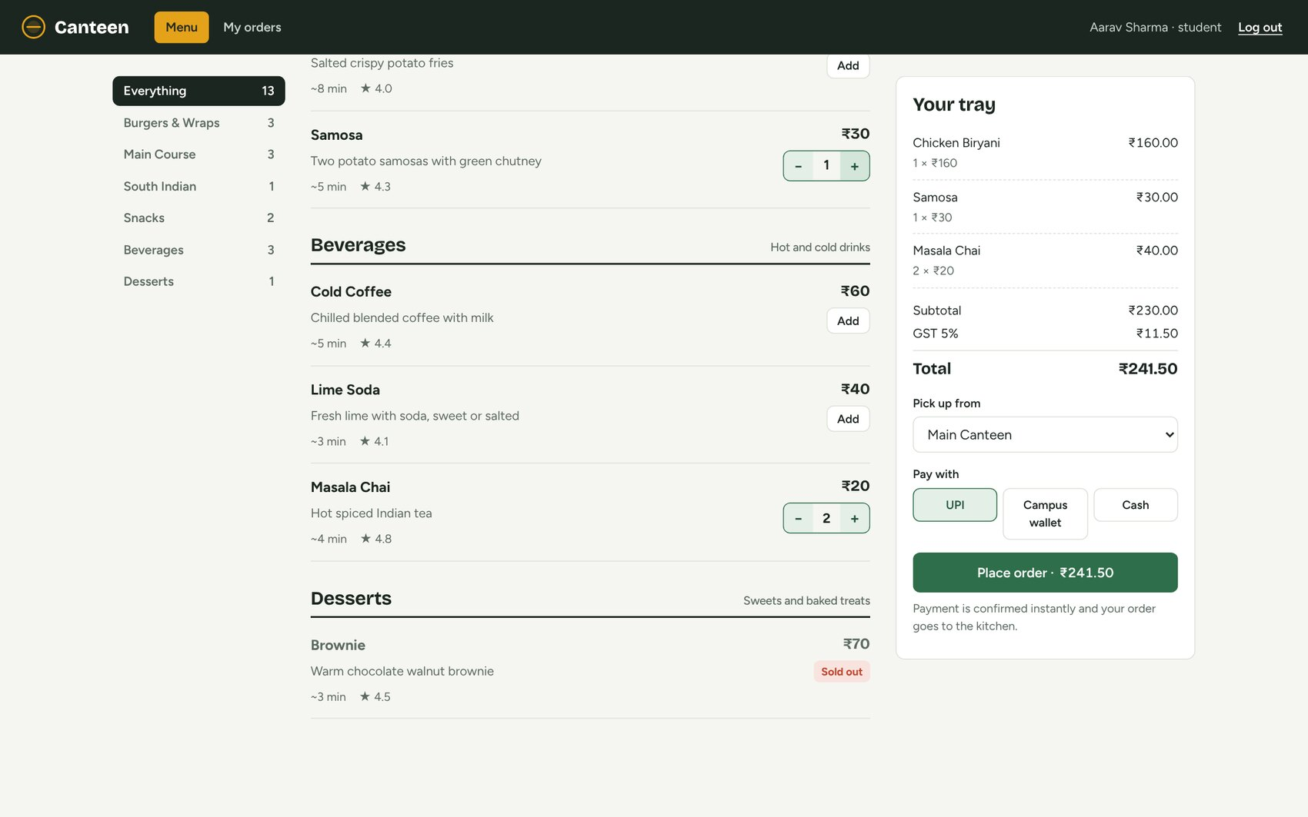
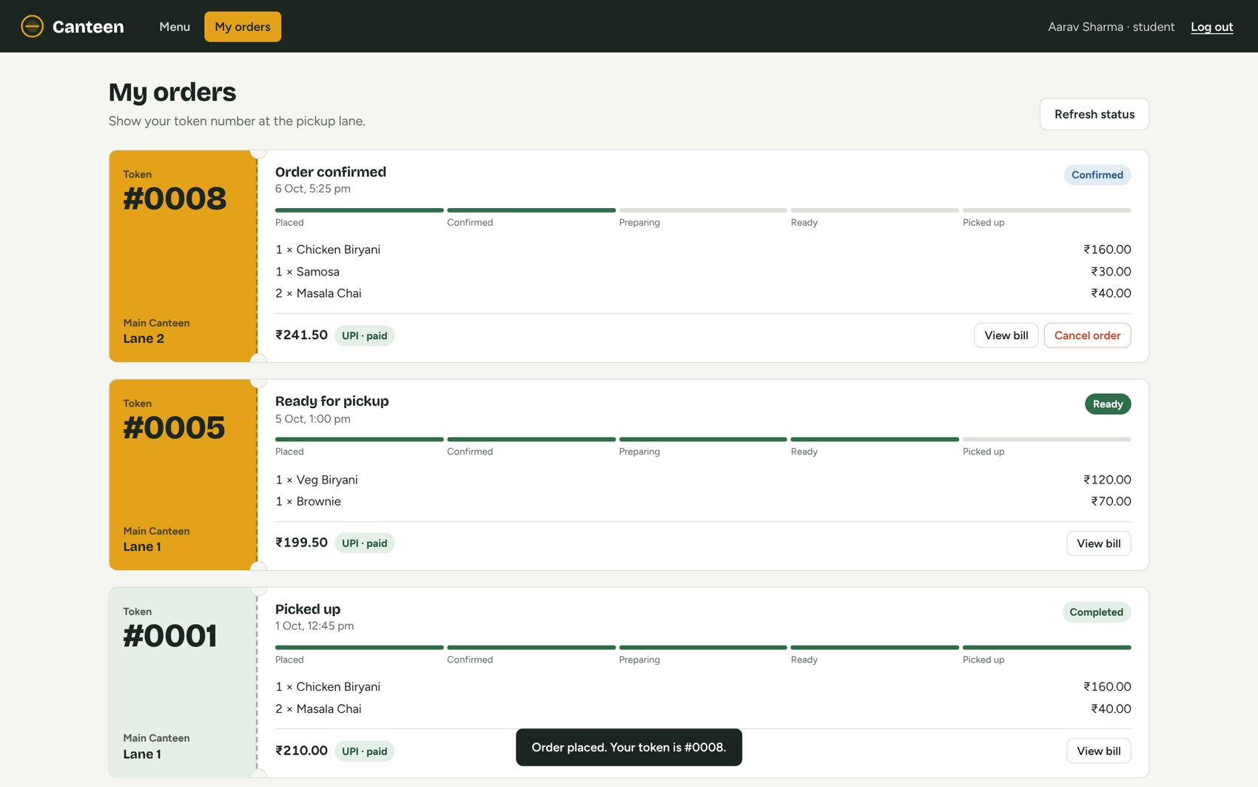
One order = one ACID transaction
Atomic: all rows or none
Locked: SELECT … FOR UPDATE on stock
Trusted: server computes prices and totals
Tray: totals, 5% GST, payment method
Stock effect: chicken 15,000 → 14,850 g, rice 25,000 → 24,800 g, milk 20,000 → 19,800 ml after one Biryani + Samosa + 2 Chai order.
Notes:
If any step fails, for example not enough stock, ROLLBACK undoes everything. Demo: log in as Aarav, add Biryani, Samosa and two Chai, pay by UPI, open My orders. One click writes to orders, order_items, bills and payments and reduces stock by recipe.

Slide 6
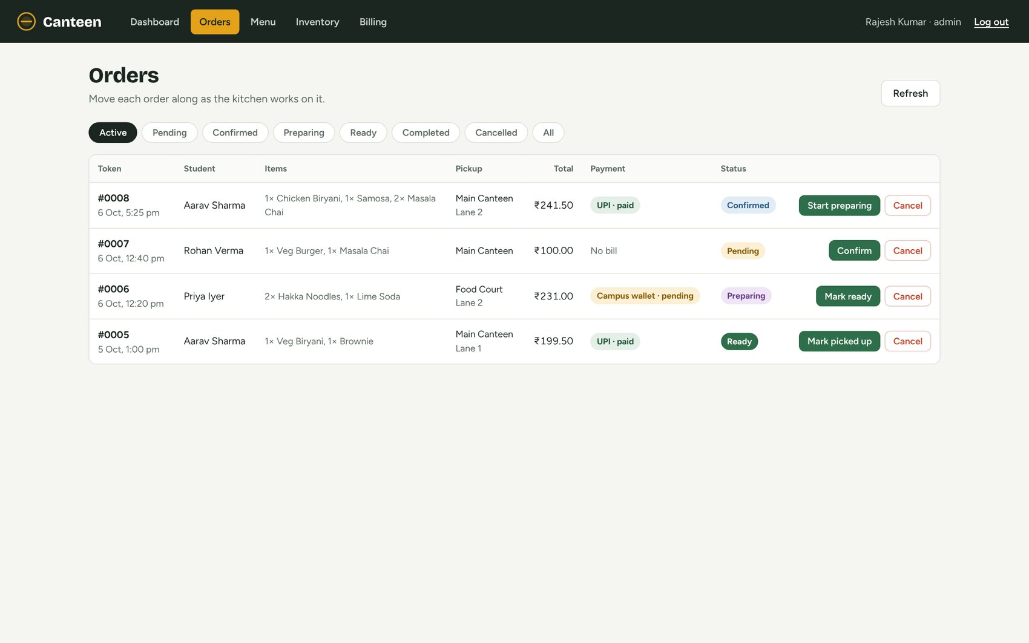
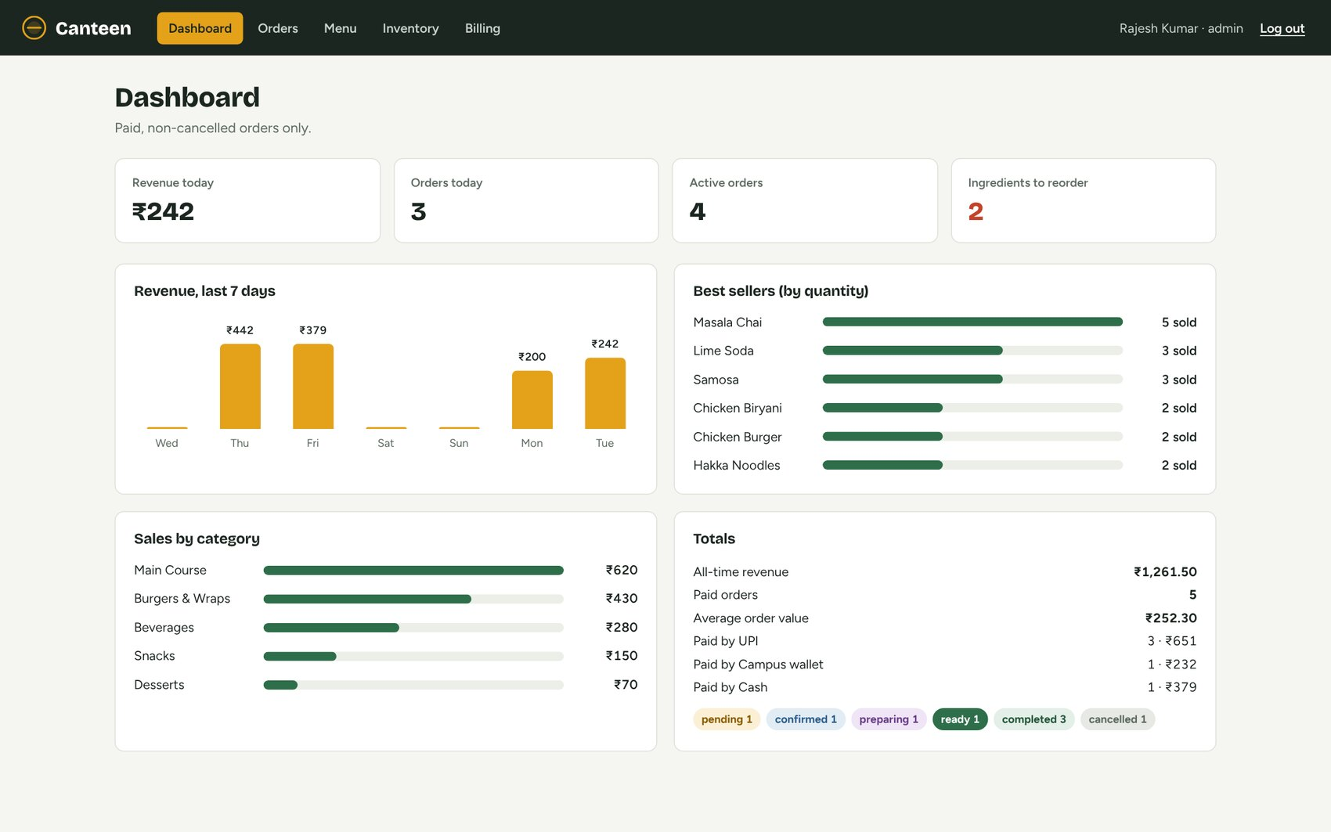
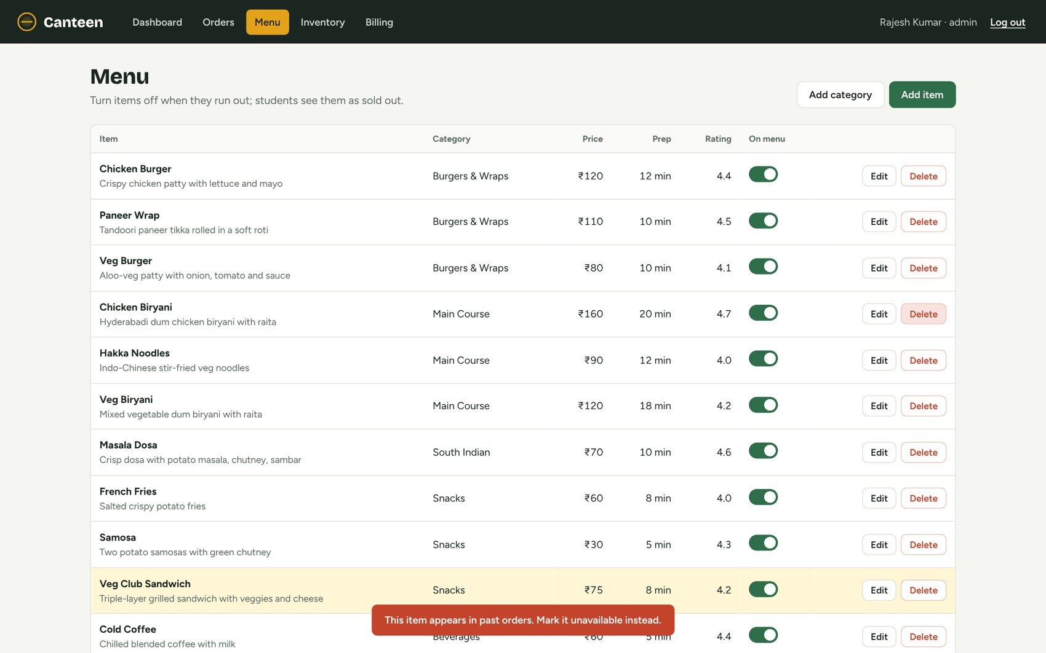
Staff and admin screens, SQL reports
Orders: next-status button
Dashboard: live revenue
Delete refused by foreign key
Best sellers (units)
Lime Soda
3
Masala Chai
3
Chicken Burger
2
Hakka Noodles
2
Notes:
Orders: staff move each order forward and cancelling restores stock. Dashboard: live revenue and best sellers. Delete refused: Chicken Biryani is in past orders so ON DELETE RESTRICT blocks it (error 1451). Bottom: query 2, revenue by category, and query 4, best sellers, from the real MySQL data.

Slide 7
Testing and conclusion
14 / 14
10 / 10
24
integrity tests passed
UI tests passed
tests in total
What we delivered
Future enhancements
ER model → 3NF schema → MySQL 8
Web app for students, staff and admins
ACID orders, recipe-based stock, GST bills
Constraints that reject bad data on their own
Real UPI / payment gateway
QR ordering and ready-order notifications
Status-history table to audit changes
Coupons and supplier orders
Notes:
14 invalid statements fired at MySQL (duplicate email, negative price, unknown category, zero quantity, second bill, wrong total) were all rejected, plus 10 UI tests. We delivered ER to 3NF schema to MySQL to a working app with ACID transactions. Future work on the right. Invite questions; any member can answer.

