Slide 1
Managing Distributed Teams via Minimum Engineering Design Artifacts

Slide 2
Intro: Matt Ferguson
Current Roles
  CTO of Galleysolutions.com
  CTO/Founder of TenonSystems.com
Prior Roles
  CTO of Zeeto.com
  VP Software Eng. Sensus
  VP Engineering Solekai

Slide 3
My Current Guiding Axioms
As Leaders we are coaches/trainers
We are here to learn and teach
We are here to teach staff to learn and teach
Behavior not Process - identify those behaviors
Fearless engagement of ideas
Success as a team requires optimization for the team not the individual
Good engineering decomposes complexity as simple subsystems

Slide 4
What you will learn today
What are my tested and proven artifacts that will drive my project to success
Why do these artifacts become even more valuable in remote organizations
How do these artifacts improve the management of projects
How do these artifacts make less experienced team members successful even on complicated tasks

Slide 5
In the Beginning
New
Feature
Request
Product
Manager

Slide 6
Instant Entropy
New
Feature
Request
Code
Changes
Data
Model
SW Engineer
Product
Manager
Data Engineer
New
Services
Front
End Code
SW Engineer
SW Engineer
UI
Design
Designer
Notes:
Lack of formal design training
Skipping to implementation (code or UI)

Slide 7
Controlled Entropy
SW Engineer
SW Engineer
New
Feature
Request
?
Why?
What?
How?
?
Data Engineer
?
Product
Manager
?
Designer
Notes:
Lack of formal design training
Skipping to implementation (code or UI)

Slide 8
Entropy Options
Uncontrolled
Project
Launch
Controlled Project Launch

Slide 9
My Initial Project Artifacts
New
Feature
Request
Customer or
Stakeholder
Expectation
Inputs
And
Outputs
High Level
Design
Resoures?
Product
Manager
Sequence Diagram
&
Wire
Frames
RTM (State Diagram)
The Work Plan
The Goal
Notes:
Lack of formal design training
Skipping to implementation (code or UI)

Slide 10
My Highest Priority Artifact
RTM
Requirements Traceability Matrix
State Diagram for you EE folks
Also probably the least used or completely unkown tool in teams I have coached

Slide 11
Every Feature is a System
SYSTEM
Inputs
Output

Slide 12
Systems Have Sub Systems
SYSTEM
Inputs
Output
SYSTEM
Inputs
Output
Inputs
Output
SYSTEM
Inputs
Output
SYSTEM
Inputs
Output
SYSTEM
Inputs
Output

Slide 13
RTM of a System (/feature)
Input A | Input B | Input C |  |  | Output X | Output Y
1 | 0 | 1 |  |  | Golf | Romeo
0 | 1 | 0 |  |  | Alpha | Foxtrot
1 | 0 | 0 |  |  | Golf | Tango
0 | 1 | 1 |  |  | Alpha | Bravo

Slide 14
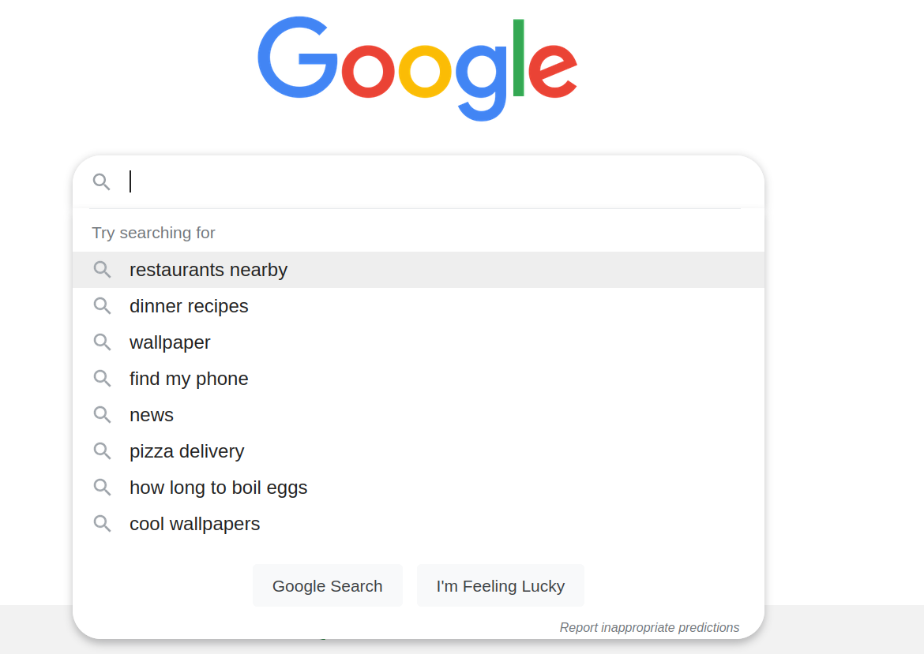
An Example - Inputs
INPUTS
Search phrase
Time of day
Location
Browser
My Cookie data
Prior searches
Paid advertisers
Content Search index
Trending Search index

Slide 15
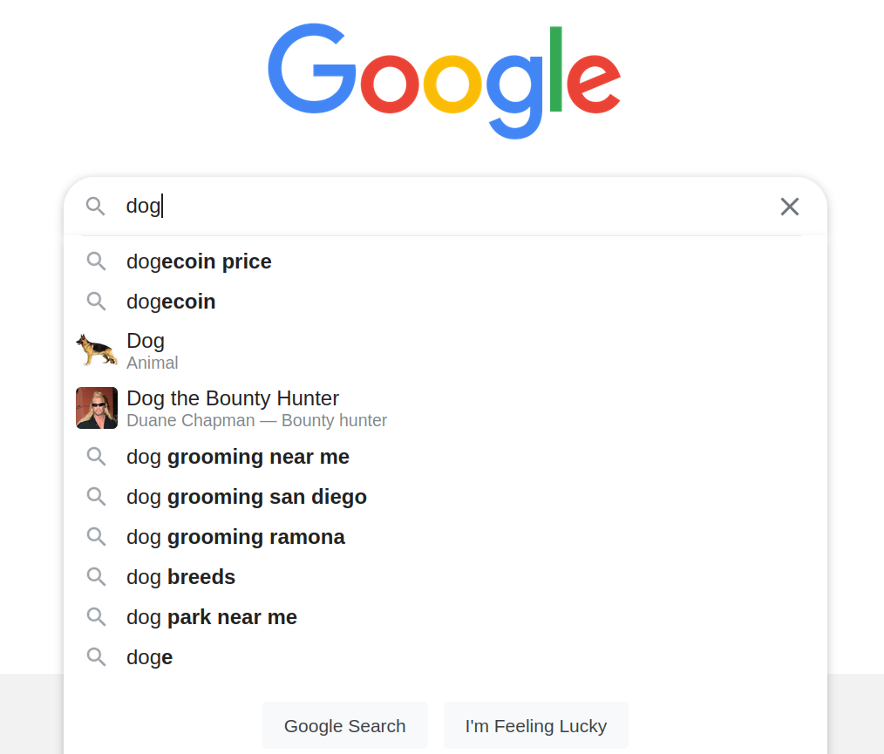
An Example – Initial Outputs
OUTPUT
Suggested sub phrases

Slide 16
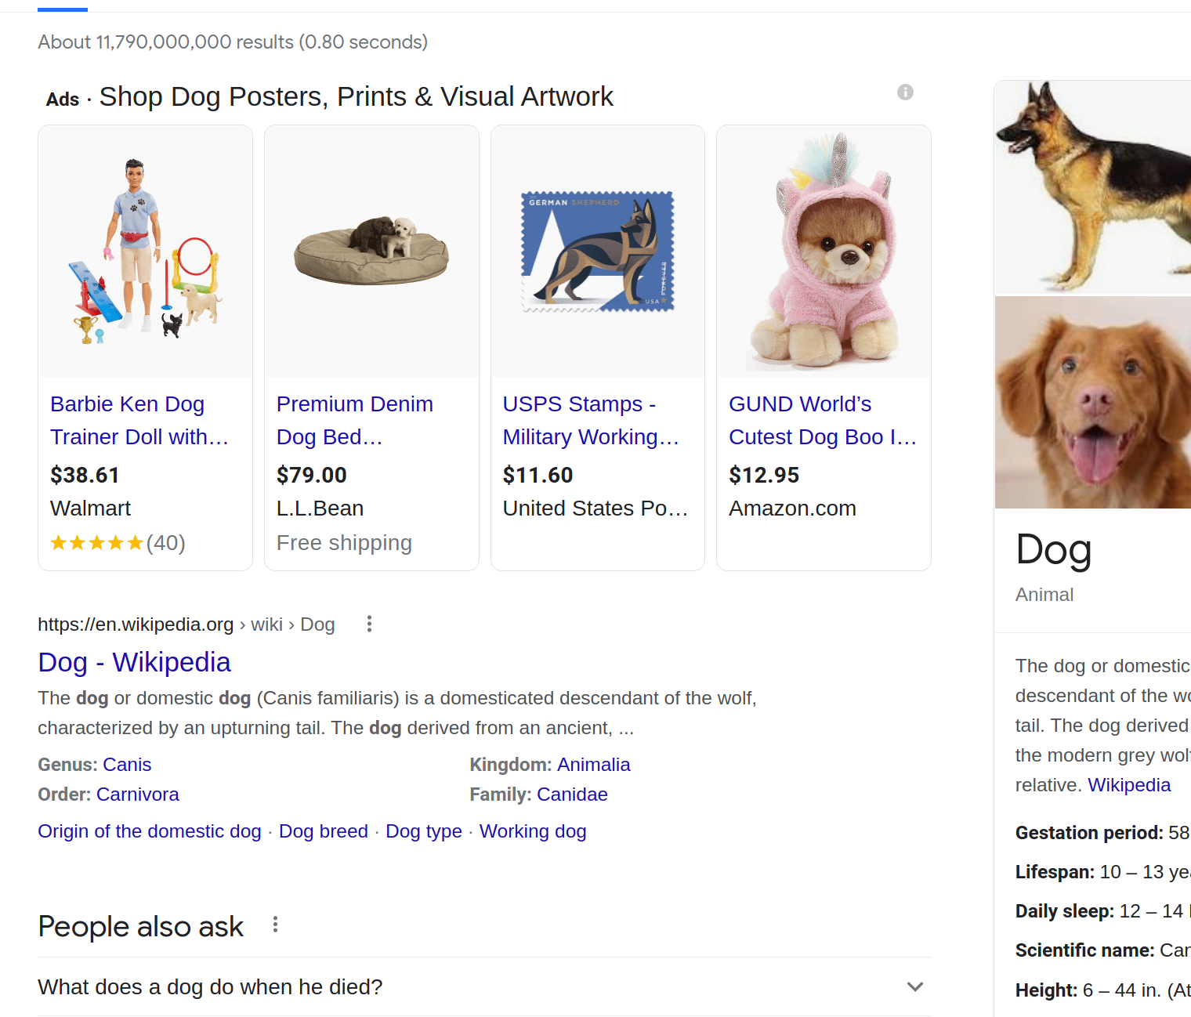
An Example – Final Outputs
OUTPUT
Paid E-commerce Ads
Top Search result
Wikipedia Definition
Alternative Questions
Local Vendors of Dog
Sorted Content Links

Slide 17
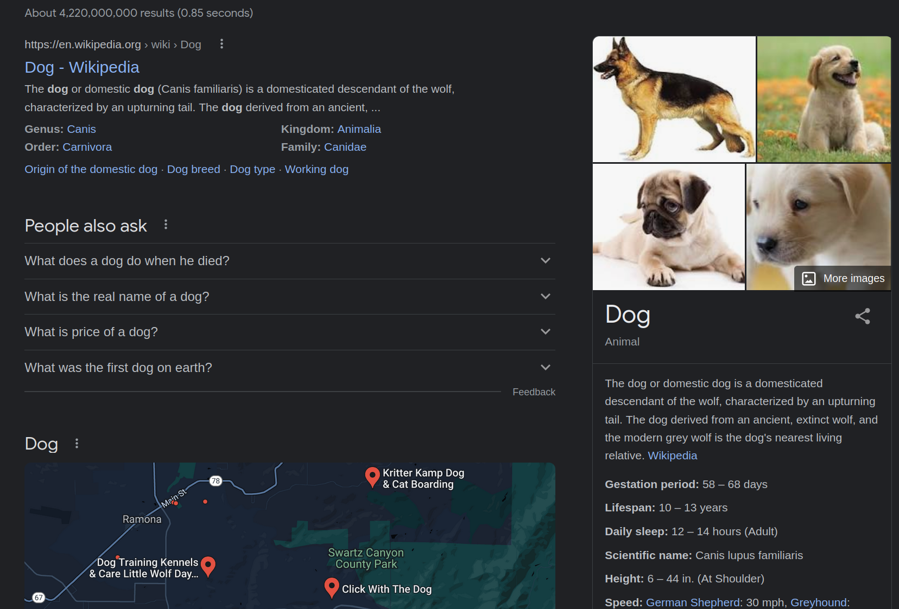
An Example - Outputs
OUTPUT
Wikipedia Definition
Alternative Questions
Local Vendors w map
Sorted Content Links

Slide 18
Example RTM for Google
Input Search phrase | Input Cookie | Input Browser |  | Output Ads | Output Local Services | Output Wikipedia
Dog | NA | Firefox |  | NA | Yelp and map | Wiki(dog)
Dog | NA | Chrome |  | Paid ads (Walmart,etc) | NA | Wiki(dog)

Slide 19
Decompose subsystems
SYSTEM
Inputs
Inputs
Output
Output
Search phrase
Time of day
Location
Browser
My Cookie data
Prior searches
Paid advertisers
Content Search index
Trending Search index
Wiki Default Content
Top Search result
Wikipedia Definition
Alternative Questions
Local Vendors of Dog
Sorted Content Links
Paid E-commerce Ads
Search Results
Paid eCommerce Ads
Yelp Service Results
Alternative Questions
Alternative Questions

Slide 20
Ex. – Permissions
Customers would like a role to
Authorize who can edit their
E-commerce catalog
New
Feature
Request
Product
Manager

Slide 21
Ex. – Permissions
Input Has Catalog Manager Role | Input Catalog Item Action |  | Output Can Delete Catalog | Output Can Edit Item | Output Can Add Item
true | Delete |  | true
true | Edit |  |  | true
true | Add |  |  |  | true
false | Delete |  | false
false | Edit |  |  | false
false | Add |  |  |  | false

Slide 22
Ex. Permissions but Wait!!!
Input Has Catalog Manager Role | Input Catalog Item Action | Input Is Super Admin |  | Output Can Delete Catalog | Output Can Edit Item | Output Can Add Item
true | Delete | true |  | true
true | Edit | true |  |  | true
true | Add | true |  |  |  | true
false | Delete | true |  | true
false | Edit | true |  |  | true
false | Add | true |  |  |  | true
true | Delete | false |  | true
true | Edit | false |  |  | true
true | Add | false |  |  |  | true
false | Delete | false |  | false
false | Edit | false |  |  | false
false | Add | false |  |  |  | false

Slide 23
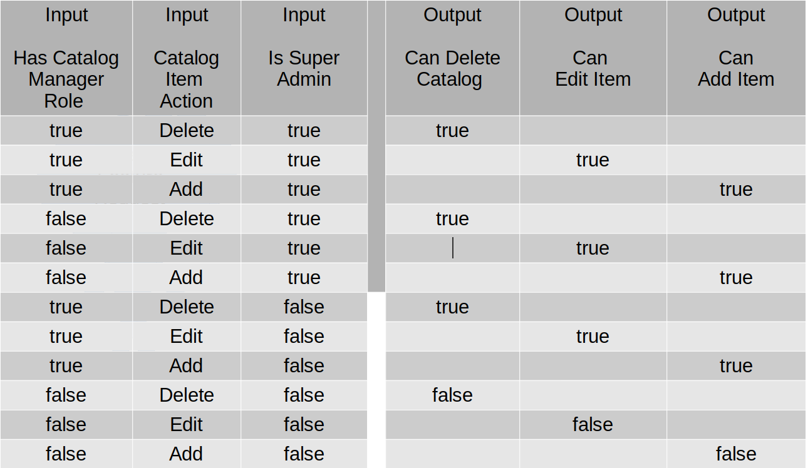
Articulate Complex Interaction
New
Feature
Request
Product
Manager
SW Engineer

Slide 24
Staying on The Same Page
Design
Product
Manager
Development
SW Eng1
Testing
Customer
Communication
SW Eng 2
Product
Manager

Slide 25
Simple to Manage and Scale
Team 1’s RTM
Team 5’s RTM
SW Eng1
Team 2’s RTM
Team 4’s RTM
Team 3’s RTM

Slide 26
Async Work Spanning TZ

Slide 27
6 months later

Slide 28
Success without Experience
Empower those with less experience to be successful
Lets be honest we don’t create new big features every day – get out of practice
Many new Engineers don’t come from CS and EE programs where they may have learned this

Slide 29
Getting on the same page
Agreeing on the problem
  Defining the inputs
  Defining the outputs
  Defining the combinations of inputs
Early investment in design catches problems
Reduce cognitive load of developers
Reduce complexity

Slide 30
Agreeing on the problem
  Defining the inputs
  Defining the outputs
  Defining the combinations of inputs
Early investment in design catches problems
Reduce cognitive load of developers
Reduce complexity

Slide 31
RTM (WHAT, HOW, WHEN)
Sequence Diagrams
Work Plan

Slide 32
Problem 2
The systems
Early investment in design catches problems
Reduce cognitive load of developers
Reduce complexity

