Slide 1
CONTROLLING CAR WITH HAND MOTION
TEAM
ENG. Ahmed ElSayed Abdelrahman Ali
ENG.ESMAIL GALAL MAKRAM MOHAMED

Slide 2
Components of the project
CAR MODULE
2 regular LM7805
2 CAP 1000/50
2 CAP 100/50
ATMEGA 32
CRYSTAL 16MHZ
2 CAP 22PF
HC-05 Bluetooth Module
H-BRIDGE L298
PCB BORD
DC MOTOR
SERVO MOTOR
CAR
Rechargeable BATTERY 12V 4 AMP
HAND MODULE
5 POT
ATMEGA 32
CRYSTAL 16MHZ
2 CAP 22PF
HC-05 Bluetooth Module
Potentiometer controller glove (3D PRINTER)
PCB BORD
HC-05 Bluetooth Module
BATTERY 6V

Slide 3
PROJECT IDEA
The idea of the project is simply to control the car by hand movements
how it works :
It works through a POT group that is in hand and each variable in the POT one has an order and each POT of the five is related to the fingertips
EXAMPLE :
If the POT responsible for the vehicle's forward movement is less than 400, it moves forward, and if it's bigger, it stops.
If the POT is responsible for the car's movement to the back less than 400, it moves forward and if it's bigger, it stops.
If the POT responsible for moving the car to the right is less than 400, it goes to the right, and if it's bigger, it goes back 90.
If the POT responsible for moving the car to the left is less than 400, it goes to the left, and if it's bigger, it goes back to 90.

Slide 4
THE DRIVERS THAT USED IN THE PROJECT
SOFTWEAR
DIO
ADC
UART
TIMER1
HARDWEAR
L298N H-BRIDGE

Slide 5
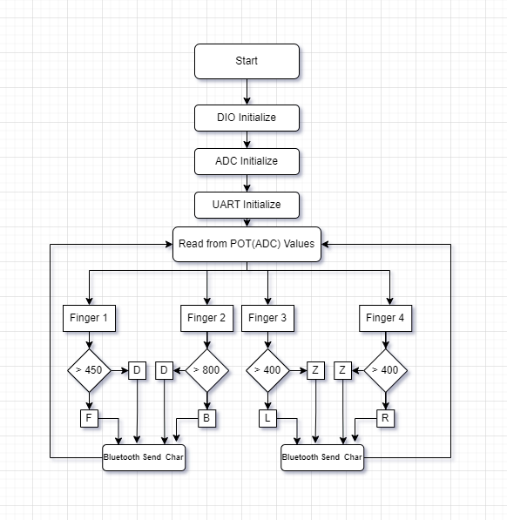
Hand Flow Chart

Slide 6
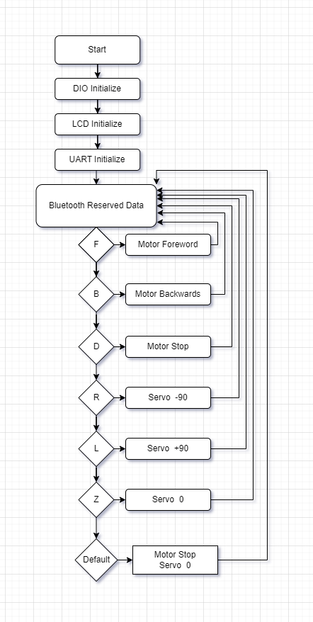
Car Flow Chart

Slide 7
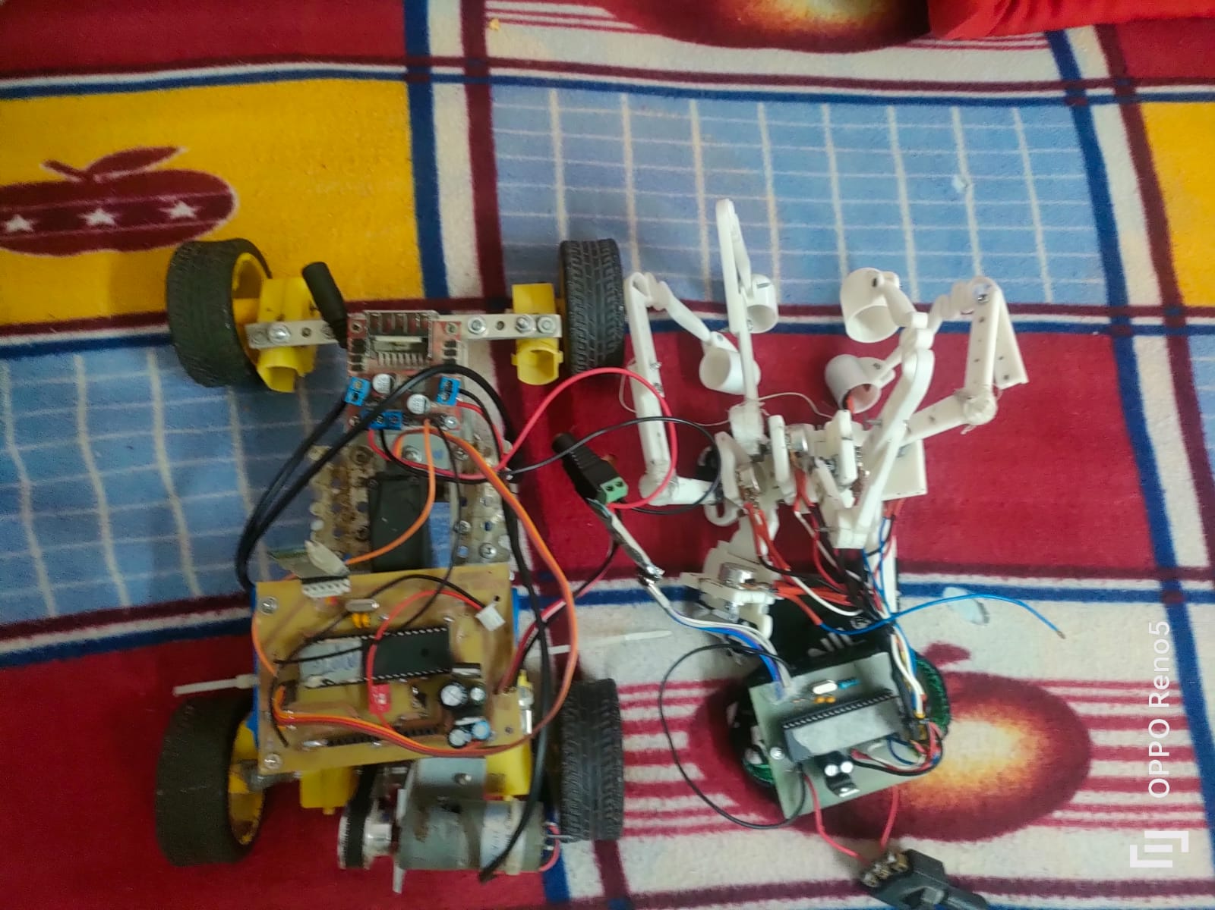
Final Project

Slide 8
Github Repo
https://github.com/MrAhmedSayedAli/AmitGraduateProject

