Slide 1
Classification using Decision Trees

Slide 2
Learning Outcomes
LO3: Gain an understanding on the supervised learning techniques.

Slide 3

Session Outcome
After completing this session you will be able to;
Explain
Decision trees and their usage
Decision tree growing with splitting
Decision tree pruning
Rule extraction from decision tree
Random forests

Slide 4
What is a Decision Tree?
A predictive model used in Machine Learning, Statistics and Data mining.
A tree structure (Directed, acyclic graph) starting with some observations about an item (Data) to conclusions (target value).
Makes a prediction on the basis of a series of decisions along the branch of a tree.
Representing possible paths.
Used for classification and regression.
Notes:
Flow chart like tree structure.

Slide 5
Decision tree structure
Top most node which represents the entire data set
Root Node (N)
Test on an attribute or Classification Rule
Branch
Internal/Non-leaf node
An Outcome of the test
Branch
Terminal/Leaf Node
Holds a class label

Slide 6
Class labeled training samples from a customer database:
# | Age | Income | Student | Credit_rating | Class:buys_computer
1 | youth | High | no | fair | no
2 | youth | High | no | excellent | no
3 | Middle-aged | High | no | fair | yes
4 | senior | medium | no | fair | yes
5 | senior | low | yes | fair | yes
6 | senior | low | yes | excellent | no
7 | Middle-aged | low | yes | excellent | yes
8 | youth | medium | no | fair | no
9 | youth | low | yes | fair | yes
10 | senior | medium | yes | fair | yes
11 | youth | medium | yes | excellent | yes
12 | Middle-aged | medium | no | excellent | yes
13 | Middle-aged | High | yes | fair | yes
14 | senior | medium | no | excellent | no

Slide 7
Example: Concept of Buying a computer
Age?
Youth
Senior
Student?
Credit rating?
Middle_aged
Yes
No
Fair
Excellent
Buy
Not Buy
Buy
Not Buy
Buy
Notes:
Given a new input, the tree is traversed by evaluating the specific input started at the root node of the tree.

Slide 8
Types of decision trees
Univariate
Vs.
Multivariate decision trees
----------------------------------------------------------
Binary
Vs.
n-ary decision trees

Slide 9
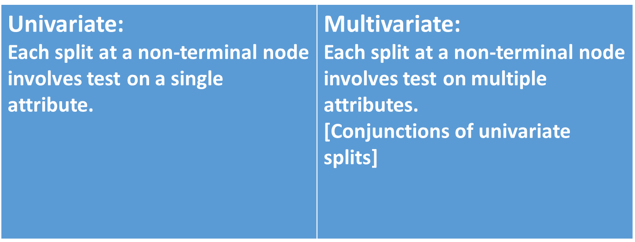
Univariate Vs. Multivariate decision trees:
Restrict the number of variables/attributes used per split.
X1>1000
X1>1000 & X2 >5000
C1
C2
C1
C2
Notes:
What about this?
X1/x2>1

Slide 10
Binary Vs. n-ary decision trees:
Restrict the number of children per node.
Binary (2-ary)
Split has 2 branches
Ternary (3-ary)
Split has 3 branches
N-ary
Split has n branches
?
1
2
?
1
2
3
?
1
2
3
n
Notes:
Can n-ary decision trees be represented as binary DT?

Slide 11
Decision Tree Learning/Induction
Construction of a decision tree from class labeled training samples.

Slide 12
Decision Tree Learning/Induction
A top-down approach is common.
Start with a training set of samples with associated class labels.
Recursively split the training set into smaller subsets as the tree is being built.
Splitting is done based on a test (splitting rule) on an attribute/variable of the dataset.
Notes:
Splitting rule determines how the samples at each node should be split.

Slide 13
Splitting attribute
[Entire Data set D]
Age?
D _{youth}
D _{Senior}
# | Age | Income | Student | Credit_rating | Class:buys_computer
1 | youth | High | no | fair | no
2 | youth | High | no | excellent | no
8 | youth | medium | no | fair | no
9 | youth | low | yes | fair | yes
11 | youth | medium | yes | excellent | yes
# | Age | Income | Student | Credit_rating | Class:buys_computer
4 | senior | medium | no | fair | yes
5 | senior | low | yes | fair | yes
6 | senior | low | yes | excellent | no
10 | senior | medium | yes | fair | yes
14 | senior | medium | no | excellent | no
Youth
Senior
?
?
Middle_aged
?
D _{Millde_aged}
# | Age | Income | Student | Credit_rating | Class:buys_computer
3 | Middle-aged | High | no | fair | yes
7 | Middle-aged | low | yes | excellent | yes
12 | Middle-aged | medium | no | excellent | yes
13 | Middle-aged | High | yes | fair | yes

Slide 14
Attribute selection measures
Determines the most appropriate attribute to partition/split samples at each node.
Methods available:
Information Gain (used in ID3 algorithm)
Gain Ratio (used in C4.5 algorithm)
Gini Index (used in CART algorithm)

Slide 15
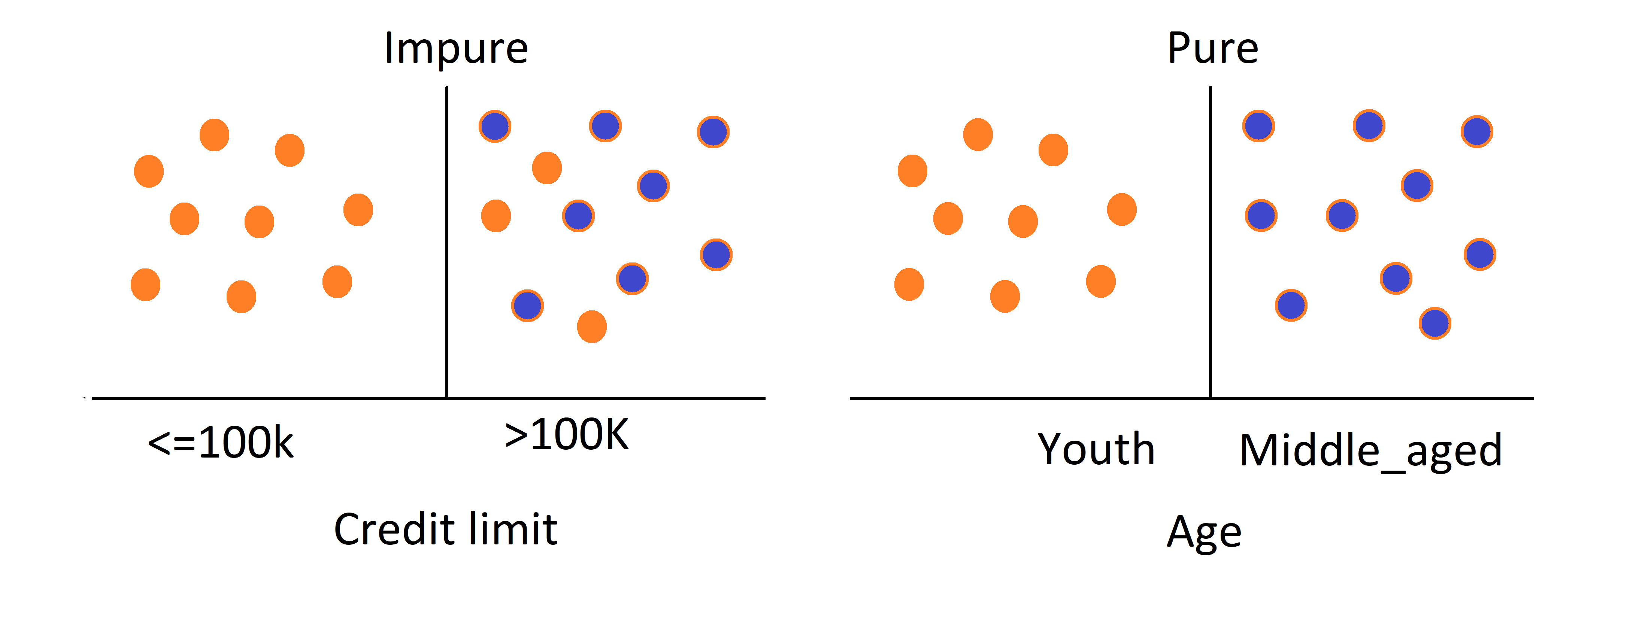
Entropy
Which test is more information to correctly classify samples? Credit limit or Age?
(Buys a computer :Yes or No)
Notes:
Entropy quantifies the amount of uncertainty involved in the value of a random variable or the outcome of a random process. For example, identifying the outcome of a fair coin flip (with two equally likely outcomes) provides less information (lower entropy) than specifying the outcome from a roll of a die (with six equally likely outcomes).

Slide 16
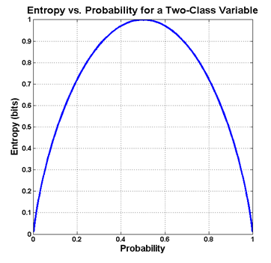
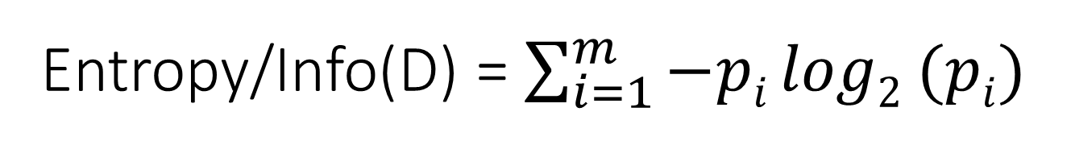
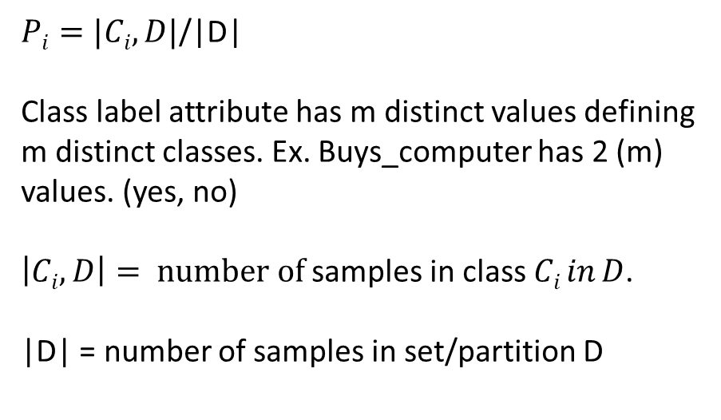
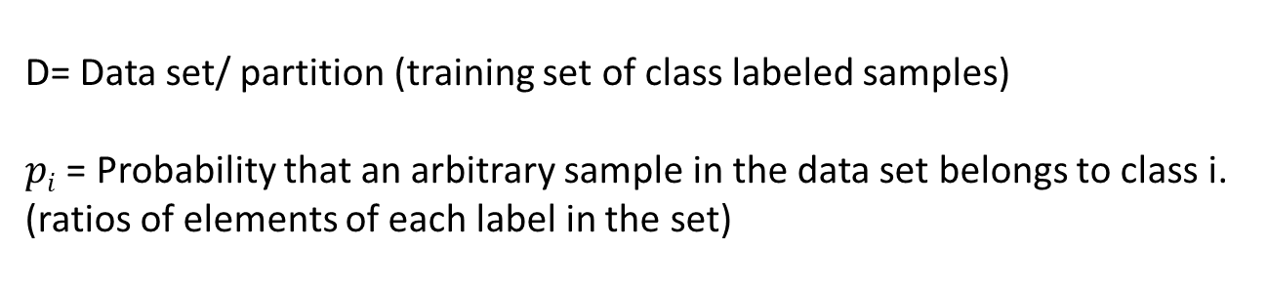
Entropy/Info(D) = $\sum_{i=1}^{m}{−pi log2 (pi)}$
D= Data set/ partition (training set of class labeled samples)
$pi$ = Probability that an arbitrary sample in the data set belongs to class i.
(ratios of elements of each label in the set)
$Pi=|Ci,D|$/|D|
Class label attribute has m distinct values defining m distinct classes. Ex. Buys_computer has 2 (m) values. (yes, no)
$\left|Ci,D\right|= number of$samples in class $Ci in D$.
|D| = number of samples in set/partition D
Notes:
E=1 : Sample is equally divided. ie 50% of each class
E=0 : completely homogenious
D= Data set/ partition (training set of class labeled samples.
Class label attribute has m distinct values defining m distinct classes. Ex. Age attribute has 3 (m) values. (youth, middle_aged and senior) youth is a class. Senior is a class.
$\left|Ci,D\right|= number of$samples in class $Ci in D$.
|D| = number of samples in set/partition D
So $Pi$ = number of youth/total in D = 5/14
-5/14 $log2$ (5/14)

Slide 17
Information Gain
Information Gain is calculated using the entropy.
Entropy of a partition:
Measures the level of impurity in a partition data.
The expected information needed to classify a given partition(D) with minimum impurity is given by
Entropy OR Info(D).

Slide 18
Calculate Information Gain
Information gain_{(attribute)} = Entropy_{(Parent)} – (weighted) Average Entropy_{(Children)}
Information gain is the difference between the amount of information that is needed to correctly make a prediction before (ie. Parent Entropy) and after (ie. Average entropy of children)a split is made.
Gain is the reduction of entropy due to the splitting on the attribute A.

Slide 19
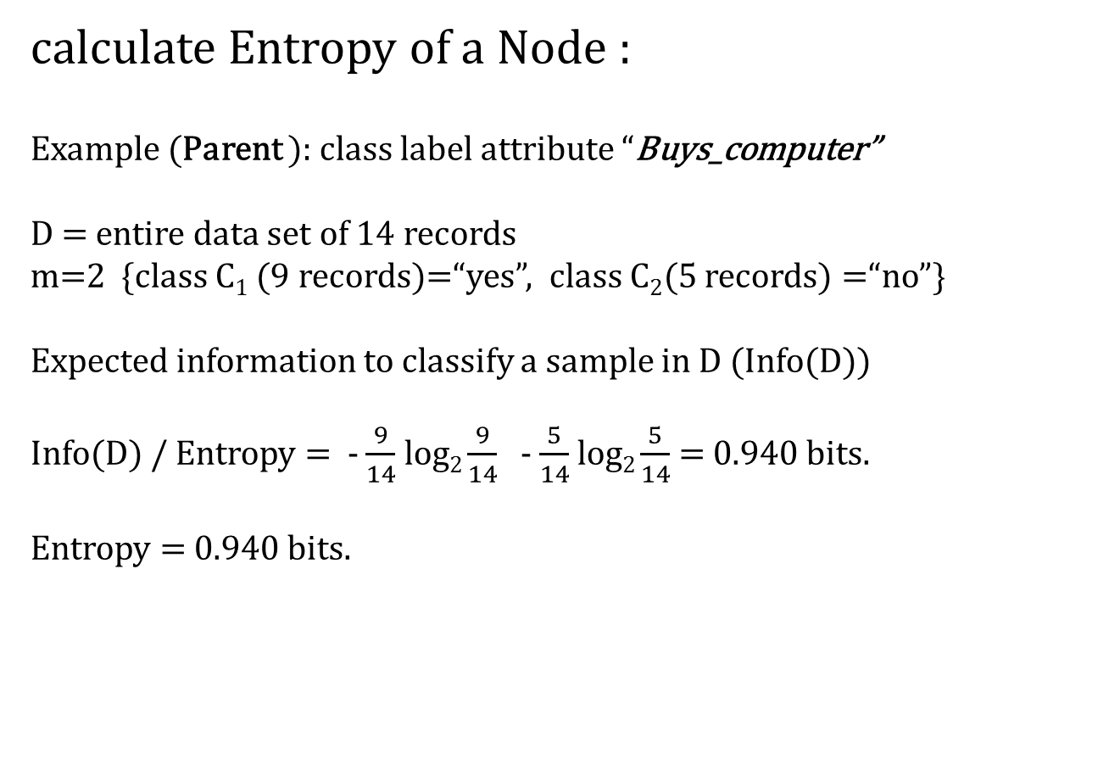
Entropy/Info(D) = $\sum_{i=1}^{m}{−pi log2 (pi)}$
calculate Entropy of a Node :
Example (Parent ): class label attribute “Buys_computer”
D = entire data set of 14 records
m=2 {class C₁ (9 records)=“yes”, class C₂(5 records) =“no”}
Expected information to classify a sample in D (Info(D))
Info(D) / Entropy = - $\frac{9}{14}$ log₂ $\frac{9}{14}$ - $\frac{5}{14}$ log₂ $\frac{5}{14}$ = 0.940 bits.
Entropy = 0.940 bits.

Slide 20
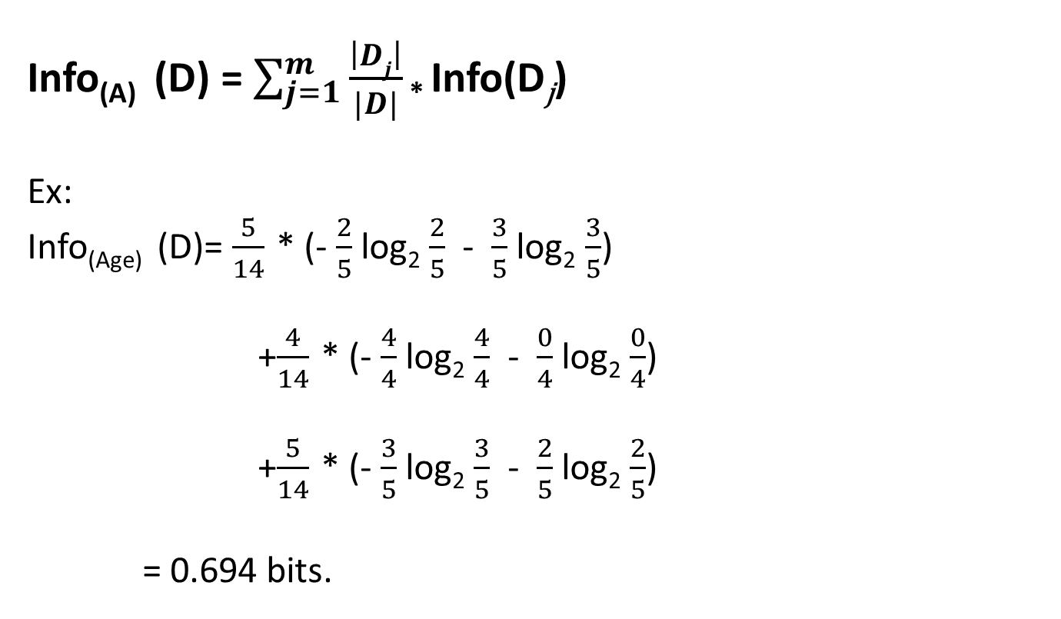
(Weighted) Average Entropy (Children)
Info_{(A)} (D) = $\sum_{j=1}^{m}{\frac{\left|Dj\right|}{|D|}}$ * Info(D_{j})
Ex:
Info_{(Age)} (D)= $\frac{5}{14}$ * (- $\frac{2}{5}$ log₂ $\frac{2}{5}$ - $\frac{3}{5}$ log₂ $\frac{3}{5}$)
+$\frac{4}{14}$ * (- $\frac{4}{4}$ log₂ $\frac{4}{4}$ - $\frac{0}{4}$ log₂ $\frac{0}{4}$)
+$\frac{5}{14}$ * (- $\frac{3}{5}$ log₂ $\frac{3}{5}$ - $\frac{2}{5}$ log₂ $\frac{2}{5}$)
= 0.694 bits.
Entropy(Youth)
Entropy(Middle_aged)
Entropy(Senior)

Slide 21





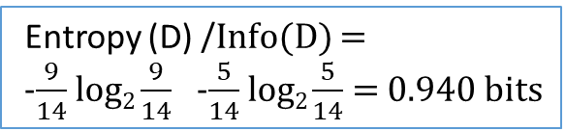

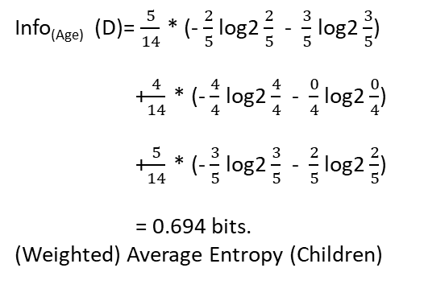
Calculate Information Gain
Entropy (D) /Info(D) =
-$\frac{9}{14}$ log₂ $\frac{9}{14}$ -$\frac{5}{14}$ log₂ $\frac{5}{14}$ = 0.940 bits
Age?
$\frac{5}{14}$ Senior
$\frac{5}{14}$ Youth
$\frac{4}{14 }$Middle_aged
Info_{(Age)} (D)= $\frac{5}{14}$ * (- $\frac{2}{5}$ log2 $\frac{2}{5}$ - $\frac{3}{5}$ log2 $\frac{3}{5}$)
+$\frac{4}{14}$ * (- $\frac{4}{4}$ log2 $\frac{4}{4}$ - $\frac{0}{4}$ log2 $\frac{0}{4}$)
+$\frac{5}{14}$ * (- $\frac{3}{5}$ log2 $\frac{3}{5}$ - $\frac{2}{5}$ log2 $\frac{2}{5}$)
= 0.694 bits.
(Weighted) Average Entropy (Children)
Entropy _{(Youth)}
[3 No , 2-yes]
Entropy _{(Middle_Aged)}
[0 No, 4-yes]
Entropy _{(Senior)}
[2 No , 3-yes]
(- $\frac{2}{5}$ log2 $\frac{2}{5}$ - $\frac{3}{5}$ log2 $\frac{3}{5}$)
(- $\frac{2}{5}$ log2 $\frac{2}{5}$ - $\frac{3}{5}$ log2 $\frac{3}{5}$)
(- $\frac{3}{5}$ log2 $\frac{3}{5}$ - $\frac{2}{5}$ log2 $\frac{2}{5}$)
Information Gain_{(Age)} = Info_{(Buys_computer)} - Info_{(Age)}
= 0.940 - 0.694
= 0.246 bits

Slide 22
How to select the splitting attribute for a node using Information gain
1)Compute Entropy of the parent node
Info_{(Buys_computer) =} 0.940
2)Compute Information gain of each attribute.
(Ex: Age, income, student, credit rating)
Gain_{(Age)} = Info_{(Buys_computer)} - Info_{(Age)}
= 0.940 - 0.694
= 0.246 bits
Gain_{(Income)} = Info_{(Buys_computer)} - Info_{(Income)} = 0.029 bits
Gain_{(student)} = Info_{(Buys_computer)} - Info_{(student)} = 0.151 bits
Gain_{(Credit_rating)} = Info_{(Buys_computer)} - Info_{(Credit_rating)} = 0.048 bits
3)The attribute with the highest information gain is selected as the splitting attribute.
Ex: Age has the highest information gain. So that it is selected as the splitting attribute at Node N (root node).

Slide 23
Splitting attribute
[Entire Data set D]
Age?
D _{youth}
D _{Senior}
# | Age | Income | Student | Credit_rating | Class:buys_computer
1 | youth | High | no | fair | no
2 | youth | High | no | excellent | no
8 | youth | medium | no | fair | no
9 | youth | low | yes | fair | yes
11 | youth | medium | yes | excellent | yes
# | Age | Income | Student | Credit_rating | Class:buys_computer
4 | senior | medium | no | fair | yes
5 | senior | low | yes | fair | yes
6 | senior | low | yes | excellent | no
10 | senior | medium | yes | fair | yes
14 | senior | medium | no | excellent | no
Youth
Senior
?
?
Middle_aged
?
D _{Millde_aged}
# | Age | Income | Student | Credit_rating | Class:buys_computer
3 | Middle-aged | High | no | fair | yes
7 | Middle-aged | low | yes | excellent | yes
12 | Middle-aged | medium | no | excellent | yes
13 | Middle-aged | High | yes | fair | yes

Slide 24
Gini index and Gini gain
https://www.upgrad.com/blog/gini-index-for-decision-trees/#:~:text=This%20value%20calculated%20is%20called,above%20manner%20with%20each%20iteration.

Slide 25
Generate_Decision_Tree Algorithm
Input:
Data partition D
a set of training samples and their associated class labels.
Attribute list
the set of candidate attributes
Attribute_selection_method
a procedure to determine the splitting criterion that “best” partitions the data samples into individual classes.
This criterion consists of a splitting_attribure and possibly either a split point or splitting subset.
Output: A decision tree

Slide 26
Generate_Decision_Tree
Create node N;
if samples in D are all of the same class C then,
return N as a leaf node labeled with a the class C
if attribute_list is empty then
return N as a leaf node labeled with the majority class in D;
Apply Attribute_Selection_Method(D, Attribute_list) to find the best splitting criterion;
Label node N with splitting criterion;
If splitting_attribute is discrete-valued and multiway splits allowed then //not restricted to binary tree
attribute_list <- attribute_list - splitting criterion //remove splitting attribute
for each outcome j of splitting criterion //partition the samples and grow subtrees for each partition.
let D_{j} be the set of data samples in D satisfying ourcome j; // a partition.
if D_{j} is empty then
attach a leaf labeled with the majority class in D to node N;
else
attach the node returned by Generate_Decision_Tree(D_{j,} Attribute_list ) to node N
end for
return N;

Slide 27
Decision Tree Pruning
Technique to reduce the size (complexity) by removing least-reliable branches.
Why pruning?
Address the problem of overfitting the data;
➔ Improves the accuracy.
Tree becomes smaller and less complex;
➔ Easier to comprehend.
Notes:
Branch = subtree

Slide 28
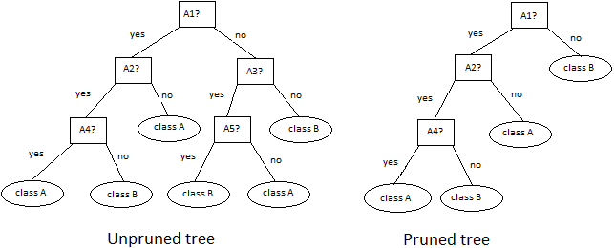
Decision Tree Pruning Cont.
Notes:
Branch = subtree

Slide 29
Decision Tree Pruning Cont.
Can prevent overfitting
Two approaches:
Pre-pruning
Post-pruning (backward pruning)
Notes:
Branch = subtree

Slide 30
Pre-pruning
Tree is pruned by halting its construction early.
Upon halting node becomes a leaf.
Assess the goodness of a split using measurement such as;
Statistical significance
Information gain
Gini Index and so on.
If measurement of the split < threshold value
Further splitting of the subtree is halted.
Notes:
Halting = Decide no to split at a given node.
What if the threshold is very high?
What if the threshold is very low?

Slide 31
Post-pruning
Common approach.
Remove a subset of a given tree in a fully-grown tree and replace with a leaf node.
Leaf := Most frequent class among subtree. Ex: A3 in the diagram
Post-pruning techniques:
Cost based pruning
Reduced error pruning
Maximum error pruning
Error complexity pruning
Notes:
Branch = subtree

Slide 32
Rule extraction from Decision Tree
The more the decision tree is large the more the complexity and difficult to comprehend.
Decision tree → →Rule-based classifier
Rule-based classifiers uses set of IF-THEN rules.
Rule Extraction
IF condition THEN conclusion
Rule antecedent(precondition) | rule consequent
one or more attributes that are Logically ANDed. IF Age = youth AND Student = yes | Class prediction THEN buys_computer = yes

Slide 33
Rule extraction from Decision Tree Cont.
Method:
One rule is created from each path from root to a leaf.
Splitting criterion at each node from root to one before leaf(except leaf) along the path are joined with logical AND to form an antecedent (IF part)
Leaf node class label prediction form the rule consequent (THEN part).
Rule # | Rule antecedent | Rule consequent
R1 | IF age =youth AND student =no | THEN buys_computer = no
R2 | IF age =youth AND student =yes | THEN buys_computer = yes
R3 | IF age =middle_aged | THEN buys_computer = yes
R4 | IF age =senior AND credit_rating= excellent | THEN buys_computer = yes
R5 | IF age =senior AND credit_rating=fair | THEN buys_computer = yes

Slide 34
Characteristics of Decision Tree Rules
A disjunction (logical OR) is implied between each of the extracted rules.
Mutually exclusive.
No rule conflicts because no two rules will be triggered for the same sample.
Exhaustive.
One rule for possible attribute-value combination.
So no default rule is required.
Unordered.
Notes:
Why Mutually exclusive? We have one rule per leaf and any sample can map to only one leaf.
Why unordered? Because exhaustive, when traverse through the DT, the order of the rules does not matter.

Slide 35
Rule Induction directly from data.
IF-THEN rules can be extracted directly from the training data. (Without having to generate a decision tree first)
Ex:
Sequential covering algorithm
Associative classification algorithms
Notes:
Associative classification algorithms: search for attribute-value pairs that occur frequently in the data. These pairs may form association rules using support and confidence criterias. (Ex: IF

Slide 36
Advantages and Disadvantages of Decision Trees
Advantages:
Construction does not require any domain knowledge or parameter setting.
Good for exploratory knowledge discovery.
Can handle high dimensional data.
Representation of acquired knowledge is easy to assimilate by human. (Intuitive)
Learning and classification steps of Decision Tree induction are simple and fast.
High accuracy.(But depend on selected data)
Used as a basis for many commercial rule induction systems.
Disadvantages:
Highly depend on the training data. Thus overfitting.
Tress becomes very complex unless an appropriate thresholds are set as termination conditions.
Use greedy approach and locally optimal (not globally optimal).

Slide 37
Random Forests
An ensemble classifier that produces multiple decision trees.
Use randomly selected subsets of training samples to produce multiple decision trees.
Each decision tree is independently produced without any pruning.
Grow the forest up to a user-defined number of trees (k).
A new unlabeled data input is thus evaluated against all decision trees created in the ensemble.
This ensemble method increases the accuracy of the output.
Notes:
Are there any methods to improve the classifier/ predictor accuracy rather than pruning? Yes.. That is ensemble methods such as bagging and boosting.

Slide 38
Sampling training samples for random forest construction(multiple decision trees)
Bootstrap Method (Sampling with replacement):
Sample the training samples uniformly with replacement.
ie. Each time a sample is selected, it is equally likely to be selected again and included in the next sample training set.
Ex. .632 bootstrap
Notes:
Are there any methods to improve the classifier/ predictor accuracy rather than pruning? Yes.. That is ensemble methods such as bagging and boosting.

Slide 39
Ensemble methods
Methods that use a combination of Models.
Ex: Multiple decision trees
An ensemble method combines a series of k learned models(classifiers/predictors) with the aim of creating an improved composite model M*
M₁, M₂, M₃, ……, M_{k} ➔ M*
M₁
New data
Data
M₁
M*
[Combine votes]
Prediction
M_{k}
Notes:
Voting strategies are used to combine the predictions for a given unknown sample.

Slide 40
Ensemble methods
Two techniques available:
Bagging (Bootstrap aggregation)
Boosting

Slide 41
Bagging
Given a data set D of d samples,
Generate k number of sample training sets D₁ to D_{k} (bootstrap samples)using sampling with replacement.
For each sample, a model(classifier) is learned.
For a new input, each model returns a prediction, which counts as one vote.
Bagged classifier M*, counts the votes and assign the class label with the most votes for the new input.
If the models predict continuous values, bagged classifier get the result from each model and average them for the final outcome.
M* has the improved accuracy over a single predictor derived from D.
Notes:
Suppose that you are a patient and would like to have a diagnosis made based on your symptoms. Instead asking one doctor, you may choose to ask several. If a certain diagnosis occurs more than any of the others, you may use that as the final or best diagnosis. That decision is made based on a majority vote, where each doctor gets an equal vote. Now replace the doctor by a classifier.

Slide 42
Algorithm: Bagging
Input:
D, a set of d training samples.
K, the number of models in the ensemble.
A learning scheme (decision tree, backpropogation etc.)
Output:
A composite model M*

Slide 43
Algorithm: Bagging Cont.
Method:
1. for i=1 to k do // create k models
2. Create bootstrap sample, Di by sampling D with replacement;
3. Use D_{i} to derive a model, M_{i}
4. end for
To use the composite model on a sample x:
1. if classification then
Let each of the k models classify X and return the majority vote;
3. If regression then
4. Let each of the k models predict a value for X and return the
average predicted values.

Slide 44
Boosting
A series of k classifiers are iteratively learned.
After the first classifier is learned, next classifier is learned paying more attention to the misclassified and non-classified samples of the previous iteration.
Do this iteratively k times and the final boosted classifier M*, combines the votes of each individual classifier.
Each classifier’s vote is a function of its accuracy.
Boosting can be extended for the prediction of continuous values.
Notes:
In boosting: suppose that as a patient, you have symptoms. Instead of consulting one doctor, you choose to consult several. Then you assign weights to the worth of each doctor’s diagnosis, based on the accuracies of previous diagnoses they have made. The final diagnoses is then a combination of the weighted diagnoses. This is the essence behind boosting.

Slide 45
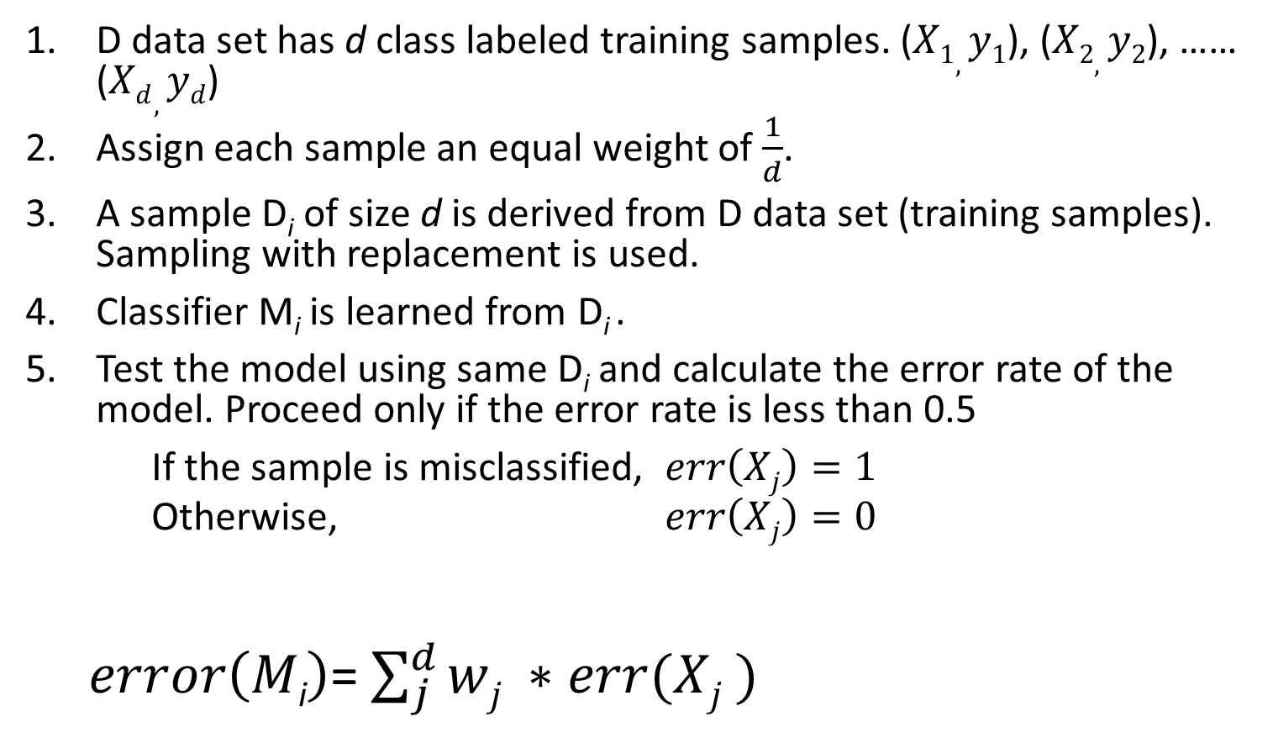
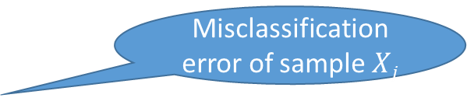
Adaboost algorithm
D data set has d class labeled training samples. ($X1, y1$), ($X2,y2$), …… ($Xd,yd$)
Assign each sample an equal weight of $\frac{1}{d}$.
A sample D_{i} of size d is derived from D data set (training samples). Sampling with replacement is used.
Classifier M_{i} is learned from D_{i} .
Test the model using same D_{i} and calculate the error rate of the model. Proceed only if the error rate is less than 0.5
If the sample is misclassified, $err\left(Xj\right)=1$
Otherwise, $err\left(Xj\right)=0$
$error\left(M\text{i}\right)$= $\sum_{j}^{d}{wj ∗err(Xj )}$
Weight of the sample
Model error rate
Misclassification error of sample $Xj$
Notes:
Generating k classifiers for ensemble requires k rounds of the algorithm.

Slide 46
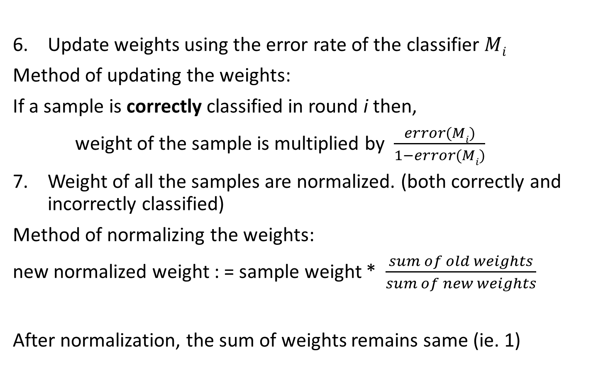
Adaboost algorithm Cont.
Update weights using the error rate of the classifier $Mi$
Method of updating the weights:
If a sample is correctly classified in round i then,
weight of the sample is multiplied by $\frac{error(Mi)}{1−error(Mi)}$
Weight of all the samples are normalized. (both correctly and incorrectly classified)
Method of normalizing the weights:
new normalized weight : = sample weight * $\frac{sum of old weights}{sum of new weights}$
After normalization, the sum of weights remains same (ie. 1)
Notes:
After normalizing their sum remains the same as it was before.

Slide 47
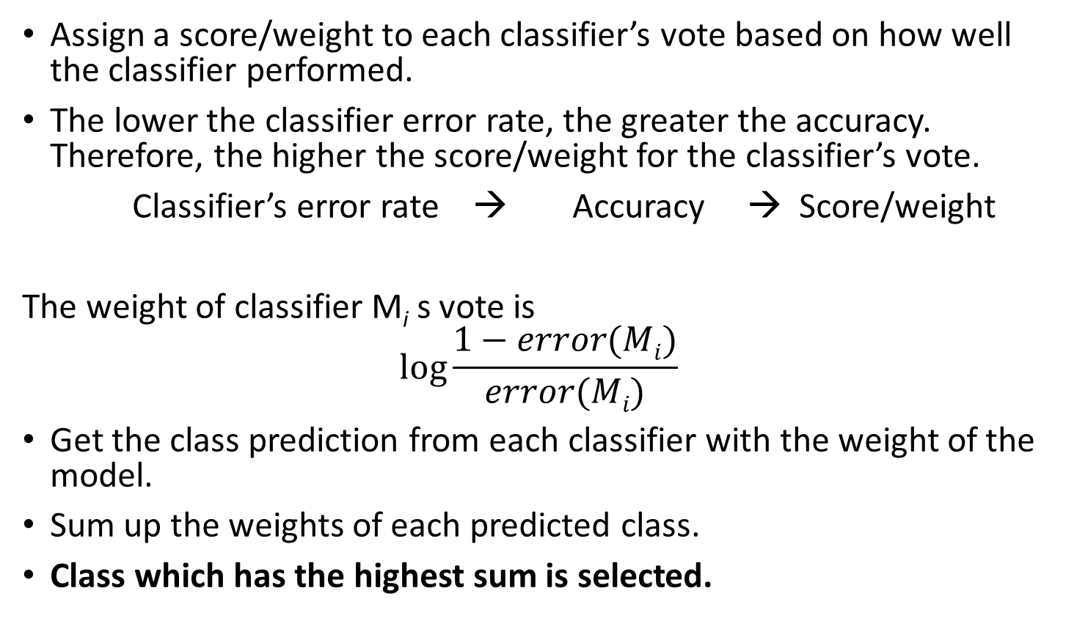
How an ensemble predict the class label of a new sample?
Assign a score/weight to each classifier’s vote based on how well the classifier performed.
The lower the classifier error rate, the greater the accuracy. Therefore, the higher the score/weight for the classifier’s vote.
Classifier’s error rate → Accuracy → Score/weight
The weight of classifier M_{i} s vote is
$$\log{\frac{1−error(Mi)}{error(Mi)}}$$
Get the class prediction from each classifier with the weight of the model.
Sum up the weights of each predicted class.
Class which has the highest sum is selected.

Slide 48
Adaboost algorithm
Input:
D, a set of d class-labeled training samples
K, the number of rounds (one classifier is generated per round)
A classification learning scheme
Output:
A composite model

Slide 49
Adaboost algorithm Cont.
Method:
01.Initialize the weight of each sample in D to 1/d;
02.for i=1 to k do// for each round
03. sample D with replacement according to the sample weights to obtain D_{i};
04. use training set D_{i} to derive a model M_{i};
05. compute error(M_{i}), the error rate of M_{i}
06. if error(M_{i}) >.5 then
07. reinitialize the weights to 1/d
08. go back to step 3 and try again;
09. end if
10. for each sample in Di that was correctly classified do
11. multiply the weight of the sample by error(M_{i})/(1-error(M_{i})); //Update weights.
12. normalize the weight of each sample;
13.end for

Slide 50
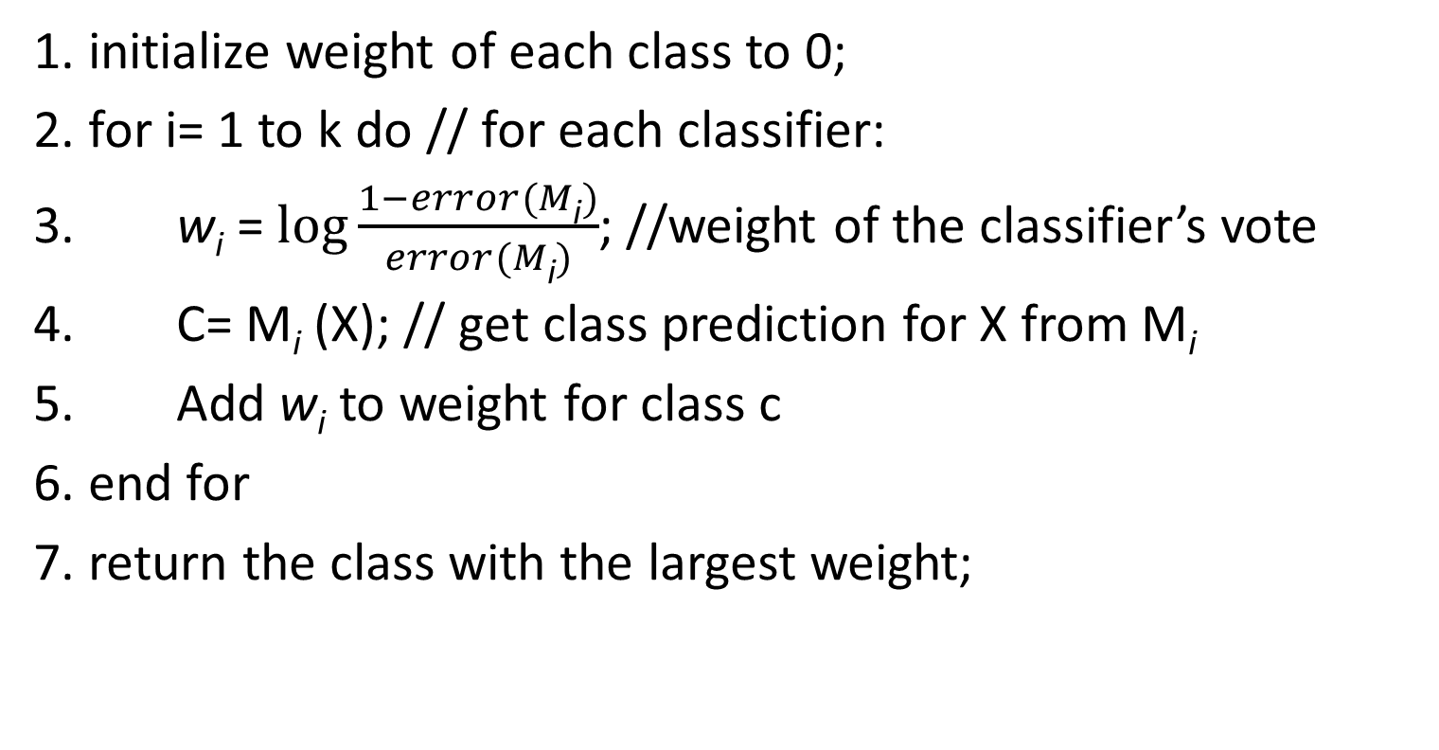
To use the composite model to classify sample X:
1. initialize weight of each class to 0;
2. for i= 1 to k do // for each classifier:
3. w_{i} = $\log{\frac{1−error(M\text{i})}{error(M\text{i})}}$; //weight of the classifier’s vote
4. C= M_{i} (X); // get class prediction for X from M_{i}
5. Add w_{i} to weight for class c
6. end for
7. return the class with the largest weight;

Slide 51
Bagging Vs. Boosting
Boosting:
Focusses on misclassified samples.
High accuracy but
Risks on overfitting the resulted composite model to such data.
Bagging:
Less model overfitting
Bagging and Boosting both have improved accuracy than a single model. But boosting tends to achieve greater accuracy.
Notes:
Due to overfitting, boosted model may less accurate than a single model derived from same data.

Slide 52
Other ensemble methods
Boolean operator-based ensemble methods
ML based ensemble methods
Stack ensemble

Slide 53
Random Forest: Advantages & Disadvantages
Advantages
- Works well with small training sets
- Can be easily parallelized
Disadvantages
- Can fail to predict rare outcomes or rare predictions (since it’s based on bootstrap sampling)
- Need to guess the no. of trees
- Overfitting can occur

Slide 54

Reference:
Data Mining (Concepts and Techniques)
-Second Edition
-Jiawei Han and Micheline Kamber

