Slide 1
Job Application Data Trends
Group 4: Amol Sanjay Bhadane, Cat Kim, Gitika Ramesh Chandnani, Ritvik ganesan
December 4, 2023
MIS 6382.501: Fall 2023

Slide 2
Agenda
Introduction of the Data
Trend Discussions of the Visualizations
Conclusion
Q & A Session

Slide 3



A Comprehensive Analysis of 10,000 Diverse Job Applications
The following dataset consist of 10,000 Job applications for companies – Apple, Boeing and Siemens.
Dataset contains Key attributes like date , title , company, type , experience , salary , Interview difficulty , unique ID which provide us rich sources for in-depth analysis.
Using key attributes we can analyze our data set with aspects like distribution of job titles, number of applications received by each company, experience and salary distribution by company and much more.
Notes:
In the dynamic landscape of job applications sourced from an aggregator website, our data encapsulates a wealth of information about various employment opportunities. Each entry in our dataset represents a unique job application, meticulously recorded with essential details such as application date, job title, company, job type, required experience, salary, and the perceived interview difficulty. To enhance the organization and analysis of this diverse dataset, we've implemented a structured class hierarchy. The foundation is laid by the JobApplication class, equipped with a unique identifier for each instance and a string representation method for easy readability.
To cater to the distinct characteristics of STEM and non-STEM job applications, we extend our class hierarchy with subclasses, namely StemJobApplication and NonStemJobApplication. Furthermore, we delve into specifics by introducing subclasses tailored to renowned companies such as Apple, Siemens, and Boeing. Each company class inherits attributes from its parent class, maintaining consistency while accommodating unique details pertinent to the respective organization.
In the subsequent steps, we put our classes to the test, generating instances like SiemensJobApplication and utilizing a pickle file to retrieve a curated set of objects. Additionally, we leverage the data to construct a CSV file, facilitating comprehensive insights into the aggregated job application data. Armed with this enriched dataset, we embark on a visual journey, creating insightful visualizations that shed light on the distribution and characteristics of job applications within our diverse and dynamic dataset.

Slide 4
Visualizations & Data Trends

Slide 5
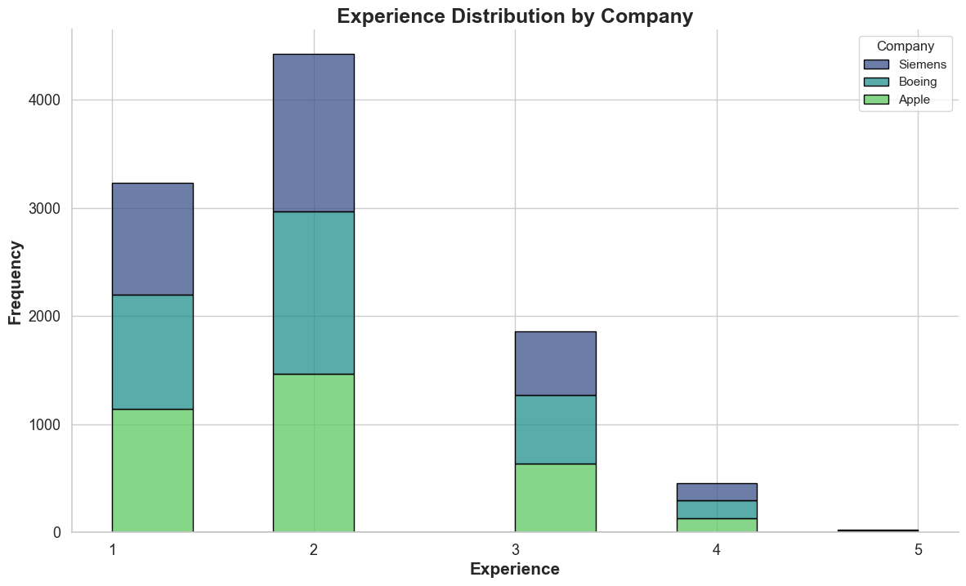
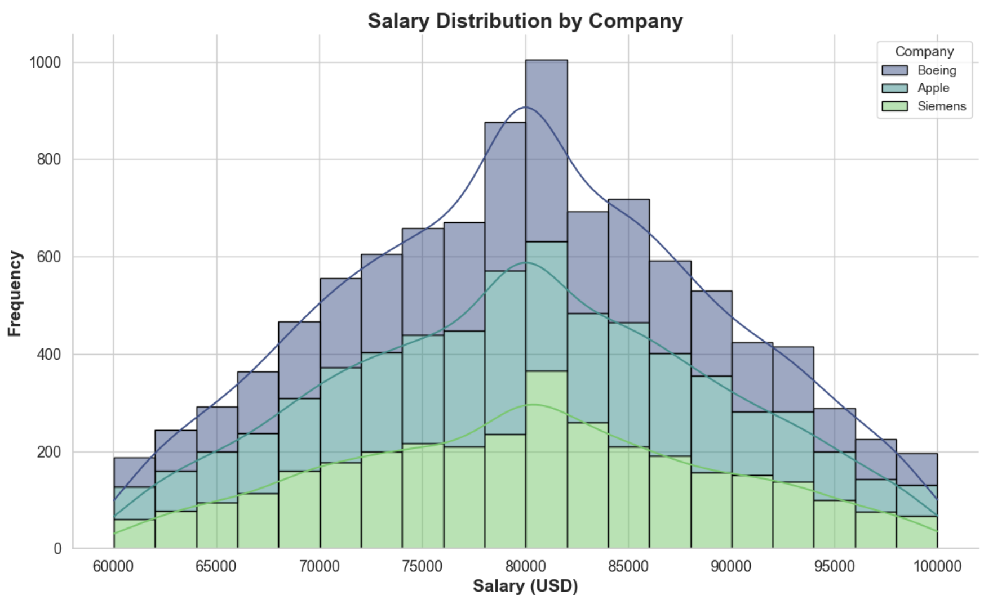
Histogram
Experience Distribution by Company:
About 4500 Job applications require candidates with 2 years of experience and very few applications or roles with more than 3 years.
The histogram shows the data for 3 companies differentiated by colors.
Salary Distribution by Company:
For all 3 companies the distribution is symmetrical and the peak or average salary for each company is around 78000 to 82000 USD.
Notes:
Experience Distribution by Company: We can see a stacked histogram where each bar represents frequency of job applications received based on the required years of experience with 3 companies differentiated by colors. Salary Distribution by Company: x-axis represents the 'Salary(USD)' variable, indicating the different salary values within the dataset. Each bin on the x-axis corresponds to a specific range of salary values. The y-axis represents the 'Frequency,' indicating the count or frequency of job applications falling within each salary range. The histogram is further enhanced by stacking bars for each company, visualized using different colors, offering insights into the distribution of salaries across various companies. The kernel density estimate (KDE) line provides a smooth representation of the overall distribution pattern, complementing the histogram bars.

Slide 6
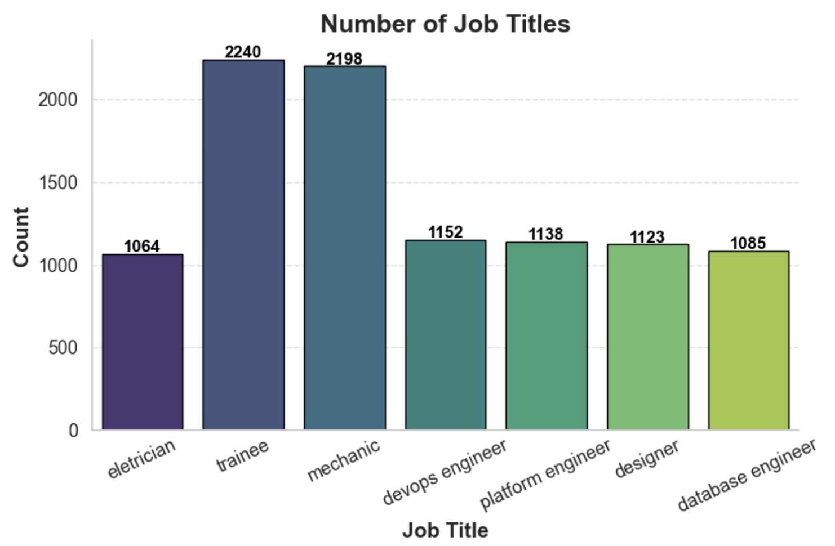
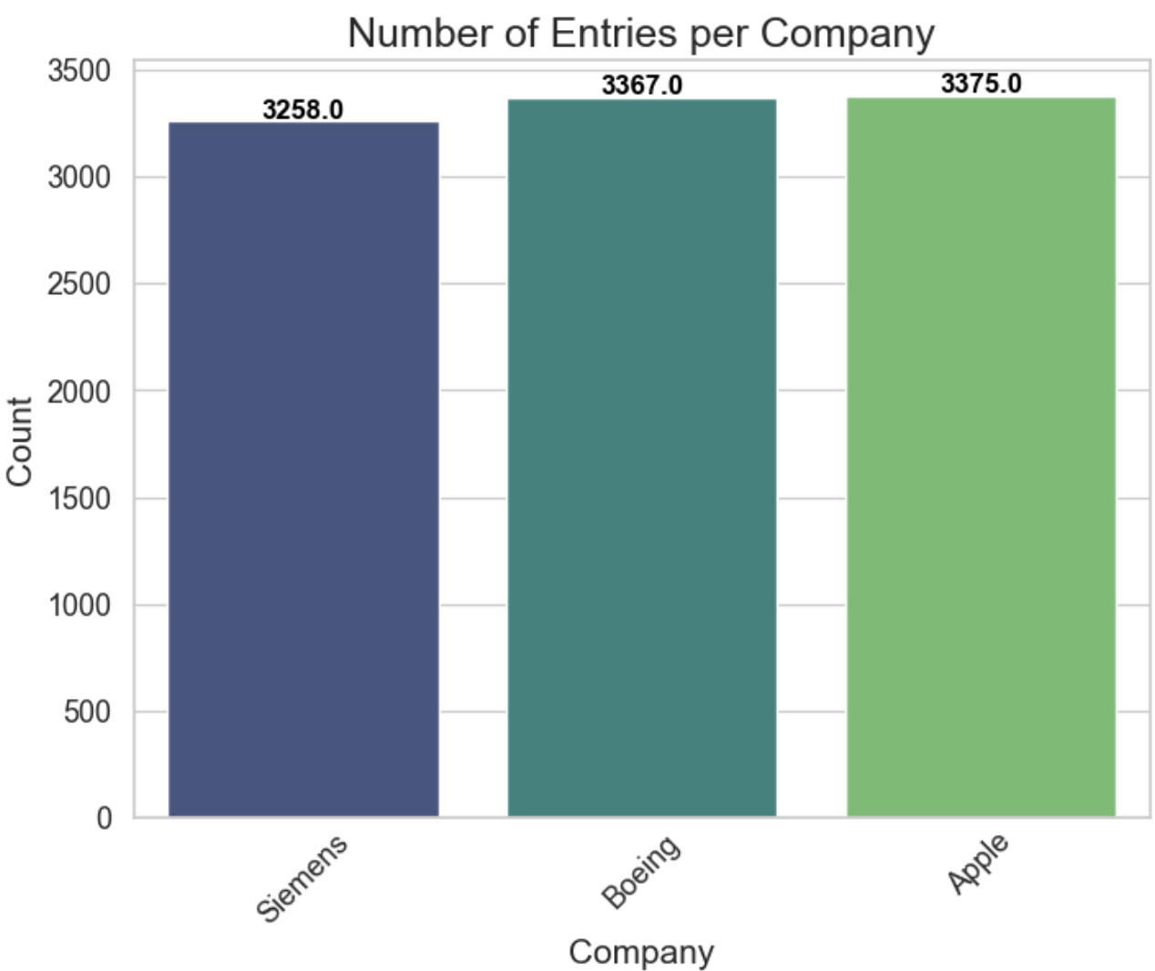
Bar Charts
Number of Job Titles:
Among multiple job applications:
Maximum of them have job title is 'Trainee,’ with count of 2240.
Following closely are - Mechanic’ (2198)
'DevOps Engineer’(1152)
'Platform Engineer’ (1138)
'Designer' boasting (1123)
'Database Engineer' rounding out the list with 1085 applications.
Number of Entries per company:
Visualization of number entries received among 3 companies:
Siemens(Lowest) – 3258
Boeing – 3367
Apple (Highest) - 3375
Notes:
Number of job titles: The distribution of job titles within a dataset is clearly communicated via the bar chart presented. The height of each bar on the chart represents the frequency or count of that specific job title in the dataset. Each bar on the chart refers to a single job title. The different work titles are shown on the x-axis, while the count of each job title is shown on the y-axis. The job titles that are more common or appear more frequently in the dataset may be identified by looking at the chart; they will have higher bars. Understanding the relative abundance of various occupations and the makeup of job titles within a certain context, like an organisation or sector, are two benefits of this kind of visualisation. Number of Entries per company: The bar chart effectively communicates the variation in the number of job applications across 3 companies, offering insights into the popularity or demand for positions within each company. among 3 companies. Each bar along the x-axis represents the company, while the height of the bar indicates the count of job entries for that company this shows that apple has got the highest job applications.

Slide 7
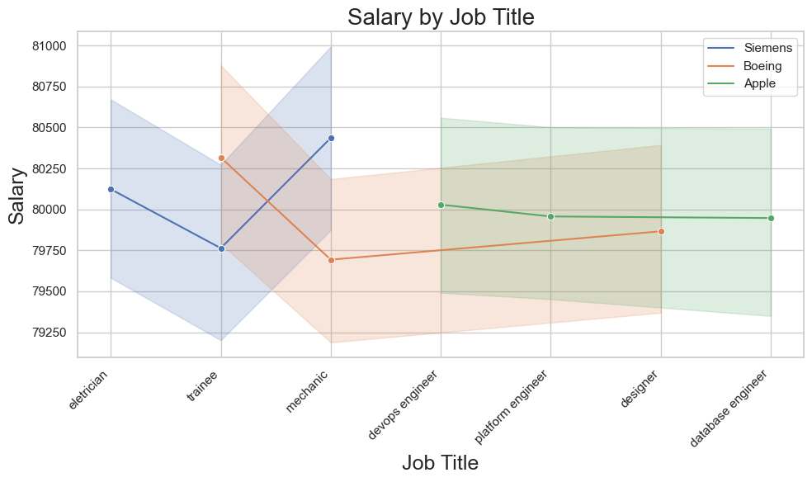
Line Plot
Simens offer the highest pay to mechanics. Electricians’ salary is less than the trainee.
Trainees in Boeing have the highest compensations among the listed job titles. Mechanics salaries are the lowest while designers come after as salaries follow.
From among the mentioned positions, DevOps Engineers at Apple have the highest salary. The Platform engineers earn comparatively and Database Engineers less than average.
Notes:
The trend in salaries is graphically expressed by a line plot. Every position in the line shows the salary at a specified moment. Time is depicted on the x-axis while the salary amount is indicated in the y-axis. The line joining the points represents an overall trend of salary change throughout the time span represented by the data set.

Slide 8
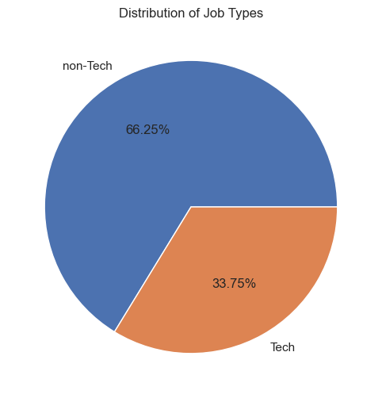
Pie Chart
The pie chart depicts the distribution of job categories in the dataset.
Non-Tech jobs are dominating over Tech jobs
‘Non-Tech’ jobs have been recorded more at about 66.25% (6625 occurrences)
‘Tech’ jobs have been noted as being slightly lower at about 33.75% (3375 occurrences)
Notes:
The pie chart depicts the distribution of job categories in the dataset. The different slices of pie represent different job types, and the size of each slice shows the percentage of that type of job in the dataset. In this particular issue, ‘Non-Tech’ jobs have been recorded more at about 6625 occurrences, which account for 66.25%, whereas ‘Tech’ jobs have been noted as being slightly lower at about 3375 occurrences the chart also indicates the percentages involved.
The representation of the distribution of job applicants, which is presented by the pie chart. The size of the slices of the pie represents the number of applications sent by each company. Here, ‘Apple’ contributes to about 33.75%, ‘Boeing’ accounts for around 33.67% and ‘Siemens’ stands at about 32.58%. In addition, the chart shows the percentages also.
A pie chart graphically reflects the proportion of job titles in the dataset. The pie chart has slices that represent job titles and the size of each slice shows the number of job applications for this title. In this particular instance, trainee takes up around 22.40%, mechanic approximately 21.98%, devops engineer roughly 11.52%, platform engineer about 11.38%, designer roughly 11.23%, database engineer almost These percentages are also shown on a chart.

Slide 9
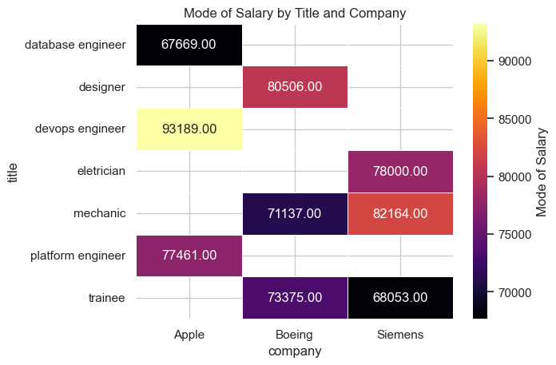
Heat Map
Apple
Pays the highest and lowest salaries between companies
Mainly technical positions
Boeing
Designers have the highest salary
Hardware and service positions
Siemens
Mechanics have the highest salary
Hardware and service positions
Notes:
**Highest Salary**
* Apple pays their devops engineers the highest salary $93,189.00 between the three companies.
* Designers at Boeing make the highest salary in the company.
* At Siemens, mechanics have the highest salary. In fact, its the second highest between the companies.
**Lowest Salary**
* Apple also had the lowest salary between the three companies. They pay their database engineers $67,669.00
* At Boeing there's only a $2,000 difference between a mechanic and trainee.
* Whereas at Siemens, trainees made the second lowest salary between the companies.
**Type of Employees**
* Apple mainly has mainly technical positions, which is not surprising since they are an electronics and software company.
* Boeing and Siemens both have mechanics and trainees due to the work with aerospace, aircraft engines and industrial manufacturing.

Slide 10
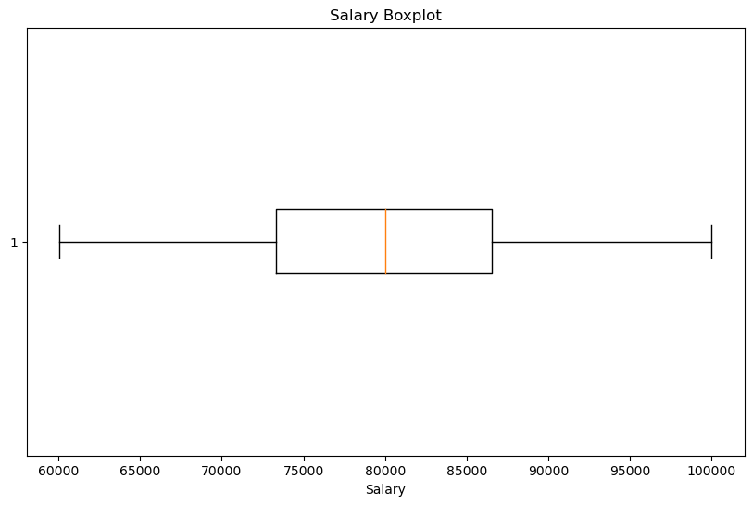
Box Plot
Median salary of employees is $80,000
IQR is between $73,000 and $86,500
Not much variability in salaries for the middle 50%
Long whiskers which represent great variabilities in the salaries
Central median and a balanced distribution

Slide 11
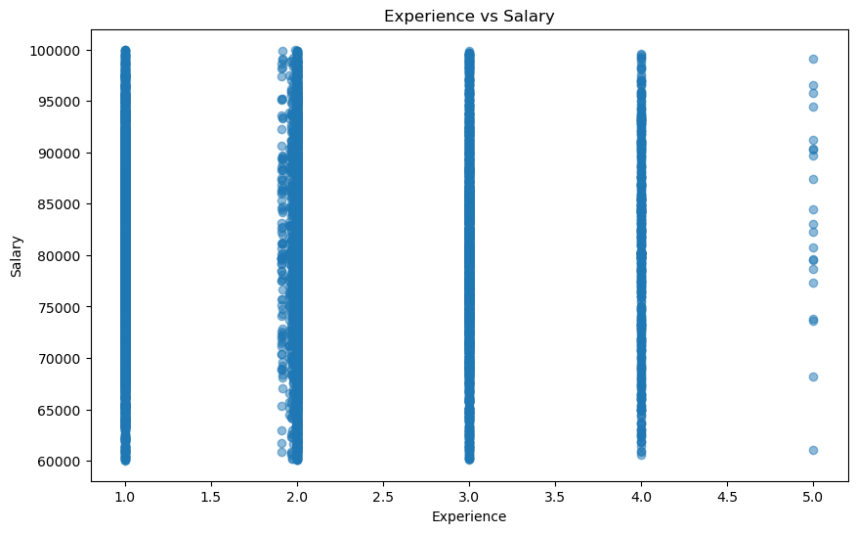
Scatter Plot
1-4 years of experience have wide range of salaries
Opportunities to improve for entry level employees
Most salaries for 5 years experience is more than $75,000
As years of experience increases, the variability of salaries decreases

Slide 12
Conclusion
Average salary among all these job applications is $80,000.
Most job applications have 2 years of work experience and are in a non-tech field.
We can tell that the salaries are very unstable throughout the year, which means that there might be uncertainty in the job market.
There is a lot of competition for entry level jobs and not a lot of job applicants have significant experience.
There are not many people that are applying for jobs that require a lot of experience versus just one year of work experience.
Notes:
* From looking at all the data, we can tell that the number of entries for Apple, Boeing, and Siemens are similar.

Slide 13
Q & A
Questions?

