Slide 1
Week 5 - Social Connect Campaign
Data Analysis & Community Building

Slide 2
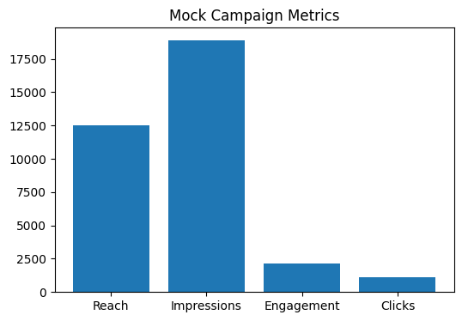
Mock Analytics

Slide 3
Email Drip Campaign
1. Welcome Email
2. Explore Communities
3. Stay Active & Invite Friends

