Slide 1
Web Service Integration In Realtime Application

Slide 2
Introduction to Web Service
Why to Use?
Simple Web Service Example
Tools & Library Used
How to Create Web Service
Use Web Service in Application
Uses (select2, DataTable)

Slide 3
Introduction to Web Service
Network-based resource that fulfills a specific task
Ex.
CRUD Operations
Image Processing
Complex Mathematical Operation
Types
SOAP (Simple Object Access Protocol)
RESTFul web Service (Representational State Transfer)
GET, POST, PUT DELETE

Slide 4
Why to Use?
Reusability : To Reduce repeatation code
Interoperability : Can be accessible to other application
To Increate Web Application Performance
To create More Dynamic Web Application

Slide 5
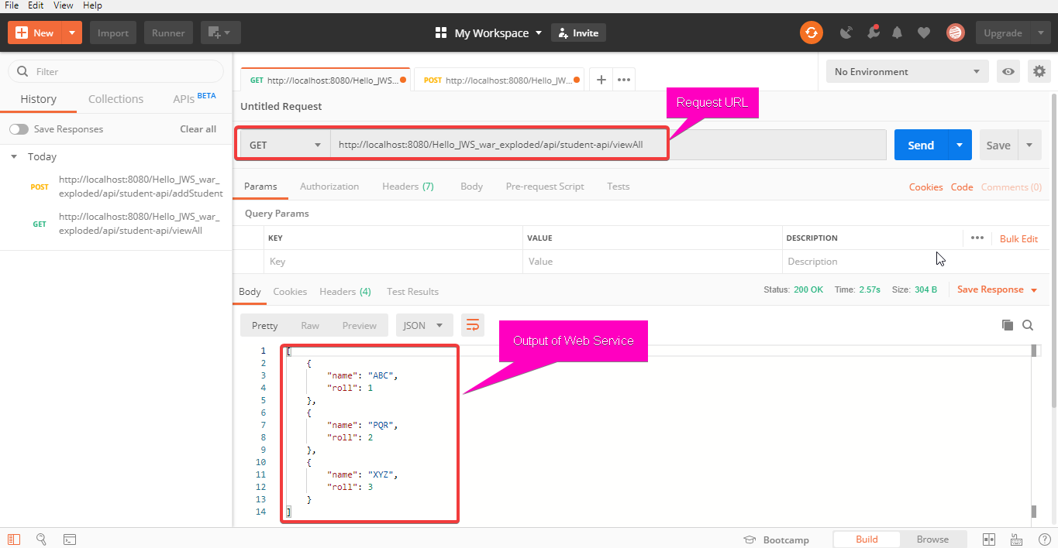
Simple Web Service Example

Slide 6
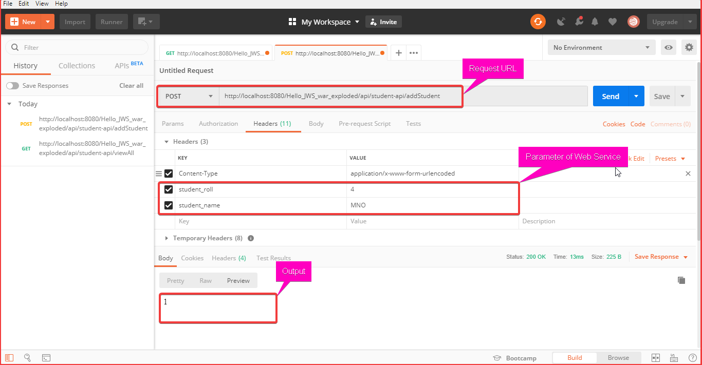
Simple Web Service Example

Slide 7
Tool & Library Used
Jersey (RESTFul API Library)
Glassfish (Web Server)
IntelliJ IDEA (IDE)
Postman (Used to Test Web Service)

Slide 8
Create Web Service

Slide 9
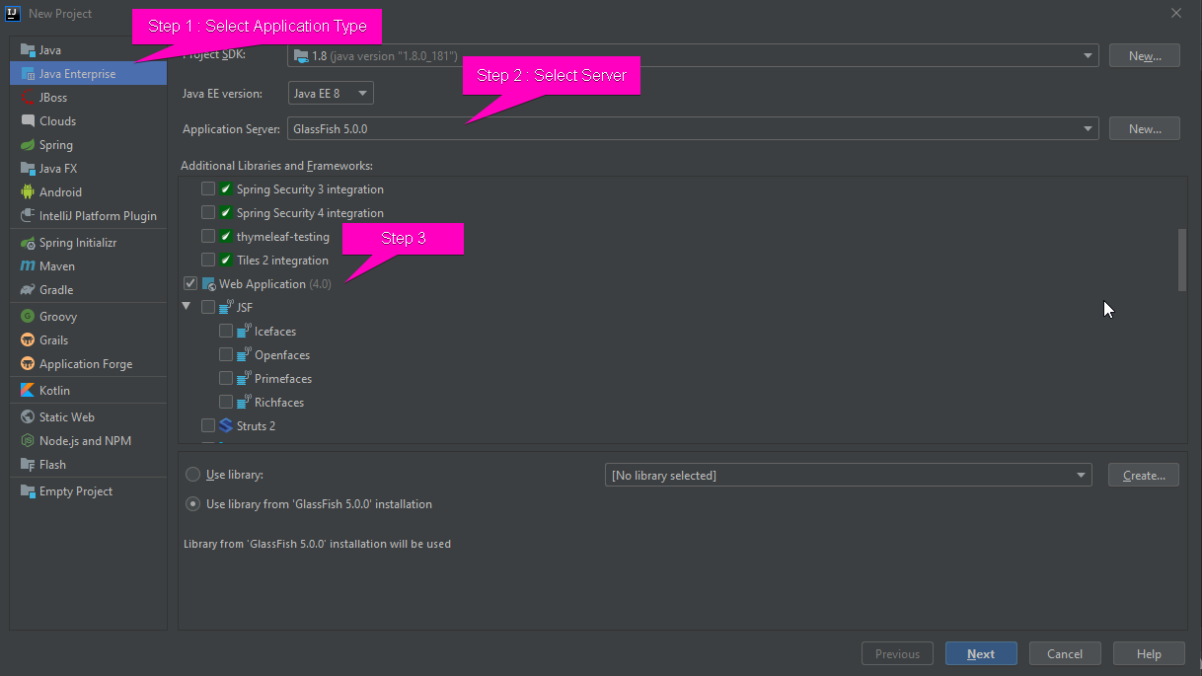

Slide 10
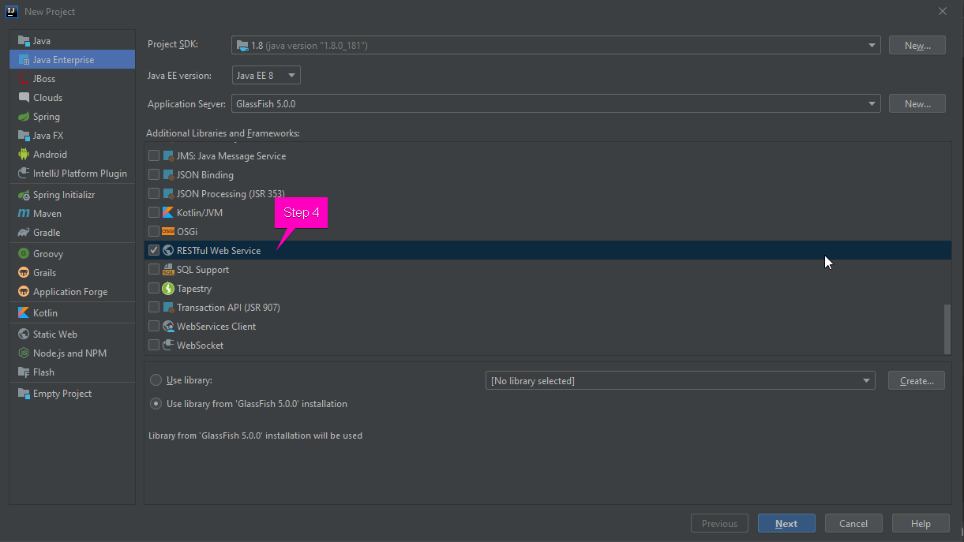

Slide 11
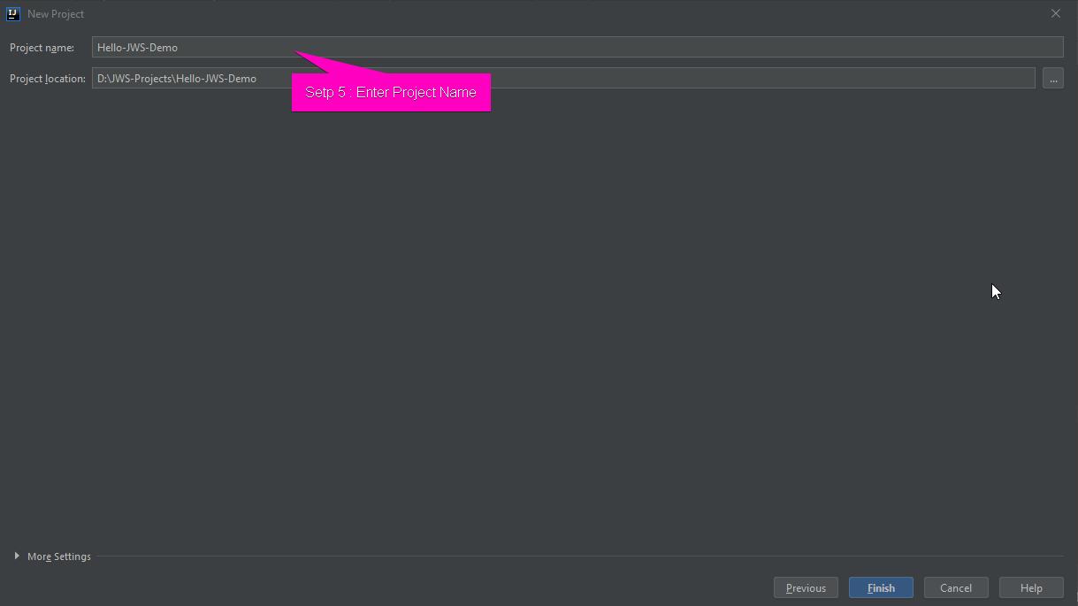

Slide 12
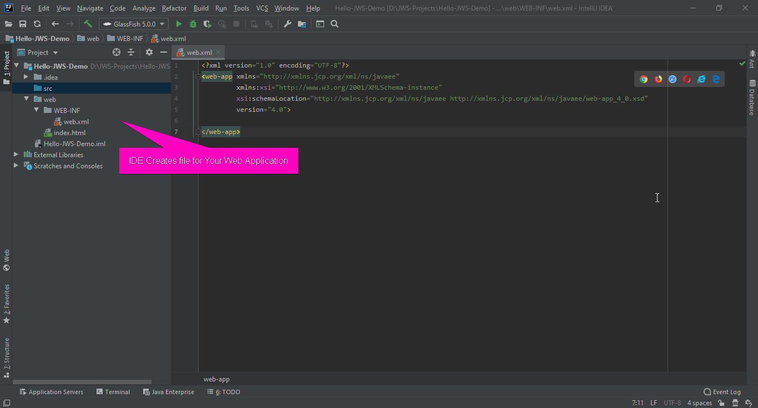

Slide 13
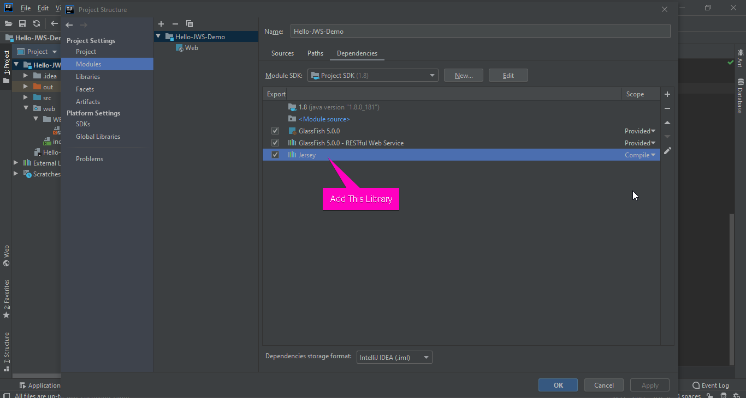

Slide 14
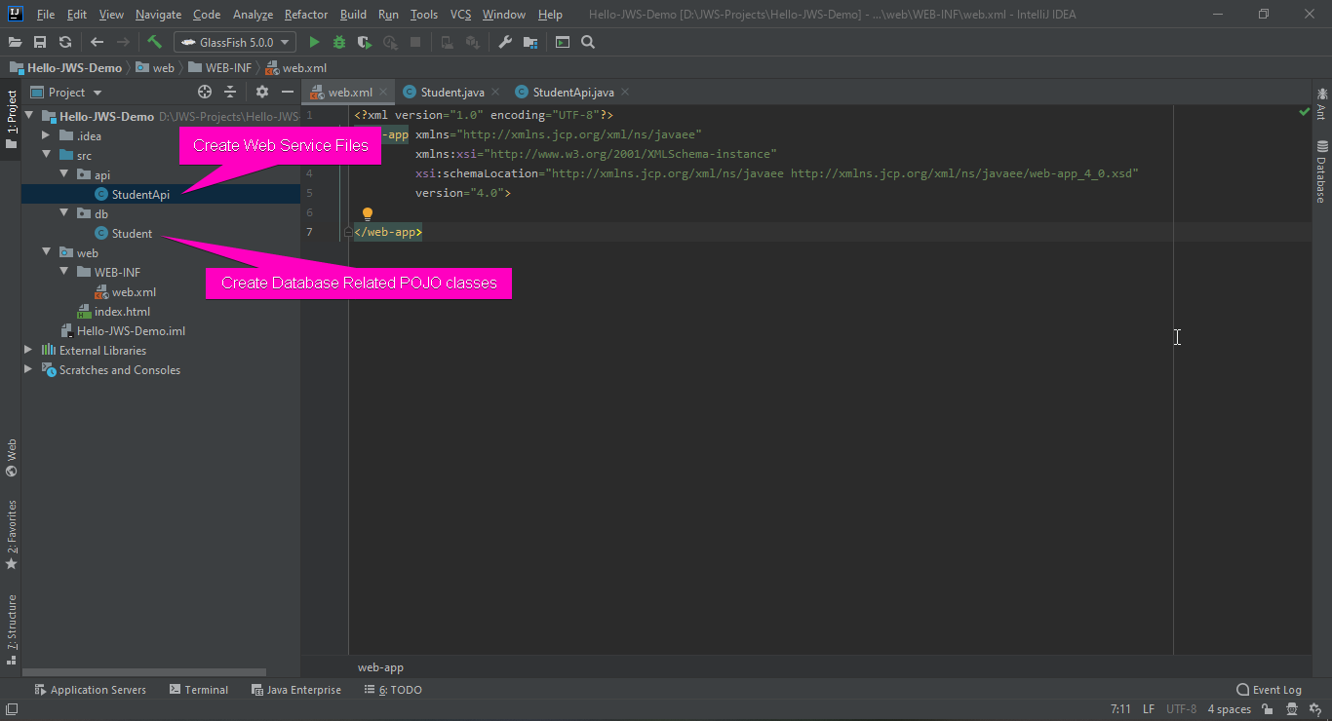

Slide 15
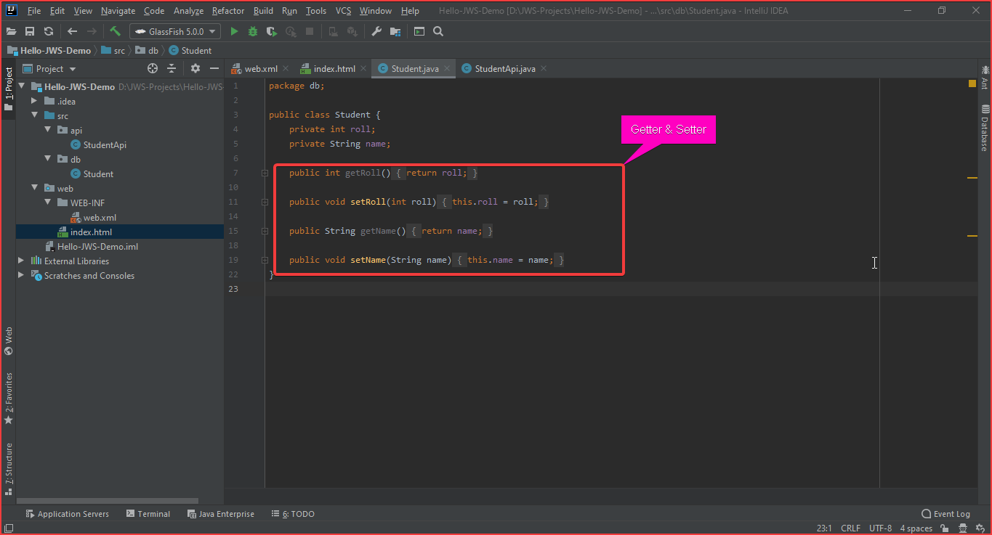

Slide 16
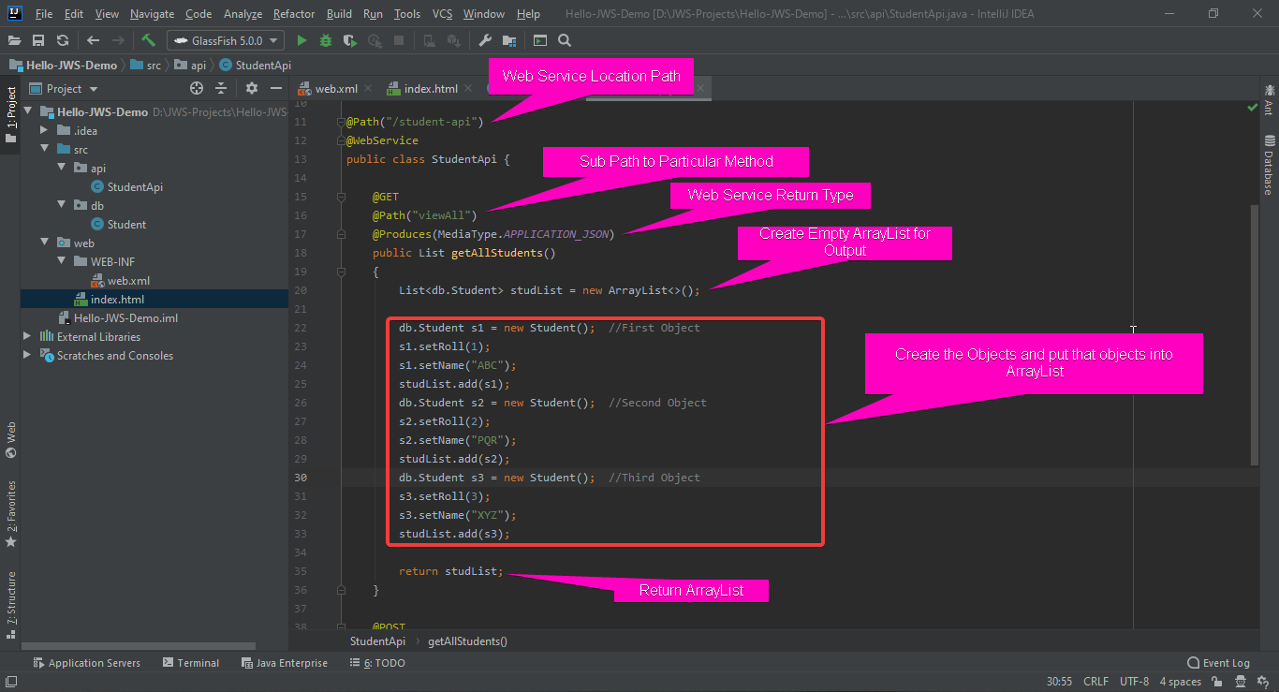

Slide 17
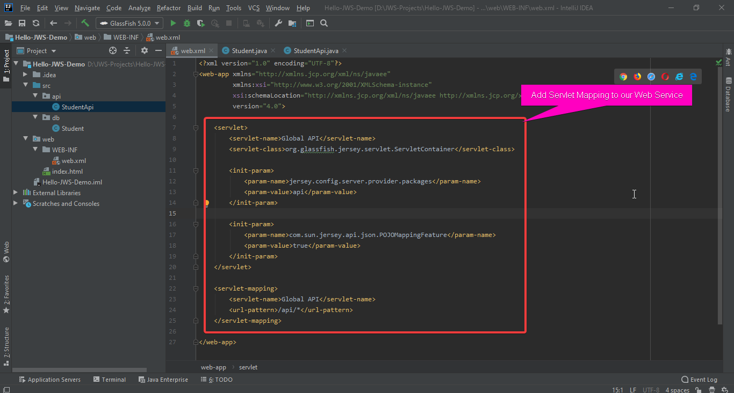

Slide 18
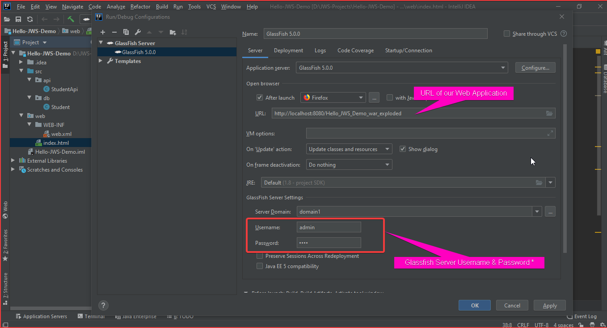

Slide 19
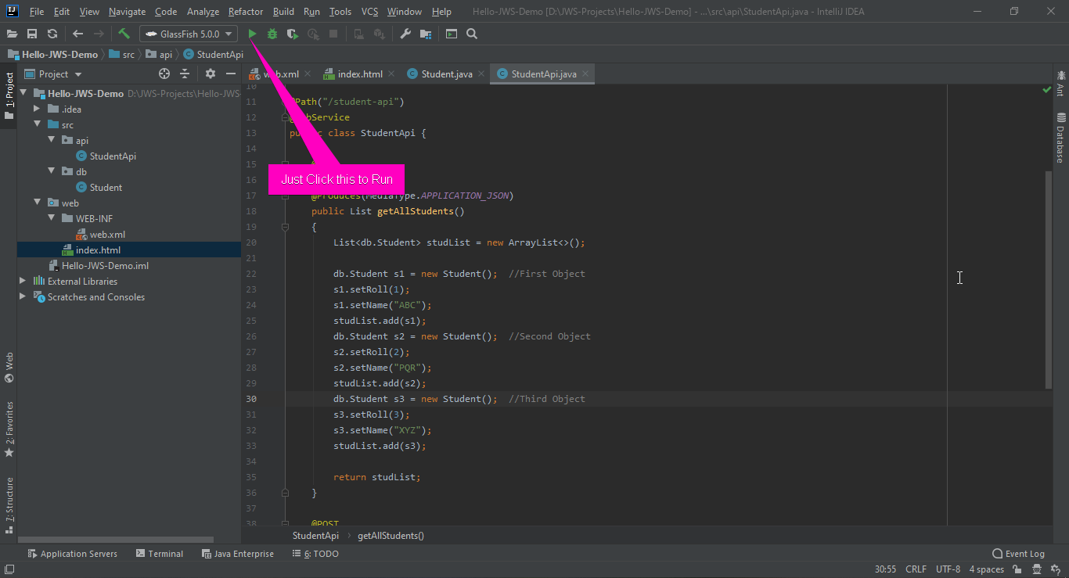

Slide 20
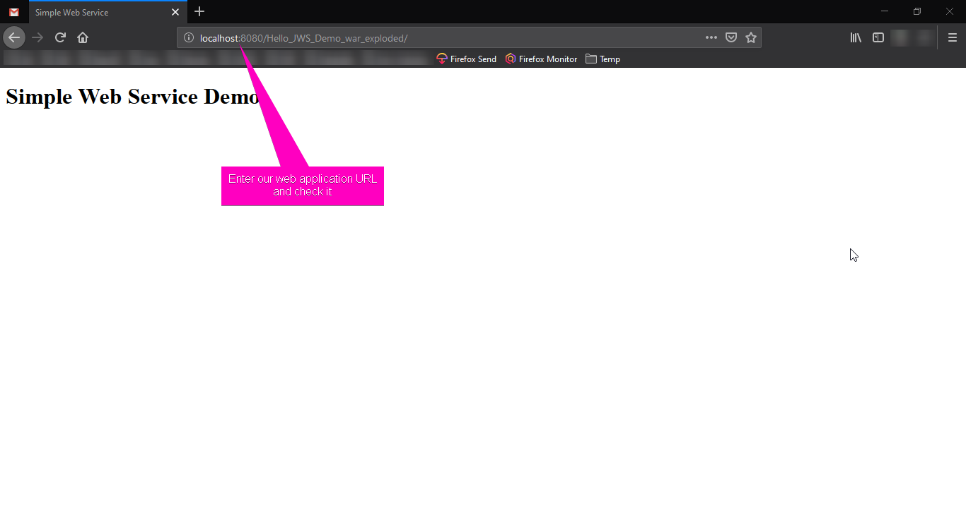

Slide 21
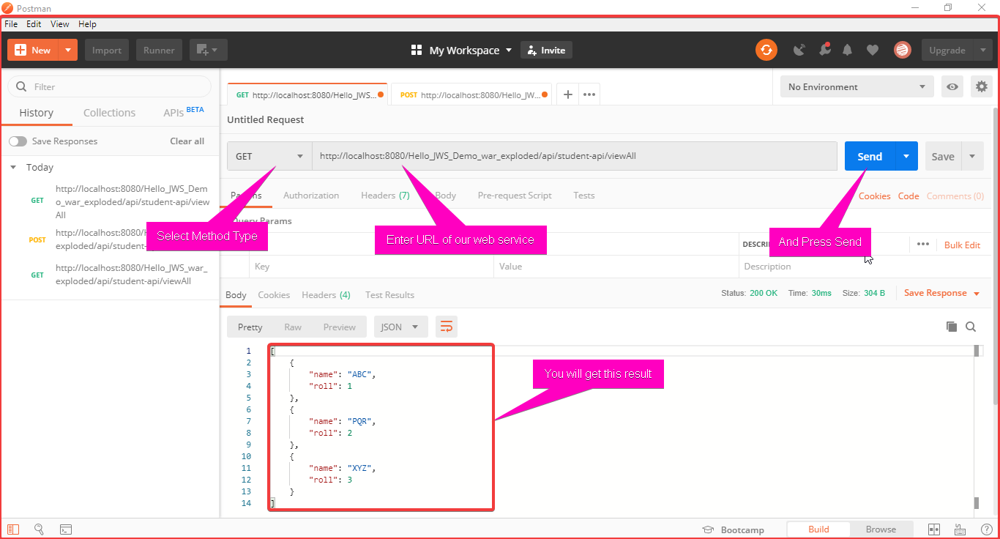

Slide 22
Use Web Service in Application

Slide 23
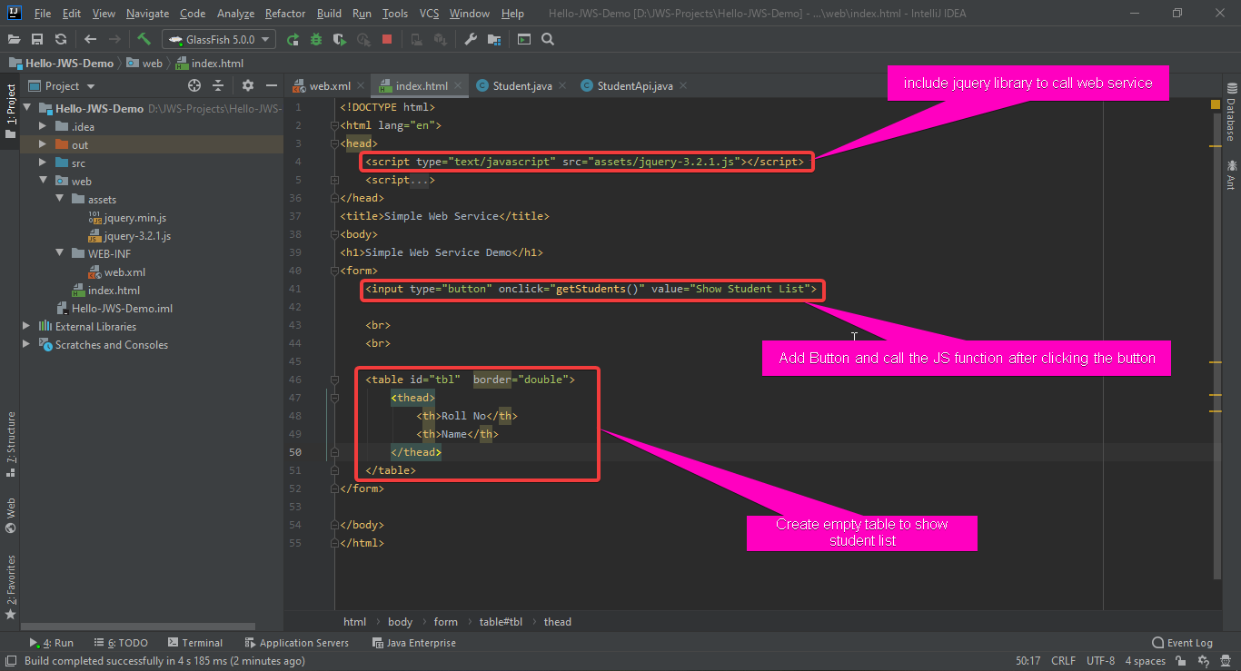

Slide 24
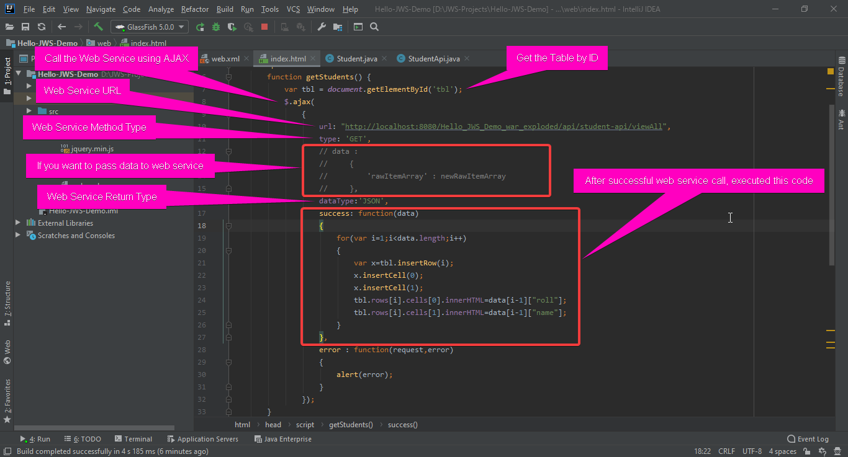

Slide 25
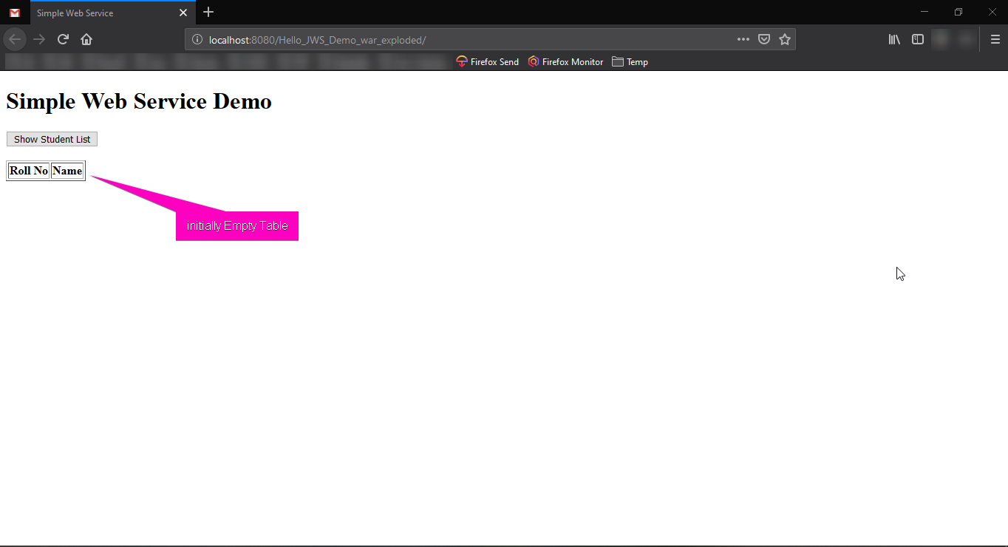

Slide 26
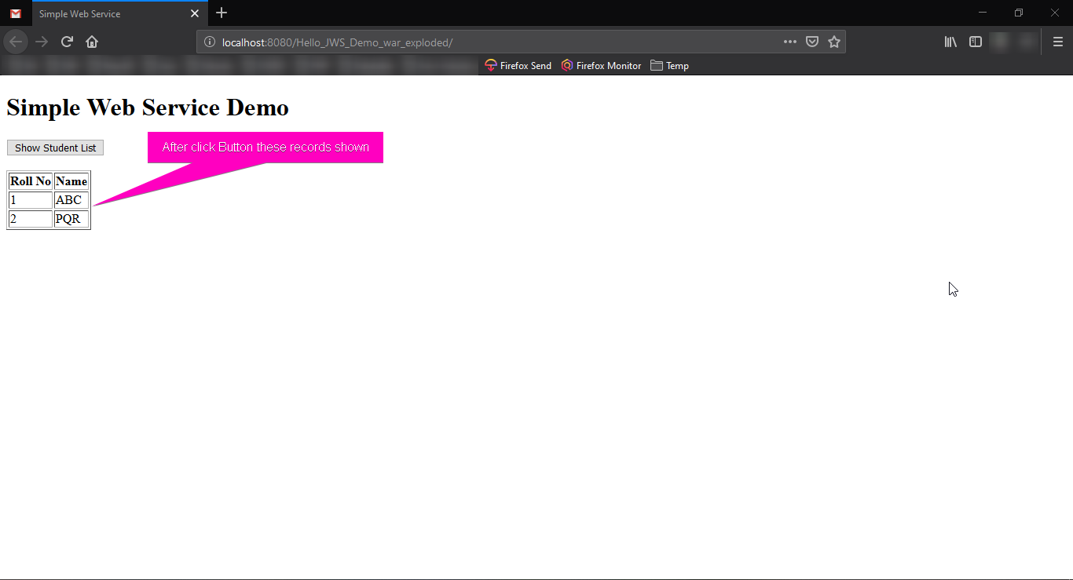

Slide 27
Uses (select2, DataTable)

